Slide 1

Function Extraction™:
Mapping Programs into Mathematica Equations
Hessamaldin Mohammadi (NJIT)
Wided Ghardallou (Univ of Sousse)
Richard Linger (AssuranceLabs)
Ali Mili (NJIT)
AssuranceLabs, Inc.
Gaithersburg, Maryland
September 2022
Confidential and Proprietary

Slide 2
AssuranceLabs Inc.
Symbolic Execution of C-like Programs
From Source Code to Program Functions
Computing Loop Functions
Computing Program Functions
Generic Recognizers
Conclusion
Copyright © 2022 All Rights Reserved

Slide 3
AssuranceLabs Inc.
Computing the Function of a Program
A decades-old dream
Increasingly urgent to make it a reality
  Precise / automatically generated / certifiably valid /
  up-to-date documentation.
  Supports reuse / use of software from unknown un-vetted source
  Exposes malicious obfuscated functionality.
    Correctness: Ensuring that the program does what it is supposed to do
    Security: Ensuring that it does not do what it is not supposed to do.
Copyright © 2022 All Rights Reserved

Slide 4
AssuranceLabs Inc.
Symbolic Execution of C-like Programs
From Source Code to Program Functions
Computing Loop Functions
Computing Program Functions
Generic Recognizers
Conclusion
Copyright © 2022 All Rights Reserved

Slide 5
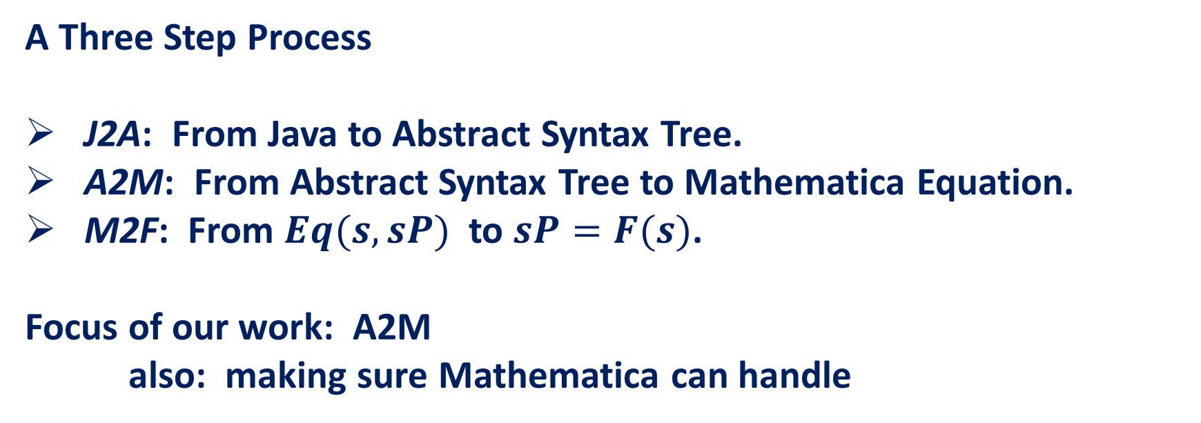
AssuranceLabs Inc.
A Three Step Process
J2A: From Java to Abstract Syntax Tree.
A2M: From Abstract Syntax Tree to Mathematica Equation.
M2F: From $Eq(s,sP)$to $sP=F(s)$.
Focus of our work: A2M
also: making sure Mathematica can handle
Copyright © 2022 All Rights Reserved

Slide 6
AssuranceLabs Inc.
Copyright © 2022 All Rights Reserved

Slide 7
AssuranceLabs Inc.
Copyright © 2022 All Rights Reserved

Slide 8
AssuranceLabs Inc.
Copyright © 2022 All Rights Reserved

Slide 9
AssuranceLabs Inc.
Copyright © 2022 All Rights Reserved

Slide 10
AssuranceLabs Inc.
Copyright © 2022 All Rights Reserved

Slide 11
AssuranceLabs Inc.
Copyright © 2022 All Rights Reserved

Slide 12
AssuranceLabs Inc.
Symbolic Execution of C-like Programs
From Source Code to Program Functions
Computing Loop Functions
Computing Program Functions
Generic Recognizers
Conclusion
Copyright © 2022 All Rights Reserved

Slide 13
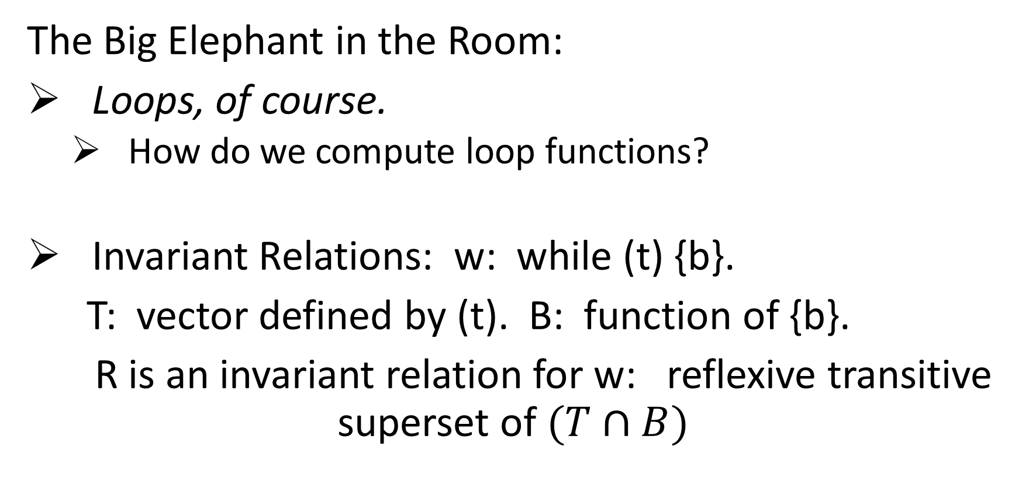
AssuranceLabs Inc.
The Big Elephant in the Room:
Loops, of course.
  How do we compute loop functions?
Invariant Relations: w: while (t) {b}.
T: vector defined by (t). B: function of {b}.
R is an invariant relation for w: reflexive transitive superset of $(T∩B)$
Copyright © 2022 All Rights Reserved

Slide 14
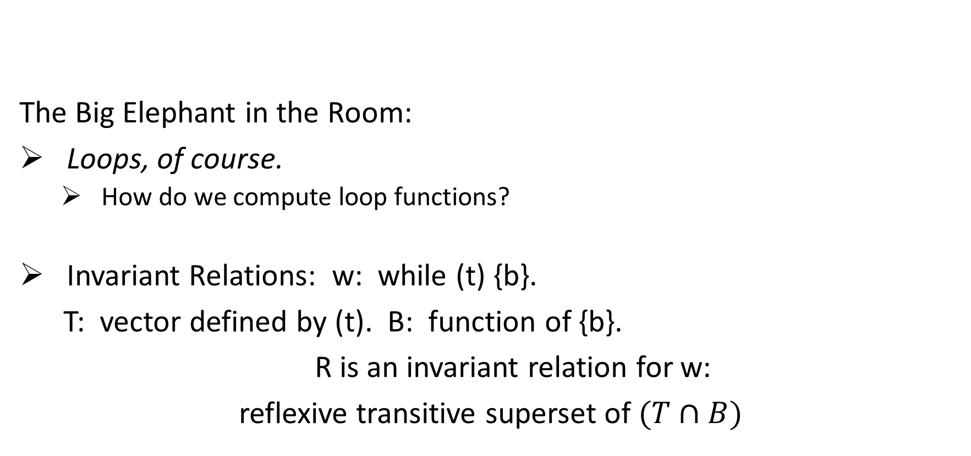
AssuranceLabs Inc.
The Big Elephant in the Room:
Loops, of course.
  How do we compute loop functions?
Invariant Relations: w: while (t) {b}.
T: vector defined by (t). B: function of {b}.
R is an invariant relation for w:
reflexive transitive superset of $(T∩B)$
T
t
Copyright © 2022 All Rights Reserved

Slide 15
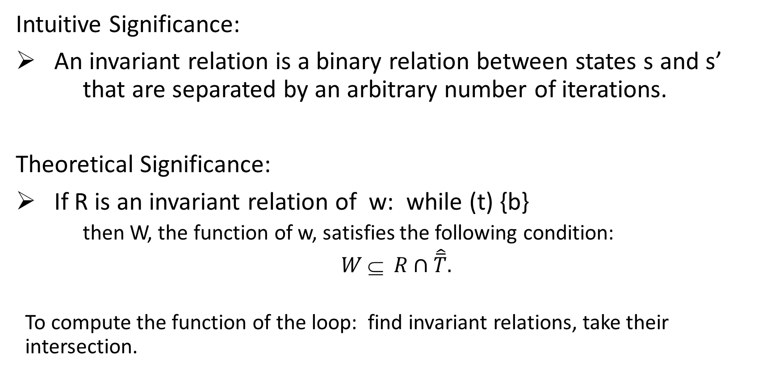
AssuranceLabs Inc.
Intuitive Significance:
An invariant relation is a binary relation between states s and s’ that are separated by an arbitrary number of iterations.
Theoretical Significance:
If R is an invariant relation of w: while (t) {b}
  then W, the function of w, satisfies the following condition:
  $W ⊆ R∩\hat{\overline{T}}.$
  To compute the function of the loop: find invariant relations, take their intersection.
Copyright © 2022 All Rights Reserved

Slide 16
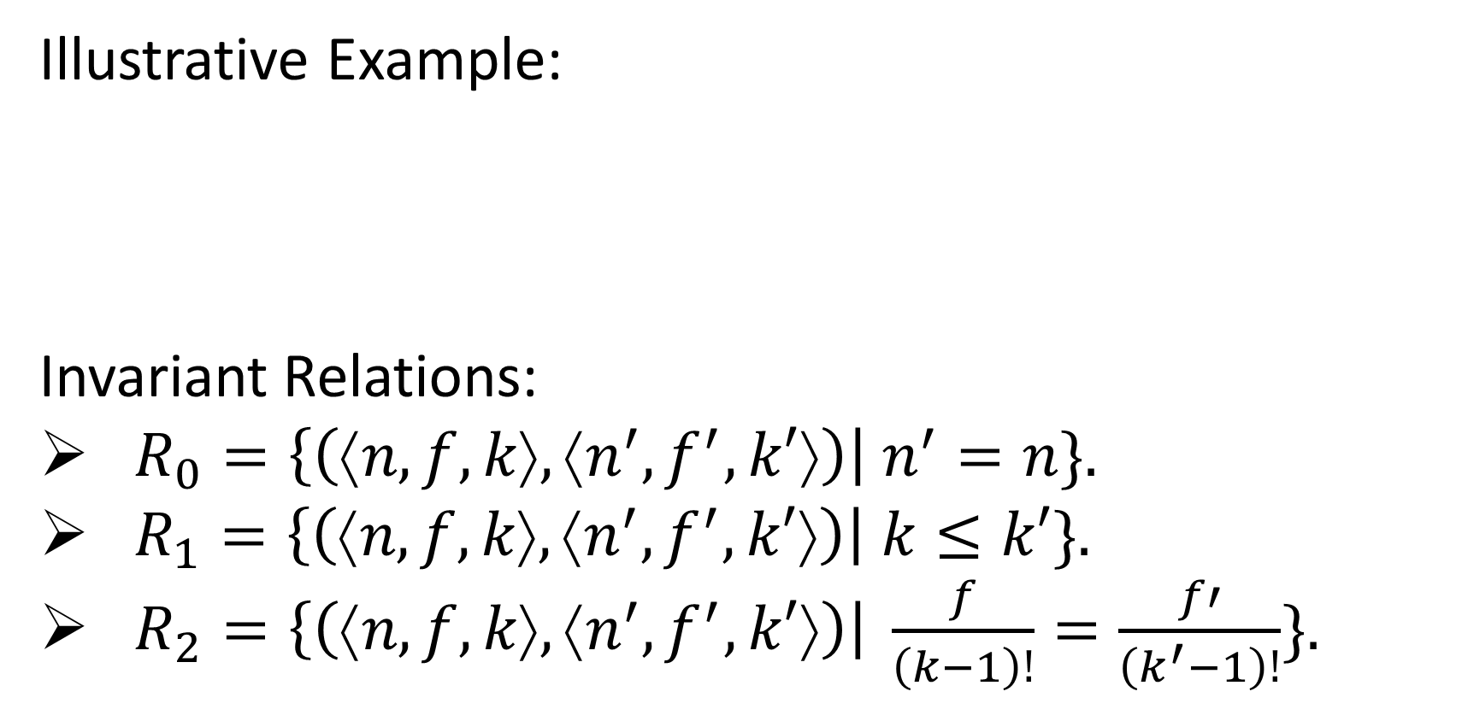
AssuranceLabs Inc.
Illustrative Example:
Invariant Relations:
$R_{0}=\left\{\left(⟨n,f,k⟩,⟨n^{′},f^{′},k′⟩\right)\right| n^{′}=n\}.$
$R_{1}=\left\{\left(⟨n,f,k⟩,⟨n^{′},f^{′},k′⟩\right)\right| k≤k′\}.$
$R_{2}=\left\{\left(⟨n,f,k⟩,⟨n^{′},f^{′},k′⟩\right)\right| \frac{f}{\left(k−1\right)!}=\frac{f′}{\left(k^{′}−1\right)!}\}.$
int n, f, k; while (k!=n+1) {f=f*k; k=k+1;}
Copyright © 2022 All Rights Reserved

Slide 17
AssuranceLabs Inc.
Uses of Invariant Relations:
Compute the function of a loop.
Compute Loops Invariants, for a given pre-specification.
Compute the termination / abort-freedom condition of a loop.
Sufficient condition of Correctness (subsumes the spec).
Sufficient condition of Incorrectness (contradicts the spec).
Repair incorrect loops.
Compute Weakest preconditions/ strongest postconditions.
Copyright © 2022 All Rights Reserved

Slide 18
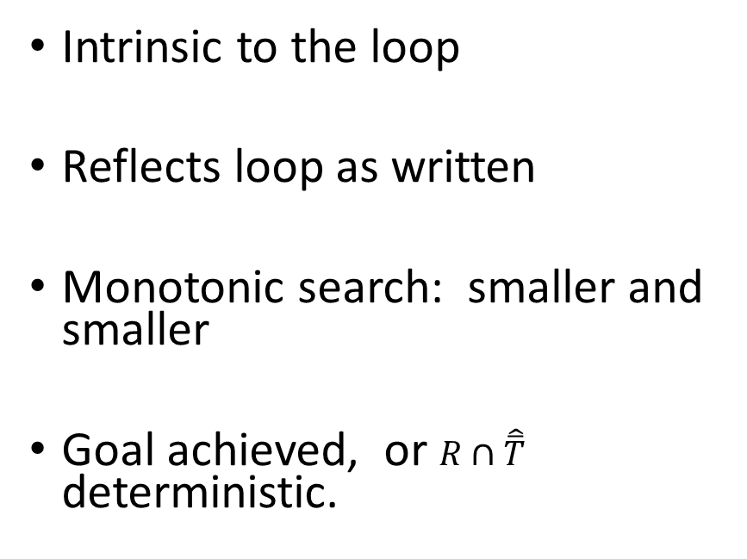
AssuranceLabs Inc.
Invariant Relations
Invariant Assertions
Intrinsic to the loop
Reflects loop as written
Monotonic search: smaller and smaller
Goal achieved, or $R∩\hat{\overline{T}}$ deterministic.
Depend on the loop and its environment
Tests assumption of correctness
In case of failure: weaken? Strengthen?
Wrong assertion or wrong assumption?
Copyright © 2022 All Rights Reserved

Slide 19
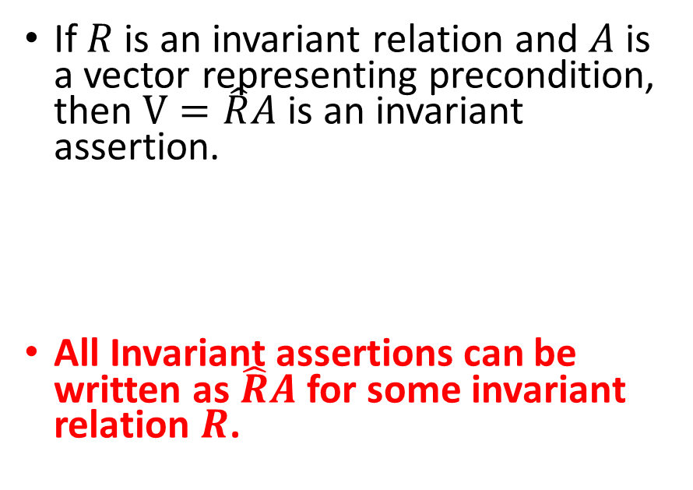
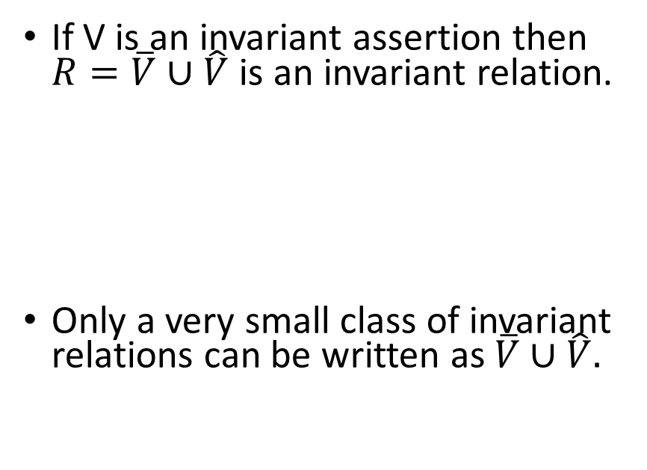
AssuranceLabs Inc.
Invariant Relations
Invariant Assertions
If $R$ is an invariant relation and $A$ is a vector representing precondition, then $V=\hat{R}A$ is an invariant assertion.
All Invariant assertions can be written as $\hat{R}A$ for some invariant relation $R$.
If V is an invariant assertion then $R=\overline{V}∪\hat{V}$ is an invariant relation.
Only a very small class of invariant relations can be written as $\overline{V}∪\hat{V}.$
Copyright © 2022 All Rights Reserved

Slide 20
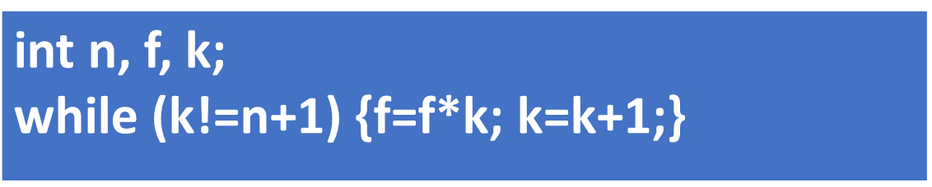
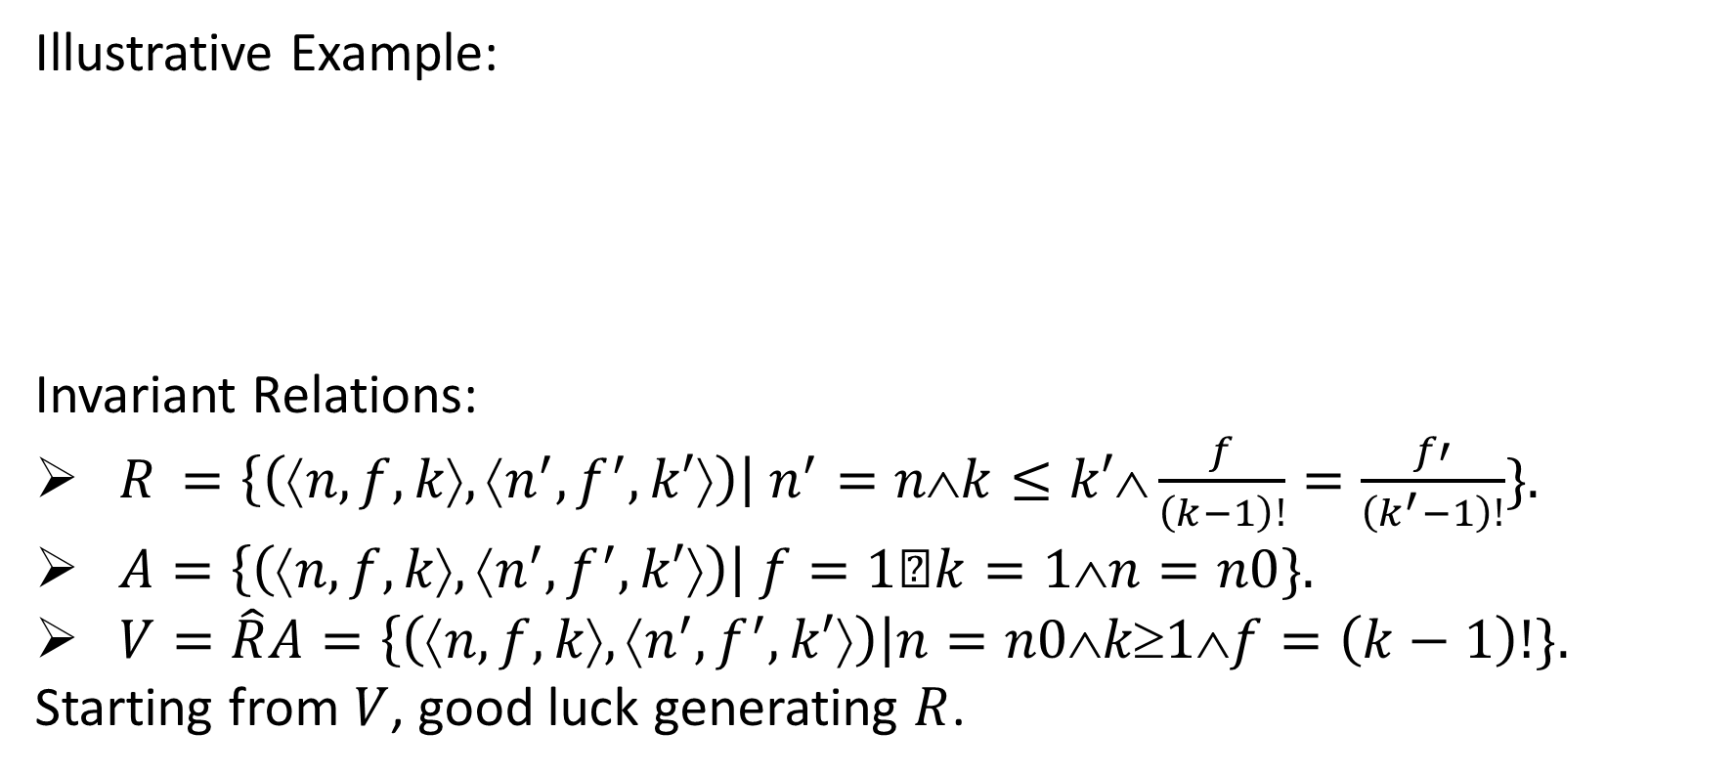
AssuranceLabs Inc.
Illustrative Example:
Invariant Relations:
$R_{ }=\left\{\left(⟨n,f,k⟩,⟨n^{′},f^{′},k′⟩\right)\right| n^{′}=n∧k≤k′∧\frac{f}{\left(k−1\right)!}=\frac{f′}{\left(k^{′}−1\right)!}\}.$
$A=\left\{\left(⟨n,f,k⟩,⟨n^{′},f^{′},k′⟩\right)\right| f=1∧k=1∧n=n0\}.$
$V=\hat{R}A=\left\{\left(⟨n,f,k⟩,⟨n^{′},f^{′},k′⟩\right)\right|n=n0∧k≥1∧f=\left(k−1\right)!\}.$
Starting from $V$, good luck generating $R$.
Copyright © 2022 All Rights Reserved

Slide 21
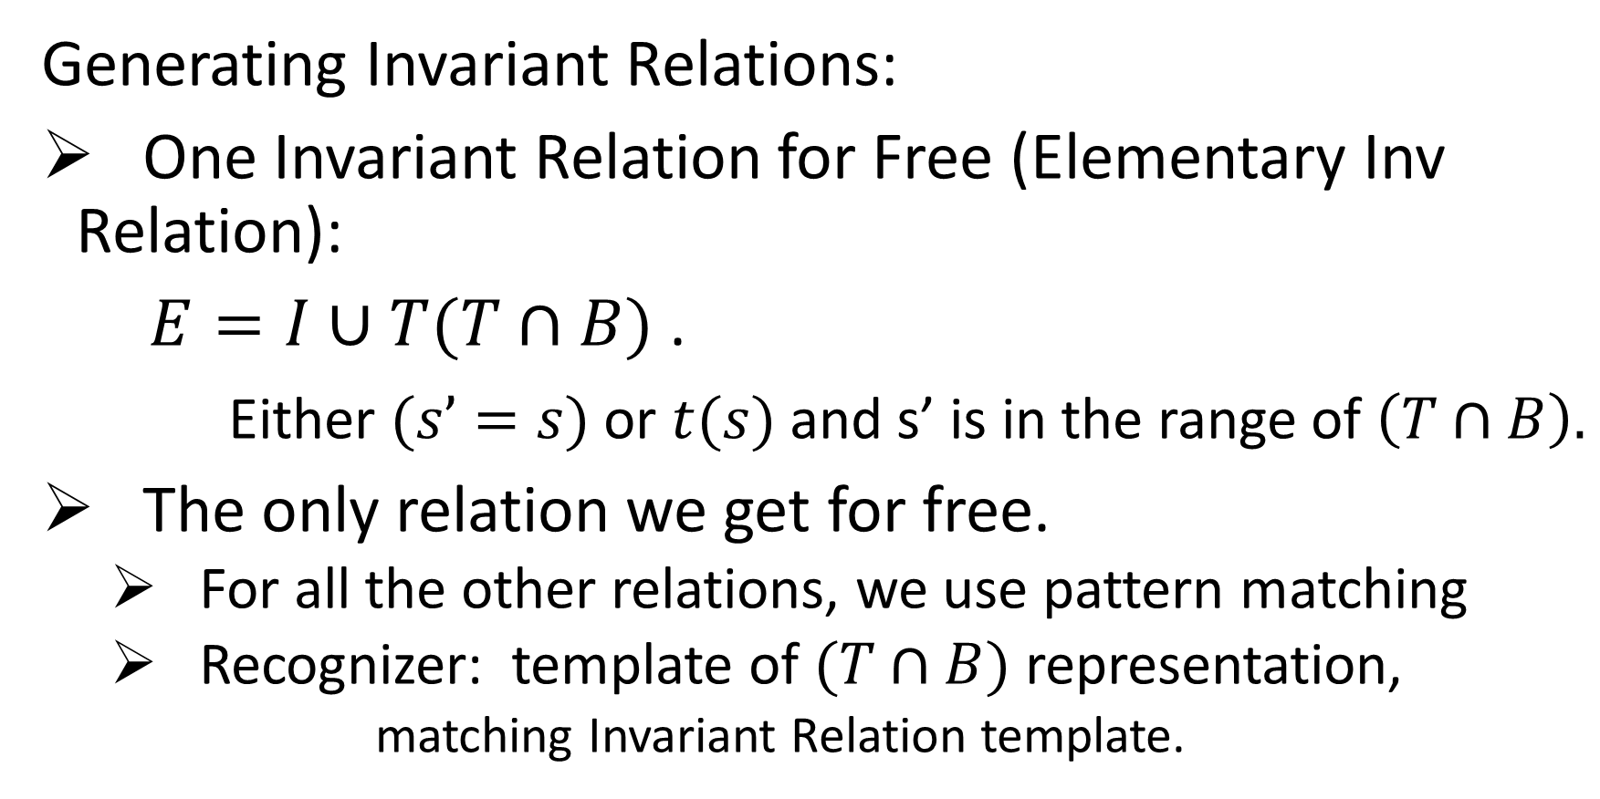
AssuranceLabs Inc.
Generating Invariant Relations:
One Invariant Relation for Free (Elementary Inv Relation):
$E=I∪T(T∩B)$ .
Either $(s’=s)$or $t(s)$and s’ is in the range of $\left(T∩B\right).$
The only relation we get for free.
  For all the other relations, we use pattern matching
  Recognizer: template of $(T∩B)$ representation,
    matching Invariant Relation template.
Copyright © 2022 All Rights Reserved

Slide 22
AssuranceLabs Inc.
Copyright © 2022 All Rights Reserved

Slide 23
AssuranceLabs Inc.
Symbolic Execution of C-like Programs
From Source Code to Program Functions
Computing Loop Functions
Computing Program Functions
Generic Recognizers
Conclusion
Copyright © 2022 All Rights Reserved

Slide 24
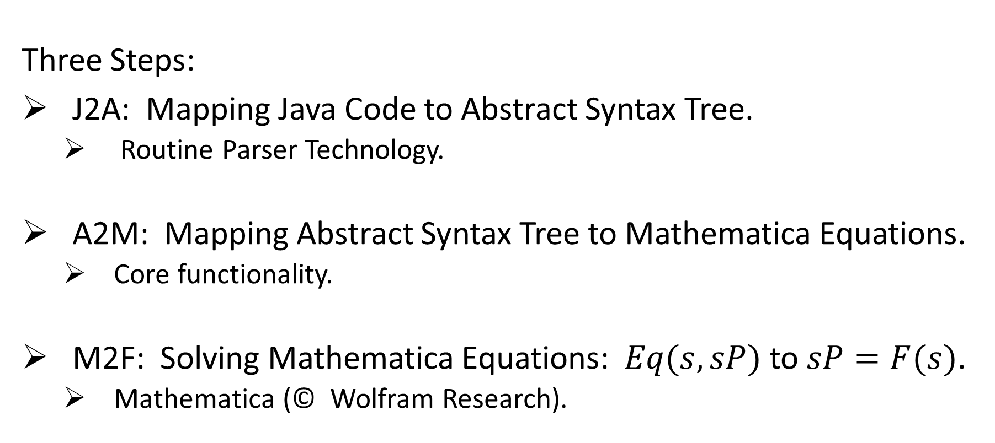
AssuranceLabs Inc.
Three Steps:
J2A: Mapping Java Code to Abstract Syntax Tree.
  Routine Parser Technology.
A2M: Mapping Abstract Syntax Tree to Mathematica Equations.
  Core functionality.
M2F: Solving Mathematica Equations: $Eq(s,sP)$to $sP=F(s)$.
  Mathematica (© Wolfram Research).
Copyright © 2022 All Rights Reserved

Slide 25
AssuranceLabs Inc.
A2M:
Recursive descent on the AST.
  At each node: Equation reflecting semantics of node.
Assignment Statement:
Copyright © 2022 All Rights Reserved

Slide 26
AssuranceLabs Inc.
A2M:
Sequence Statement:
Copyright © 2022 All Rights Reserved

Slide 27
AssuranceLabs Inc.
A2M:
Conditional Statements:
  A2M(if (t) {A} else {B})
  = t(s) && A2M(A) || ! t(s) && A2M(B).
  A2M(if (t) {A})
        = t(s) && A2M(A) || !t(s) && sP==s.
Copyright © 2022 All Rights Reserved

Slide 28
AssuranceLabs Inc.
While Loop: while (t) {b}
Copyright © 2022 All Rights Reserved

Slide 29
AssuranceLabs Inc.
For Loop: for (int i=l; i<=h; i++) {b}
Copyright © 2022 All Rights Reserved

Slide 30
AssuranceLabs Inc.
Symbolic Execution of C-like Programs
From Source Code to Program Functions
Computing Loop Functions
Computing Program Functions
Generic Recognizers
Conclusion
Copyright © 2022 All Rights Reserved

Slide 31
AssuranceLabs Inc.
This approach is critically dependent on our ability to
match as many clauses as possible
  with as few recognizers as possible.
Particularly valuable:
  Widely Applicable Recognizers.
Affine Transformations
  Two recognizers.
Copyright © 2022 All Rights Reserved

Slide 32
AssuranceLabs Inc.
Copyright © 2022 All Rights Reserved

Slide 33
AssuranceLabs Inc.
If, instead of two affine transformations, we have N, then it suffices to apply R0 to one of them (the pivot) and R1 to (pivot, Ri).
Copyright © 2022 All Rights Reserved

Slide 34
AssuranceLabs Inc.
Copyright © 2022 All Rights Reserved

Slide 35
AssuranceLabs Inc.
iter# | x'=5x+3 | y'=3y+5 | log5(x+3/4) | log3(y+5/2) | fr(log5(x+3/4)) | fr(log3(y+5/2)) | log5(x..)-log3(y..) | log5(x+3/4)-log5(15+3/4) | log3(y+5/2)-log3(40+5/2)
0 | 15 | 40 | 1.712921228 | 3.41294569 | 0.712921228 | 0.41294569 | -1.700024462 | 0 | 0
1 | 78 | 125 | 2.712921228 | 4.41294569 | 0.712921228 | 0.41294569 | -1.700024462 | 1 | 1
2 | 393 | 380 | 3.712921228 | 5.41294569 | 0.712921228 | 0.41294569 | -1.700024462 | 2 | 2
3 | 1968 | 1145 | 4.712921228 | 6.41294569 | 0.712921228 | 0.41294569 | -1.700024462 | 3 | 3
4 | 9843 | 3440 | 5.712921228 | 7.41294569 | 0.712921228 | 0.41294569 | -1.700024462 | 4 | 4
5 | 49218 | 10325 | 6.712921228 | 8.41294569 | 0.712921228 | 0.41294569 | -1.700024462 | 5 | 5
6 | 246093 | 30980 | 7.712921228 | 9.41294569 | 0.712921228 | 0.41294569 | -1.700024462 | 6 | 6
Copyright © 2022 All Rights Reserved

Slide 36
AssuranceLabs Inc.
Symbolic Execution of C-like Programs
From Source Code to Program Functions
Computing Loop Functions
Computing Program Functions
Generic Recognizers
Conclusion
Copyright © 2022 All Rights Reserved

Slide 37
AssuranceLabs Inc.
We have a three-step algorithm for computing the function of a program.
Symbolic execution of the program.
Function from initial states to final states.
Capturing the function of iterative statements:
  While loops.
  For loops.
Standing on the Shoulders of two Giants
  Compiler Generation Technology
  Symbolic Equation Solving Technology.
Copyright © 2022 All Rights Reserved

Slide 38
AssuranceLabs Inc.
Comparison to other works, in terms of invariant assertions:
Invariant Relations (x0, y0, z0, w0) | Other research prototypes (x=0,y=90,z=0,w=1)
 | Aligator: no polynomial solution. Daikon: Sting: InvGen, ESMBC, Dynamate: failure.
Copyright © 2022 All Rights Reserved

Slide 39
AssuranceLabs Inc.
Critique/ Threat to Validity:
We can only handle loops for which we have
recognizers.
We argue:
    There is no way to analyze programs without programming knowledge and domain knowledge.
    Recognizers are our way to capture/ store this requisite knowledge.
    Need for knowledge is a feature of the problem. Not a feature of our solution.
Copyright © 2022 All Rights Reserved

Slide 40
AssuranceLabs Inc.
Prospects
Core Functionality/ Back End:
  Database of Recognizers (special-purpose, prog knowledge, domain knowledge).
  Semantic Matching (theorem proving)
User Interface/ Front End:
  Program Function: could be as obnoxious as the source code.
  User Interface: Enable user to query the source code at scale
    Assume(), Capture(), Verify(), Establish().
    Apply to labels or program parts.
Copyright © 2022 All Rights Reserved

Slide 41
AssuranceLabs Inc.
Symbolic Execution of C-like Programs
From Source Code to Program Functions
Computing Loop Functions
Computing Program Functions
Generic Recognizers
Conclusion
Copyright © 2022 All Rights Reserved

