Slide 1
Mathematica – Applications at Cochlear
Peter Bradley, PhD,
Director of Advanced Wireless Technology
5-Jun-25

Slide 2
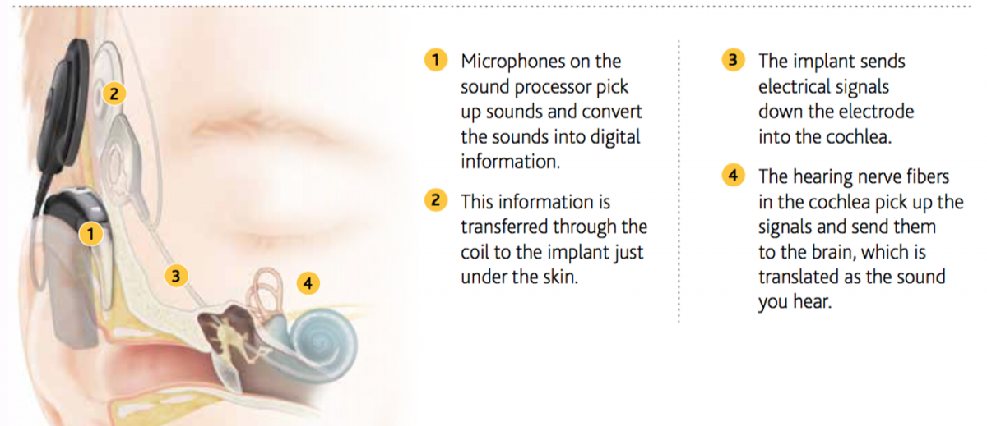
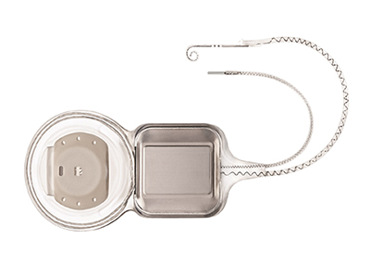
What is a Cochlear Implant ?

Slide 3
Cochlear at a glance
Notes:
FY22

Slide 4

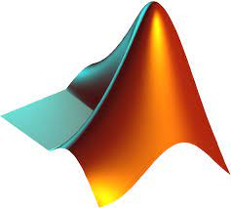



Technical Analysis Tools
Stage | Characterization Test Analysis, Design Analysis, Debug | Verification
Requirements | Free flowing analysis, Self-documenting Flexibility, Ease of use Visualisation (Ideally Dynamic) Statistical Capability Curve fitting and Modeling | Software Robustness, Rigorous testing Self-documenting
Tools | Mathematica, Matlab, Python(+Jupyter), R, Excel | Python commonly used (other possibilities as well)

Slide 5
Reliability Analysis

Slide 6
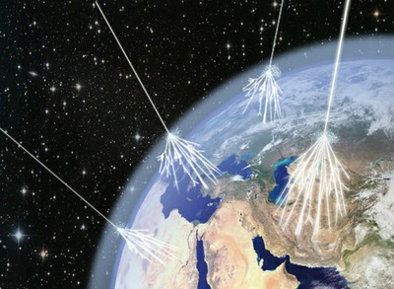
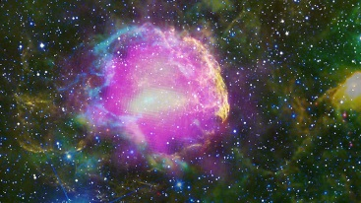
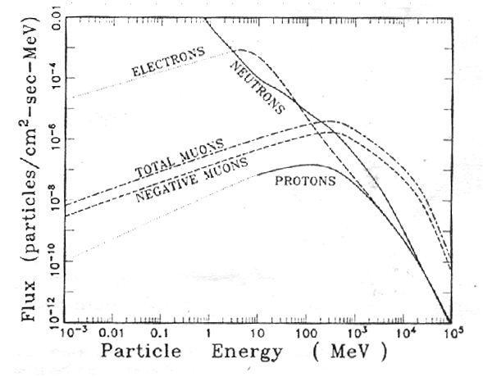
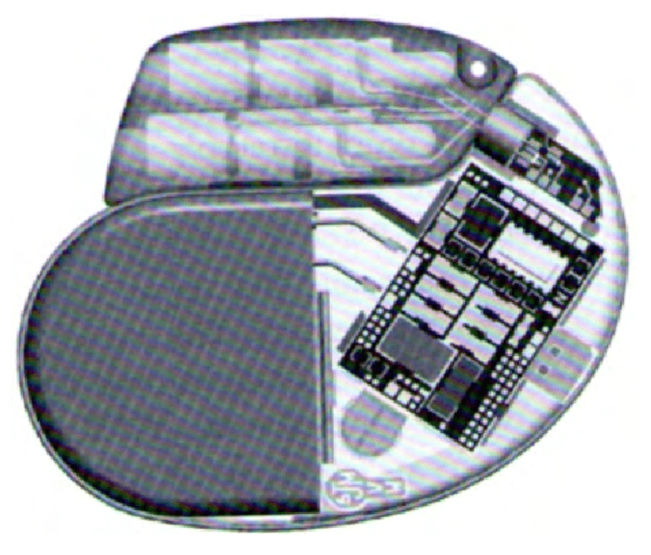
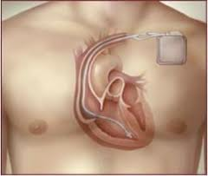
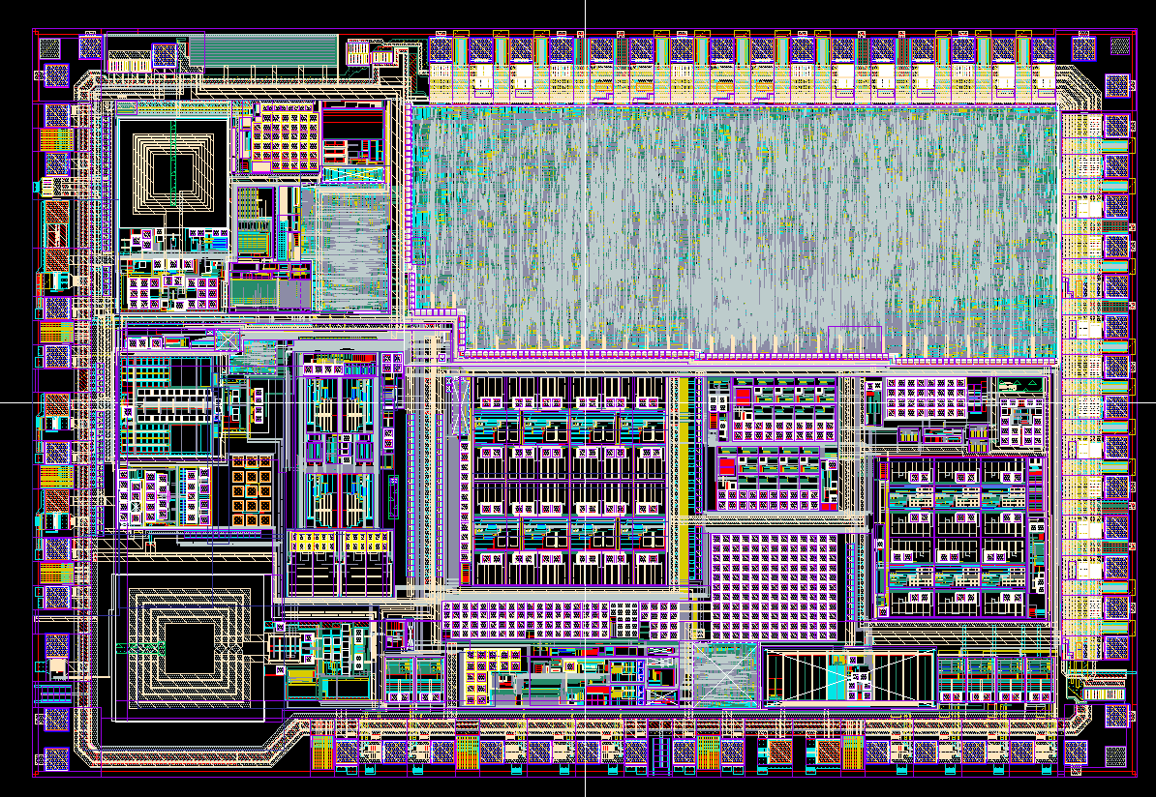
Cosmic Radiation Interaction - Sequence of Events
High Energy Cosmic Rays are born in magnetic field generated by shock wave of Supernova explosions
Primary Cosmic Rays
(92% protons, 6% alpha, rest heavy ions)
Secondary Cosmic Ray flux
Interaction with atmosphere - N and O₂ - gives series of cascade reactions. Resultant spectrum at sea-level is shown below.
Postulated by Enrico Fermi in 1949, Feb. 14, 2013 NASA's Fermi Telescope Proves Supernova Remnants Produce Cosmic Rays (Nasa News Link)
Single Event Upsets
(Bit Flips in Medical Implants)
SRAM memory vulnerable

Slide 7
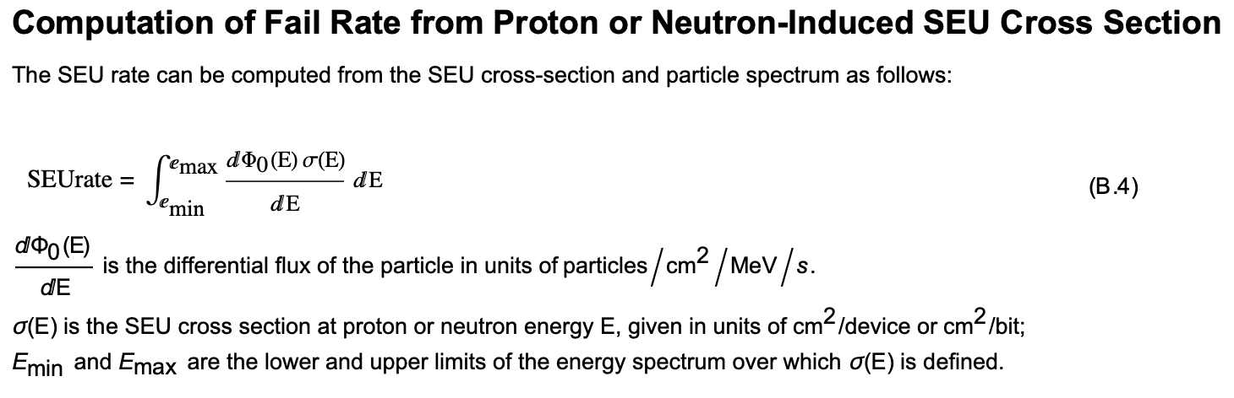
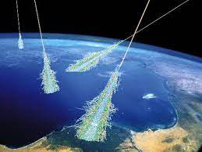
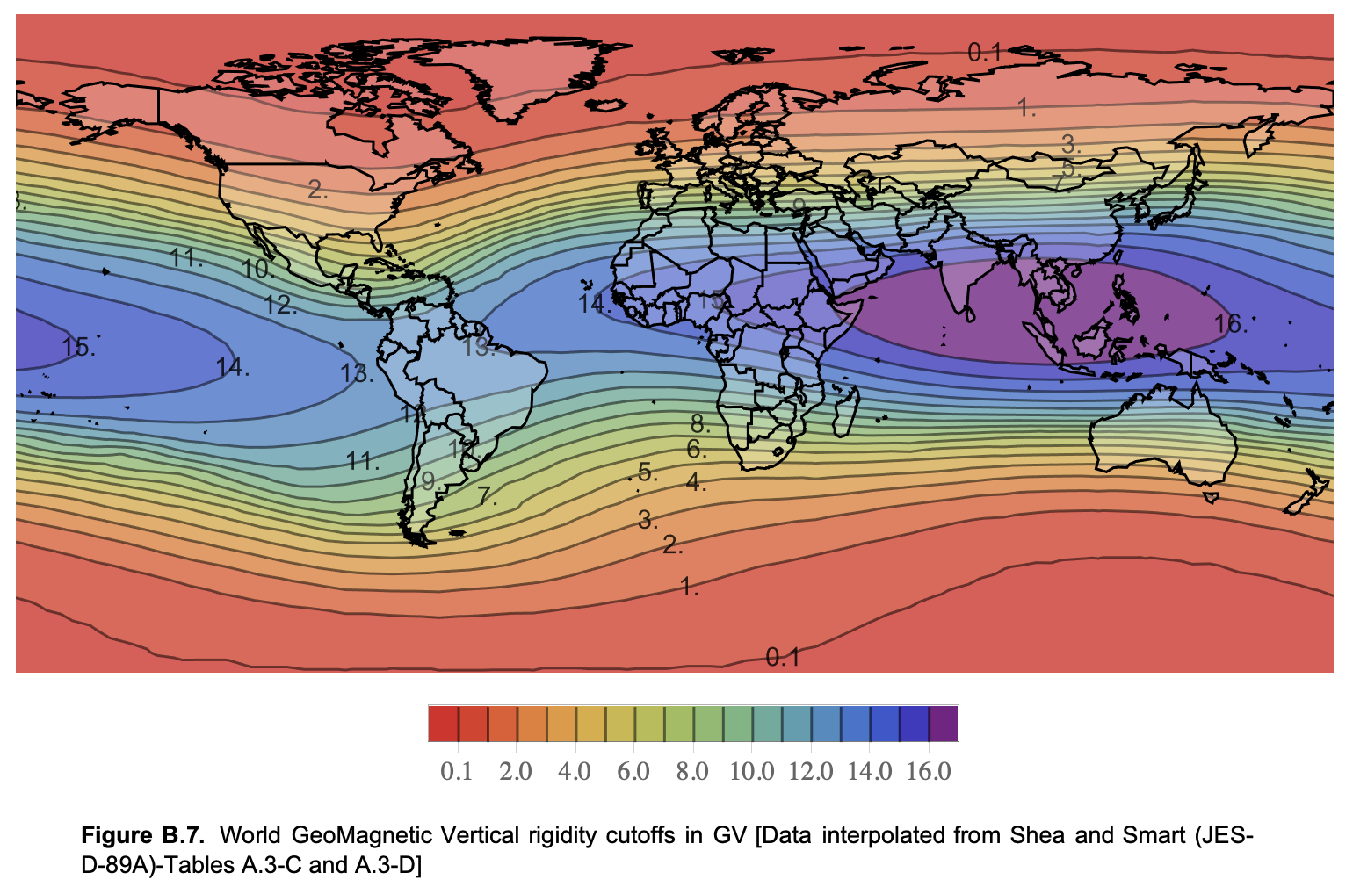
Example 1: Reliability Analysis – Cosmic Radiation on Implants
Highlights
Modelling Worldwide Cosmic Radiation Neutron Flux
Important reliability issue in medical implants (single event memory upsets)
Very difficult with any other tool since complex data sets (elevation, implant distribution world wide, geomagnetic position, neutron flux spectra from cosmic rays). Mathematica has in built connectivity to datasets.
Then capable of complex integration over this data set.
Impossible to do with Matlab

Slide 8
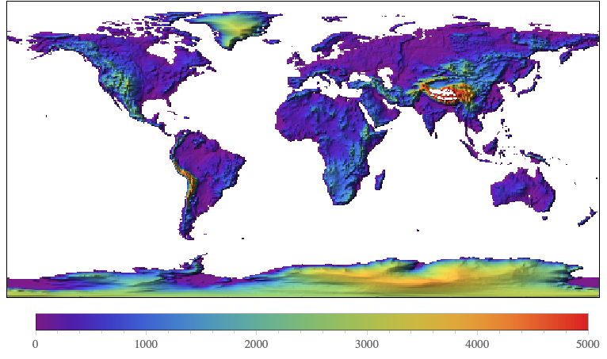
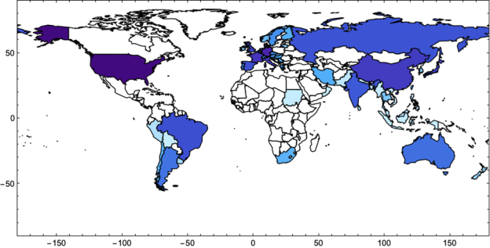
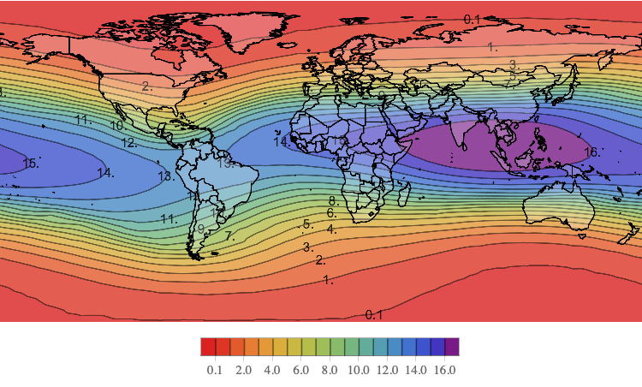
Radiation Environment Model
Using Mathematica
Combined global distribution of implants with neutron flux model.
A key result is that the approximation of NYC is surprisingly accurate
(within a few percent for the given model) for medical implanted devices.
Total neutron flux above 10 MeV is 3.6 x 10⁻³ n/cm²/s
(or equivalently 13 /cm²/hr)
Soft Error Rate Model
for Implants
World Elevation
Relative Geographic Distribution of implanted Cardiac Devices
(NOTE: Countries which are not shaded have not been included in the analysis yet)
Geomagnetic Rigidity – influence of Mag Field
(interpolation of data presented in JESD89A originally from Shea and Smart)

Slide 9
Wireless Analysis

Slide 10
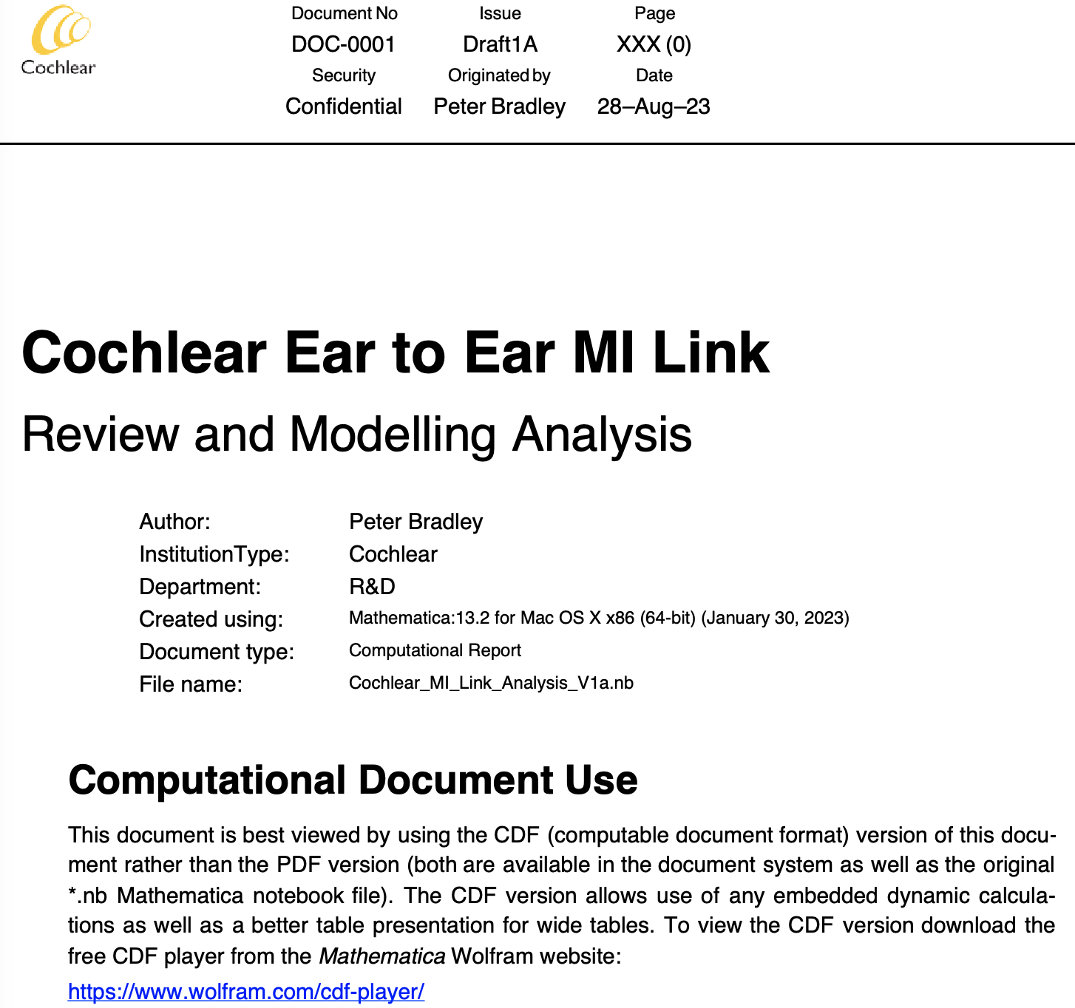
Example 2: Communications - Magnetic Induction (MI) Link Modelling
Highlights
A fully computable technical document that looks like a Word document (Not possible in Matlab)
Calculations inbuilt and notebook content generated automatically with document template
Dynamic Visualisation
Complex Symbolic computations (Integrations) not possible in R,Matlab or Python.

Slide 11
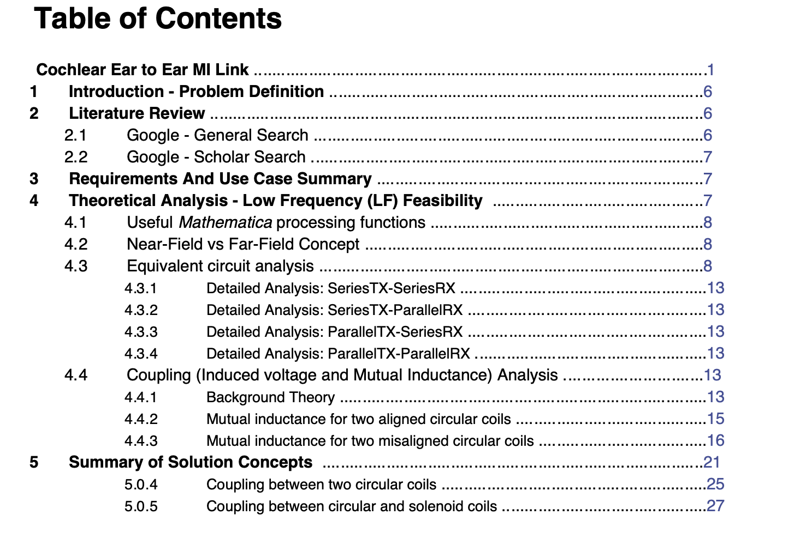
Example 2: Communications – MI Link Modelling
Highlights
A fully computable technical document
This computable document contains the following table of contents

Slide 12
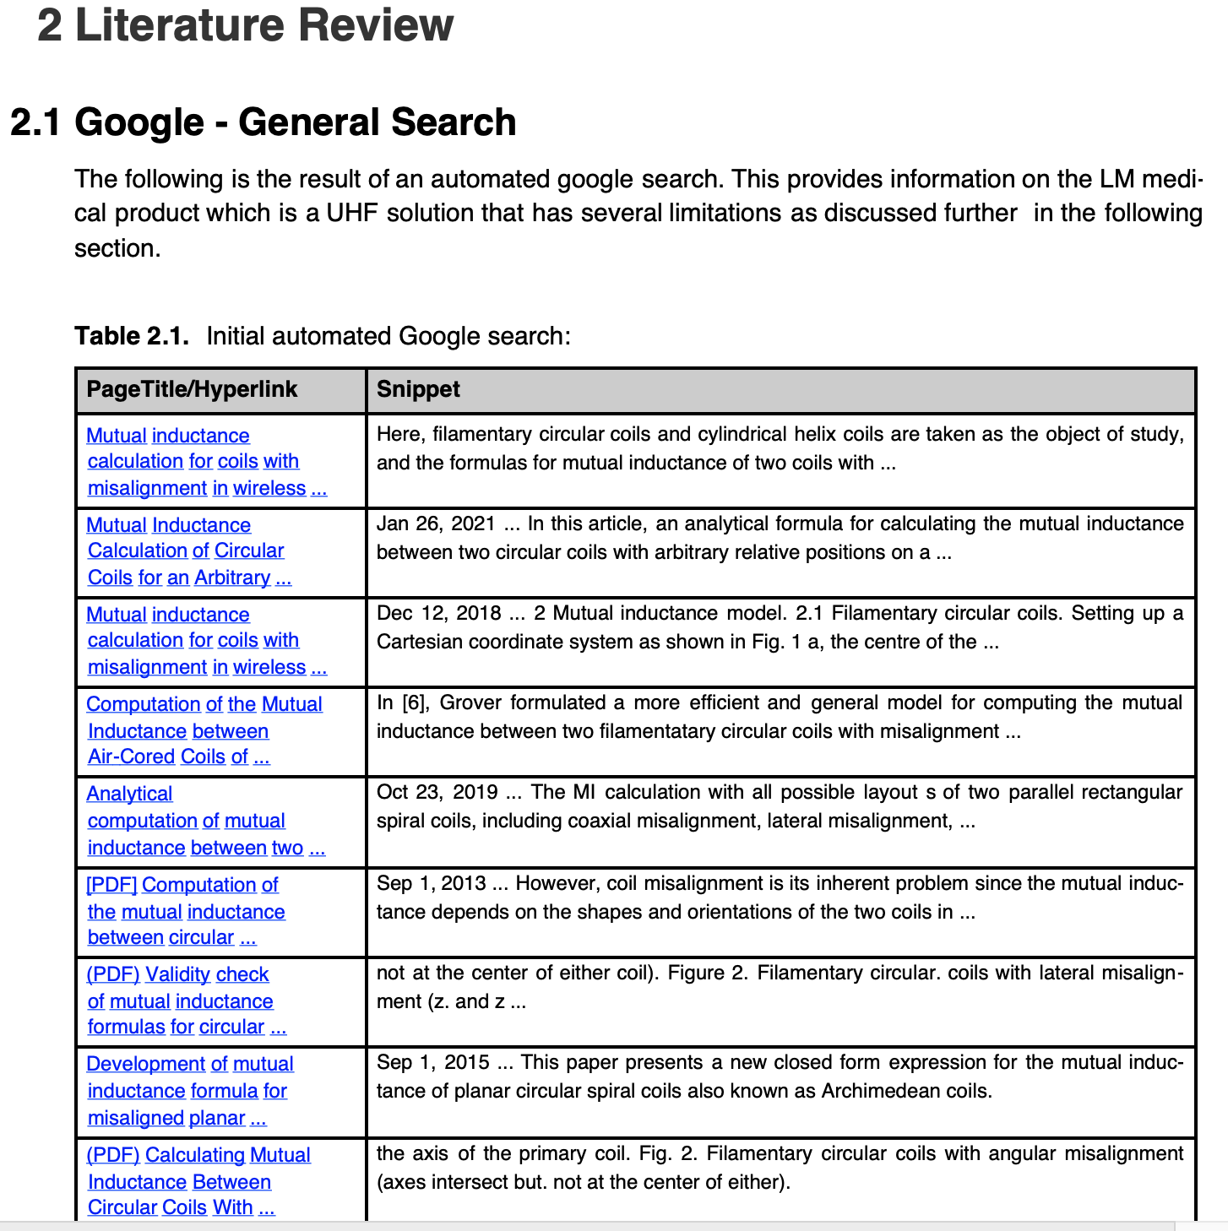
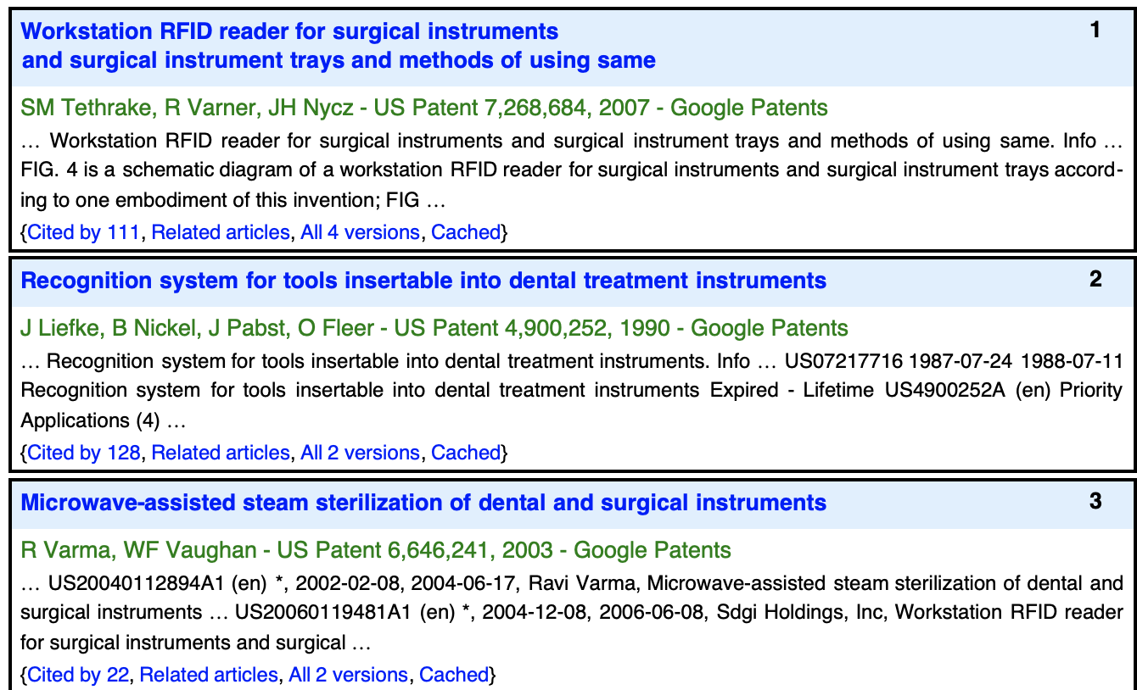
Example 2: Communications – MI Link Modelling
Highlights
A fully computable technical document
Embedded automatic google search (code to search embedded in doc)

Slide 13
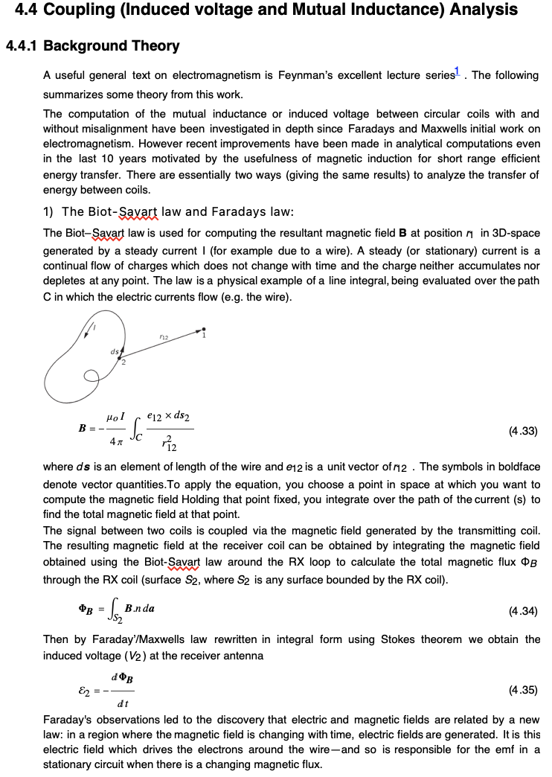
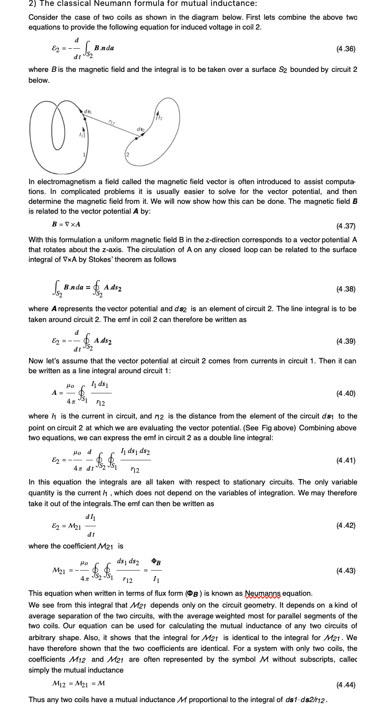
Example 2: Communications – MI Link Modelling
Highlights
A fully computable technical document
Calculations inbuilt and notebook content generated automatically with document template
Dynamic Visualisation
Complex Symbolic computations not possible in R,Matlab or Python.
ALL COMPUTATIONS DERIVED FROM FIRST PRINCIPLES TO MINIMIZE ERRORS (Many papers have errors in equations!!!)

Slide 14
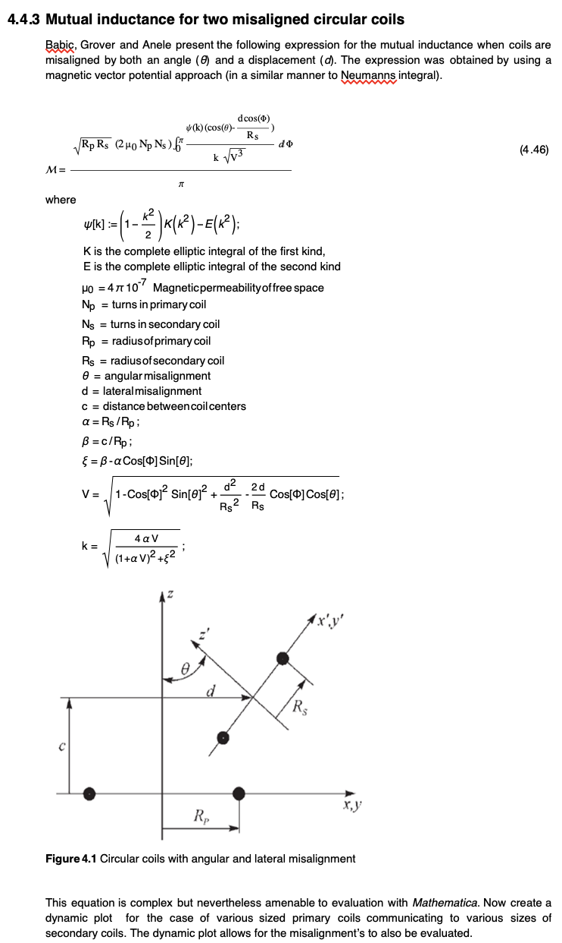
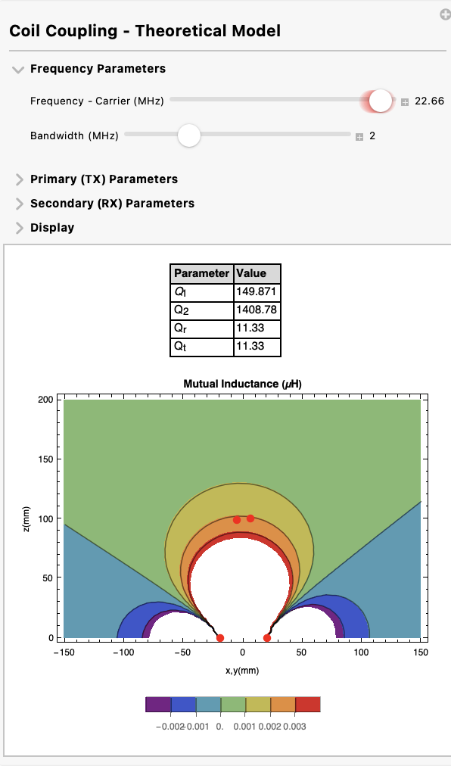
Example 2: Communications
– MI Link Modelling
Highlights
A fully computable technical document
Calculations inbuilt and notebook content generated automatically with document template
Dynamic Visualisation. The dynamic manipulator is embedded and computable in the document so the user can see what happens when parameters vary
Complex Symbolic computations not possible in R, Matlab or Python. (such as these elliptic integrals)

Slide 15
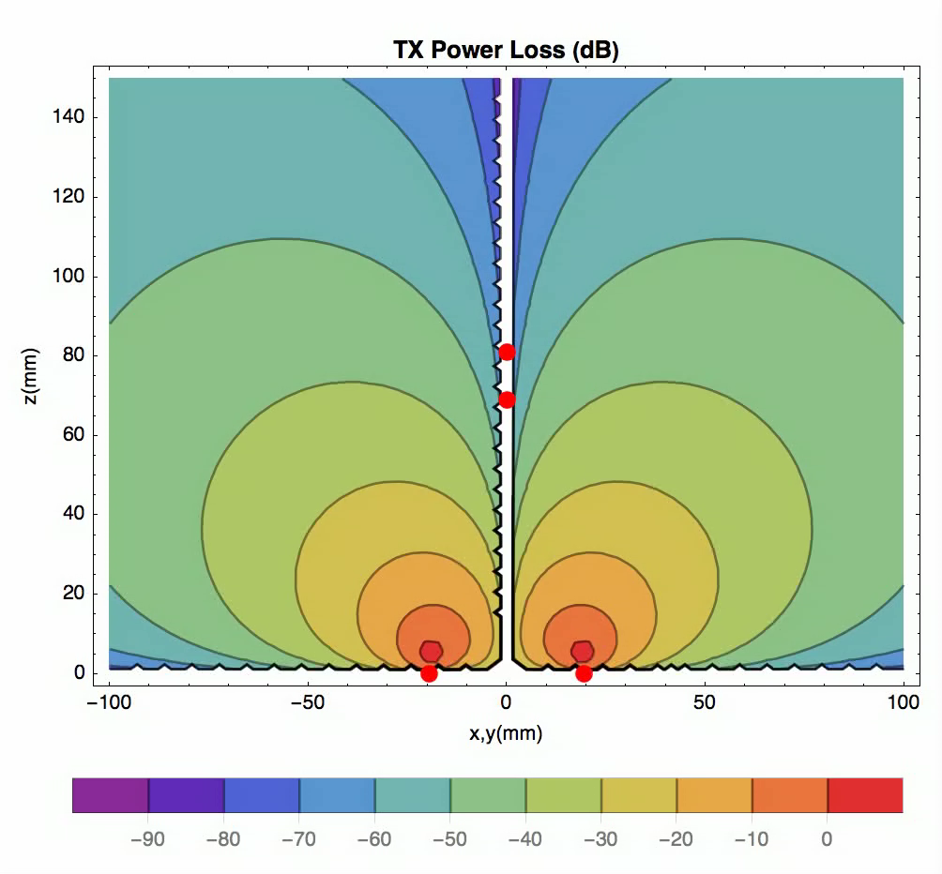
Example 2: Communications – MI Link Modelling
Animation:
Click mouse over plot to show movie controls
Highlights
A fully computable technical document
This visualisation was automatically generated by the document.
Click the picture and hit play for the movie
This plot shows the variation in power lost in a low frequency link between a transmitter coil and receiver coil as the receiver coil angle varies. Several similar dynamic visualization methods are used in the computable report

Slide 16
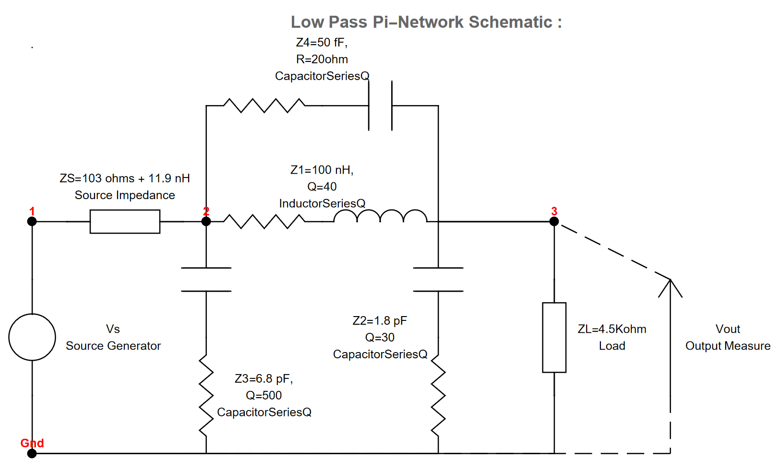
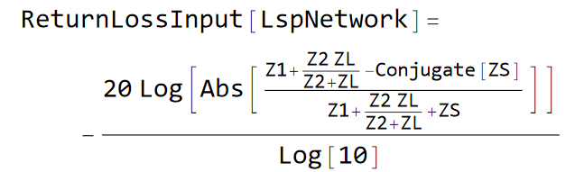
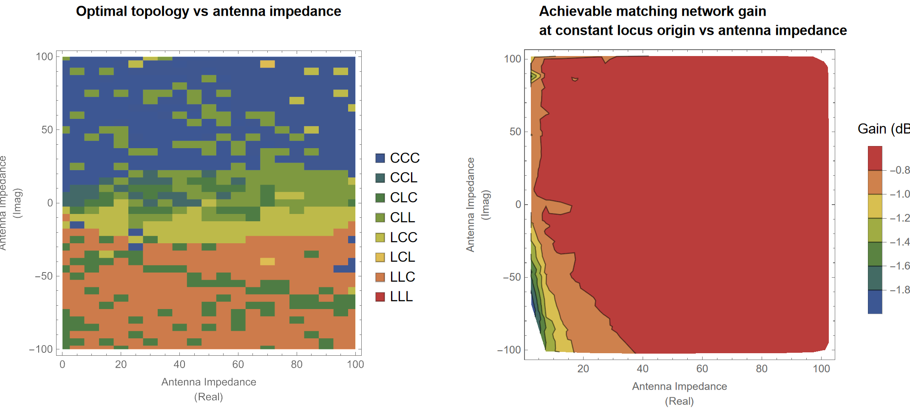
Example 3: Analytical modelling of antenna matching networks
Highlights
Derives equations symbolically
Solves complex circuit equations analytical (linear algebra of kirchoffs loop equations) (not possible with other tools which are all numeric eg SPICE, Matlab etc)
This is proving extremely useful for our Bluetooth RF design !!
Great for any passive circuit analysis

Slide 17
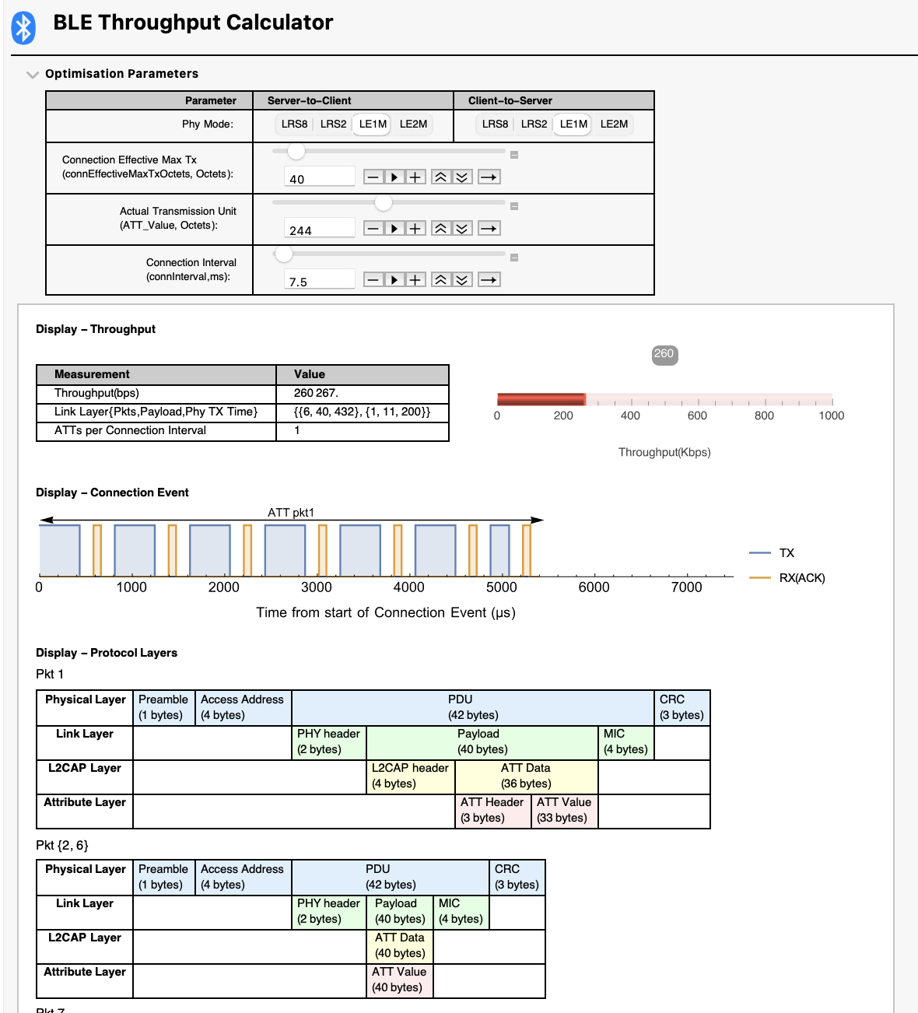
Example 4: Communications - Bluetooth Throughput Analysis
Highlights
Dynamically visualize packet construction as we change key bluetooth link parameters
Different displays to teach firmware engineers and optimize link throughput and power consumption
=> Improve battery life
Hyperlinks to link layer information

Slide 18
Signal Processing and Chip Development

Slide 19
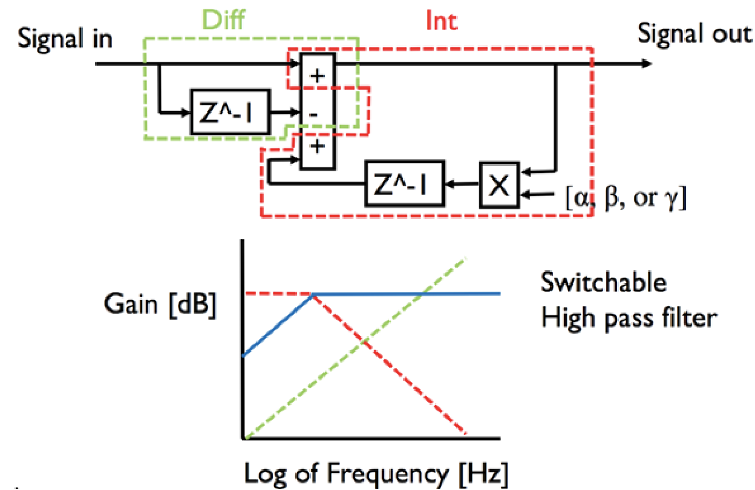
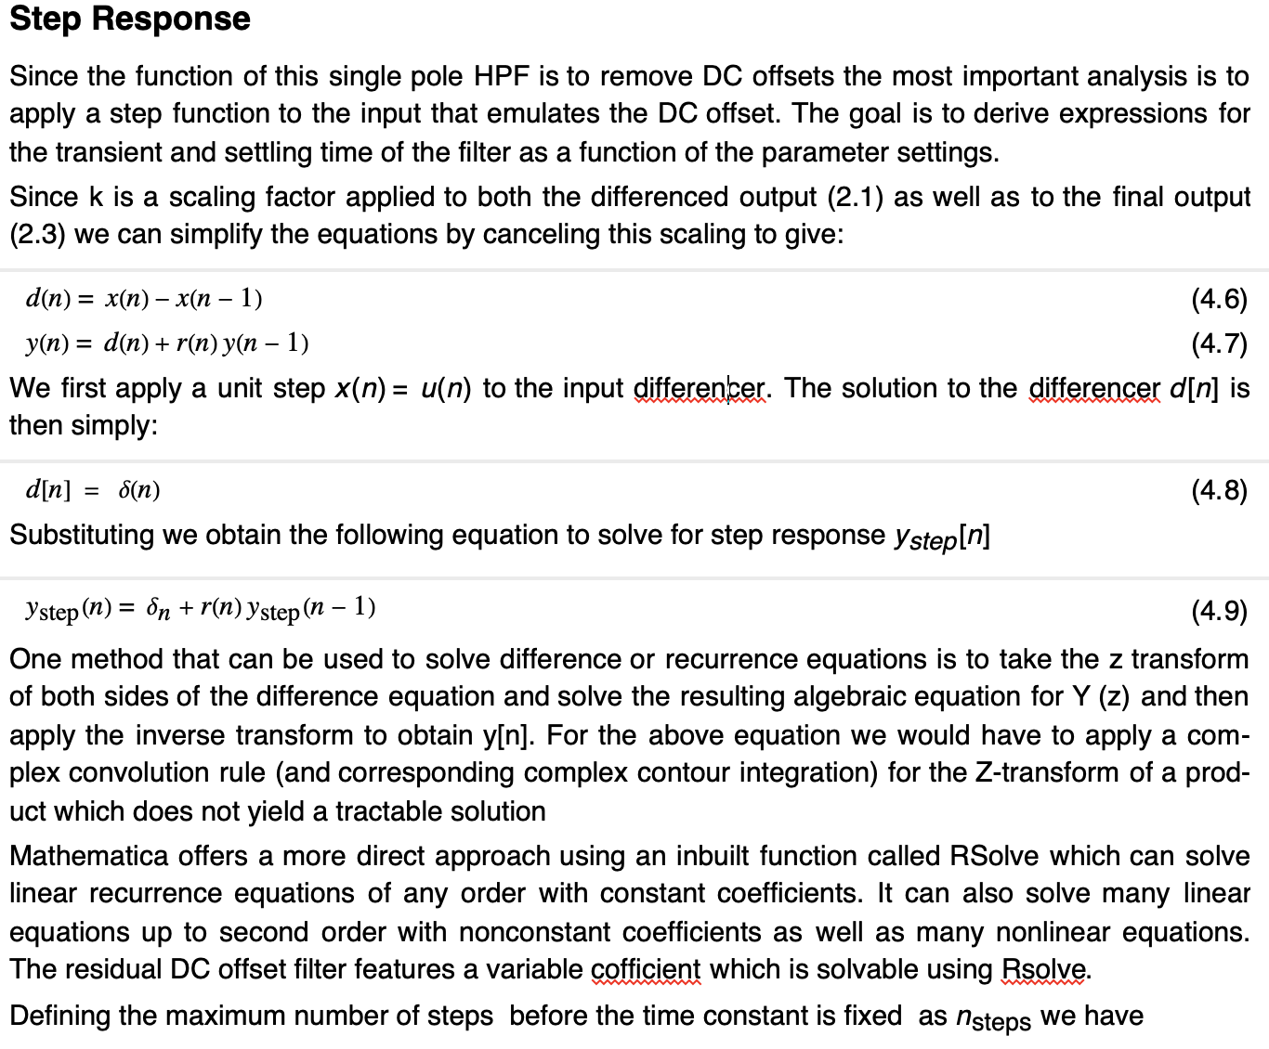
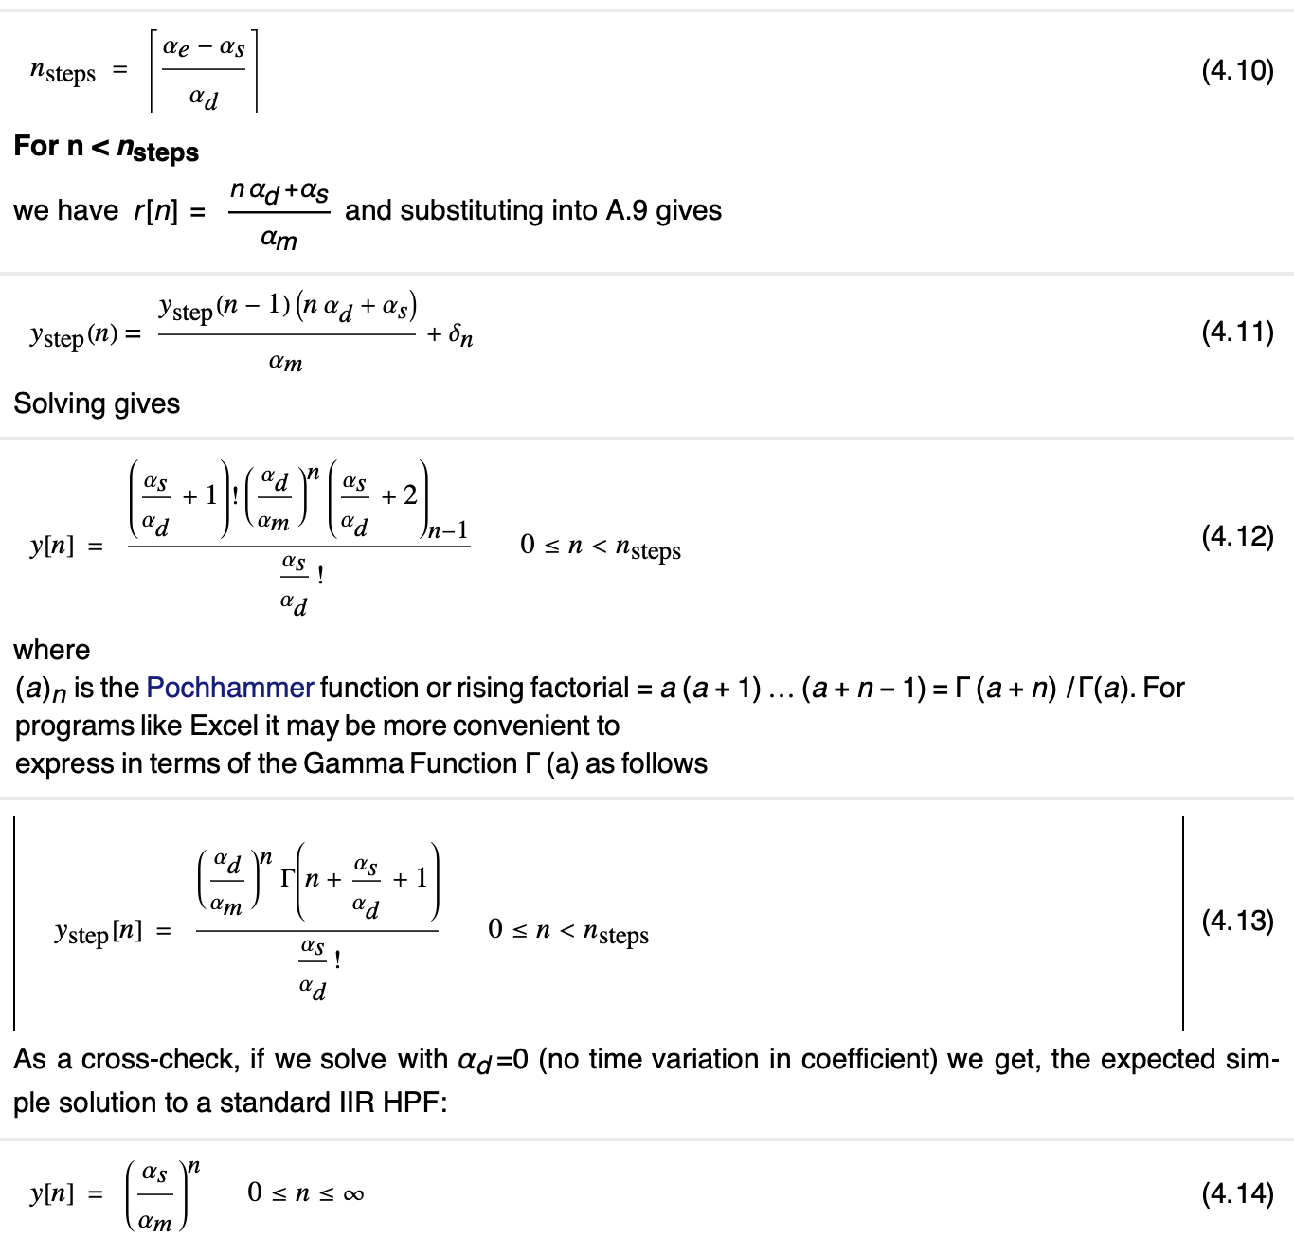
Example 5: Analytical modelling for Digital Signal Processing
Requirements
Analytical manipulation and analysis for DSP
Uses symbolic solving capability of recursive equations
Example HPF – IIR with time-variant properties adjusted to optimize DC removal very quickly

Slide 20
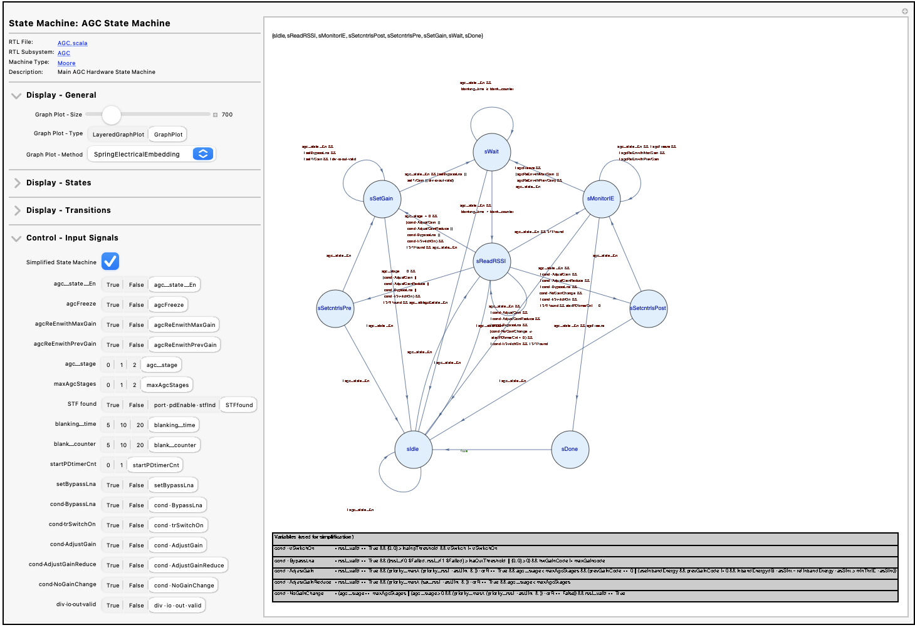
Example 6: Dynamic Visualisation of State Machines
Highlights
Novel concept for verification of state machines
Read code (ANY Code C, RTL etc) and create Boolean expressions
Visualize dynamically the operation and logic of the machine
Impossible to do with Matlab

Slide 21
Key advantages with respect to other tools
Mathematica combines
  Symbolic computation (absolute best tool, symbolic tools in python and matlab are very weak)
  Excellent notebook for self documenting computable documents
    (been developed for 25 years) Much more powerful than Jupyter in Python
  Dynamic visualisation very easy to code (this makes it really suited to test characterization analysis where visualisation is important and flexibility is key)
  Very strong modelling, statistical analysis and equation solving (since it can do symbolic analytical calculations)
  The examples will show many instances some recently developed and others from my experience that showcase these features especially when combined.
  Competing options don’t adequately combine these capabilities
  It is an excellent tool to supplement others in an Engineers Toolkit.

