Slide 1
The inclusion of Arts in science with the help of new technologies
By S. Paulina Toimil DÁvila
Notes:
1

Slide 2
Content
Introduction.
Historical relationship between Art and Science.
The convergence of Art and Science in Technology.
New Technologies and the Wolfram Language.
Final comments.

Slide 3
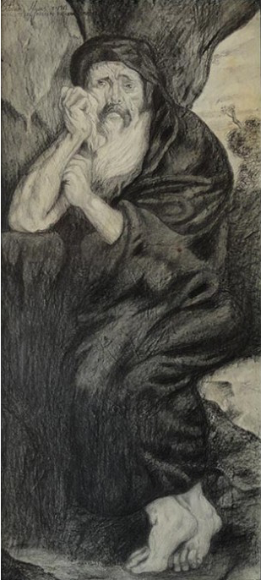
“The opposite is in agreement, from unconformities is born the most beautiful harmony and everything comes from the struggle. They do not understand how the discordant is in agreement with itself, a harmony of opposite tensions, like the bow and the lyre”.
Heraclitus of Ephesus.
“Heraclitus the philosopher who cries” by Octavio Mejias.

Slide 4
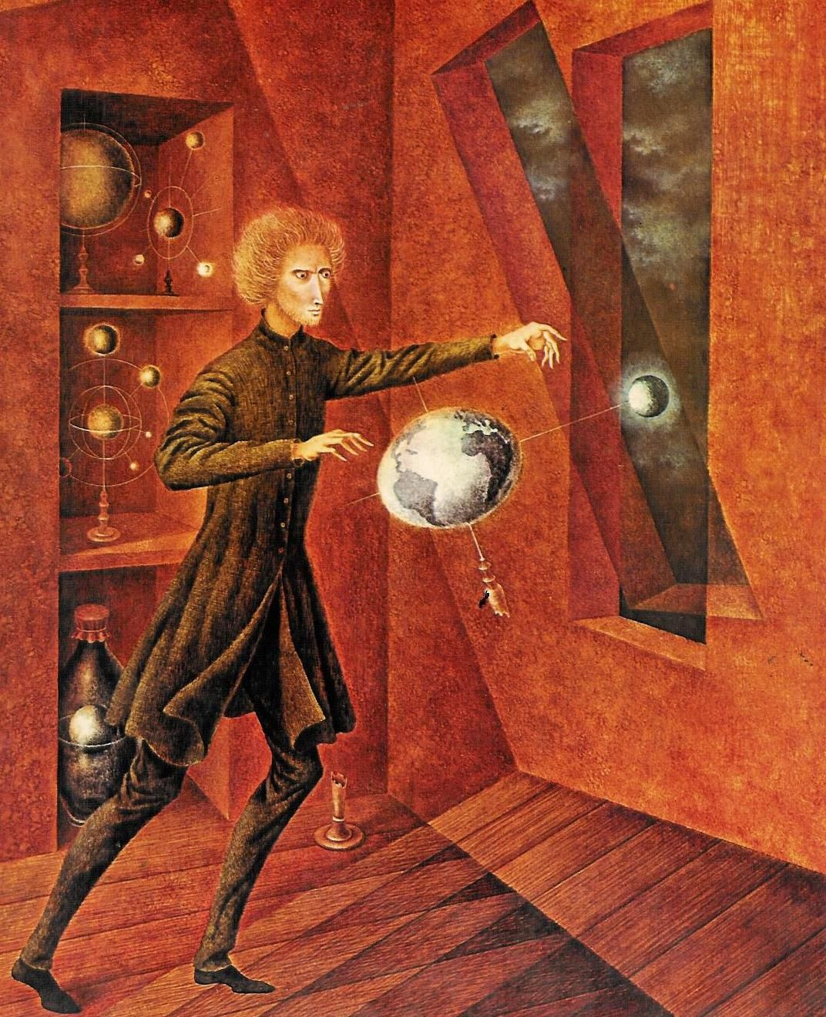
Art and Science observe the world in order to understand it, and, therefore, they are two languages in constant exchange with each other with a common denominator: the inspiration of the human being and his imagination.
The scientist has the aesthetic pleasure of producing a well-designed, “elegant” experiment; and the artist or art critic well knows that reflection and contrast are not excluded from art; in fact they are part of it.
“Phenomenon of Weightlessness” by
Remedios Varo,1963.

Slide 5
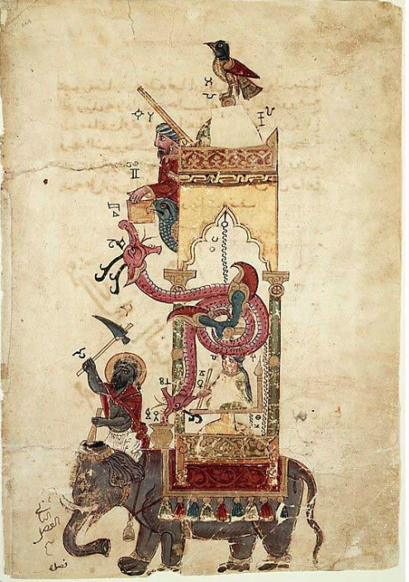
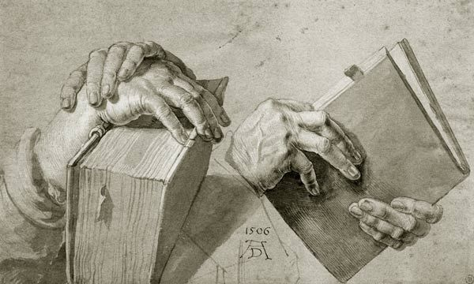
This creative process confirms the convergence of art and science in both technology and technique. These words come from techné (τέχνη) in Greek , a bridge that unites both from the moment of conception of material goods, since without it, no process can be conceived.
"Elephant clock" from the Book of knowledge of mechanical devices, by al-Jazari, 1206
“Two Hands Holding A Pair Of Books” by
Alberto Durero, 1506.

Slide 6
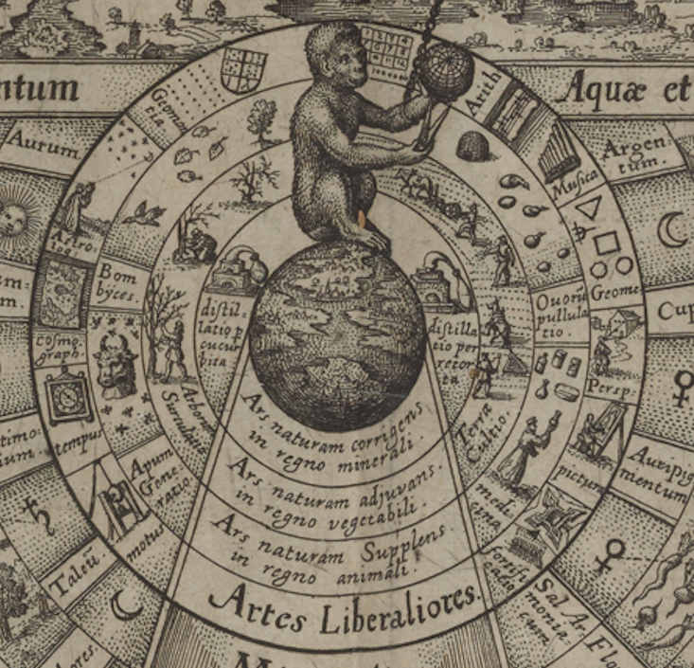
With the arrival the Renaissance, this interrelationship became weaker, however and by the period of Enlightenment a deep division had developed between them. It was only in the 20th century with the beginning of Quantum Theory and Planck’s studies, that classical conceptions of art and science were put to the test.
Here you can see an image of a monkey sitting on the material world while observing a representation of the world from a distance.
"The mirror of all nature and the image of art" from Utriusque Cosmi Maoiris et Minoris Metaphysica, Physca atque technica historia, by Robert Fludd, 1617.

Slide 7
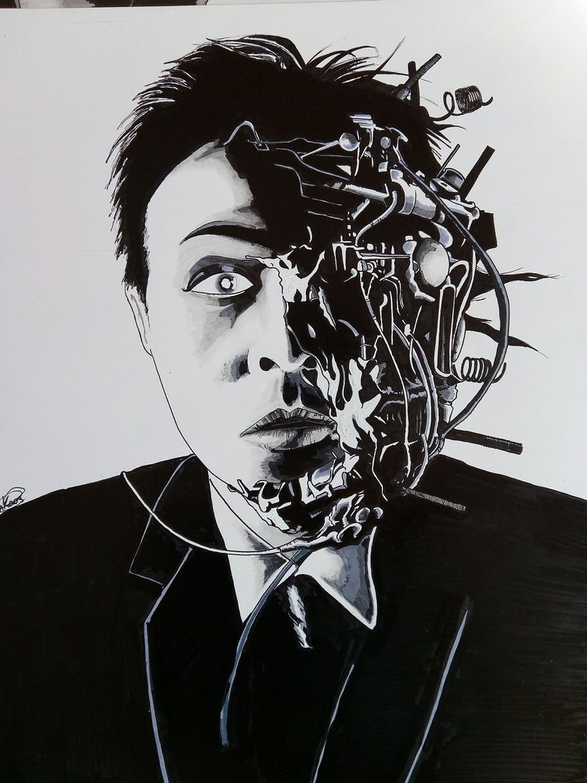
A piece of technology is interactive in the sense that it returns the consequences of our actions or decisions to us. It is a means by which we communicate with ourselves, a mirror. It gives us back to ourselves, transformed, encoded, and sequenced.
“Tetzuo” Ankaos (Angel Aguilar), 2017.

Slide 8
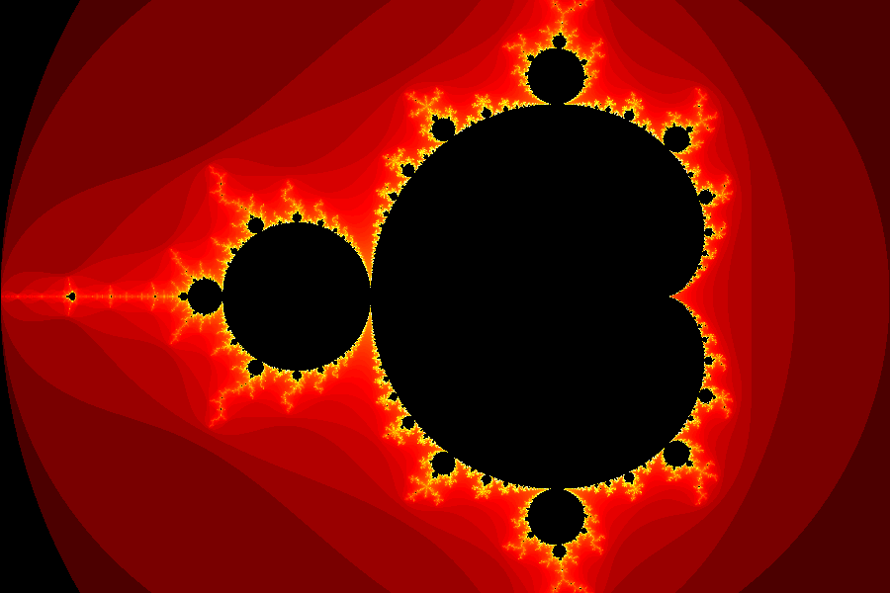
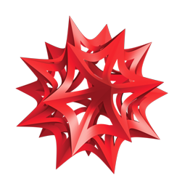
Everything that exists in nature contains information. If we look closely at natural phenomena, we can extract this information and express it in a mathematical model or in a mathematical equation.
Representation of the Mandelbrot set.
Through simple rules, the Wolfram language allows us to encode this mathematical information to solve the equations with the help of technology such as a computer. We tell the computer what to do and how we want it to do it, using the code we developed.
Wolfram language.

Slide 9
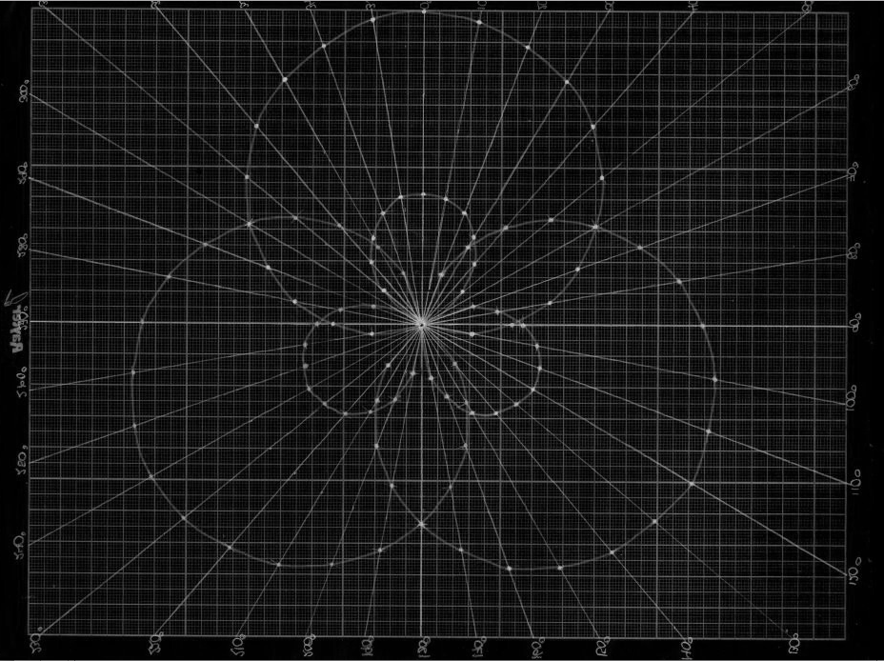
Through the code it is much simpler to change a numerical value in order to express colors, graphs, sounds or geometrical shapes to obtain demonstrations that predict scientific facts or natural phenomena.
“Hybrid Orbital sp2 graph” Paulina Toimil Dávila, 2012.

Slide 10
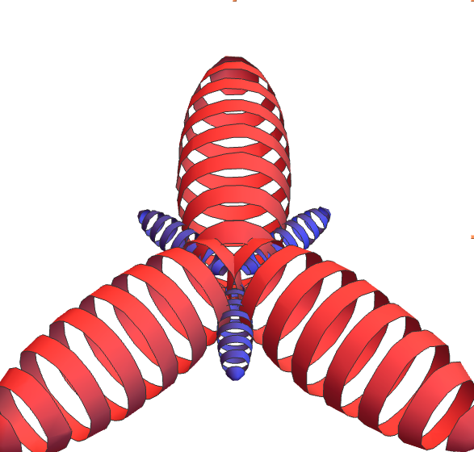
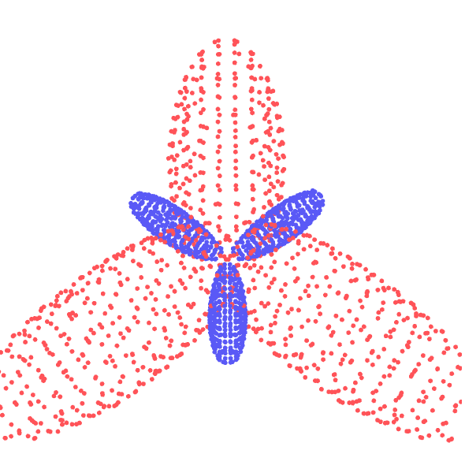
HYBRID ORBITALS IN ORGANIC CHEMISTRY
by Guenther Gsaller.
Wolfram demonstration.

Slide 11
FINAL COMMENTS
-Without a doubt , these forms are more elegant and aesthetically pleasing than a mathematical equation. In addition, they stimulate the sensibility of those who appreciate them, generating an authentic interest for sciences.
-With Wolfram being an open language, we can make changes to the codes programmed by others, which makes it a dynamic technology that has created a large community of developers around the world which is self-enriched by the exchange of ideas.
-The importance of the inclusion of art in science with the help of new technologies rests on these innovative ways of transmitting and teaching scientific knowledge, where programming is applied to mathematical models to generate a “New Kind Of Science” that breaks paradigms.

Slide 12
BIBLIOGRAPHY
● Wolfram S. A new kind of science. U.S.A. : Wolfram Media Inc; 2002. ● Ibáñez F. El enlace químico. Chile: Ediciones Universidad Católica de Chile;1996.
● Daudel R. Teoría cuántica del enlace químico. Spain: Ediciones Bellaterra; 1975.
● Derrida J. Introducción a “el origen de la geometría”. Argentina: Manantial, 2000.
● Díaz J. El ábaco, la lira y la rosa. Las regiones del conocimiento. México: Fondo de cultura económica; 2002.
● Díaz M, Roig A. Química Física.Vol. 1. Spain: Alhambra mexicana; 1989.

Slide 13
Thank you so much! ☺
Wolfram Research.
Toimil & Dávila Family.
The Anglo Mexican Foundation.
-Manager. Gaby Gonzales Fucazagua
-Emma Sharpe
-Silvia Mora
Unidad Cañera Democratica del Ingenio la Margarita, A. C. Oaxaca, Mexico.
- Leader Tomas Cenobio Manuel
U.N.A.M.
-Mtra. Enriqueta Castrejón Rodríguez -Mtro. Pablo Flores Campos

