Slide 1


Computational Thinking for the Masses
Ben Koo, Sun Yi Qiao
Gautam Dasgupta, Ron Rusay, and Ray Dougherty
iCenter of Tsinghua, Columbia U, NYU
contact: benkoo@tsinghua.edu.cn

Slide 2
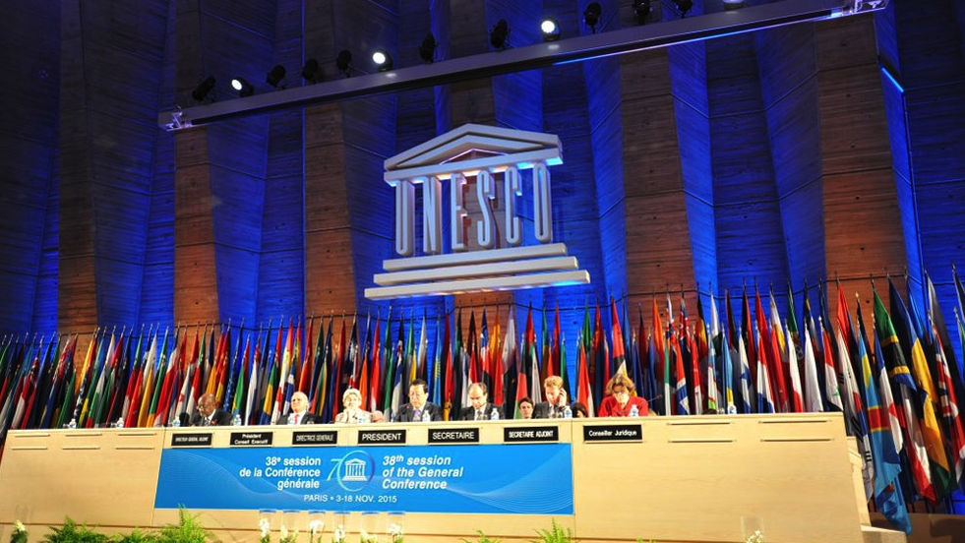
“Education systems in many countries are not yet relevant to fast-changing labour market opportunities”
on UNESCO Education Strategy 2014-2021 page 15

Slide 3
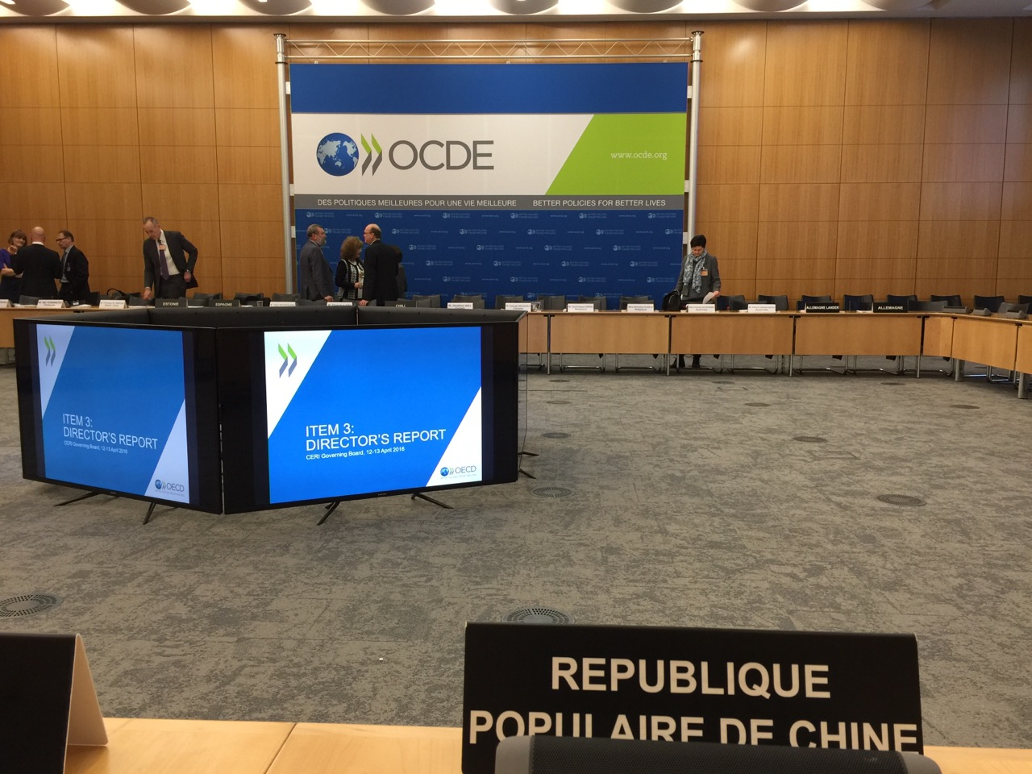
“Artificial Intelligence and Robot Technologies are changing Educational Needs…”
Andreas Schleicker 2016 June
Director of Education

Slide 4
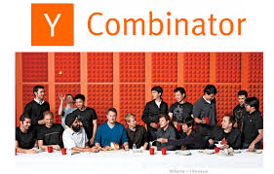
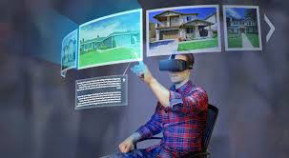



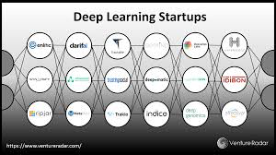

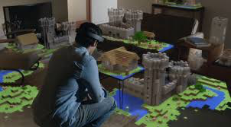
Paradigm Shift
Schools? Incubators?
Technologies are transforming the
social function of schools
A Totally Free Professional Education that
Challenges Degreed Programs

Slide 5

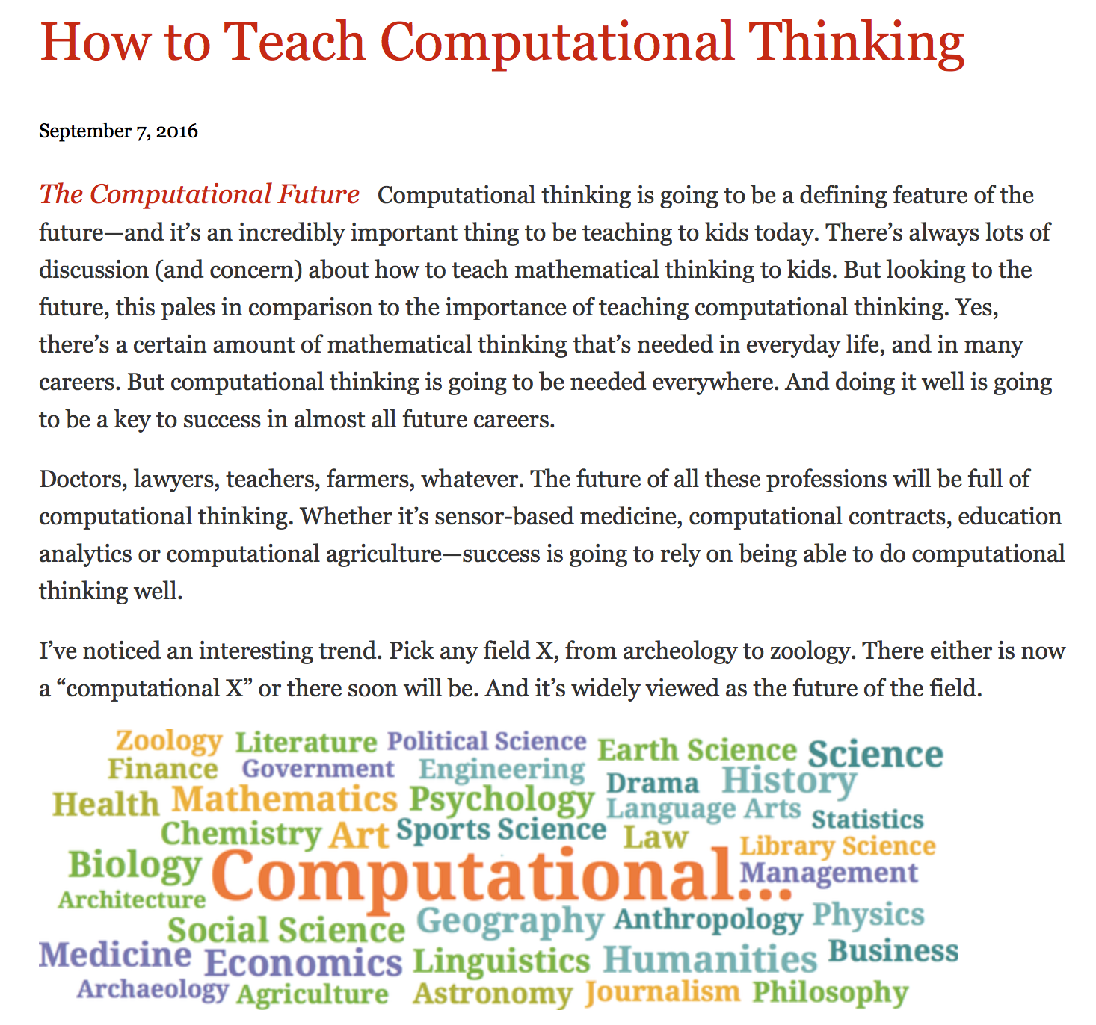
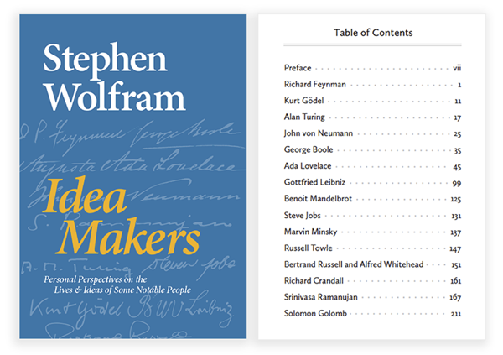
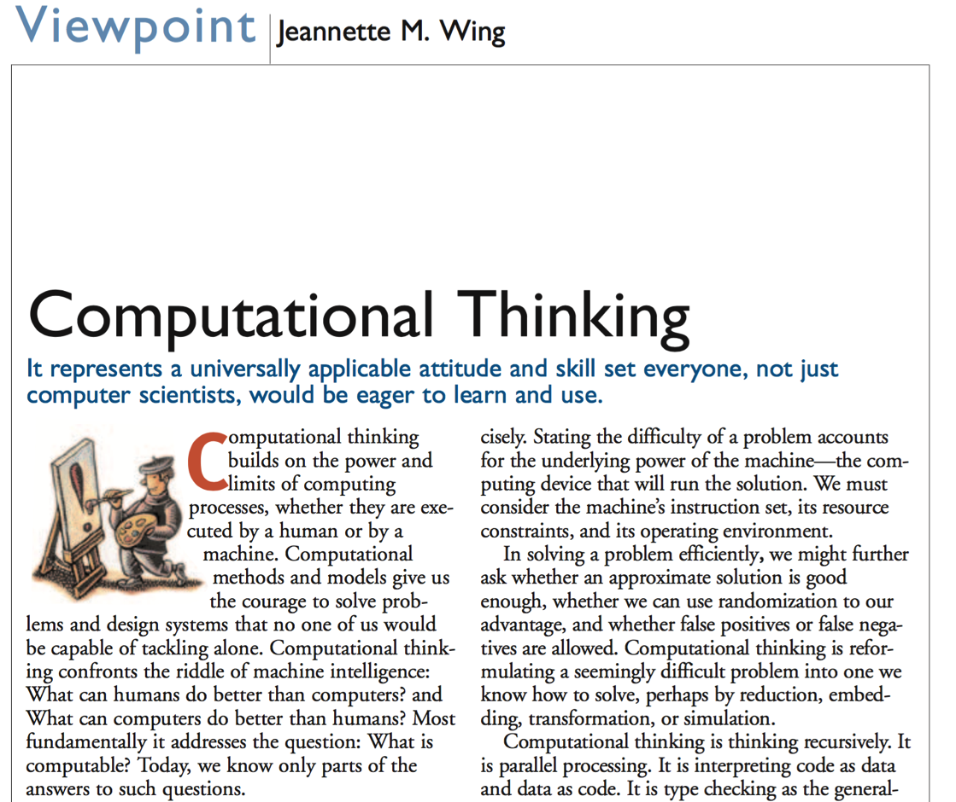
Historical Accounts of Computational Thinking (as a Course)
March 2006, CACM

Slide 6
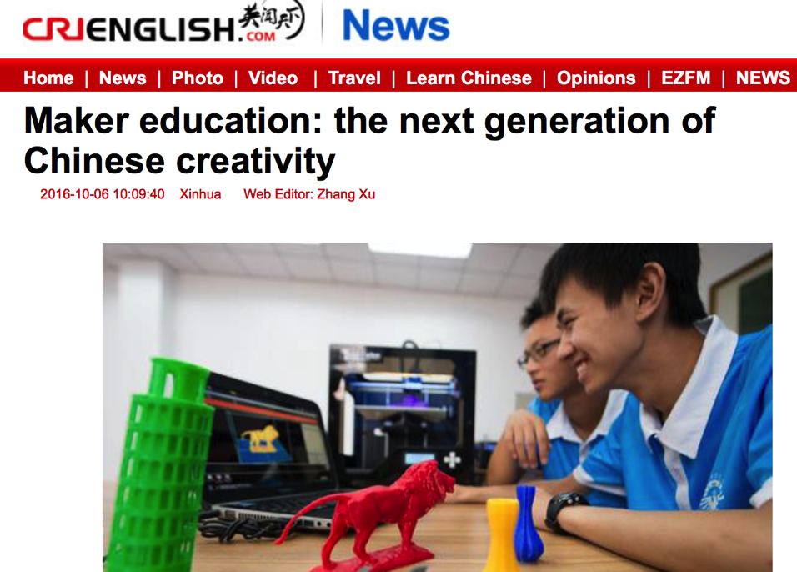

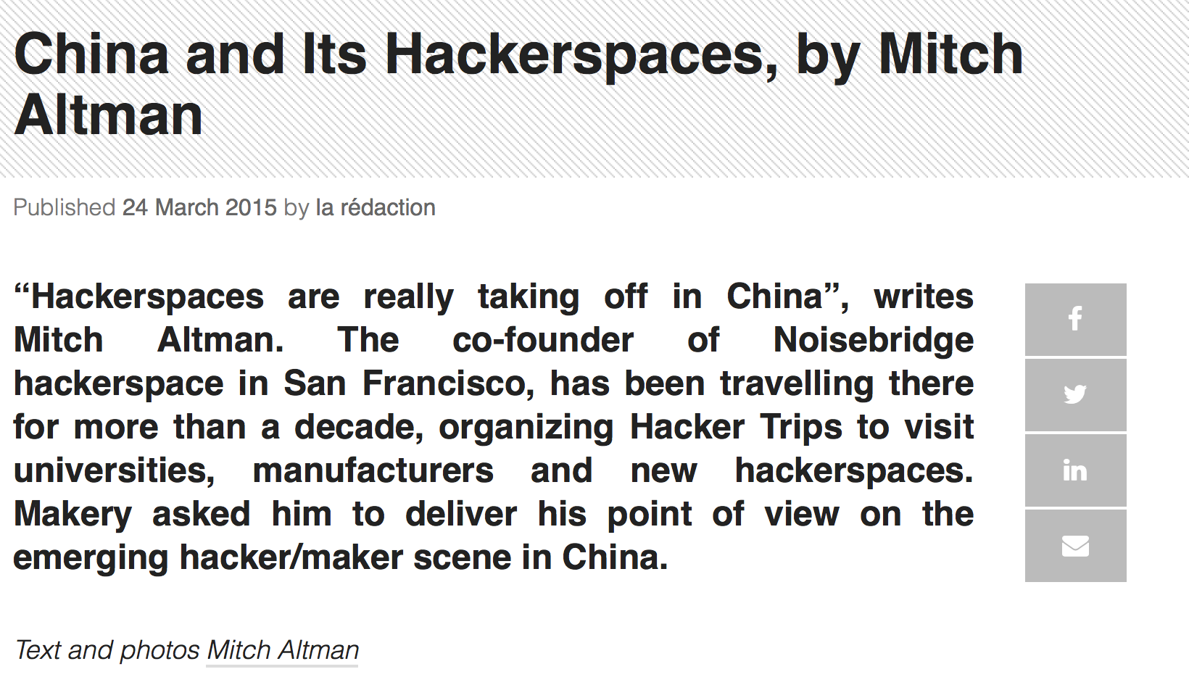
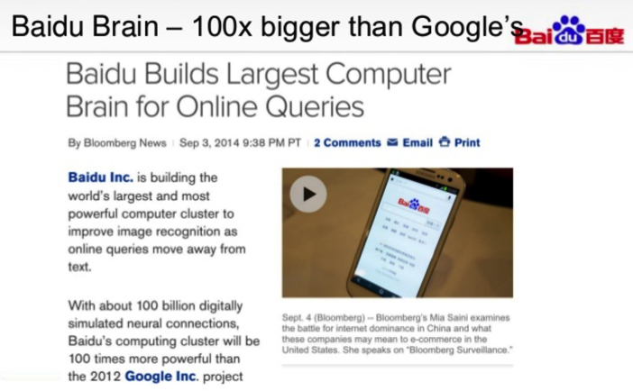
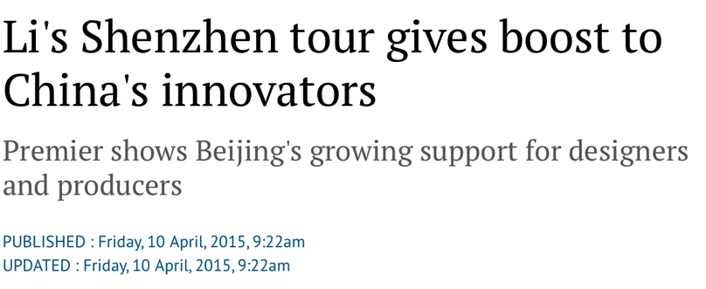
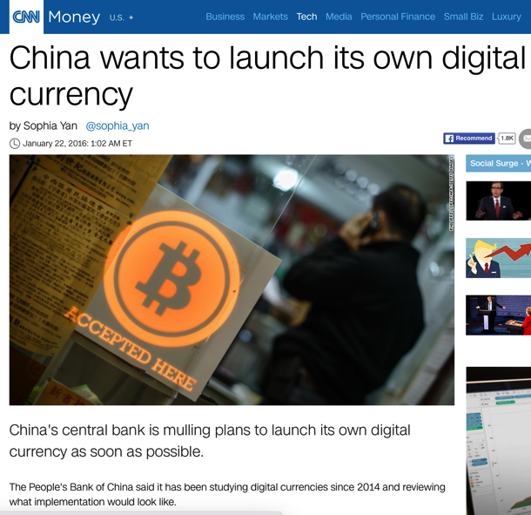
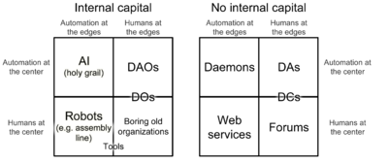

Social Demand for Computational Thinking

Slide 7
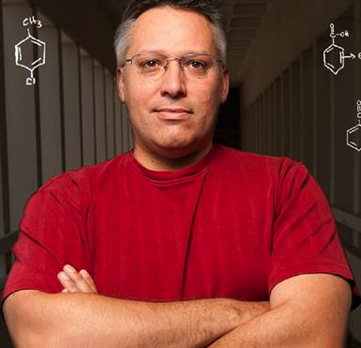



The Masses is already using Scalable Knowledge Management Tools
by Prof. Delmar S. Larsen@ UC Davis
The world’s largest open-source
STEM Content Production Workflow.
（Students write their own Textbook on Wiki）
40+ Universities，7000+students involved.
5 Million/Per Month Individual Visits
Funded

Slide 8
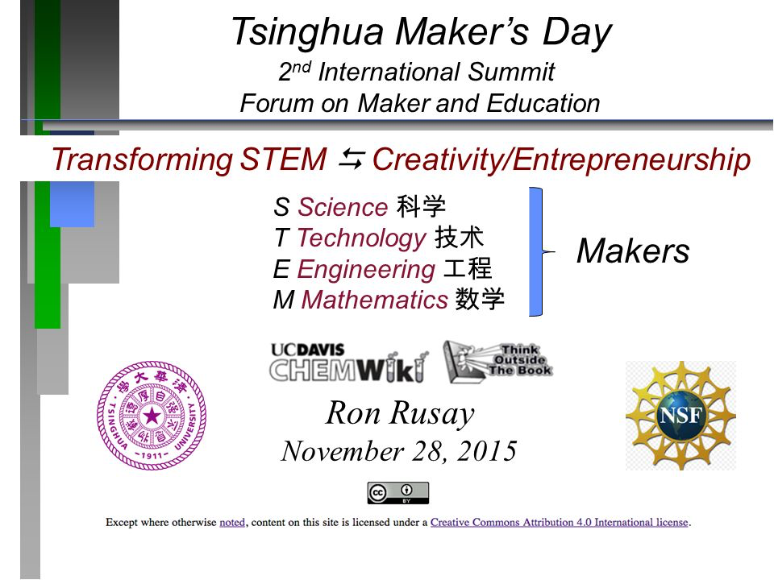
Collaboration with the LibreTexts (ChemWiki) team

Slide 9


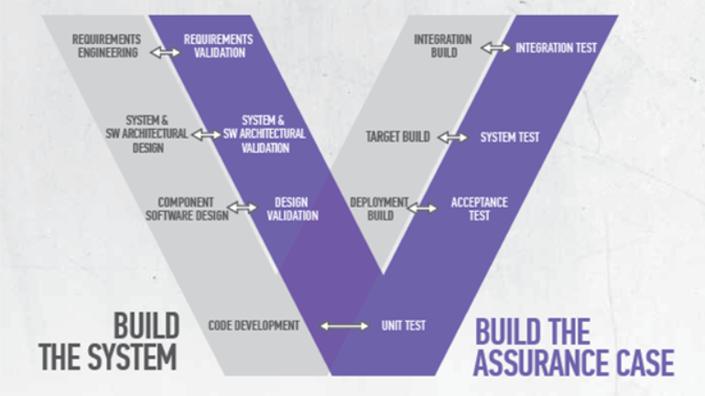
How do we know that we know?
A. Creating Rich Context
(Build a complete stack
of computing systems)
B. Writing Design Contracts
(Rigorous Tools to enable
documentation)
C. Automated Test Cases
(Provide Interactive Feedback
To individual students)
Verification and Validation in Software Engineering

Slide 10

An Overview of ABC School
Orientation
Program and
Examining
Students’
Team Performance
Strategy Analysis based-on Computational Thinking
Senior Students
Design or
Modify
Curriculum
For Incoming Students
A. Application (Training executives)
Mission
Executor
Challenge
Designer
Industry Frontier
Operations based-on digital workflow infrastructures
B. Business Operations (Workflow)
System Design in Computational Thinking
C. Content Orientation (Discipline-specific explorations)
技术架构
Virtual Reality
Content Production
Deep Learning
Technologies
Manufacturing and Logistic Management
Domain-Specific Courses
Trans-Disciplinary Cognitive Foundation
Based on Legal Protocols in Global Creative Commons

Slide 11
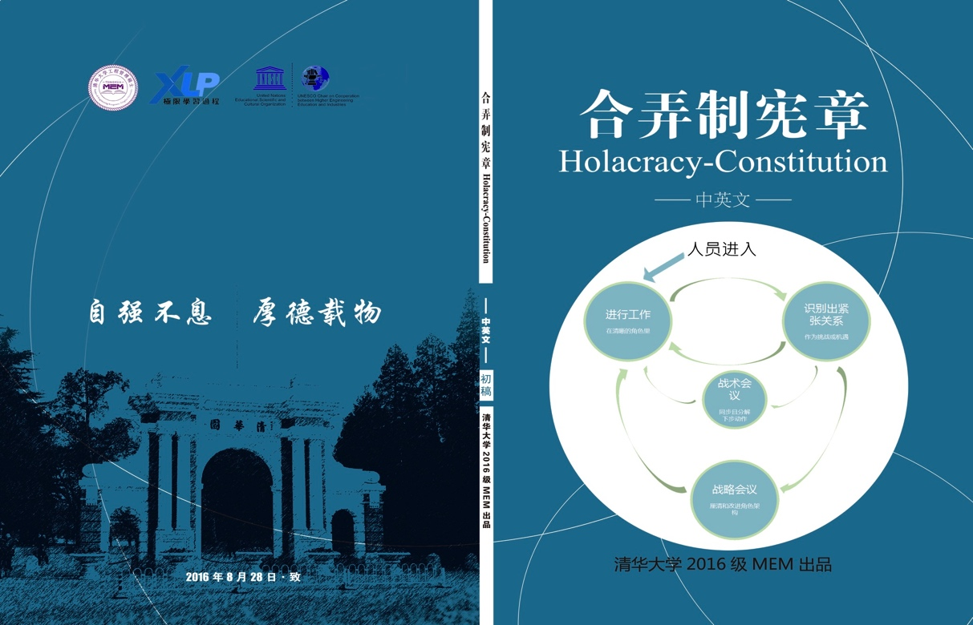
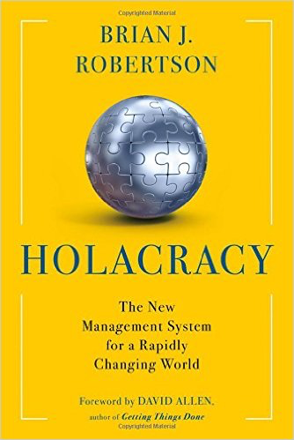
2016 example: 130+ Incoming Masters in Engineering Management Students Translated “Holacracy Constitution 4.1” to Chinese in 24 hours (during their first week XLP-based orientation program)
Create Rich Contexts for Learning
The original text in
English is 41 pages long
They also used
The same wiki
knowledge repository
http://toyhouse.cc/wiki/index.php/合弄制宪章4.1

Slide 12
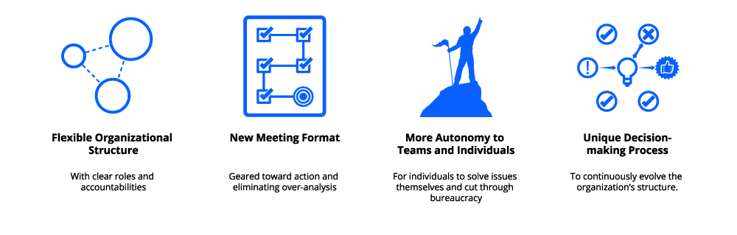
Writing Smart/Flat/Governance
Contracts
Human
Abstract design
Thought
abstract interface
Chapters 9, 12
H.L. Language
&
Operating Sys.
Writing Organizational Design Contracts
Circles
Links

Slide 13
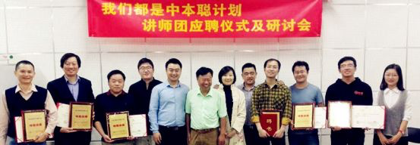

The Leading Blockchain NGO in China (DACA) invited 10 leading Ethereum Developers to help develop ABC Course Content
Around 5:00PM October 14, 2016, before the Industry Frontier class starts at 7:20PM

Slide 14
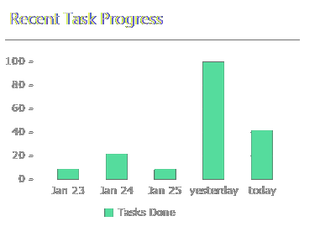
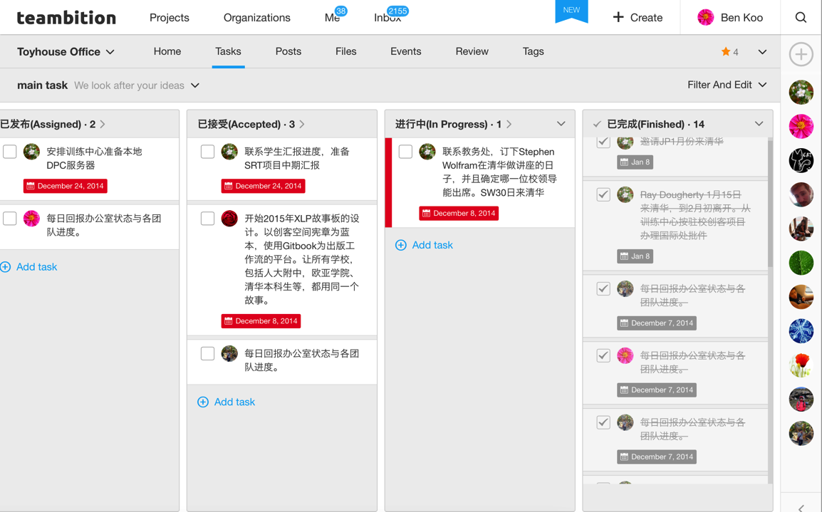
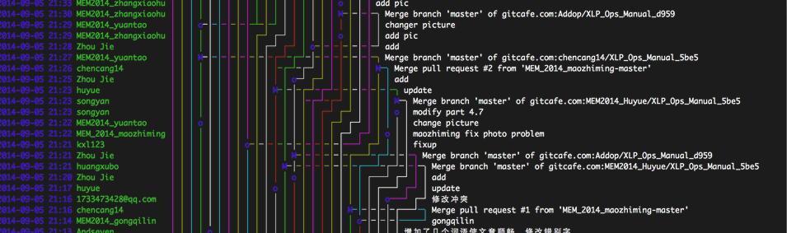
ABC Course Process Data Verifying Learning Actions

Slide 15
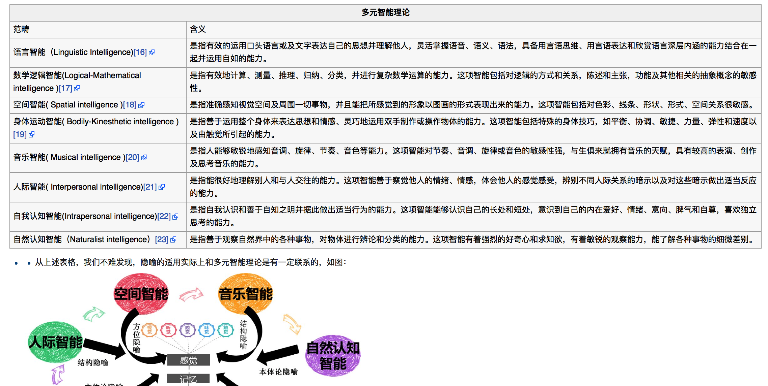
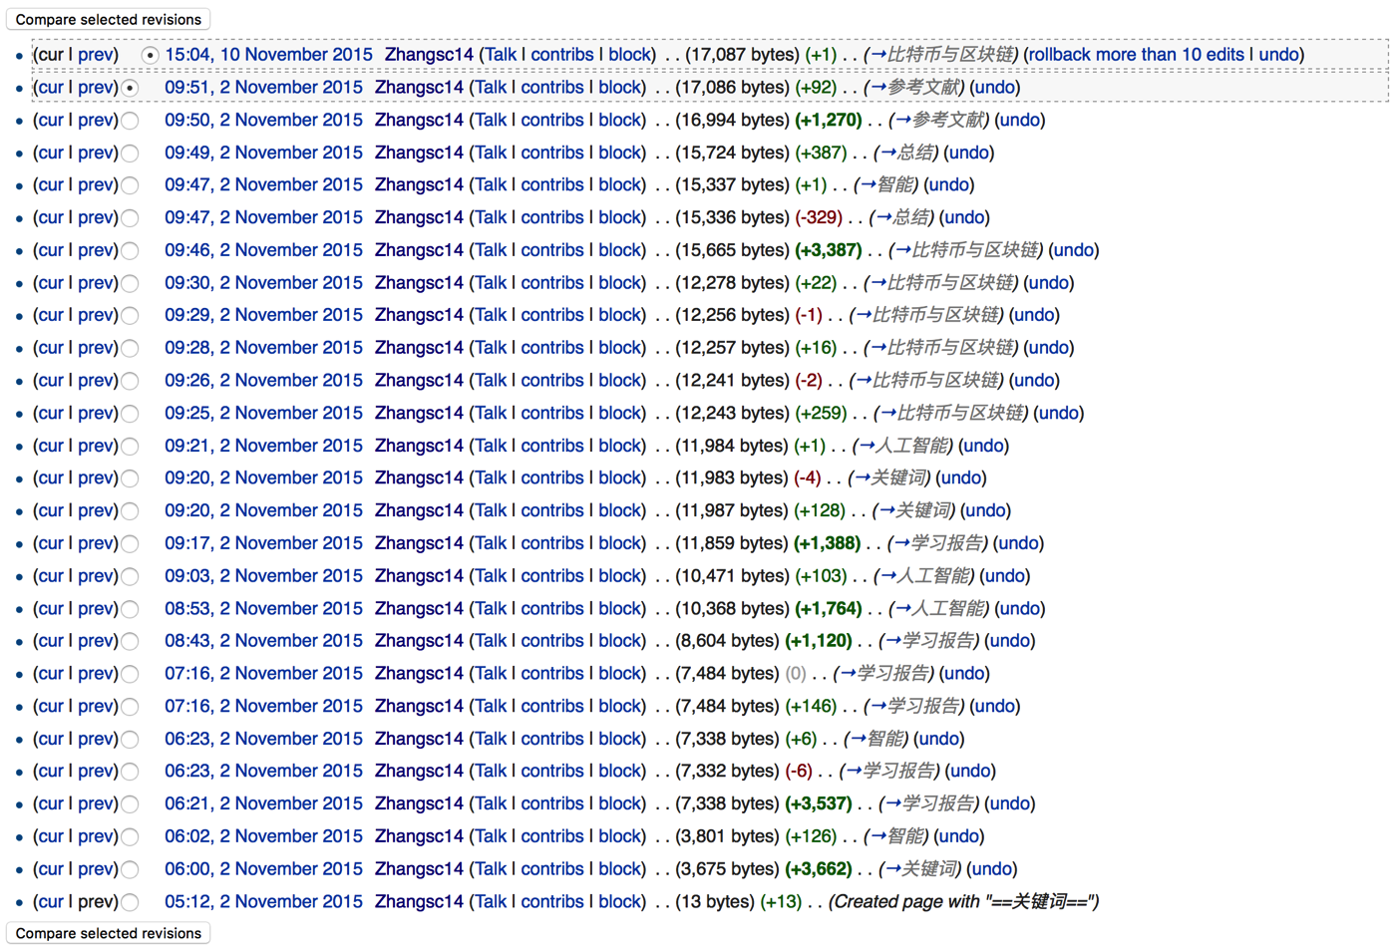
Process Data Validates Content Data, so that we know students knows
http://toyhouse.cc/wiki/index.php?title=《超越学科的认知基础》2015张世超学习报告第七周&action=history

Slide 16
Mathematica and Wolfram Alpha is integrated as a part of homework assignments
Cognitive Foundation | System Design in Computational Thinking | Industry Frontier
Metaphors in Category Theory (WildCat as a Mathematica Package) | Creating Full Stack Computing System | Documenting and Generating Diagrams using Mathematica and W|A
Play with Functional Programming And System Composition | From Boolean Algebra, Logic, to Parsers and File Manipulation | Collect Data for Writing Industry Analysis Reports

Slide 17
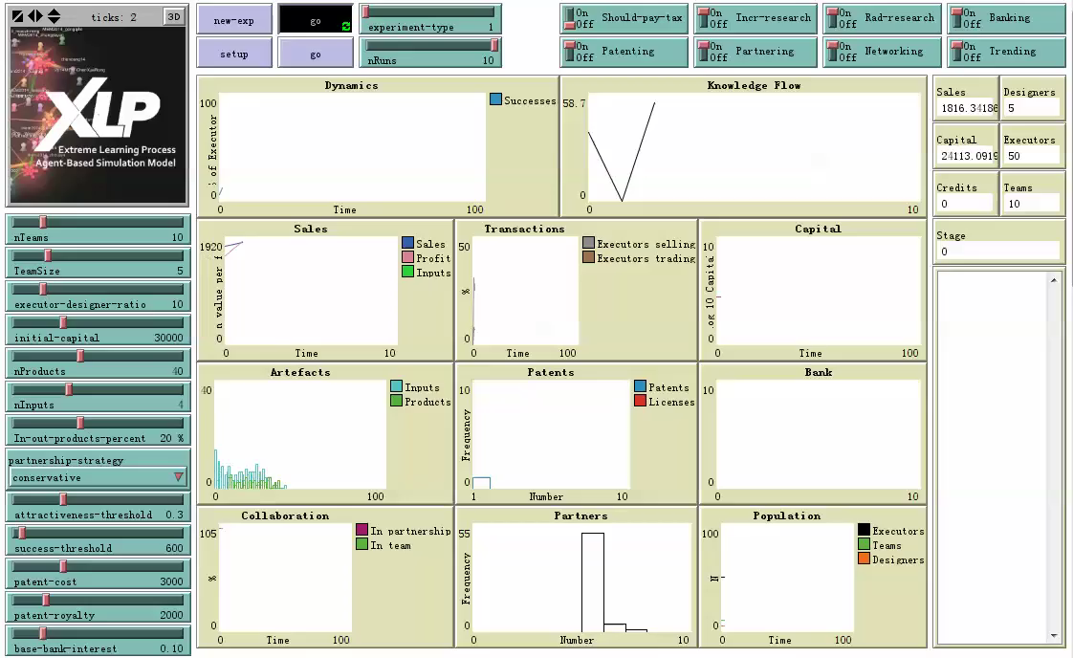

Agent-based Simulation matching real process data in NetLogo

Slide 18
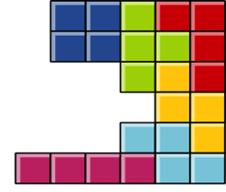
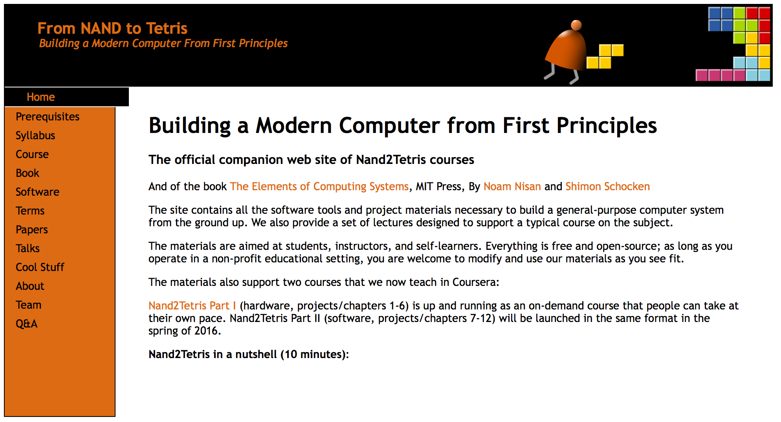
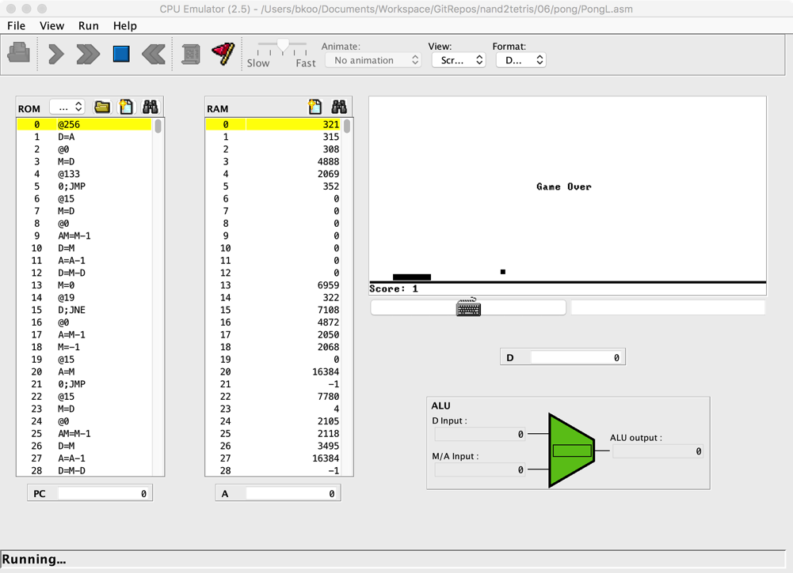
From Gates to CPU in 5 Weeks
abstract interface
H.L. Language
Human
&
Thought
Operating Sys.
abstract interface
Virtual
Machine
abstract interface
Machine
Language
abstract interface
Assembly
Language
abstract interface
Hardware
Platform
abstract interface
Physics
Chips &
Logic Gates

Slide 19
Assembly to High Level Language Compiler in the remaining 7 Weeks
Human
Abstract design
Software
Thought
abstract interface
hierarchy
Chapters 9, 12
H.L. Language
Compiler
&
abstract interface
Operating Sys.
Chapters 10 - 11
Virtual
VM Translator
Machine
abstract interface
Chapters 7 - 8
Assembly
Language
Assembler
Chapter 6
abstract interface
Computer
Machine
Architecture
Language
abstract interface
Chapters 4 - 5
Gate Logic
Hardware
abstract interface
Platform
Chapters 1 - 3
Electrical
Hardware
Chips &
Engineering
Logic Gates
Physics
hierarchy

Slide 20
Before you take Nand2Tetris:
“The two entries slots .. CS-2”—immediately after learning programming, and “CS-199”—a capstone course coming at the end of the program.”

Slide 21
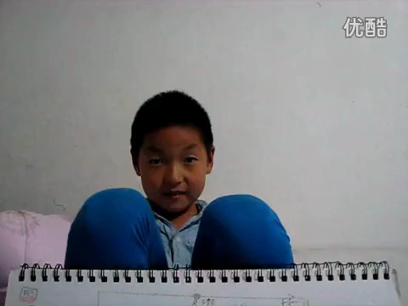
An 8 year old teach other teens the first 5 weeks
in 5 Days
5 Week on Hardware?
Notes:
14

Slide 22
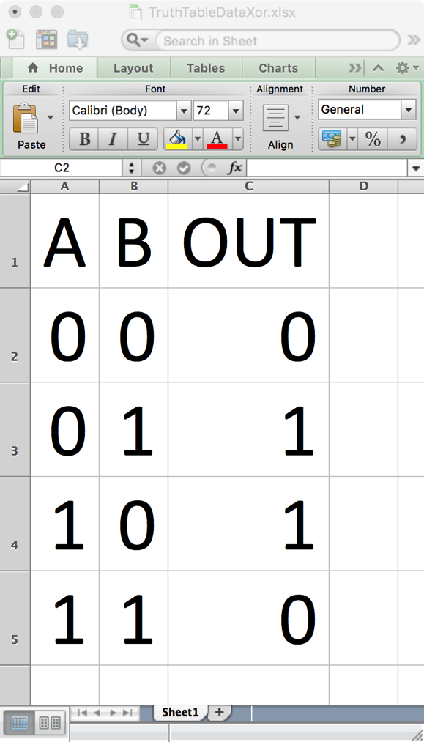

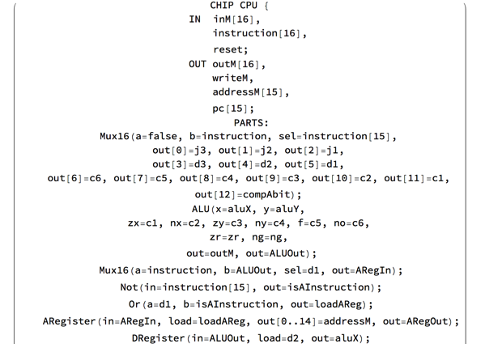
Computational Thinking homeworks are all
Code Translation (compiler-implementation) assignments
BooleanConvert[..]
FullSimplify[..]
HDLExport[..]
BooleanFunction[..]
TraverseExpressionTree[..]
Notes:
14

Slide 23
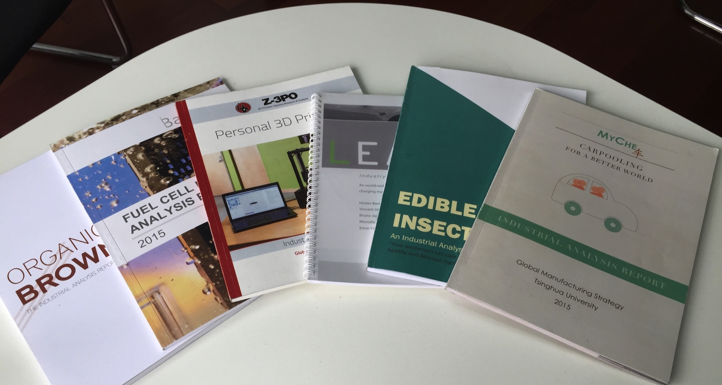
Industry Frontier and Cognitive Foundation
are report compilation processes
Notes:
14

Slide 24
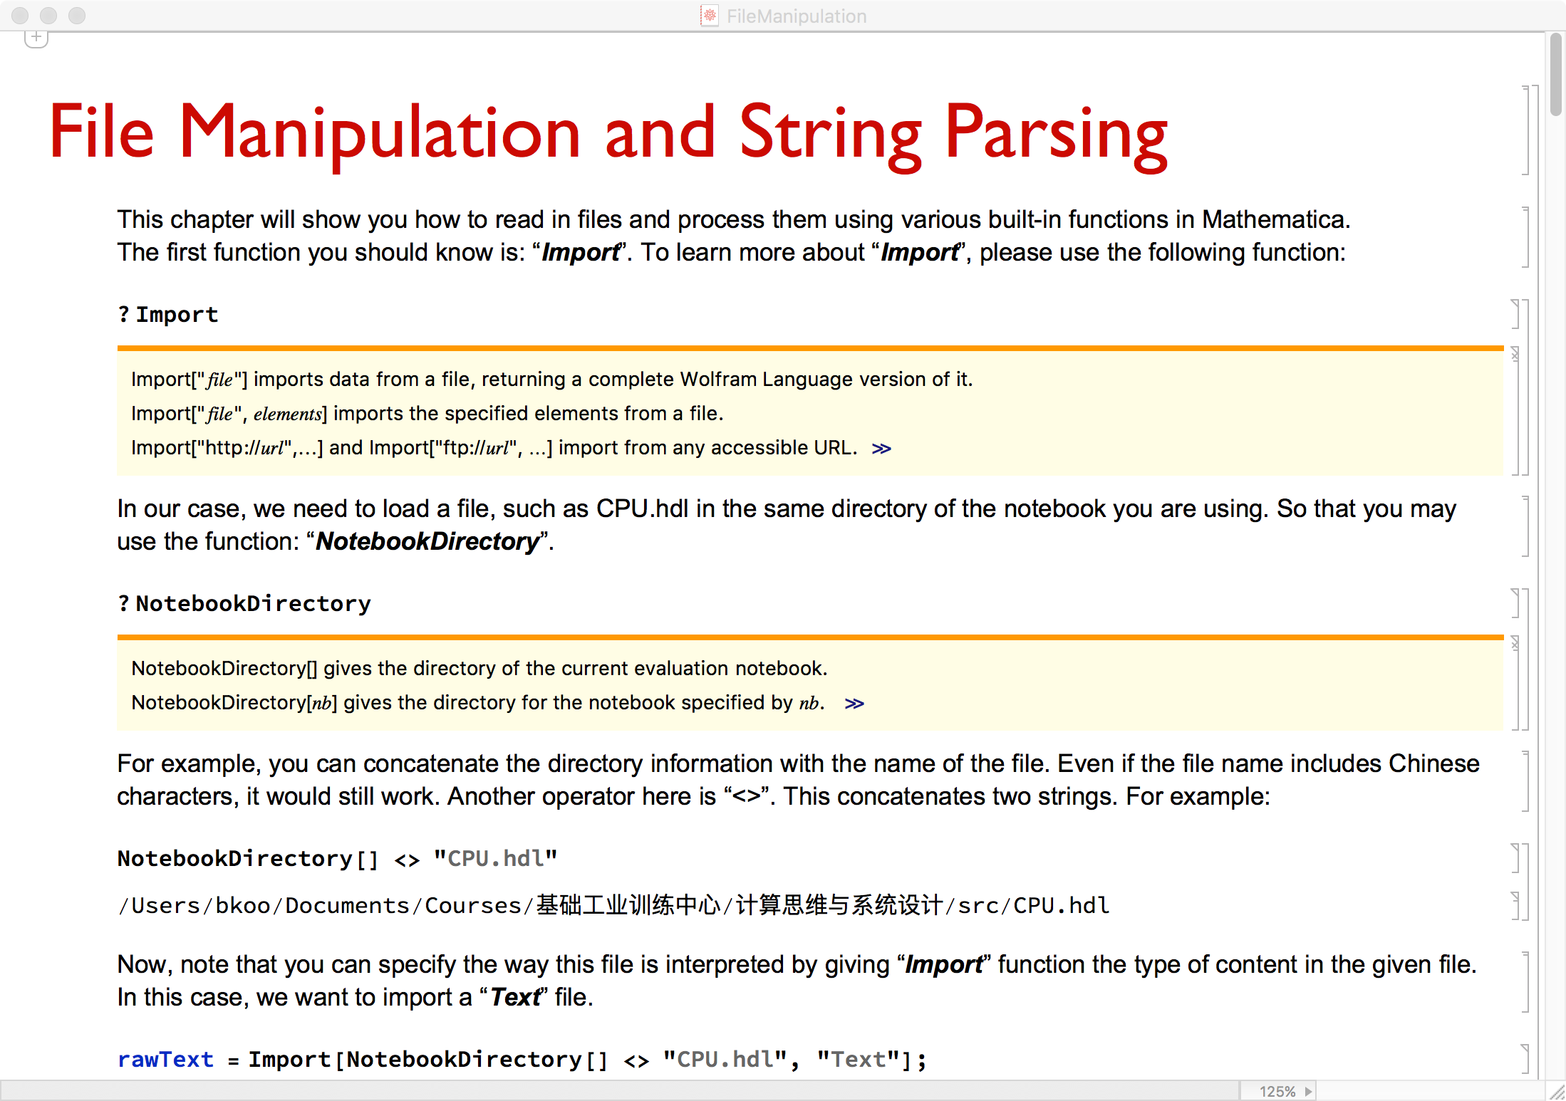
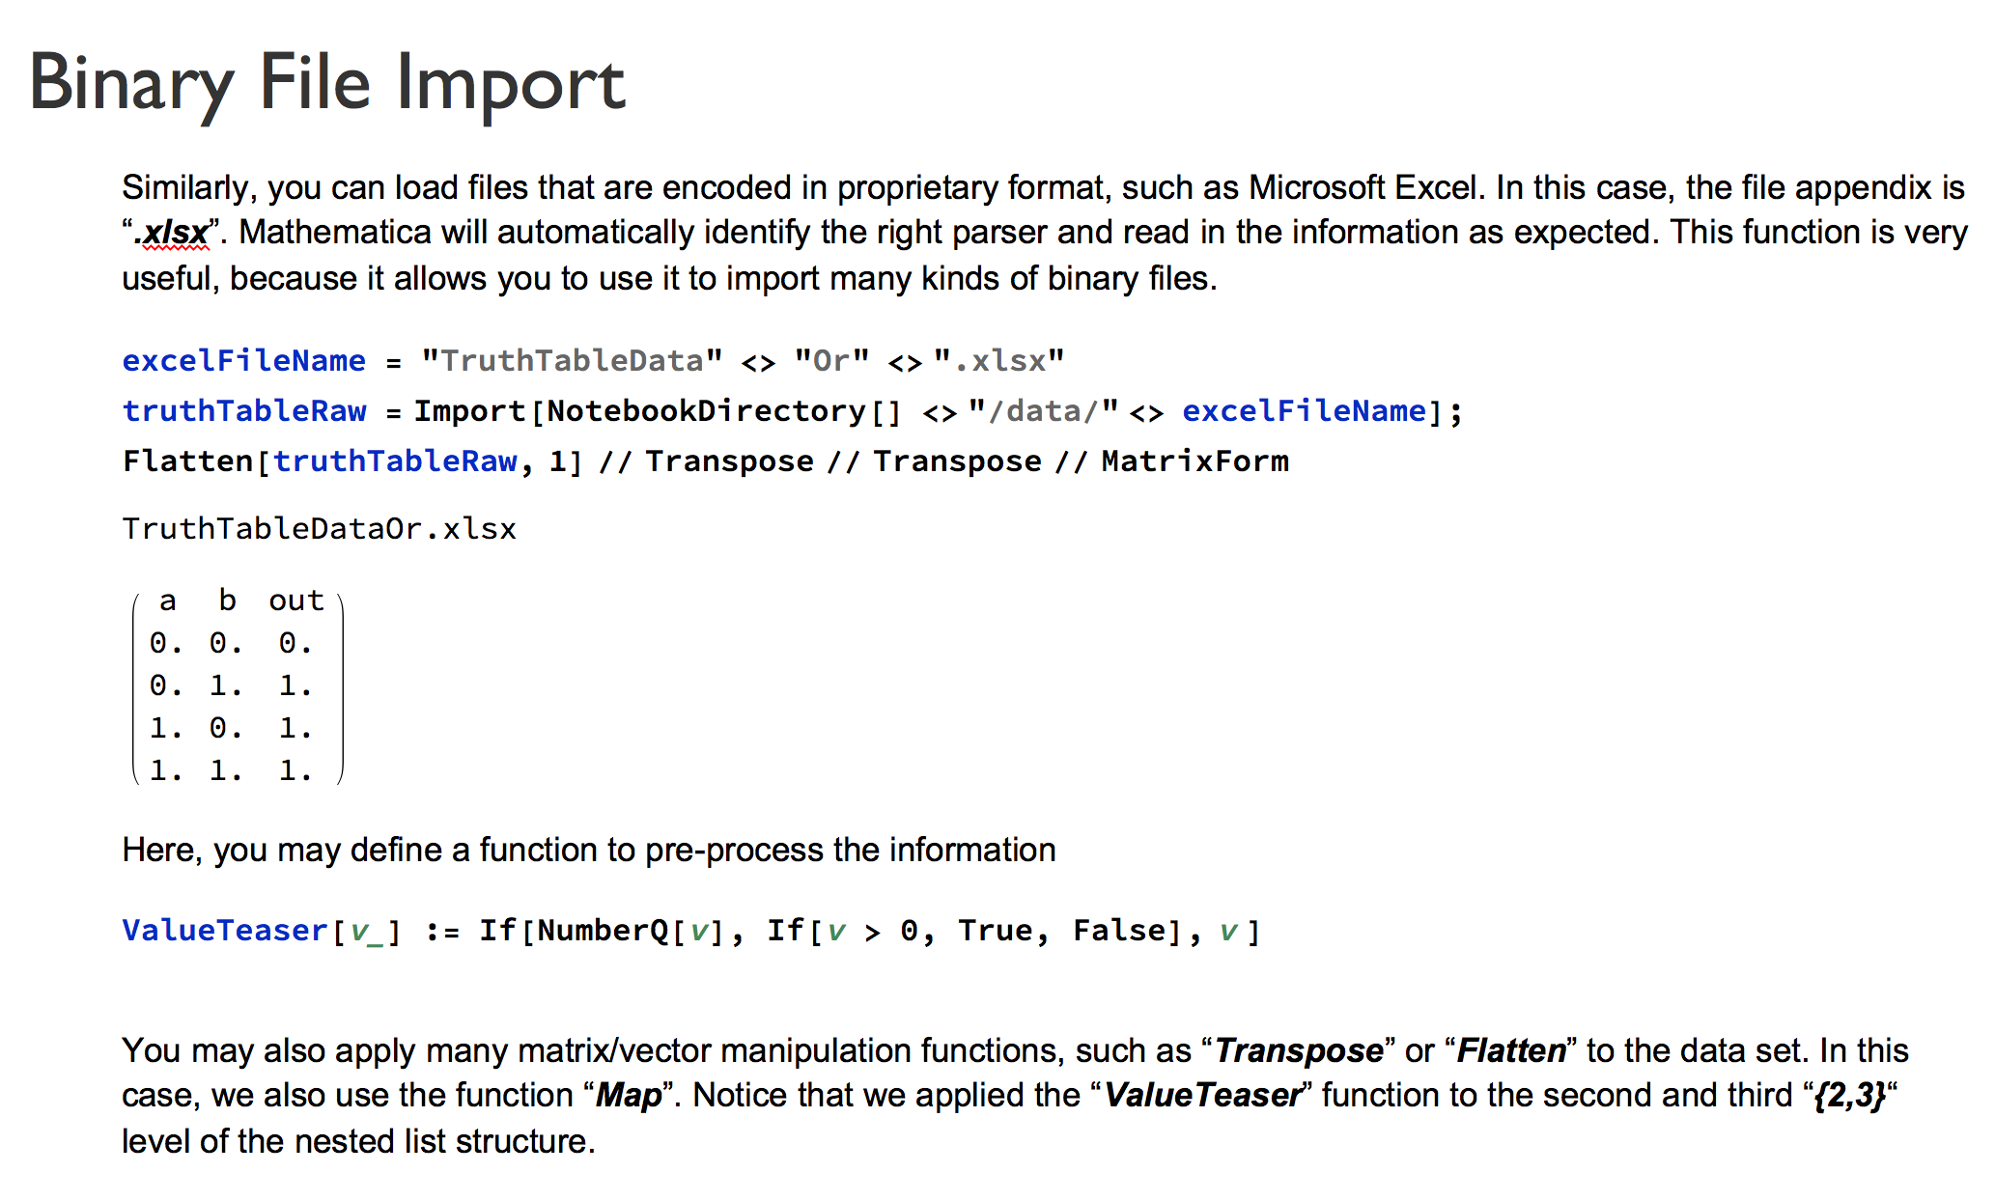
Transforming Hardware Design Problems
into Code Translation (compiler-implementation) problems
Provide Interactive Notebooks as Learning Aides from the first 5 weeks, so that they can be prepared to deal with
The Software Aspect of the Computational Thinking Course later.
Notes:
14

Slide 25
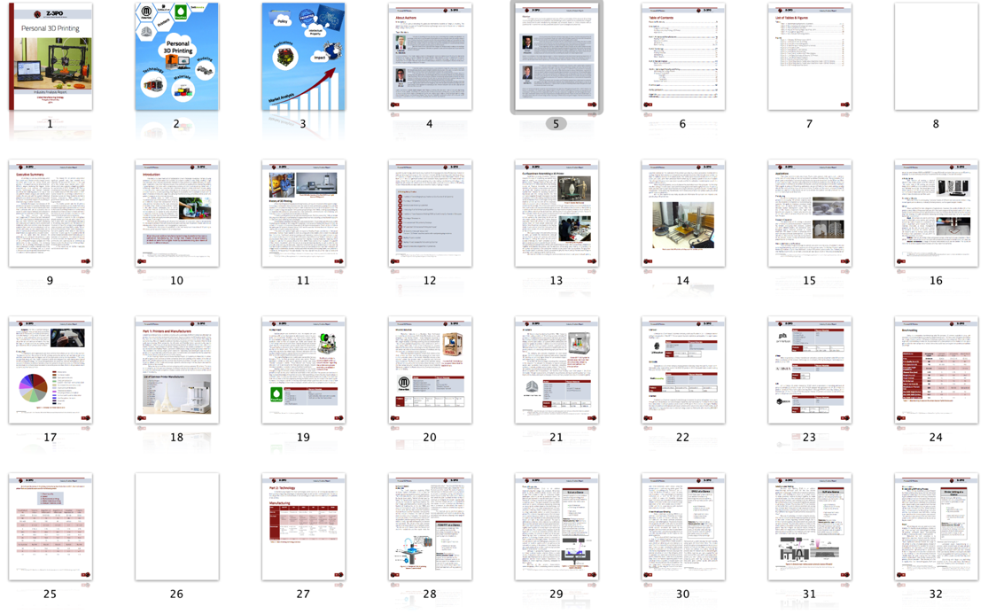
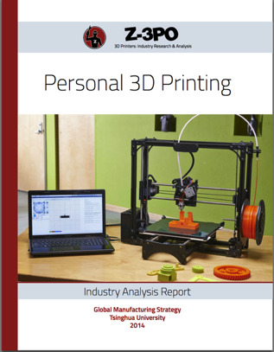
Sample Industry Analysis Report
product cycles are Digital Publishing Workflows
Notes:
14

Slide 26



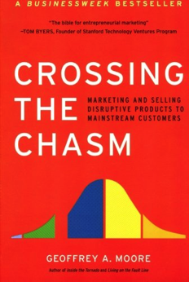
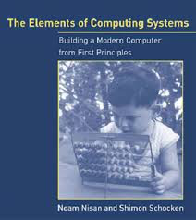

The classic literature for ABC curriculum?
B. Computational Thinking
A. Industry Frontier
C. Cognitive Foundation
Notes:
14

Slide 27
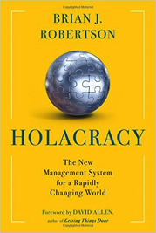
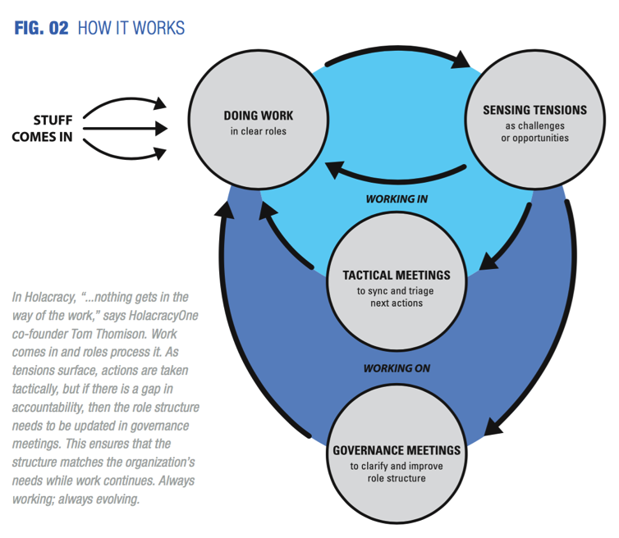



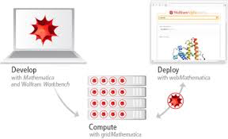

Group Learning Workflows are Content Compilation Processes…
knowing how to organize?
Knowing how to draw metaphors?
knowing what is worth writing?
Knowing what and how to write (code)?

Slide 28
All Building Blocks in the
ABC course series
are some kind of
“Functions”!
Arrow
Process
Morphism
Workflow
Functor
Natural Transformation

Slide 29
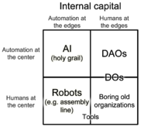

Mapping Course Content Across Abstraction Levels
Category Theory | C. Cognitive Foundation | B. Computational Thinking | A. Industry Frontier | Learning Workflow Tool Stack
Morphism | Ontological Metaphors | Functional Programming | Name Space Management for Computable Knowledge
Functor | Orientation Metaphors | Parser for Complex Structures | System (Compiler) Engineering
Natural Transformation | System/Structural Metaphors | Code Generators for Implementing Solutions | Digital Publishing Workflow

Slide 30

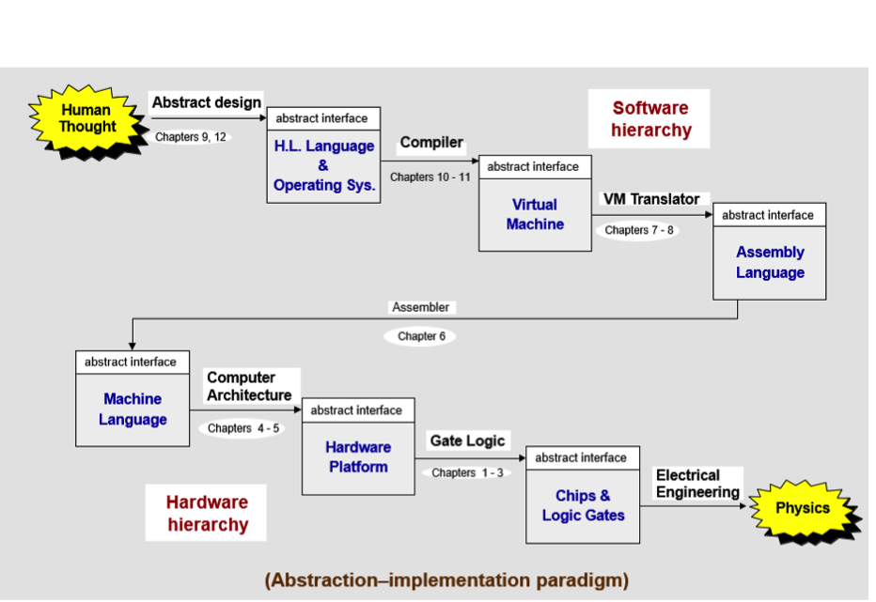
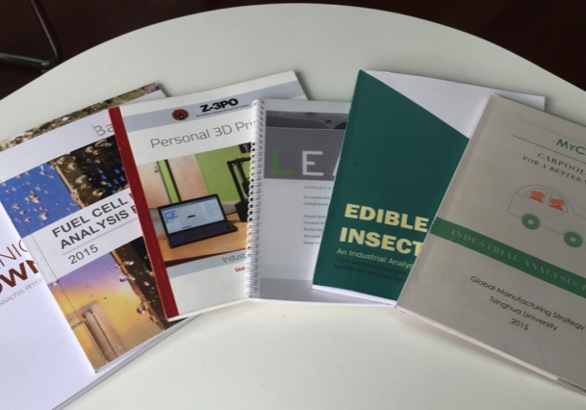
Smart Contracts
for IOT
Lacking a Comprehensive
Product System to Verify and Validate the Metaphors
Cognitive
Foundation
Metaphors | Category Theory
Ontology | Objects and Morphisms
Orientation | Functor
System | Natural Transformation
Industrial Frontier
Computational Thinking
Lacking Data and Report
Generating Tools and Skills.
Lacking Network
And Security elements.

Slide 31
To Deliver Computational Thinking
Metaphors helps Thinking take place in a Rich Contexts
    There are 3 basic types of metaphors/analogies/functions
    Industry Frontier course provides the social contexts for the Masses
Learning takes place by Refining Social Contracts
    Abstract Contract Templates are available and can be computationally generated
    Contract generation and refinement are about “writing code” (nand2tetris)
Learning Process Data and Verifiable/Validation workflows makes Thinking Computable
    It is necessary to use modern digital infrastructure to enable adequate feedback
    Organization’s learning potentials are bounded by its computational capacity

Slide 32









Delivering to the Masses

Slide 33

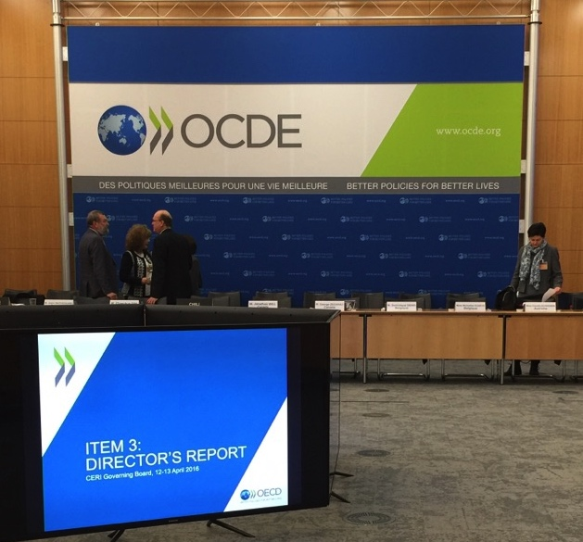
Working with OECE and UNESCO to refine policies
Author: John Cha and Ben Koo
On November 10th, 2016,OECD’s 2030 Future Education Summit (50+ Countries) @ Tsinghua Unviersity

