Slide 1

Incompressible Four-node Shear-free
Finite Element Implementing
Moore-Penrose PseudoInverse[]
Student: Xian Zhang
Advisor: Prof. Gautam Dasgupta
Columbia Univeristy
Wolfram Technology conference 2016
Notes:
Elastic response

Slide 2
Outline
Introduction
  Nodal analysis and its constraints
  Incompressibility
Rayleigh mode formulation
  From nodal to modal (DOFs, displacement, stiffness matrix)
  Derivation of isochoric modes
  Moore-Penrose PsudoInverse[]
Mathematica package
Conclusion
Outline
Notes:
Introduction: why/what/how
Motivation
citation
Experiments
Tell a story

Slide 3

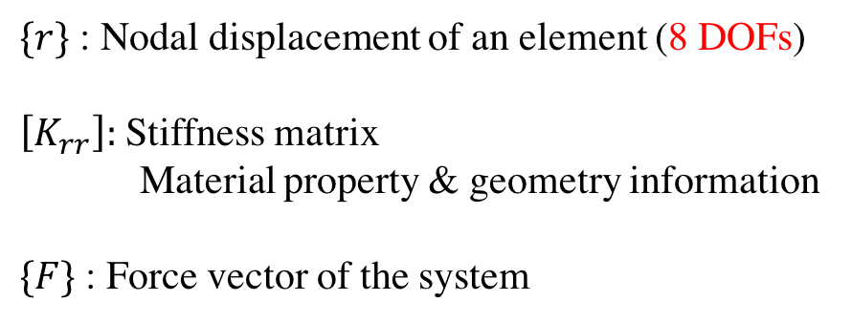
Introduction-Traditional Nodal Analysis
$${[K}_{rr}]\left\{r\right\}=\{F\}$$
1
$$\left({u_{x1} \atop u_{y1}}\right)$$
2
$$\left({u_{x2} \atop u_{y2}}\right)$$
$\{r\}$ : Nodal displacement of an element (8 DOFs)
$\left[K_{rr}\right]:$ Stiffness matrix
Material property & geometry information
$\{F\}$ : Force vector of the system
$$\left({u_{x4} \atop u_{y4}}\right)$$
$$\left({u_{x3} \atop u_{y3}}\right)$$
4
3
2 dimensional 4-node element
What if the element is incompressible ?
Subjected to constraints:
Essential BCs (displacement)
Natural BCs (stress/ force)
8 DOFs are NOT independent
CAN’T WORK
Constraints of conventional finite element methods
Notes:
Low pressure and High pressure
This part is a bit confusing

Slide 4
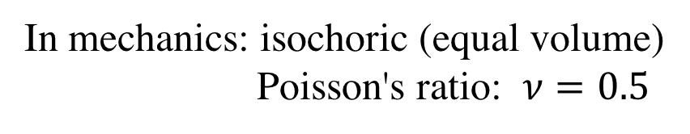
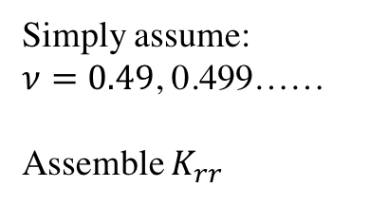
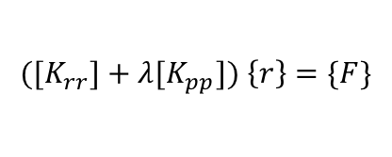
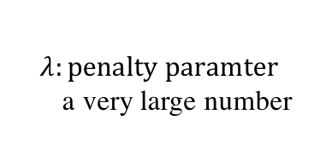
Introduction-Incompressibility
In mechanics: isochoric (equal volume)
Poisson's ratio: $ν=0.5$
1
$$\left({u_{x1} \atop u_{y1}}\right)$$
2
$$\left({u_{x2} \atop u_{y2}}\right)$$
Method 1
Method 2
$$\left({u_{x4} \atop u_{y4}}\right)$$
$$\left({u_{x3} \atop u_{y3}}\right)$$
Simply assume:
$ν=0.49$, 0.499……
Assemble $K_{rr}$
Penalty Method
4
3
$${([K}_{rr}]+λ{[K}_{pp}]) \left\{r\right\}=\{F\}$$
$$λ:penalty paramter$$
a very large number
2 dimensional 4-node element
Not accurate/working
Still approximation
A new way to deal with it is to adopt Rayleigh Polynomial Modes Analysis
Ways to deal with Incompressibility

Slide 5

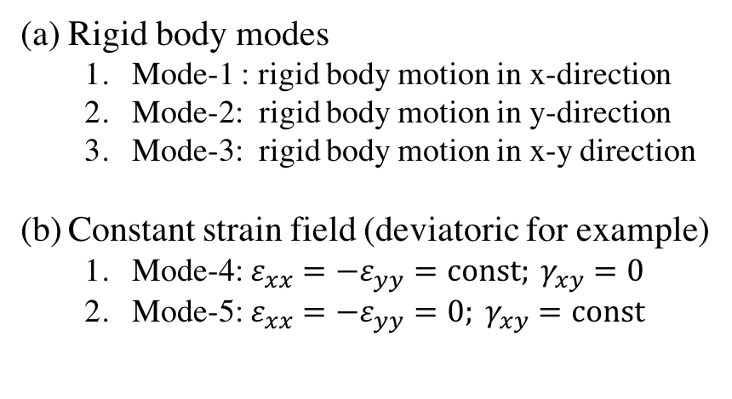
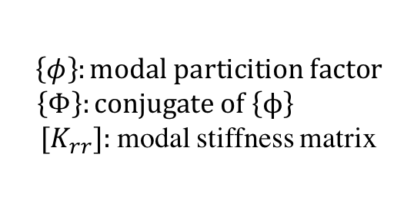
Rayleigh Polynomial Modes Analysis
Actual mode in terms of
Rigid body
Constant strain field
Linear field
Bending ….
$$\left\{\begin{matrix}Δ \\ Δ\end{matrix}\right\}$$
Example
A Rayleigh mode: rigid body motion in the bar
Rigid body modes
  Mode-1 : rigid body motion in x-direction
  Mode-2: rigid body motion in y-direction
  Mode-3: rigid body motion in x-y direction
Constant strain field (deviatoric for example)
  Mode-4: $ε_{xx}=−ε_{yy}=const; γ_{xy}=0$
  Mode-5: $ε_{xx}=−ε_{yy}=0; γ_{xy}=const$
Formulation
$\left\{φ\right\}:modal particition factor$
$\left\{Φ\right\}:conjugate of \left\{ϕ\right\}$
${ [K}_{rr}]:$ modal stiffness matrix
Rayleigh Polynomial Modes Analysis

Slide 6
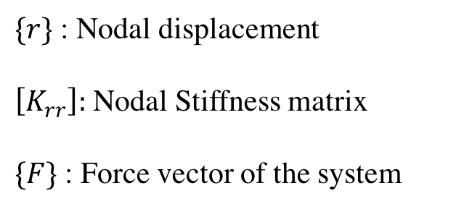
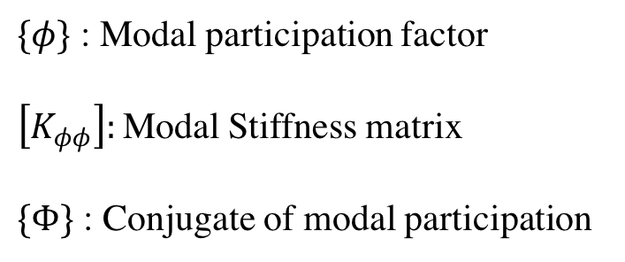


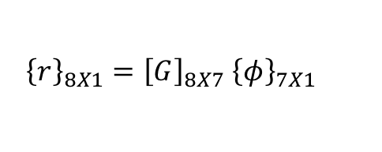

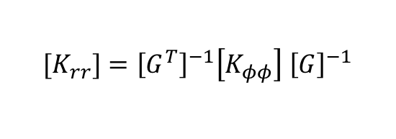
From Nodal to Modal Analysis
Nodal
Modal
$\{r\}$ : Nodal displacement
$\left[K_{rr}\right]:$ Nodal Stiffness matrix
$\{F\}$ : Force vector of the system
$\{φ\}$ : Modal participation factor
$\left[K_{φφ}\right]:$ Modal Stiffness matrix
$\{Φ\}$ : Conjugate of modal participation
$${[K}_{rr}]\left\{r\right\}=\{F\}$$
$$\left[K_{φφ}\right]\left\{φ\right\}=\{Φ\}$$
${\left\{r\right\}}_{8X1}={\left[G\right]}_{8X7} {\left\{φ\right\}}_{7X1}$
${\left\{R\right\}}^{T}\left\{r\right\}={\left\{Φ\right\}}^{T}\{ϕ\}$ (Energy conjugate )
$${[K}_{rr}]={\left[G^{T}\right]}^{−1}\left[K_{φφ}\right] {\left[G\right]}^{−1}$$
Rayleigh Polynomial Modes Analysis

Slide 7

Derivation of isochoric modes
To produce quadratic (4-node) incompressible field, we start with the expression for u and v to be full quadratic polynomial in (x,y):
Equal volume, volumetric strain vanishes : $\frac{∂u}{∂x}+\frac{∂v}{∂y}=0$;
Further assume shear-locking: $\frac{∂u}{∂y}+\frac{∂v}{∂x}=0$;
12
9
7
8 nodal DOFs
7 modes
Isochoric modes

Slide 8

Isochoric displacement modes
The uniform field: rigid body translation
The linear field
Pure bending modes
Four-node incompressible for $ν= \frac{1}{2}$
Isochoric modes

Slide 9

Solve the nodal displacement
Strain mode
Stress mode
$$K_{rr}$$
Include the incompressible constraint
Isochoric modes

Slide 10

Moore-Penrose PseudoInverse[]
$$K_{rr}$$
Dimension: 8*7, need to inverse a rectangular matrix
Definition of weak inverse
Right inverse
Left inverse
Isochoric modes

Slide 11
Symbolic Programming in Mathematica
Exact integration
Steps for determining the variable and auxiliary functions
Isochoric modes

Slide 12
Isochoric modes

Slide 13
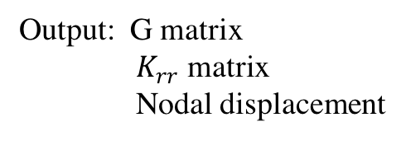
Computing on irregular quadrilaterals
Unit shear force for unit shear modulus
Corresponding nodal displacement
Input: nodes coordinates
Boundary condition
Displacement modes
Stress Modes
Output: G matrix
$K_{rr}$ matrix
Nodal displacement
Isochoric modes

Slide 14
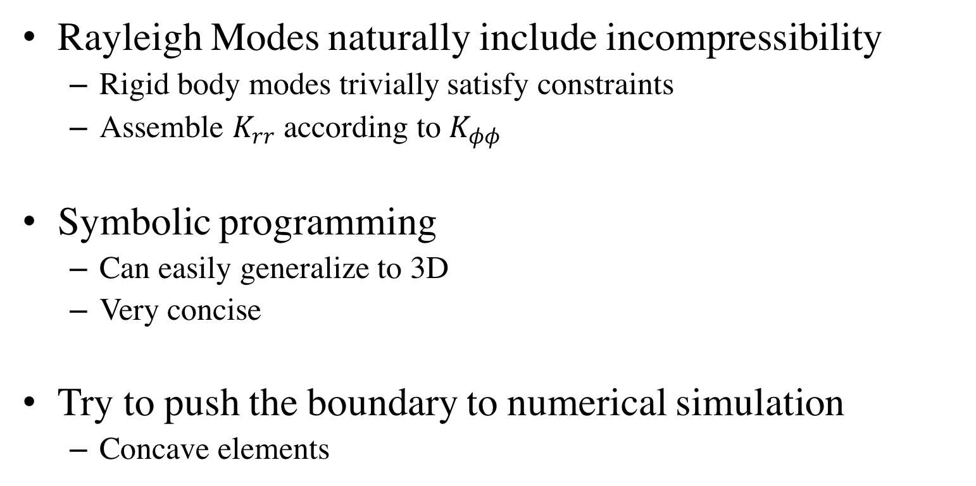
Conclusion
Rayleigh Modes naturally include incompressibility
  Rigid body modes trivially satisfy constraints
  Assemble $K_{rr}$ according to $K_{φφ}$
Symbolic programming
  Can easily generalize to 3D
  Very concise
Try to push the boundary to numerical simulation
  Concave elements
Mathematica makes it all possible !!!

