Slide 1


From time series to brain networks: Analysis of brain network dynamics in case of epilepsy.
D. Quesada, N. Astudillo, and M. Garcia-Russo
School of Science, Technology, and Engineering Management, St. Thomas University, Miami Gardens, FL 33054
Wolfram Technology Conference 2016, Urbana - Champaign

Slide 2
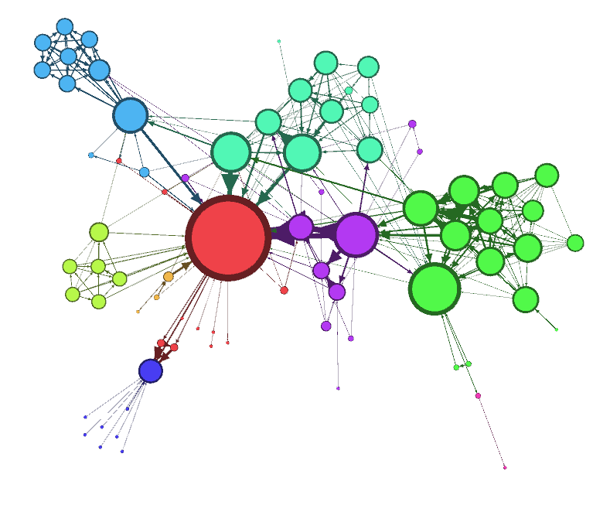

From time series to brain networks: Analysis of brain network dynamics in case of epilepsy
Motivations
MAD 3300 Graph Theory and Networks
Course Project for students motivated by Biomedical Applications
Wolfram Technology Conference 2016, Urbana - Champaign

Slide 3
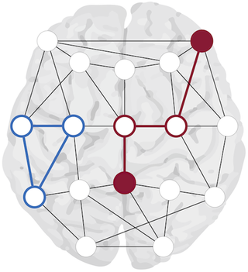
From time series to brain networks: Analysis of brain network dynamics in case of epilepsy
Content:
What is meant by Epilepsy and how frequent it is?
2. fMRI and EEG: from images and time series to networks.
3. Anatomical and Functional Networks.
4. Graph Theory and Networks.
5. Mathematica implementation.
6. Fitzhugh-Nagumo and Kuramoto models solved on networks.
7. Synchronization on a network of neurons.
8. Conclusions.
Wolfram Technology Conference 2016, Urbana - Champaign

Slide 4

From time series to brain networks: Analysis of brain network dynamics in case of epilepsy
What is meant by Epilepsy and how frequent it is?
Epilepsy is a medical condition characterized by seizures or disruptions of the electrical communication between neurons.
Some epileptic seizures can be controlled with medications while others require surgical interventions. In these cases, surgeons must decide how much of the brain to remove or disconnect: Translational medicine.
Epilepsy is the 4th most common neurological problem in the USA, followed by migraines, strokes and Alzheimer disease. The average incidence of this condition each year in the USA is estimated at 48 incidents for every 100,000 people.
Young children and older adults are the groups with the highest rates. In addition, the prevalence of this condition is estimated at 2.2 million people or 7.1 for every 1000 people in the USA.
Wolfram Technology Conference 2016, Urbana - Champaign

Slide 5
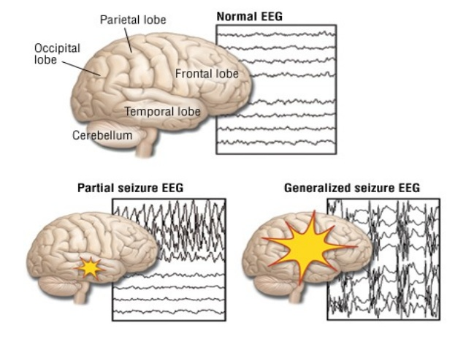
From time series to brain networks: Analysis of brain network dynamics in case of epilepsy
fMRI and EEG: from images and time series to networks.
EEGs are used as a very accurate diagnostic method due to its tremendous temporal resolution.
Different types of epileptic seizures produce different time series: more irregular across the entire set of channels more intense is the epileptogenic episode.
The spread of the seizures over large cortical areas is an indication of the strength of the neural dysfunction.
Fig 1: The EEGs images of the epileptic person showing areas of major activity.
Wolfram Technology Conference 2016, Urbana - Champaign

Slide 6
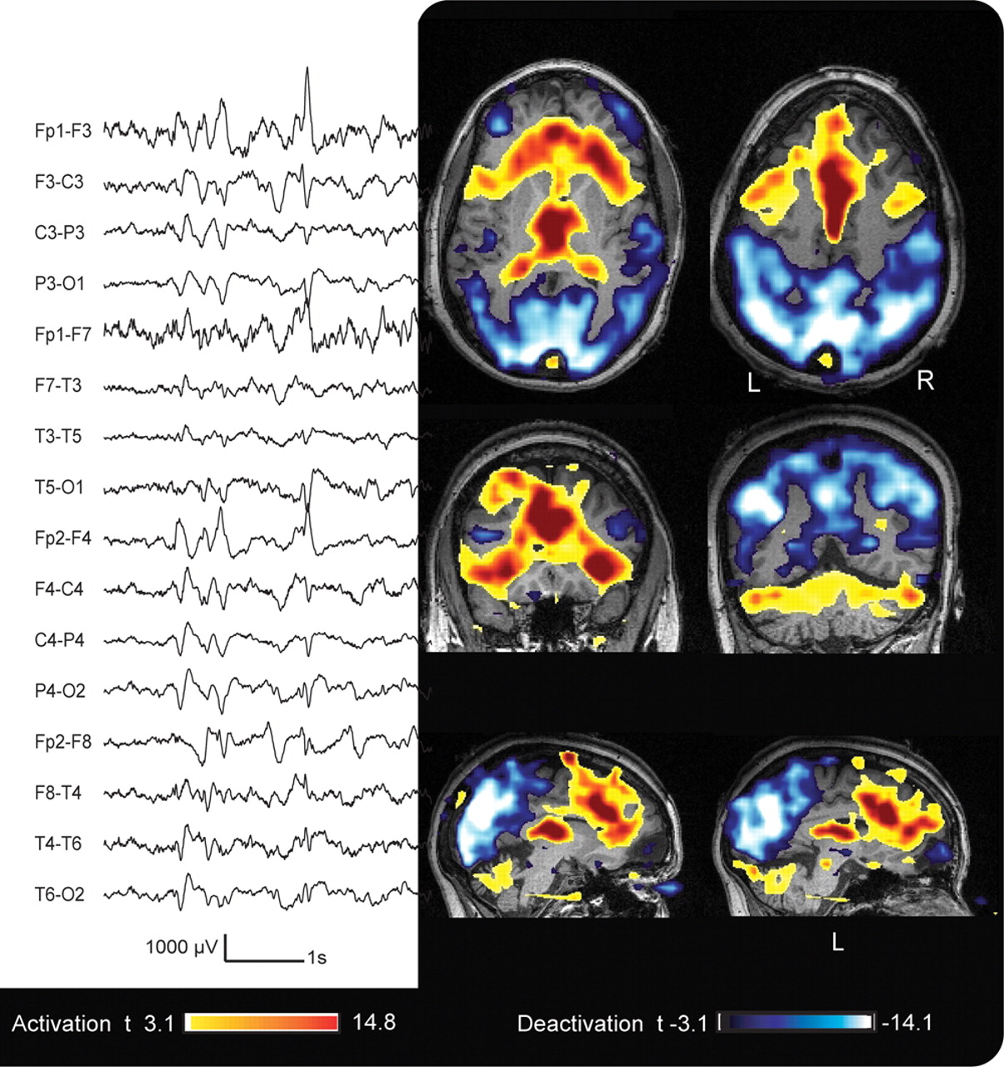
From time series to brain networks: Analysis of brain network dynamics in case of epilepsy
fMRI and EEG: from images and time series to networks.
The modern brain imaging techniques Magnetic Resonance Imaging (MRI) and Functional Magnetic Resonance Imaging (fMRI) are used to produce large data sets of brain activity.
MRI: reveals peculiarities of anatomical structure
fMRI: registers blood flow levels in the brain
fMRI is a technique with large spatial resolution, which combined with EEGs provides a valuable information about the sources of seizures.
Fig 2: The fMRI images of the epileptic person showing areas of major activity. fMRI technique has an excellent spatial resolution while the temporal resolution might fail a bit.
Wolfram Technology Conference 2016, Urbana - Champaign

Slide 7
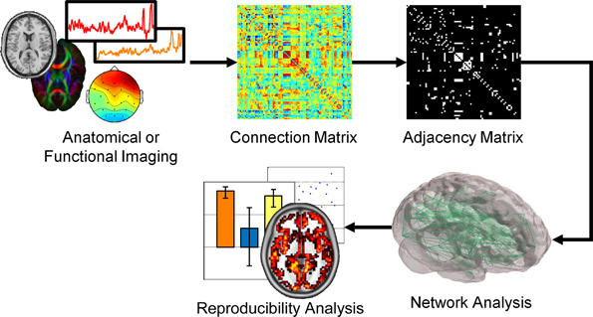
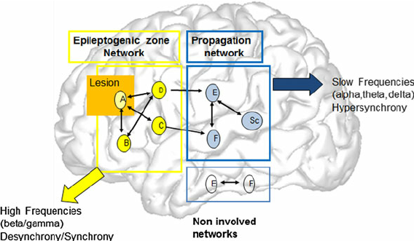
From time series to brain networks: Analysis of brain network dynamics in case of epilepsy
Anatomical and Functional networks
Fig 3: The brain connectivity atlas is determined using both fMRI and EEG techniques. The former provides the spatial resolution while the second the temporal resolution. Networks are classified into anatomical (structural) and functional .
Q.K. Telesford, J.H. Burdette, P.J. Laurienti, “An exploration of graph metric reproducibility in complex brain networks,” http://dx.doi.org/10.3389/fnins.2013.00067
Wolfram Technology Conference 2016, Urbana - Champaign

Slide 8
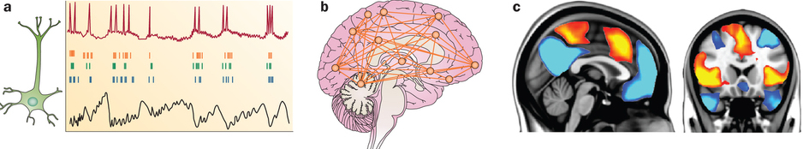
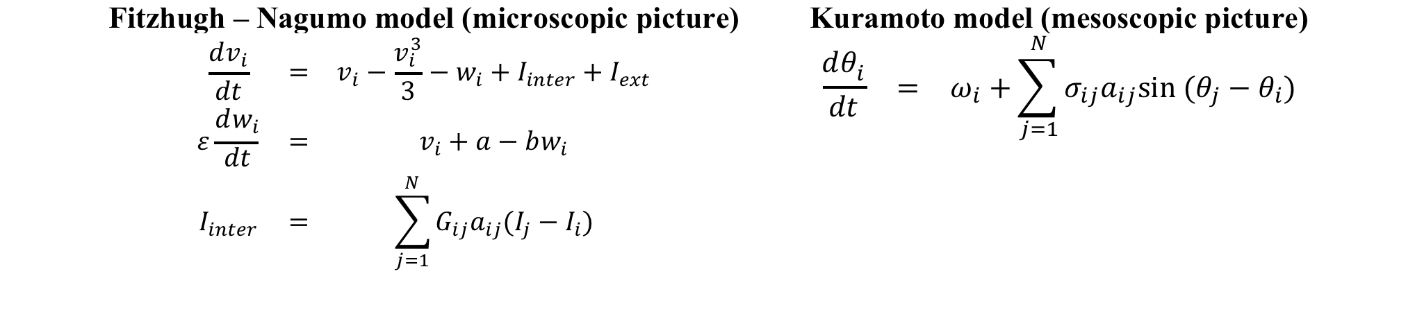
From time series to brain networks: Analysis of brain network dynamics in case of epilepsy
Modeling Philosophy – Bottom - Top
From a single neuron to a bundle of neurons with different topologies of connectivity and interaction strengths.
Cortical patches of neurons with different topologies of connectivity and interaction strengths.
Neuronal Activity as a result of synchronization of either neural bundles or patches in the cortical area.
M. Rubinov and O. Sporns, “Complex networks measures of brain connectivity: Uses and interpretations”, NeuroImage 52, 1059 – 1069 (2010).
P.N. Taylor, M. Kaiser, J. Dauwels, “Structural connectivity based whole brain modeling in epilepsy”, J. Neuroscience Methods 236, 51 – 57 (2014).
Wolfram Technology Conference 2016, Urbana - Champaign

Slide 9
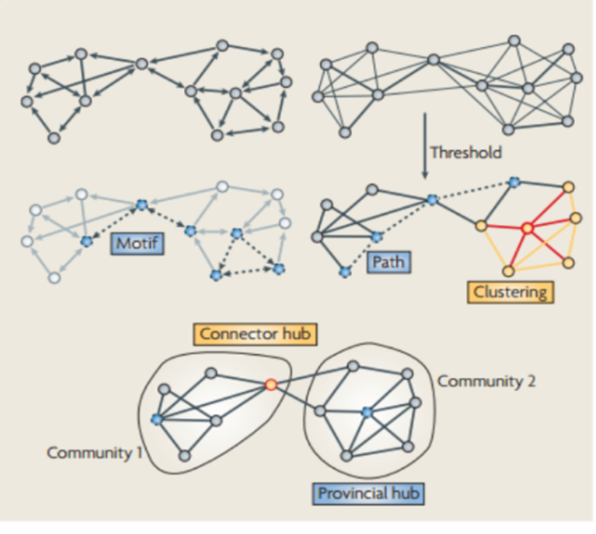
From time series to brain networks: Analysis of brain network dynamics in case of epilepsy
Steps for Modeling
Generate a model network
Compute the topological indices of the graph.
Save the information about the Adjacency matrix A = ||a_{ij}|| and the Weight-of-Connection matrix G = ||g_{ij}|| .
Solve the system of ODE on the network.
Compute the synchronization properties for each of the two models: Fitzhugh-Nagumo and Kuramoto models.
H. Schmidt, G. Petkov, M. Richardson, J.R. Terry, “Dynamics on networks: The role of local dynamics and global networks on the emergence of hypersynchronous neural activity”, Plos Computational Biology 10, 1 – 16 (2014).
E. Bullmore and O. Sporns, “Complex brain networks: graph theoretical analysis of structural and functional systems”, Nature Reviews Neuroscience 10, 186 – 198 (2009).
Wolfram Technology Conference 2016, Urbana - Champaign

Slide 10
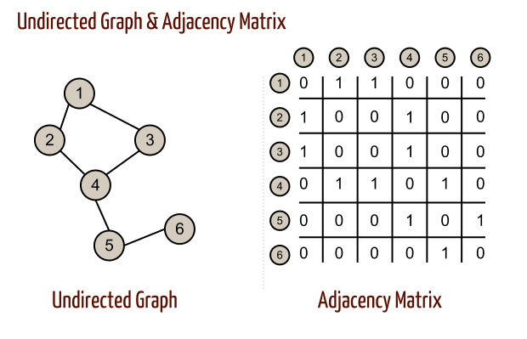
From time series to brain networks: Analysis of brain network dynamics in case of epilepsy
Mathematica implementation
Agraph=RandomGraph[Distribution[Nodes,3]]
A1=AdjacencyMatrix[Agraph]
Distributions available in Mathematica
BarabasiAlbertGraphDistribution[Nodes,k-edges]
WattsStrogatzGraphDistribution[Nodes,rewiring-probability]
BernoulliGraphDistribution[Nodes,rewiring-probability]
Definition of the system of ODEs
Fitzhugh – Nagumo model (bundle of neurons)
Kuramoto model (patches in the cortex)
Solution of the system of ODEs
NDSolve
Initial Conditions
Order parameter synchronization
Wolfram Technology Conference 2016, Urbana - Champaign

Slide 11
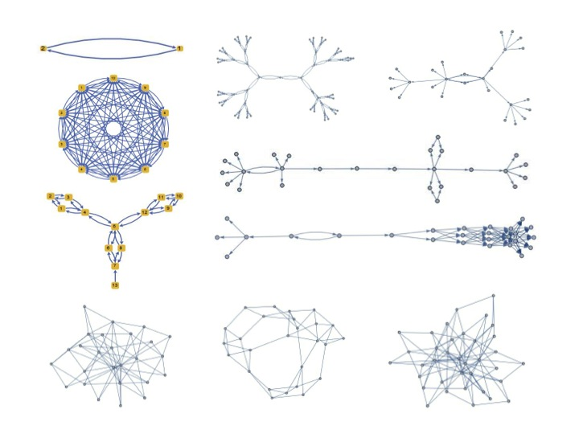
From time series to brain networks: Analysis of brain network dynamics in case of epilepsy
Network Models simulating local neuronal environments
Networks created with random tables from 0 and 1, and used for the Fitzhugh – Nagumo model of neuron bundles
BarabasiAlbert[36,3]
Kuramoto Model
BarabasiAlbert[36,4]
Kuramoto Model
WattsStrogatz[36,0.2]
Kuramoto Model
Wolfram Technology Conference 2016, Urbana - Champaign

Slide 12
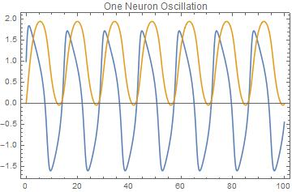

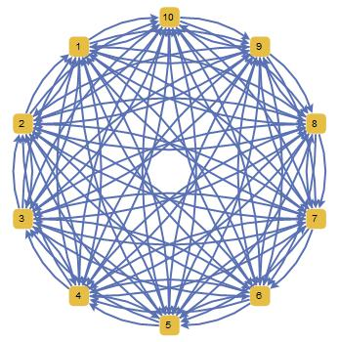
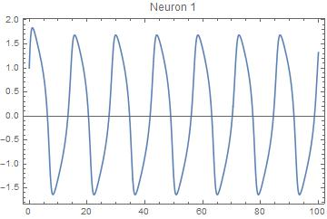
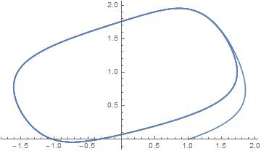
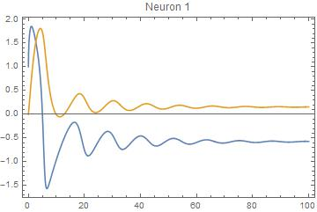
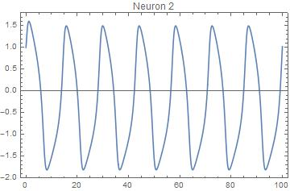
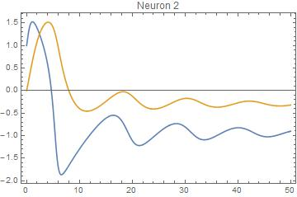
From time series to brain networks: Analysis of brain network dynamics in case of epilepsy
Solutions for the Fitzhugh – Nagumo Model
Single Neuron
Two Neurons
Ten Neurons
Wolfram Technology Conference 2016, Urbana - Champaign

Slide 13
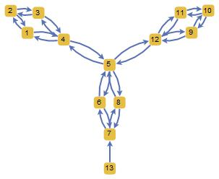
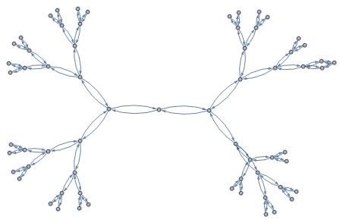
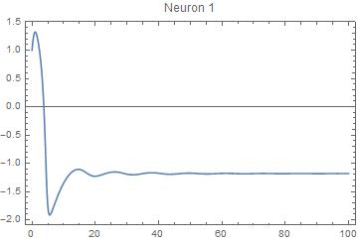
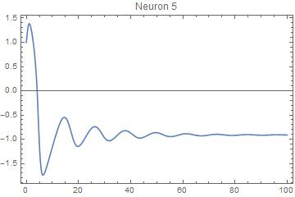
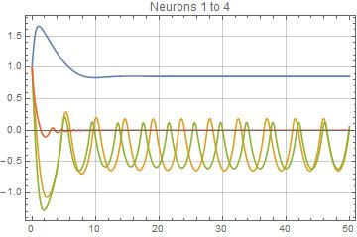
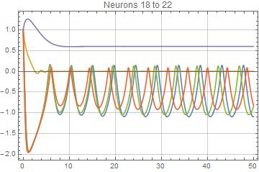
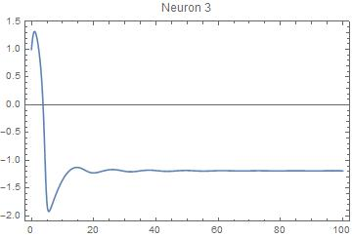
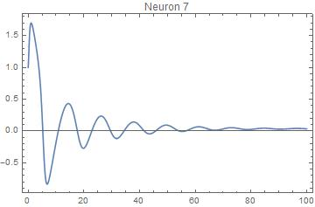
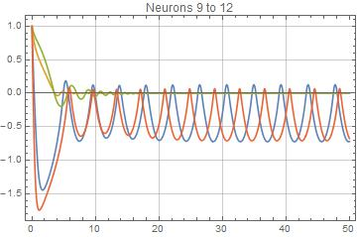
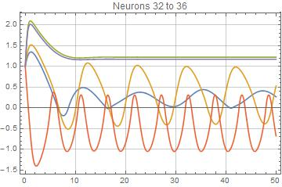
From time series to brain networks: Analysis of brain network dynamics in case of epilepsy
Solutions for the Fitzhugh – Nagumo Model
Thirteen Neurons
Sixty-four Neurons
The lack of connectivity, and the presence of bridge points in the neural network is extremely important when you are forced to do surgical interventions. It will determine the extension of the surgical removal and the concrete spot where the procedure should be done.
Wolfram Technology Conference 2016, Urbana - Champaign

Slide 14
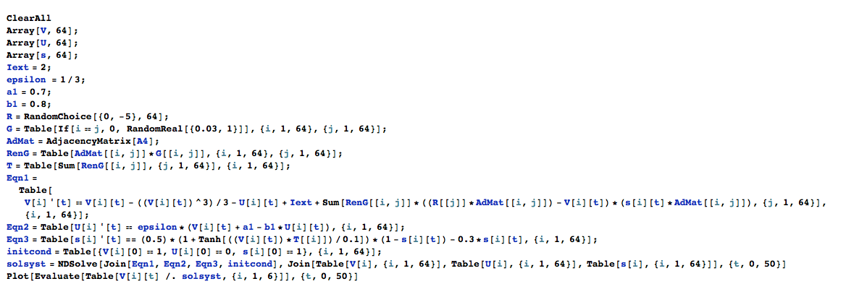
From time series to brain networks: Analysis of brain network dynamics in case of epilepsy
Solutions for the Fitzhugh - Nagumo Model
The function s(t) is addressing the changes in strength of all connections based on the mutual interaction and the random weights (strengths) assigned at the beginning of the run.
Notice that oscillatory behavior imposes over fast decaying transients.
Wolfram Technology Conference 2016, Urbana - Champaign

Slide 15
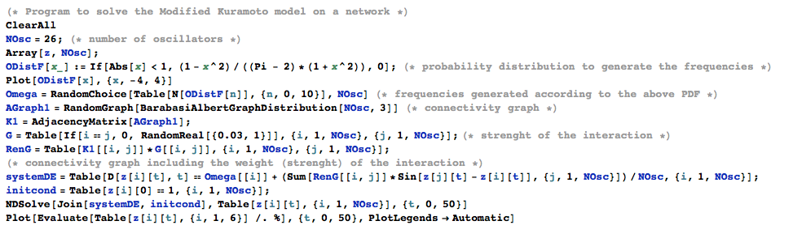
From time series to brain networks: Analysis of brain network dynamics in case of epilepsy
Solutions for the Kuramoto Model
Wolfram Technology Conference 2016, Urbana - Champaign

Slide 16
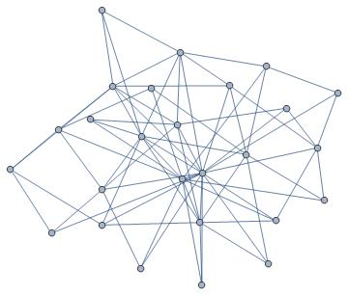
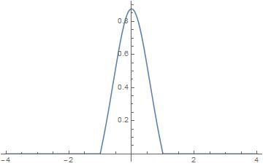
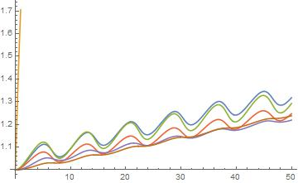
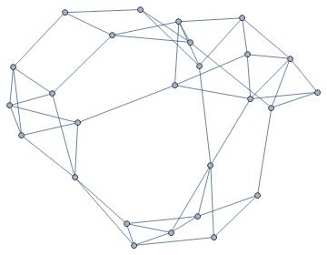
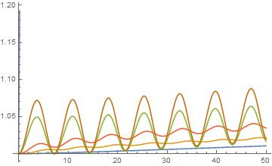
From time series to brain networks: Analysis of brain network dynamics in case of epilepsy
Solutions for the Kuramoto Model
BarabasiAlbert Distribution with 36 nodes – Power Law Vertex Distribution
The Kuramoto model is used to simulate the interaction between different patches or cortical neurons, each of which contains a large group of subunits. The variable θ is an emergent phase per patch as a result of internal patch synchronization. It is “a slave variable” in terms of control theory. The synchronization between different “cortical patches” is fundamental for the well functioning of the brain and for its ability to maintain enough plasticity for adaptation.
WattsStrogatz Distribution with 36 nodes
Wolfram Technology Conference 2016, Urbana - Champaign

Slide 17
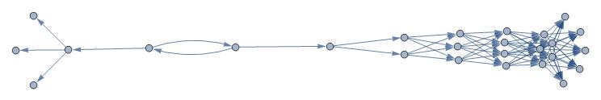
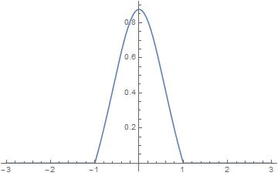
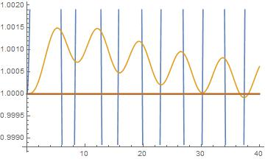
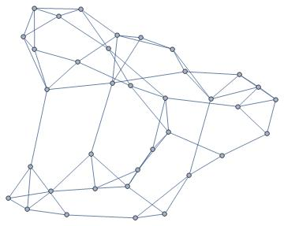
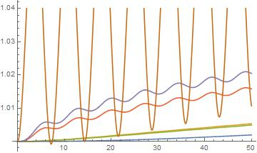
From time series to brain networks: Analysis of brain network dynamics in case of epilepsy
Solutions for the Kuramoto Model
Nodes = 36 – Two groups (clusters) of coherent patches
Nodes = 36 – Bernoulli Distributions of clusters of coherent patches
Wolfram Technology Conference 2016, Urbana - Champaign

Slide 18
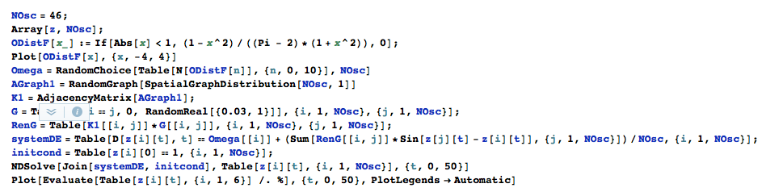
From time series to brain networks: Analysis of brain network dynamics in case of epilepsy
Solutions for the Kuramoto Model
Wolfram Technology Conference 2016, Urbana - Champaign

Slide 19
From time series to brain networks: Analysis of brain network dynamics in case of epilepsy
Conclusions
Both mathematical models for the dynamics of interacting neurons were solved showing signs of synchronization (qualitative picture). The order parameter which quantifies the strength of the synchronization was not calculated this time.
Sensitivity to the strength and connectivity of the network appears as one of the most striking features.
The study was limited to synaptic connections that do not change over time (strength of the connection remains constant). This limitation might miss the fact that synaptic connections either improve or deteriorate over time, leading to CNS disorders. In this case it was controlled by the connectivity.
A comparison with real epileptic brain networks obtained from EEG inverse signal processing is planned for the future.
Quesada, D.; Astudillo, N.; Garcia-Russo, M. Effect of Brain network topologies on the synchronization of neuronal oscillations: Is this, the gateway to the understanding of Central Nervous disorders?. In Proceedings of the MOL2NET, International Conference on Multidisciplinary Sciences, 2016; Sciforum Electronic Conference Series, Vol. 2, 2016 , 07004; doi:10.3390/mol2net-02-07004
Wolfram Technology Conference 2016, Urbana - Champaign

Slide 20
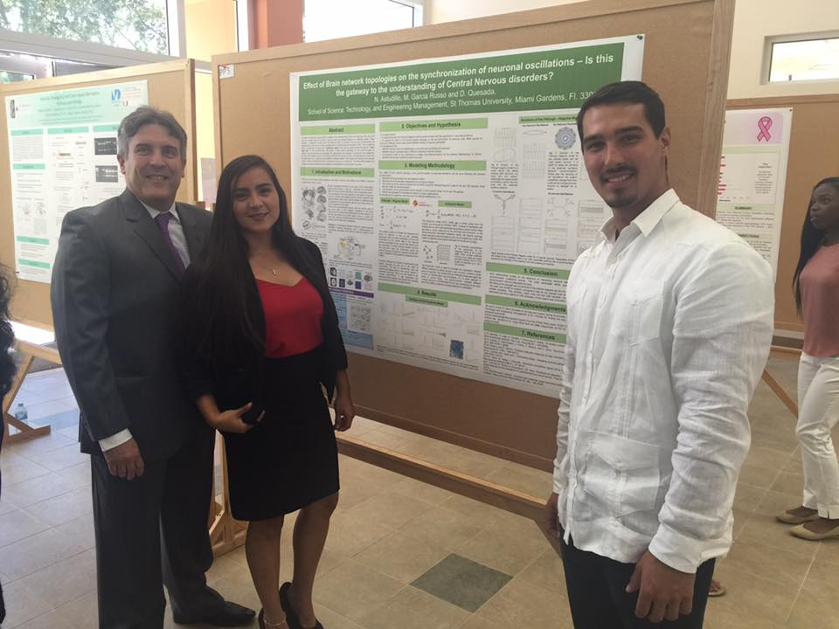

From time series to brain networks: Analysis of brain network dynamics in case of epilepsy
Acknowledgments
For sponsoring the research an for supporting the attendance to conferences and workshops.
Natasha Astudillo, Mathematics major
Manuel Garcia-Russo, Pre-Engineering student
Both undergraduate students are from the School of STEM at St. Thomas University.
Jorge Riera, Department of Biomedical Engineering at Florida International University.
Wolfram Technology Conference 2016, Urbana - Champaign

