Slide 1
Big Tree: Using Machine Learning to Create a Knowledge Graph of Mankind
Lei Wu
Data Science @ Ancestry
Notes:
Hi Everyone, Glad to be here and share some work Ancestry data science team is working on recently. Especially I will focus on how do we use machine learning to generate a big tree as a representation of knowledge graph of mankind.

Slide 2
Which is most important to you?
Jobs
Friends
Family
Notes:
How many of you
1) Geographically dispersed physical records
2) Paper and microfiche storage without cross-indexing
-Difficult to collaborate and share findings
-Little help available -Expensive - Time-consuming
3) 1996 – Ancestry.com launches!
Imagine not having to fly across the country, imagine being able to do this in your pajamas!?
“Our goal with Ancestry was to build the largest online genealogy database and subscription service in the world.” - Paul Allen

Slide 3
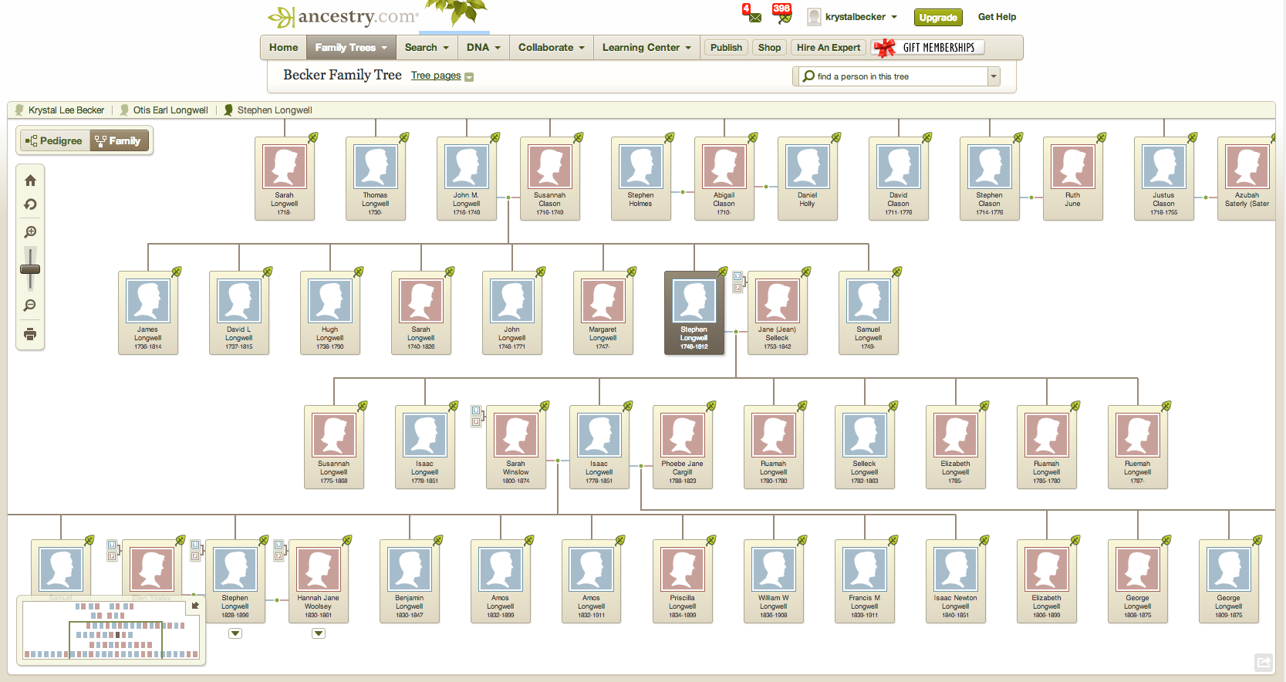
Ancestry is the global leader in family history and consumer genomics
Notes:
How many of you
1) Geographically dispersed physical records
2) Paper and microfiche storage without cross-indexing
-Difficult to collaborate and share findings
-Little help available -Expensive - Time-consuming
3) 1996 – Ancestry.com launches!
Imagine not having to fly across the country, imagine being able to do this in your pajamas!?
“Our goal with Ancestry was to build the largest online genealogy database and subscription service in the world.” - Paul Allen

Slide 4
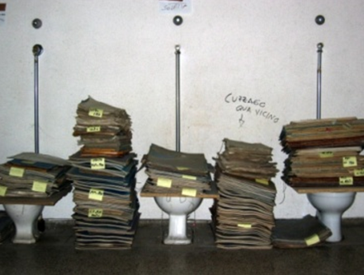
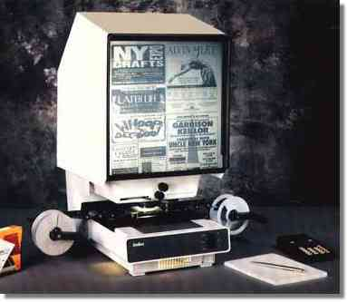
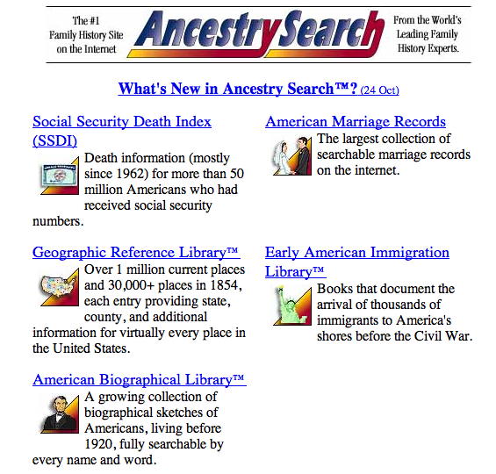
How Ancestry’s traditional family history research works…
Notes:
How many of you
1) Geographically dispersed physical records
2) Paper and microfiche storage without cross-indexing
-Difficult to collaborate and share findings
-Little help available -Expensive - Time-consuming
3) 1996 – Ancestry.com launches!
Imagine not having to fly across the country, imagine being able to do this in your pajamas!?
“Our goal with Ancestry was to build the largest online genealogy database and subscription service in the world.” - Paul Allen

Slide 5
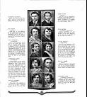
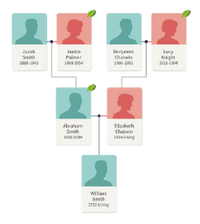
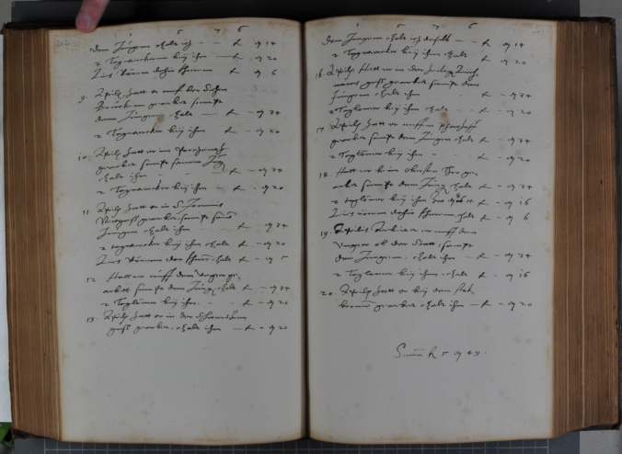
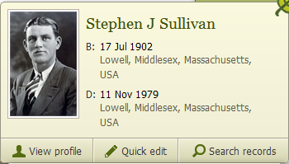
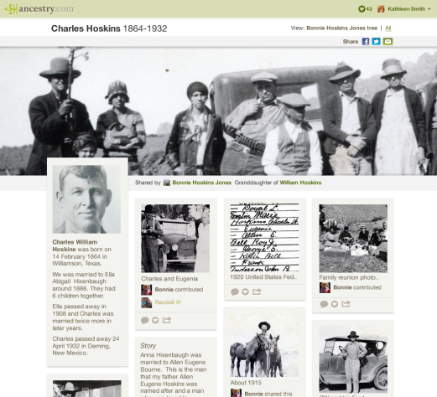
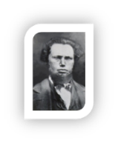
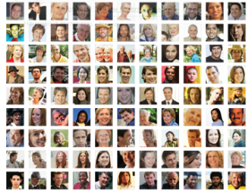
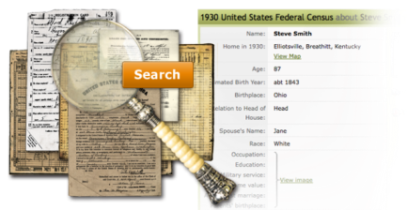
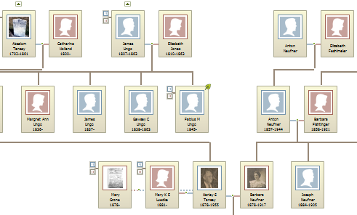
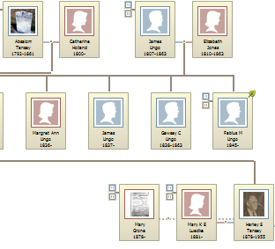
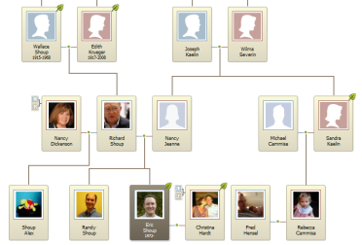
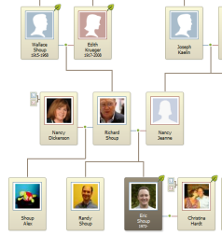
Record data leads to hints and discoveries
Content

Tools
“Discoveries”
Over 20 years and $200 million invested
70% is effectively proprietary
Nearly 200 record categories
18+ billion historical records, 80+ million family trees, 300+ million user-uploaded photos and docs
Intelligent searching
Learning algorithms “hint” records and ancestors
“Big Tree” further strengthens moat
Social sharing and collaboration
Notes:
For decades we have worked with government archives, historical societies, and other organizations all over the world, to acquire and subsequently transcribe and make searchable more than 18 billion records and images. We’ve invested over $200M in content since our inception. These historical records date back to the 12th century and form more than 30,000 collections including birth, marriage and death records; military service, immigration and even incarceration records. From this data and our family tree building tool users have created more than 80 million family trees.
We have an incredible amount of data to support a our efforts and we decided to leverage our data by employing these tools to generate discoveries.

Slide 6
Launched AncestryDNA

Slide 7
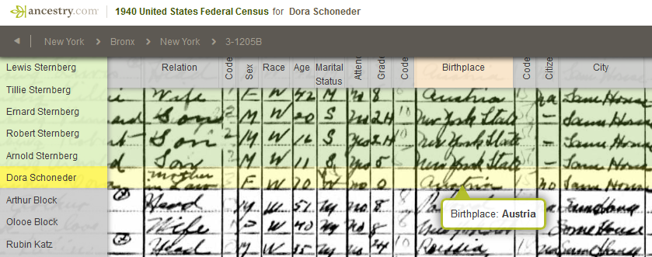
Data Science Team
Deep Learning
Hand written Recognition
Form classification
Natural Language Processing
Name correct
Event detection
Notes:
Talk about how we process – OCR Scanning, Deep Learning, Form Classification to extract meta data

Slide 8
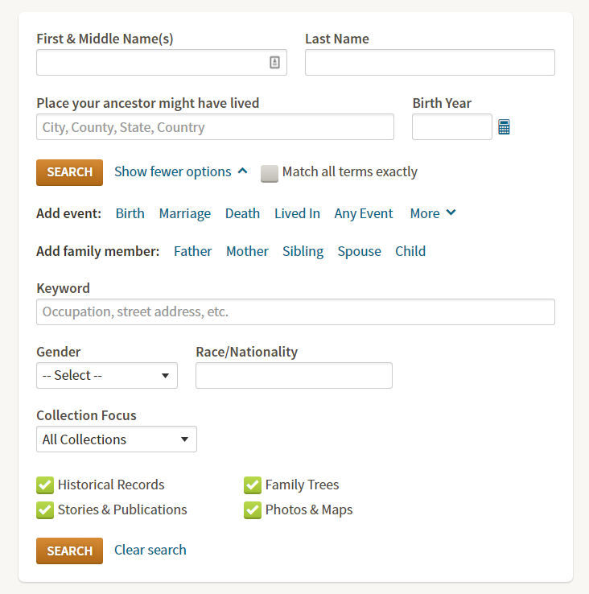
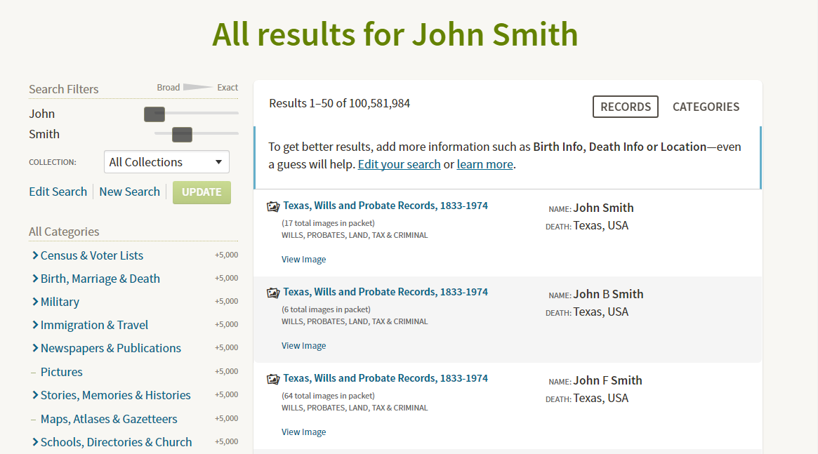
Data Science Team
Optimize Search Engine
Learning to Rank
Dimension reduction
Recommendation Engine
Tree hints
Photo hints
DNA hints
Notes:
Out of 100 million hits for John Smith, you want to find your John Smith. 18 billion records don’t matter if it’s not relevant to you.

Slide 9
Quiz
How many family trees does Ancestry have?
A. about 80 Thousand
B. about 80 Billion
C. about 80 Million
D. about 80 Trillion

Slide 10
Quiz
How many family historical records does Ancestry have?
A. about 18 Thousand
B. about 18 Million
C. about 18 Billion
D. about 18 Trillion

Slide 11
Quiz
How many individual profiles does Ancestry have?
A. about 8 Thousand
B. about 8 Million
C. about 8 Billion
D. about 8 Trillion

Slide 12
Quiz
How many family photos and scanned documents does Ancestry have?
A. about 300 Thousand
B. about 300 Million
C. about 300 Billion
D. about 300 Trillion

Slide 13
Data Science Team
Big Tree: Ancestry’s Knowledge Graph about Mankind
Mother
Father
Mother
Father
Mother
Father
Name
Spouse
Name
Name
Mother
Father
Mother
Father
Spouse
Spouse
Father
Mother
Child
Name
Name
Spouse
Mother
Father
Name
Mother
Father
Spouse
Spouse
Child
Child
Name
Spouse
Name
Spouse
Child
Child
Child
Child
Child

Slide 14
How do we generate Big Tree?
Feature Extractor
Blocking Mechanism
Persona Compare Engine
Service API
Evaluator
Aggregator
Stitch Engine
Notes:
Feature ext. – construct features, name, DOB, match or not, raw data and calculate the distance. How many similarities between years, etc. Data engineering calculate similarities. [Science team]
Retrieval engine -- Blocking Mechanism, Fast filtering
Person compare –
Stitch engine –
Aggregator – Base person aggregator
Evaluator – Curated tree (Golden data set)

Slide 15
How do we generate Big Tree?
Feature Extractor
Retrieval Engine
Persona Compare Engine
Service API
Evaluator
Aggregator
Stitch Engine

Slide 16
Top 10 Features
?
First name: J.
Last name: Black
DOB: 3/1/1974
…
First name: Julie
Last name: Black
Married: 3/1/1976
…
Spouse name: J
Last name: Black
Married: 3/1/1993
…
Spouse name: Jack
Last name: Black
DOB: 7/1/1991
…
Notes:
How do we compare persons?
1. Given name similarity (based on Jaro-Winkler)
2. Spouse similarity (note: similarity scores derived from a sep`rate machine learning model)
3. Mother similarity
4. Father similarity
5. Birth year difference
6. Child similarity
7. Death year difference
8. Uniqueness of surname
9. Surname similarity (based on Jaro-Winkler)
10. Given name uniqueness

Slide 17
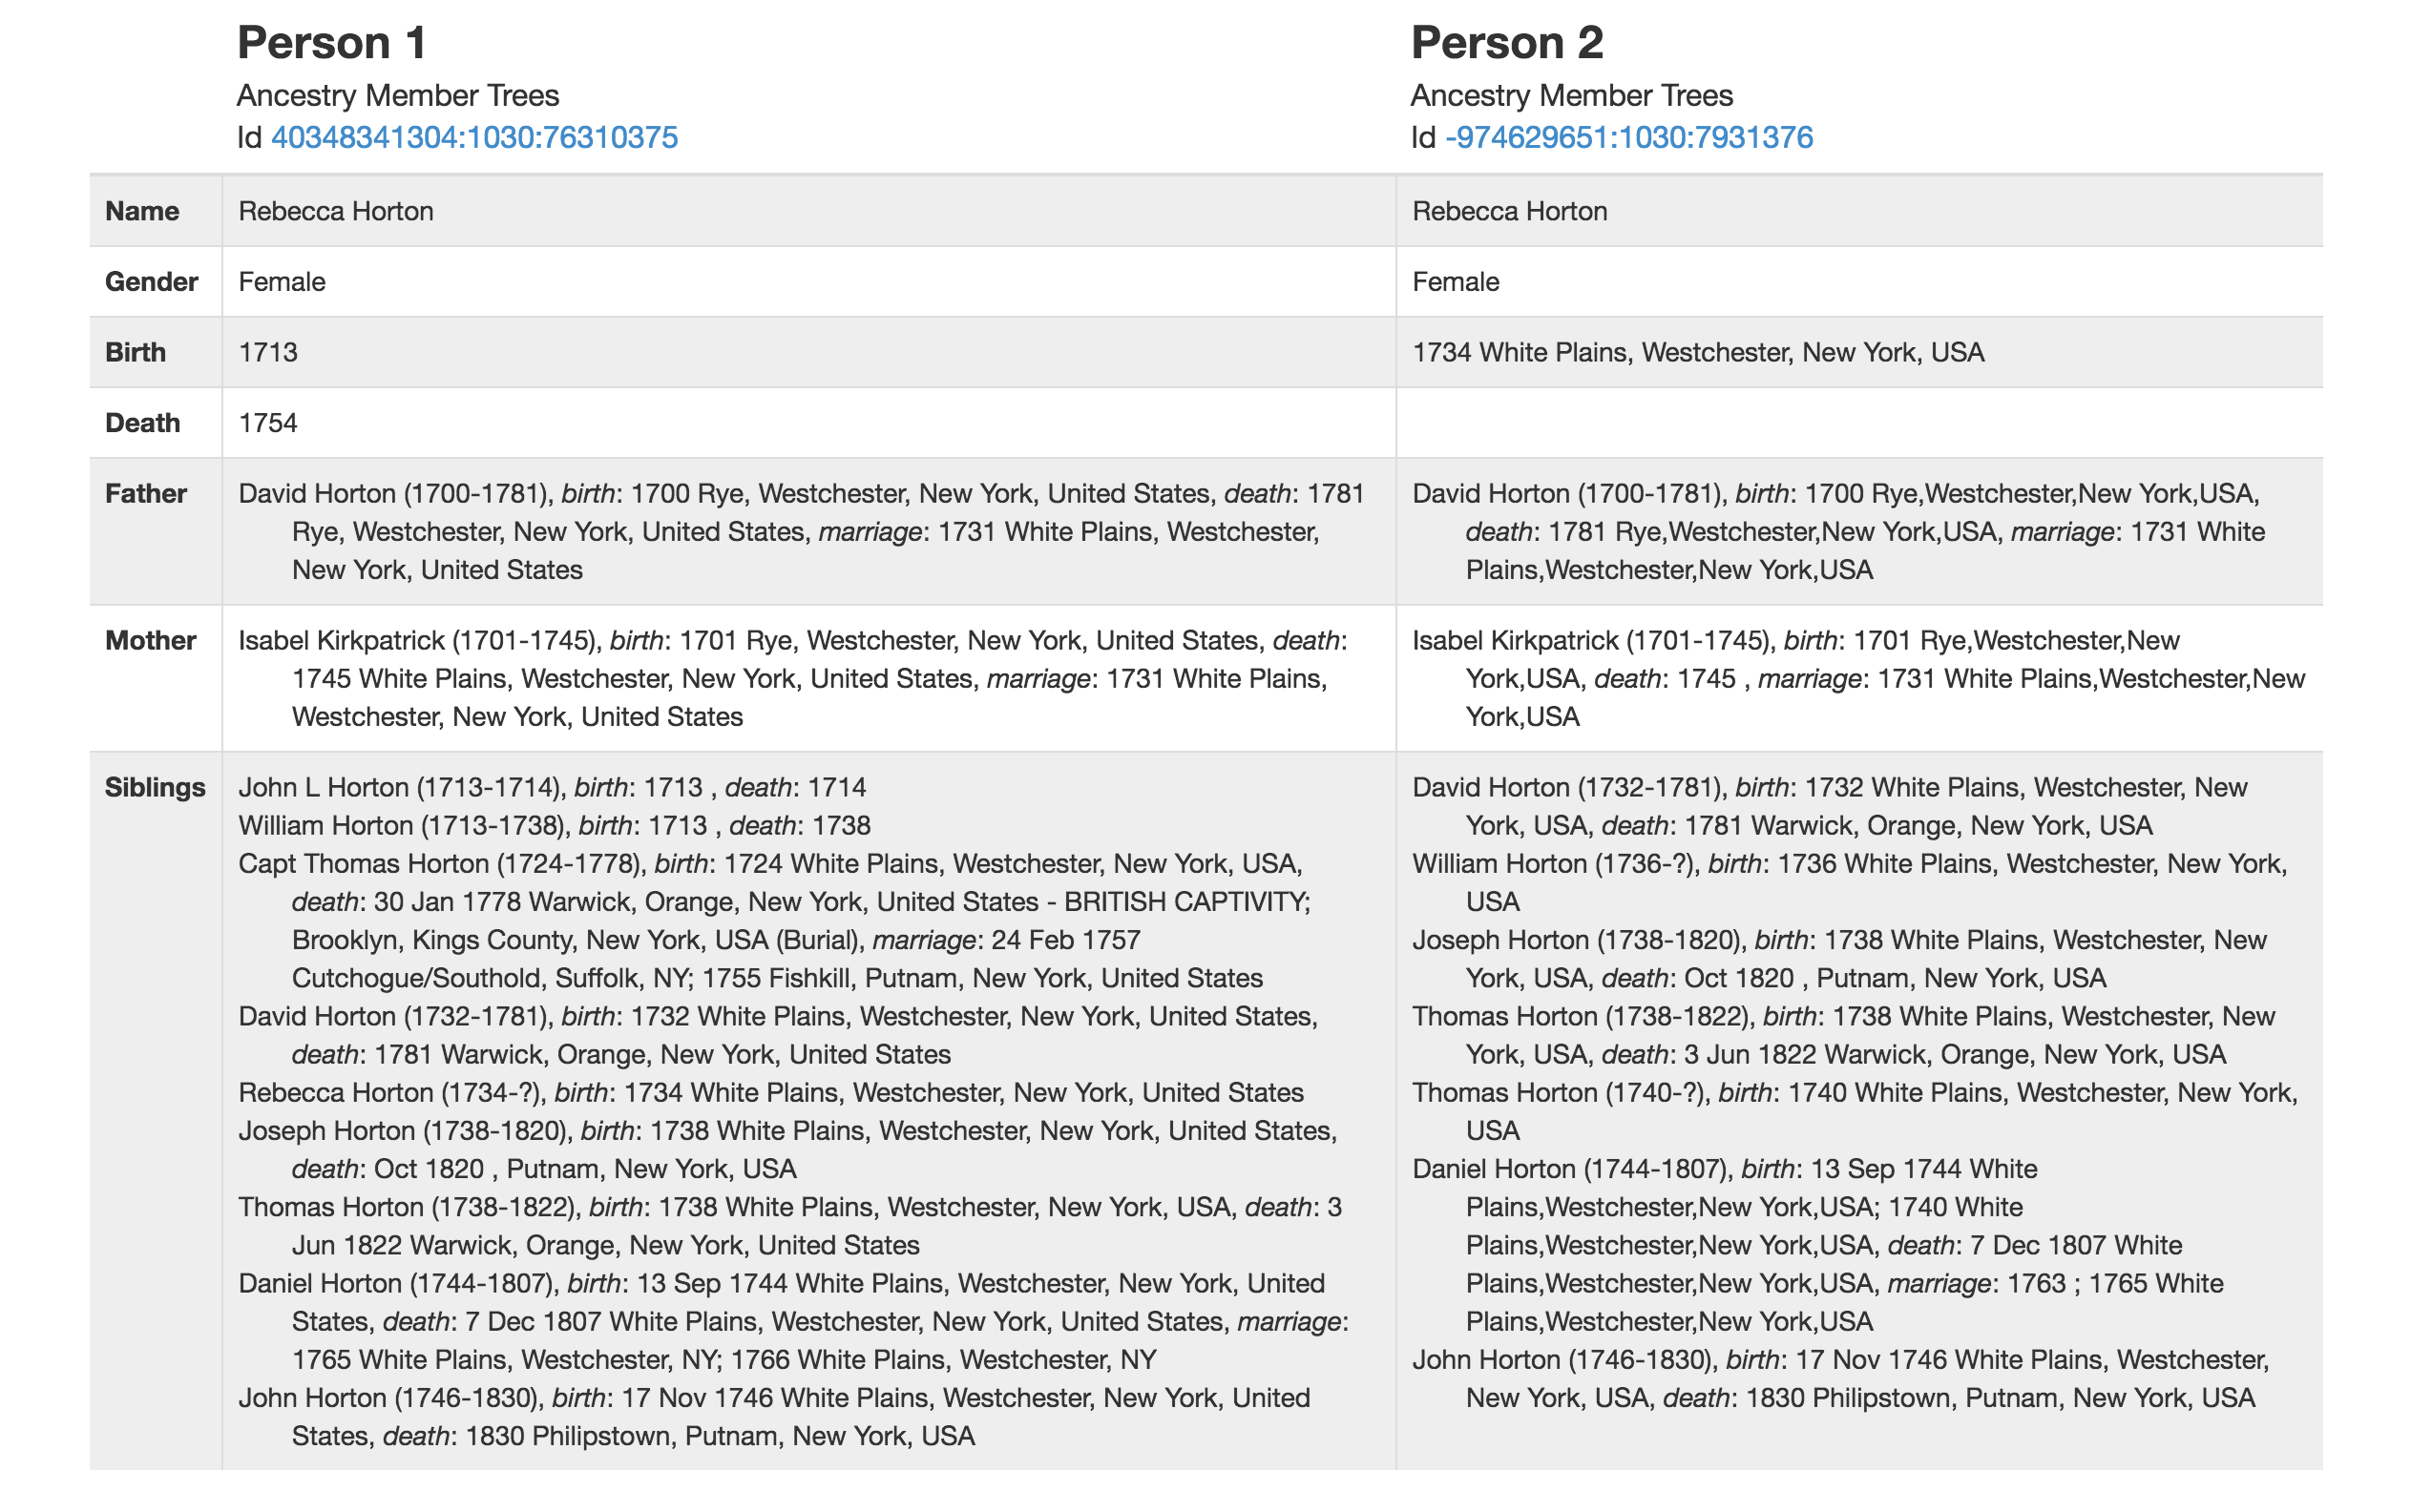
Quiz
Different!
Notes:
Siblings. For example, siblings born less than two years apart with sometimes the same given name can be very hard to distinguish.
Spouses of re-married men. This is hard because the current and ex-spouse now share the same surname potentially and may be of similar age and lived in similar places. Lead to discovering surnames for women not as strong a feature since can change based on marriage

Slide 18
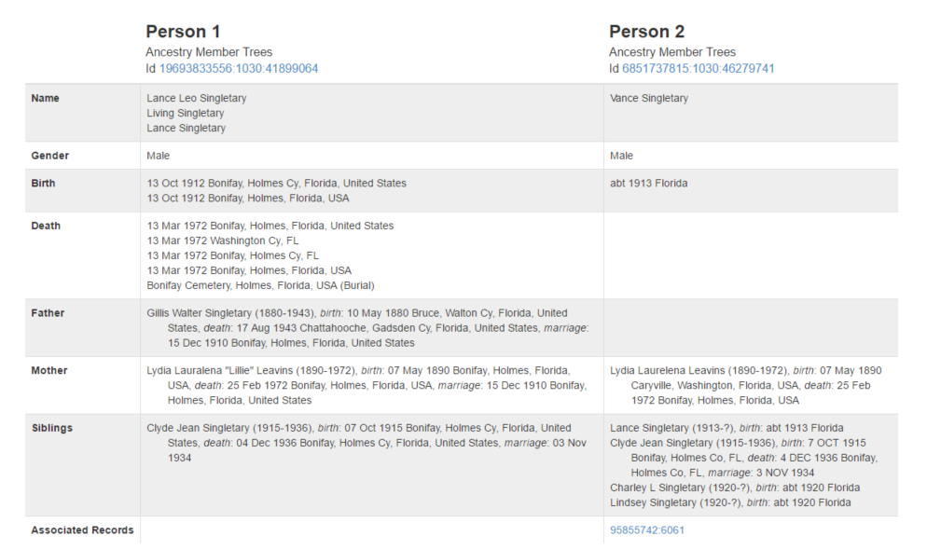
Quiz
Same!
Notes:
Yes, they are the same person. Lance vs. Vance.

Slide 19
How we evolved our algorithms

Slide 20
Straight forward solution
if first name match and last name match:
if DoB match:
if spouse name match:
if ….
return SAME
else
return DIFFERENT
else
return DIFFERENT
else
return DIFFERENT
else
return DIFFERENT

Slide 21
Straight forward Solution
if first name match and last name match:
p += 0.05
if DoB match:
p += 0.05
if ….
p += 0.05
else
p -= 0.05
else
p -= 0.05
else
p -= 0.05
return p

Slide 22
ThunderCompare Engine v1.0
Data
Statistical Analysis
Machine Learning
Prediction
Notes:
Standard machine learning platform – logistic regression and random Forrest, to generate a prediction on whether people are the same or not. 200 data points and with Progen data we have 60,000.

Slide 23
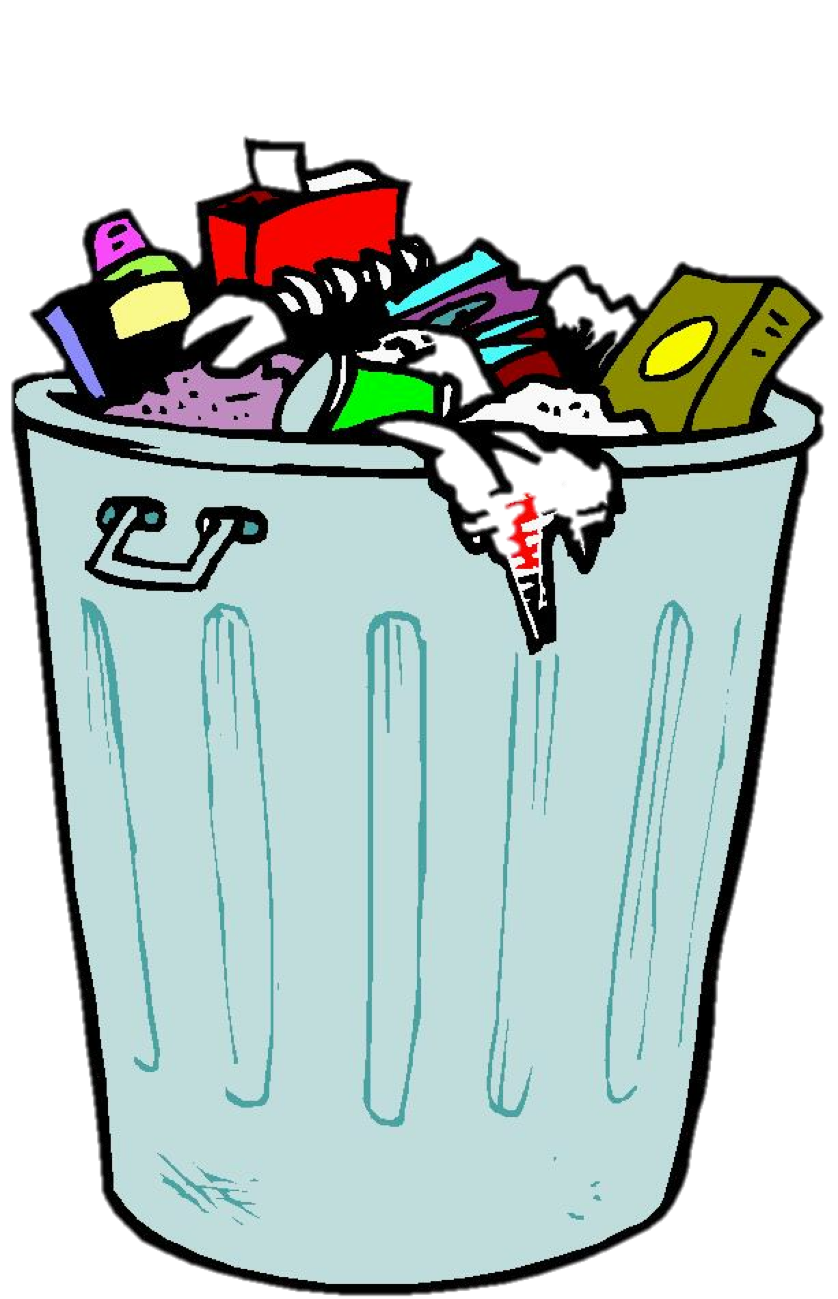
ThunderCompare v1.0
Statistical Analysis
Machine Learning
Notes:
Data quality has challenges. A lot of noise in the data. Standard machine learning gives us problems. By the book process, we need to make better.

Slide 24
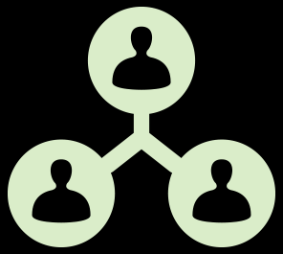
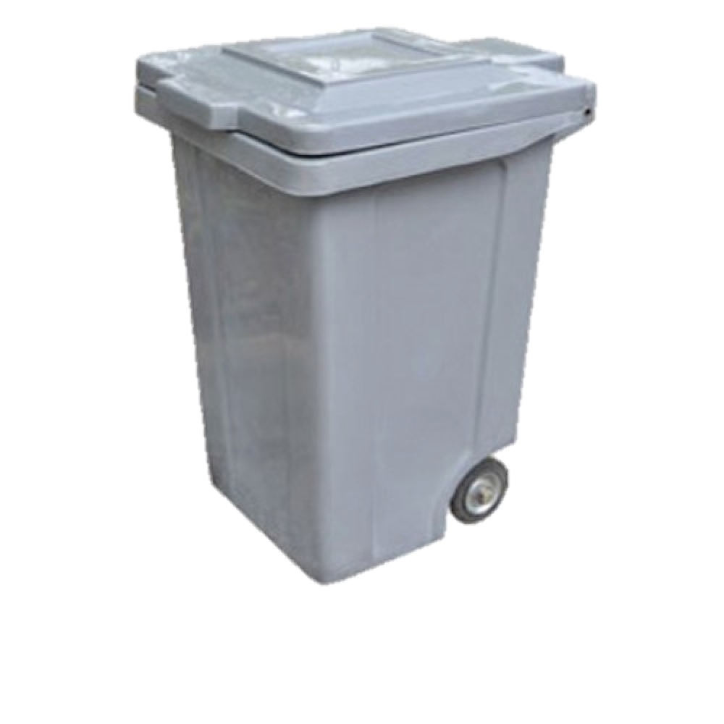
ThunderCompare Engine v2.0 ?
Clean
Filter
Recycle
Machine Learning
Prediction
Discard
Data Awareness
Quality Adaption
Human Interaction
Notes:
How do we deal with the noise in the data. Categorize into different qualities. Example – how many missing values are there (not edge cases). Model selector depending on the quality of the data.
Filter data based on quality and use that high quality data to train the model. What is cleaning? Here’s a father’s name, but the sons name is missing. Simple inference to make the data more complete.
Recycle/repurpose – If we have this data, we can reuse it for different purposes. 2 labels – yes or no for if someone is the same or a different person. Use different labels to train the model. Reuse the data vs. generating new labels. 5 labels and now we need 2 labels to change binary classifier instead of regenerating the labels.
2 class model to output the model.
ProGen label – If prediction is confident we know. Judgement scoring process.
Prediction – Really a score 0-1. Yes or no – same or different, how much they are the same, not the same, or can’t decide.
Discard – too many errors

Slide 25
Data Loading
Preprocess
Pairwise sampling
Edge Case Detection
ProGen
Label
Tree
DB
Record
DB
Model Selector
Confidence Scoring
Compare
Model
Model
Accept
Auto Labeler 1
Auto Labeler 2
Training
Auto Labeler 3
ProGen
Labeler Evaluation
Notes:
Hint of what is behind this.
A lot of iterative experiments of labeling to send less confident (compare score away from and 1) pair to progen
Prepress: cleaning of missing value, inferred last name from father.
Pairwise sampling: In ProGen (or clean data is about the k-fold validation)
In Blocking algorithm to generate candidate copy.)
Several models we’re considering.
- Logistic regression & Random Forrest
- Boosted tree
Except or TC Engine, everything else in training.

Slide 26
Performance
Compare Quality improved 25.8%
Compare Speed increased by 130%
Notes:
Machine learning & one is rule

Slide 27
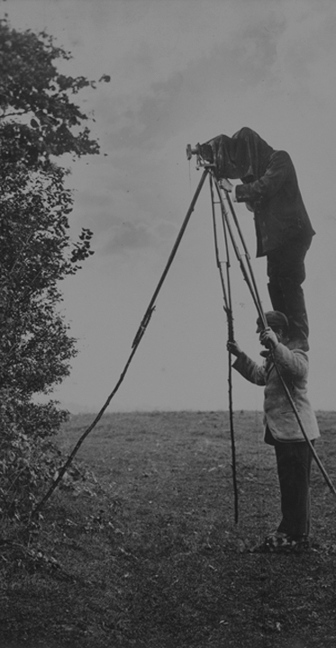
Game changing strategies in big tree
Convert data into knowledge Big Tree
Engage users into the modeling loop
Marry human intelligence with machine intelligence
Better understanding of human kind with big data
Real time adaptation to new information
Personalized family history stories

Slide 28
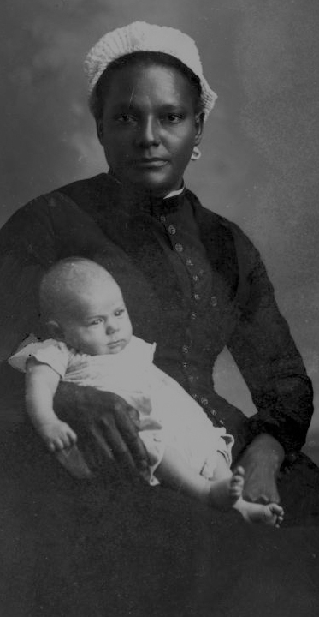
Takeaways:
Family history is important to everyone
Discover the family relationship between people is super complicated and critical
Machine learning is our powerful tool for building a knowledge graph about mankind
Hire the best data scientists

Slide 29
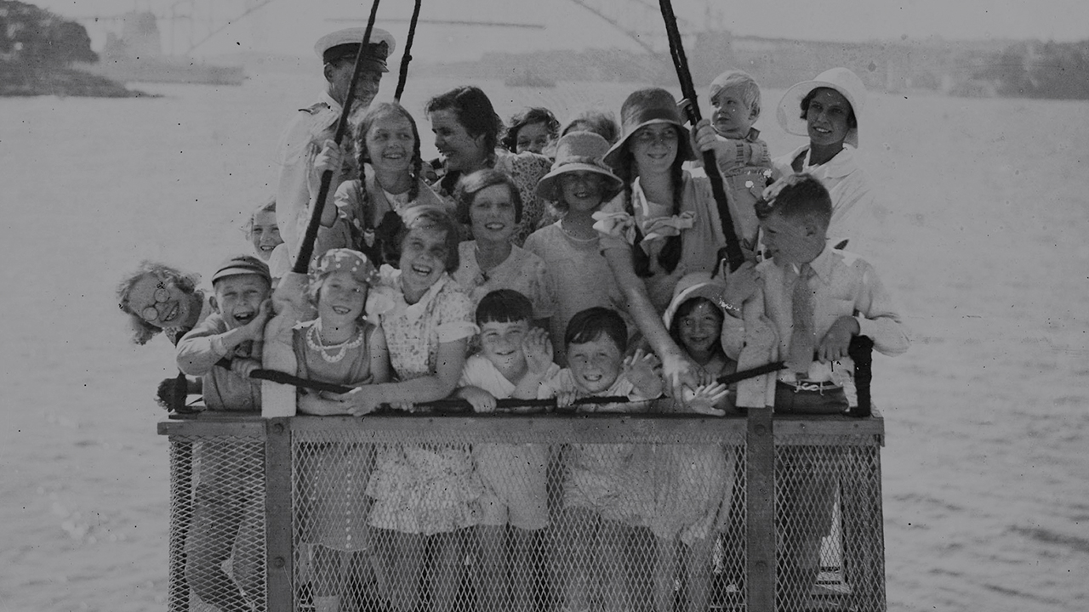
In Data Science We Believe Thanks.

