Slide 1
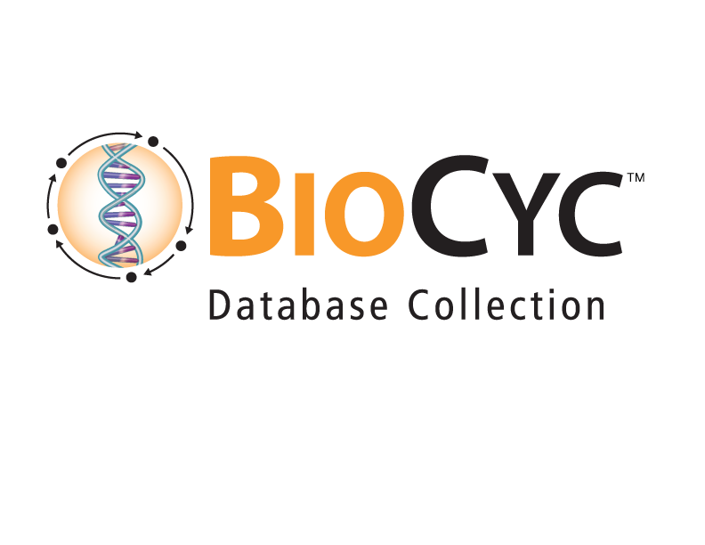
BioCyc: "Big Knowledge" of Genomes and Metabolic Pathways
Peter D. Karp ecocyc.org
SRI International biocyc.org
metacyc.org

Slide 2
BioCyc Overview
Integrates diverse data and knowledge for thousands of genomes
Curated and computationally generated
Serves a diverse set of use cases
Metabolic-flux models for individual organisms and organism communities
Extensive domain-specific visualization tools
Sustainability: New subscription model

Slide 3
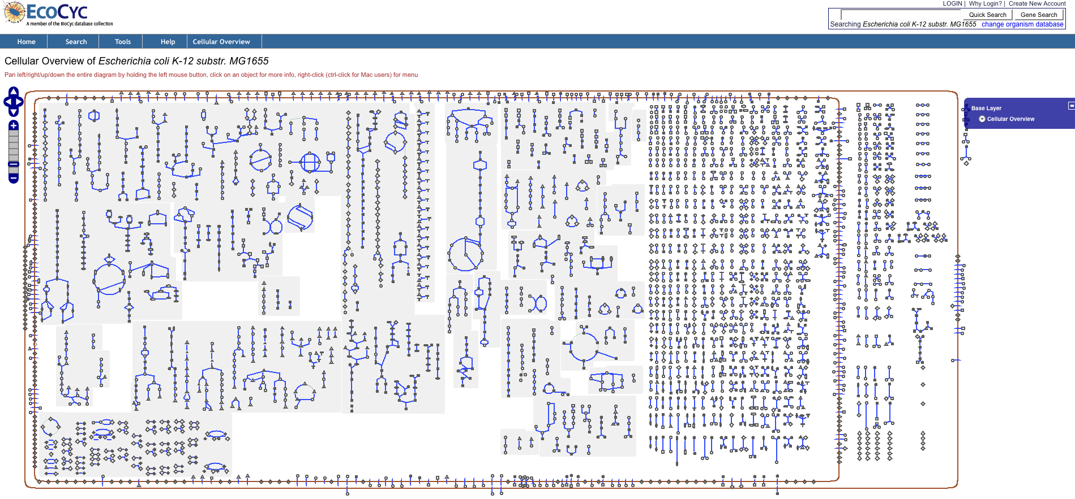
Notes:
This is the E. coli metabolic map
It took decades of work by hundreds of scientists to elucidate
Scientists love to specialize, so this information was originally spread across thousands of publications
What could it mean to integrate much of the scientific information we have about some complex system
Both as a reference source for scientists
AND
To permit computation across the system as a whole

Slide 4
EcoCyc Project – EcoCyc.org
E. coli Encyclopedia
Organism-specific database for the best-studied organism on earth: Escherichia coli (first isolated in 1885)
Biologists enter information from E. coli publications
EcoCyc contents derived from 31,000 publications
Mini-review summaries (2,300 pages) and literature citations
Programmers author web query and visualization tools
“Multi-dimensional annotation of the E. coli genome”
Describes the molecular parts-list of E. coli and the functions of those parts
Gene functions, regulation of gene expression
Metabolic model derived from EcoCyc predicts lethality of gene knock-outs with 95% accuracy
Nucleic Acids Research 41:D605 2013

Slide 5
Model Organism Databases (MODs)
Each “complete” genome is incomplete in several respects:
40%-60% of genes have no assigned function
Roughly 7% of those assigned functions are incorrect
Need continuous updating of these databases to incorporate new experimental findings
Gene positions, sequence, gene functions, regulatory sites, pathways
MODs are platforms for global analyses of an organism
Interpret omics data in a pathway context
In silico prediction of essential genes
Characterize systems properties of metabolic and genetic networks

Slide 6
Pathway/Genome Database Organization
Pathways
Reactions
Compounds
Proteins
RNAs
Sequence Features
Regulation
Operons
Promoters
DNA Binding Sites
Regulatory Interactions
Genes
Chromosomes
Plasmids
CELL

Slide 7
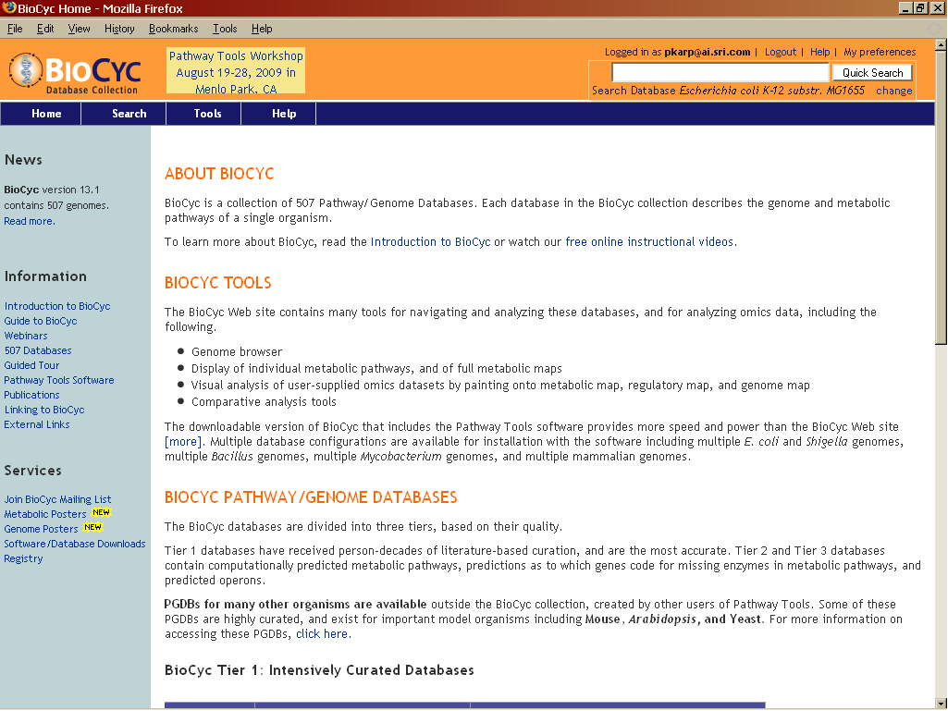
BioCyc Collection of 7,600 Pathway/Genome Databases
Pathway/Genome Database (PGDB) – combines information about
Pathways, reactions, substrates
Enzymes, transporters
Genes, replicons
Transcription factors/sites, promoters, operons
Tier 1: Highly curated PGDBs
MetaCyc, HumanCyc, YeastCyc
EcoCyc -- Escherichia coli K-12
AraCyc – Arabidopsis thaliana
Tier 2: Moderately curated -- 34 PGDBs
Bacillus subtilis, Mycobacterium tuberculosis
Tier 3: Computationally-derived DBs, No Curation -- ~7,600 PGDBs
Curated information derived from 66,000 publications

Slide 8
Creation of BioCyc Databases
Computational Inferences
NIH RefSeq
Predict metabolic reactions
Predict operons
Predict transport reactions
Compute orthologs
Predict metabolic pathways
Compute Pfam domains
Predict pathway hole fillers
Curation
PGDB
Regulatory data [regtransbase]
Database links
Organism phenotype data
Subcellular locations [psortdb]
Gene essentiality data
Phenotype microarray data
GO terms [uniprot]
Protein features [uniprot]
Data Import

Slide 9
What is Curation?
Ongoing manual updating and refinement of a PGDB
Incorporating information from experimental literature
Authoring of mini-reviews and citations
Updating database fields
Gene positions, names, synonyms
Protein functions, activators, inhibitors
Addition of new reactions and chemical compounds

Slide 10
BioCyc Accelerates Science
Experimental biologists
Computational biologists
Study properties of E. coli metabolic and regulatory networks
Bioinformaticists
Training and validation of new bioinformatics algorithms – predict operons, promoters, protein functional linkages, protein-protein interactions,
Metabolic engineers
“Design of organisms for the production of organic acids, amino acids, ethanol, hydrogen, and solvents “
Educators
Microbiology and metabolism education

Slide 11
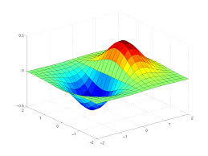
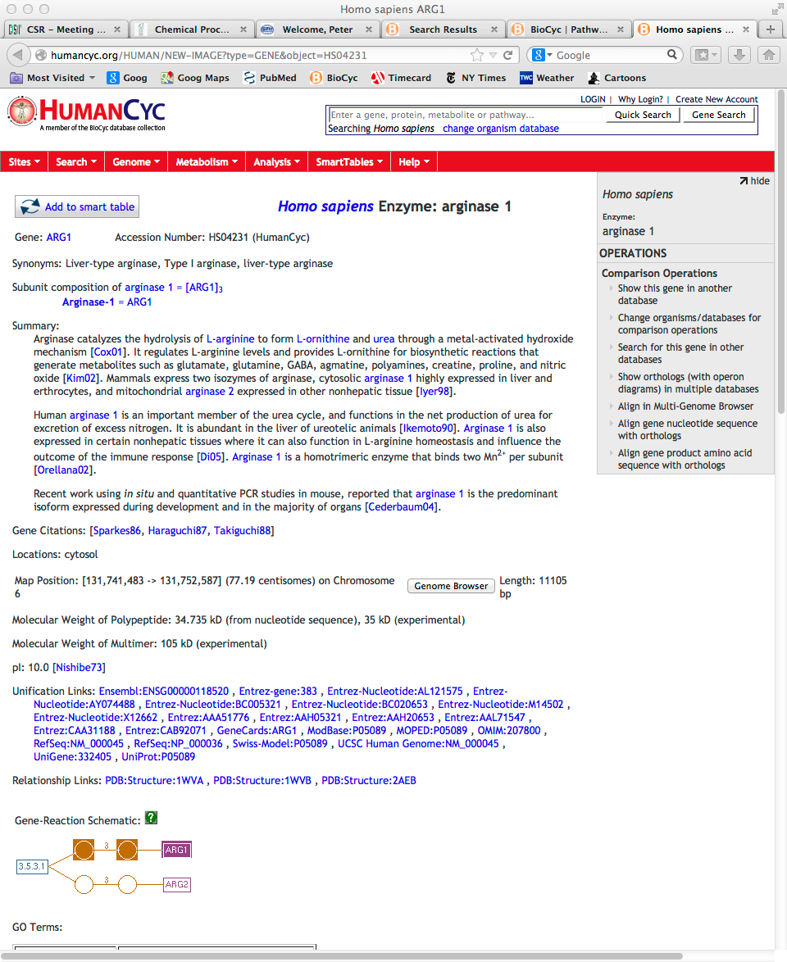
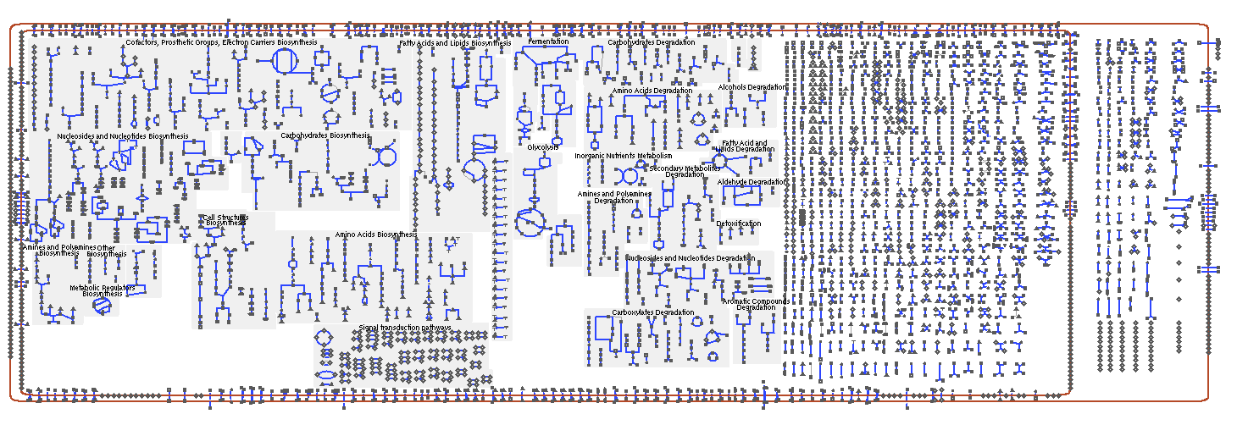
BioCyc Databases Serve Multiple Use Cases
Encyclopedia
Metabolic Model
Queryable Database
Zoomable Metabolic Map
Omics Data
Analysis
Notes:
Mention that all of these five usage facets are validated.

Slide 12
Perspective 1: EcoCyc as Online Encyclopedia
All genes for which experimental literature exists are curated with a minireview summary
3,730 gene products contain summaries
Summaries cover function, interactions, mutant phenotypes, crystal structures, regulation, and more
Additional summaries and other data found in pages for genes, operons, pathways
Textbook-equivalent pages in summaries: 2,300

Slide 13
Perspective 2: EcoCyc as Queryable Database
350 database fields capture object properties and relationships
Each molecular species defined as a DB object
Genes, proteins, small molecules
Each molecular interaction defined as a DB object
Metabolic and transport reactions, regulation
Extensive search tools
Object-specific search Search Menu
Advanced search Search -> Advanced
APIs enable programs to compute across the data
Python, Java, Perl, Lisp, Web services

Slide 14
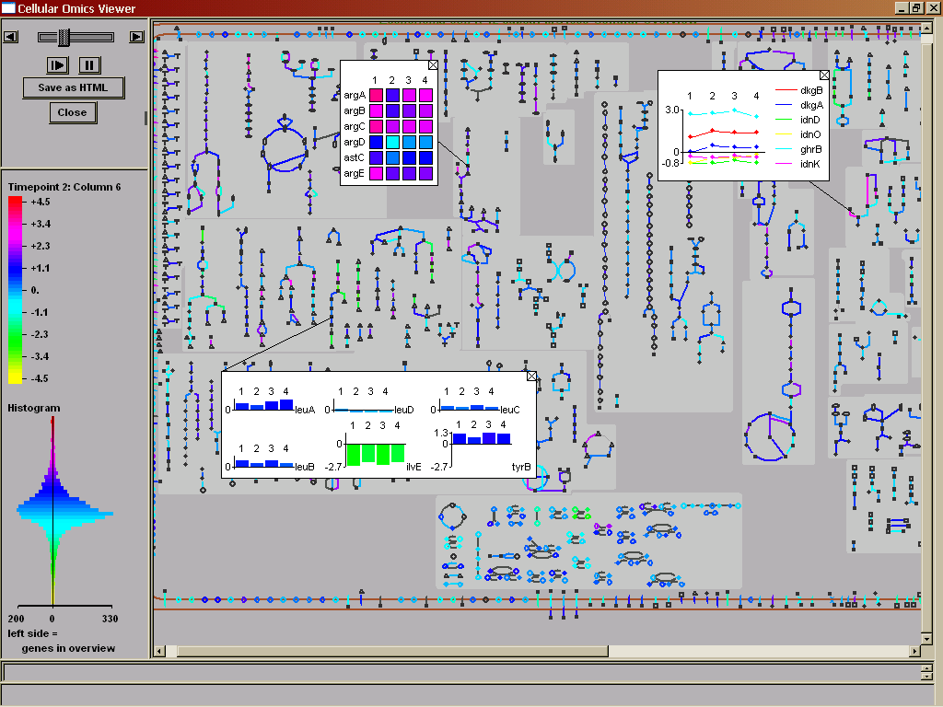
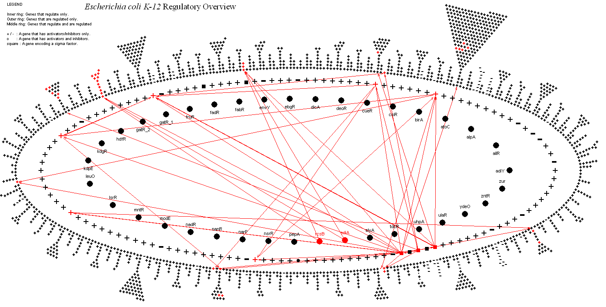
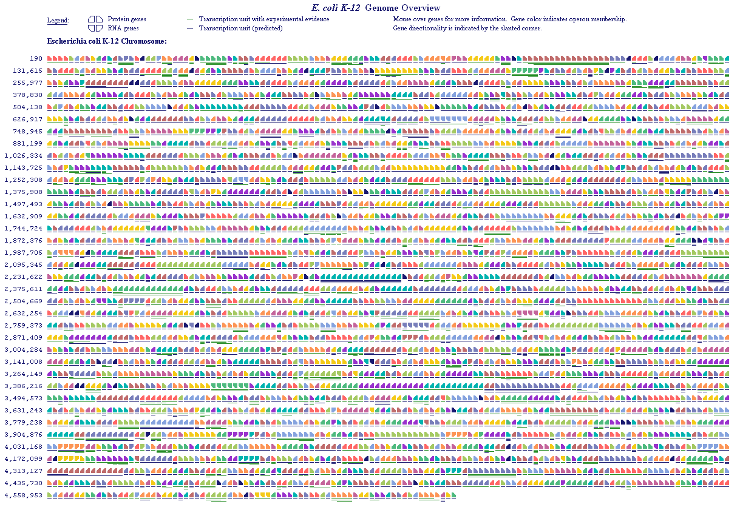
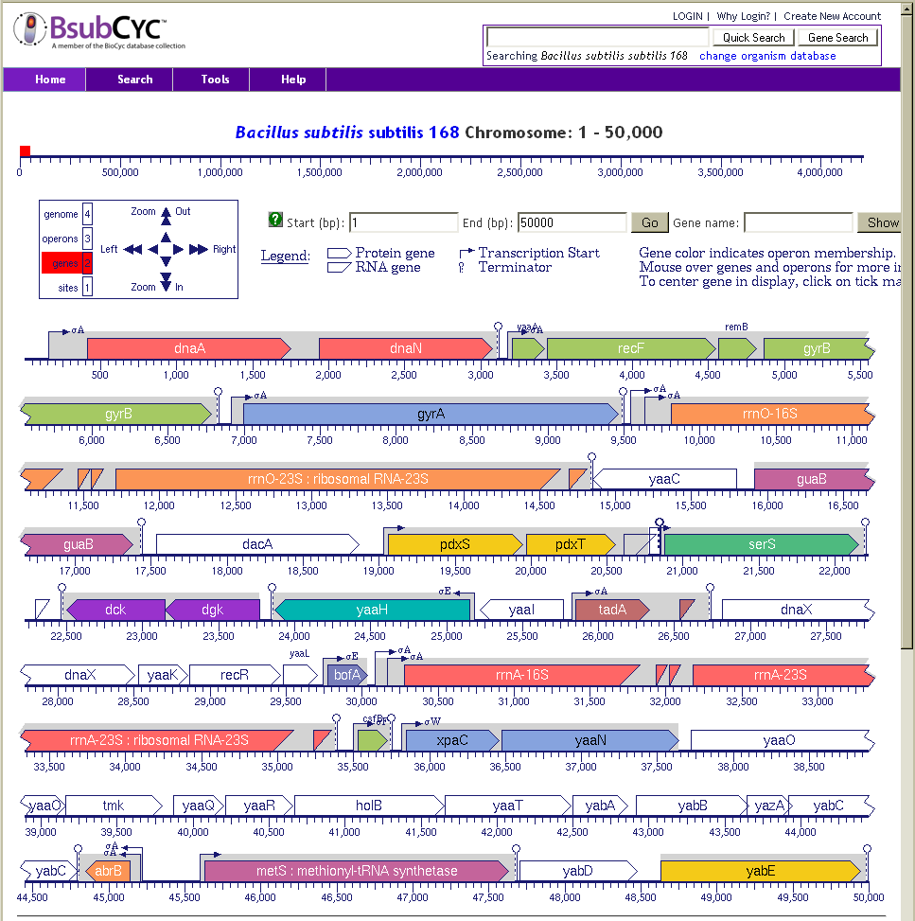
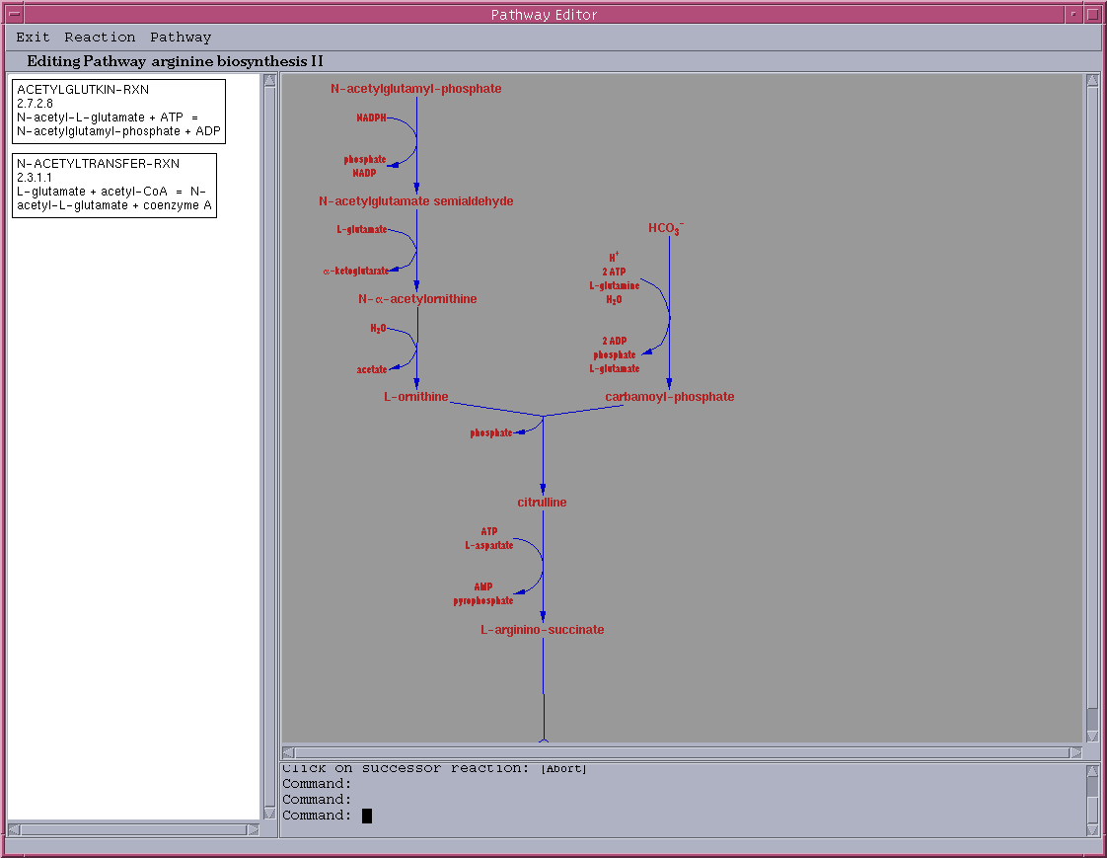
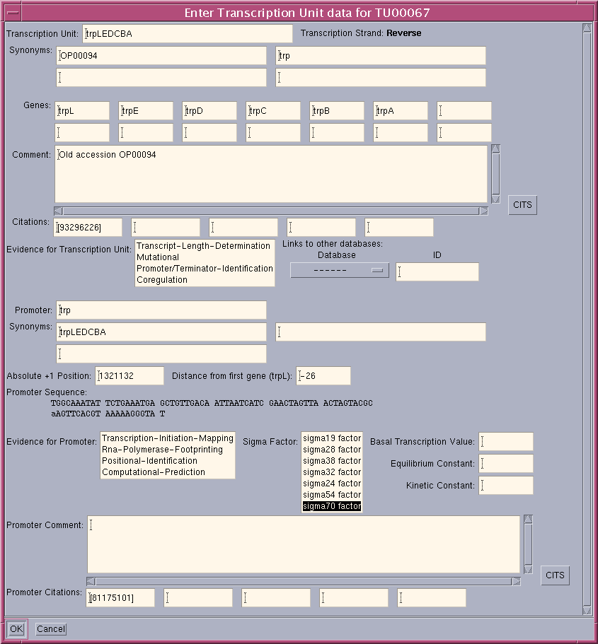
+
Annotated
Genome
PathoLogic
Pathway/Genome
Database
Pathway/Genome
Navigator
MetaFlux
Pathway/Genome
Editors
Briefings in Bioinformatics 11:40-79 2010
640,000 lines of Lisp code ~= 1.5M lines of C or Java code

Slide 15
Pathway Tools Software Stack
OS: Windows, Mac OS X, Linux
DB: Ocelot, MySQL, SOLR
Prog Lang: Javascript, Common Lisp
GUI: Ghostscript, SKIPPY, YUI
Solver: SCIP
Bioinformatics: Textpresso, MUSCLE, PatMatch, BLAST, libSBML, cytoscape.js
Chemoinformatics: Marvin, GlycanBuilder, InChI

Slide 16
Genome-scale Visualizations of Cellular Networks
Generated automatically from PGDB
Magnify, interrogate
Paint with high-throughput data

Slide 17
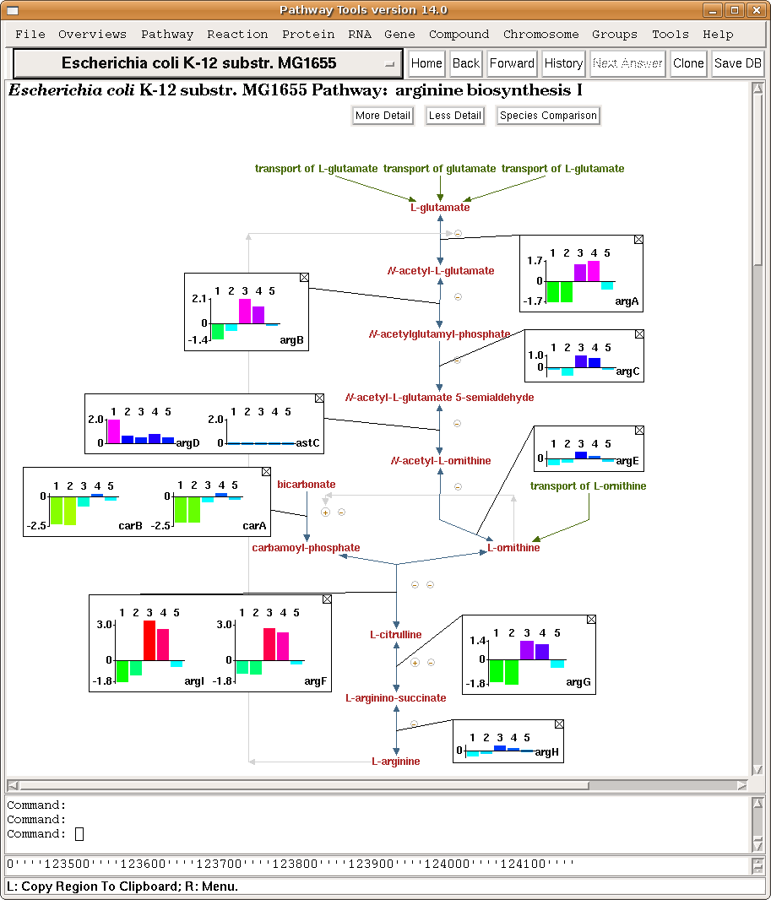
Gene Expression Data on Single Pathway

Slide 18
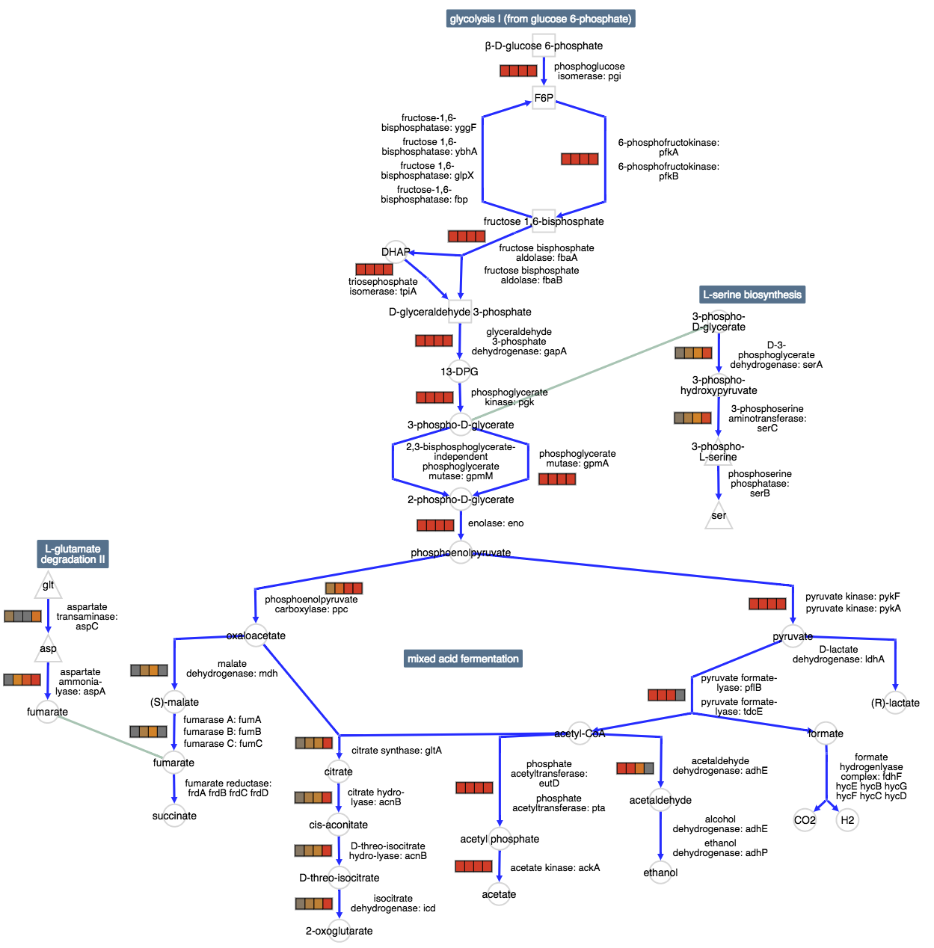
Pathway Collage with Gene Expression Data

Slide 19
E. coli Cellular Overview

Slide 23
Gene Expression Data on Cellular Overview

Slide 24
Genome Overview

Slide 25
Genome Poster

Slide 26
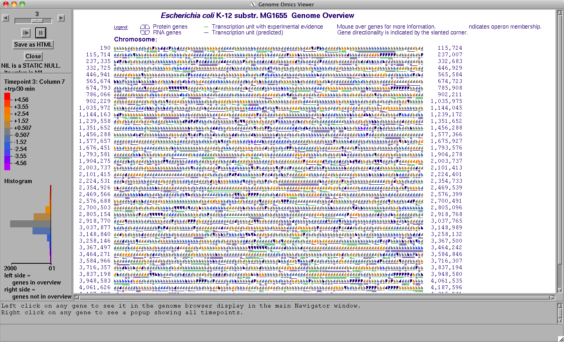
Genome Overview

Slide 27
Regulatory Overview
Show regulatory relationships among gene groups

Slide 28
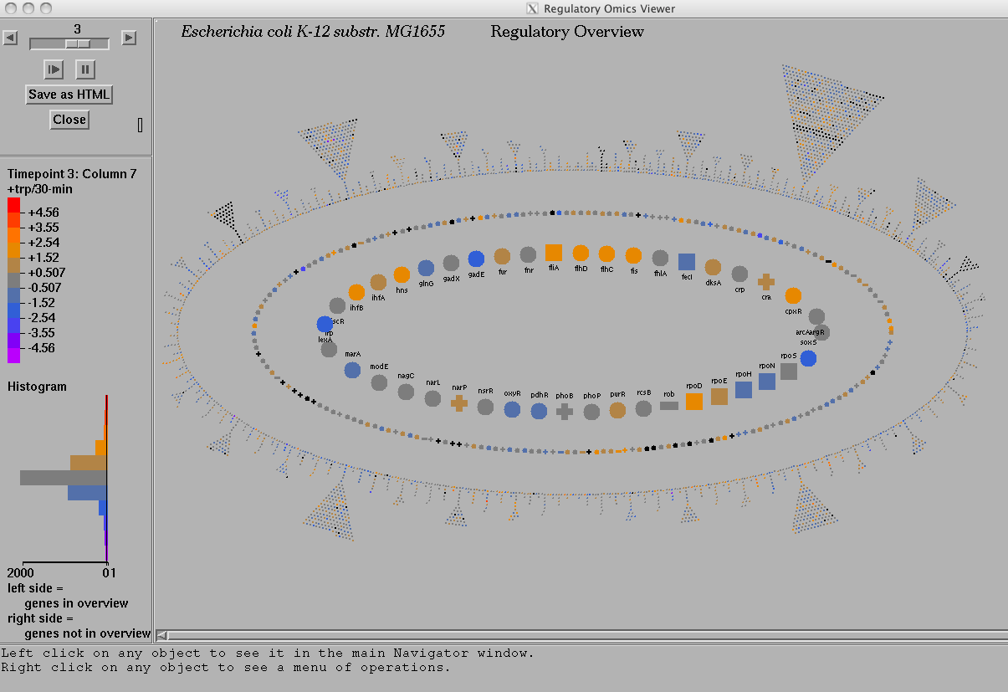
Regulatory Omics Viewer

Slide 29
Metabolic Modeling Applications
Predict steady-state reaction fluxes for the metabolic network
Predict growth rates, nutrient uptake rates
Remove genes/reactions from model to predict knock-out phenotypes
E. coli: 95.2% accuracy for 1445 genes
Serve as quality check on EcoCyc data
Metabolic engineering

Slide 30
Flux-Balance Analysis
Steady state, constraint-based quantitative models of metabolism
E. coli model derived from EcoCyc (BMC Sys Biol 2014 8:79):
16 nutrients
108 biomass metabolites
2286 reactions
Nutrients
Metabolic Reaction List
Secretions
A
A
B
C
D
D
X
Biomass

Slide 31
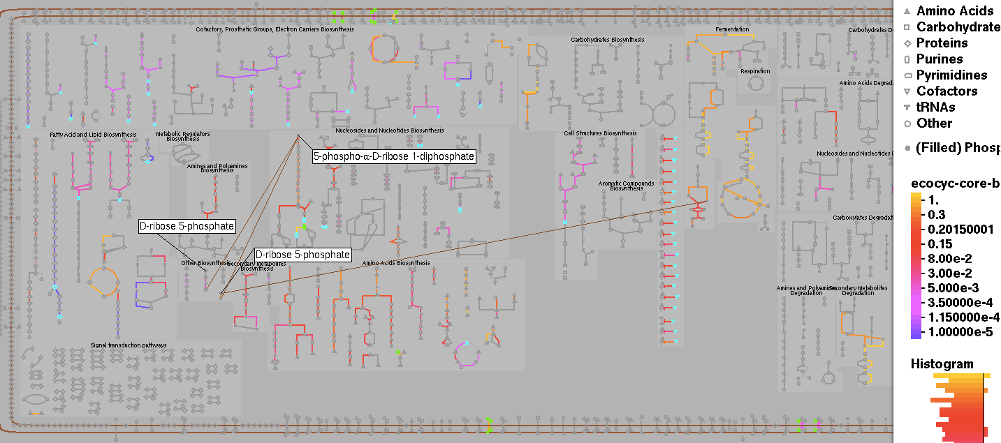
Painting E. coli Fluxes on Metabolic Map

Slide 32
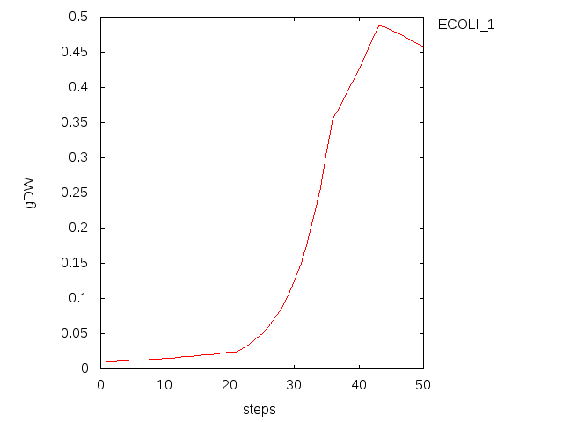
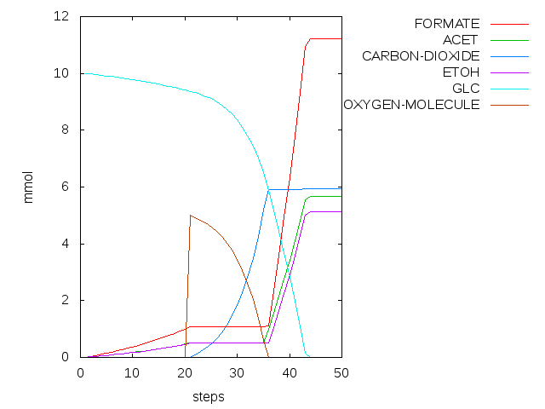
Dynamic FBA Modeling of E. coli
Dynamic FBA modeling of E. coli growth under varying nutrient conditions
t=1-20: E. coli grows anaerobically on 10 mmol glucose
t=21-34: O₂ is added to the simulation; E. coli grows completely aerobically
t=34-35: O₂ availability becomes limiting; acetate forms
t=36-44: O₂ is exhausted; anaerobic growth resumes
t=45 onwards: glucose is exhausted, cells begin to die

Slide 33
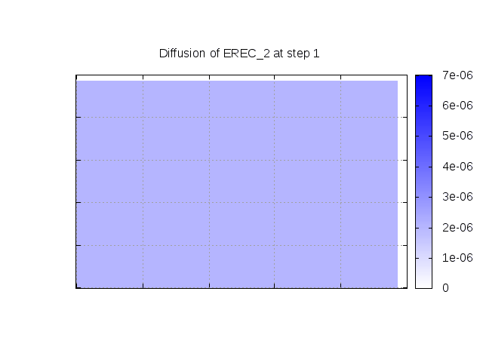
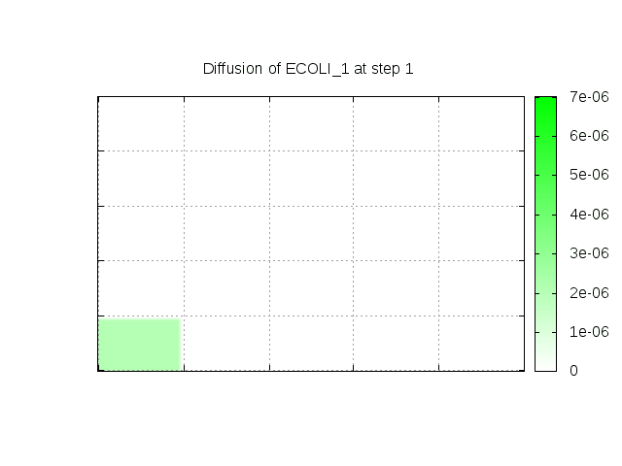
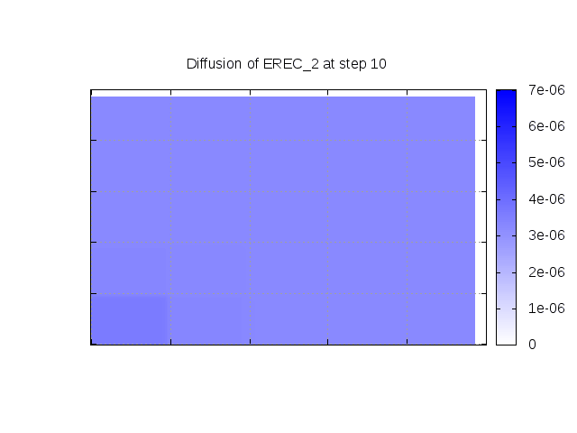
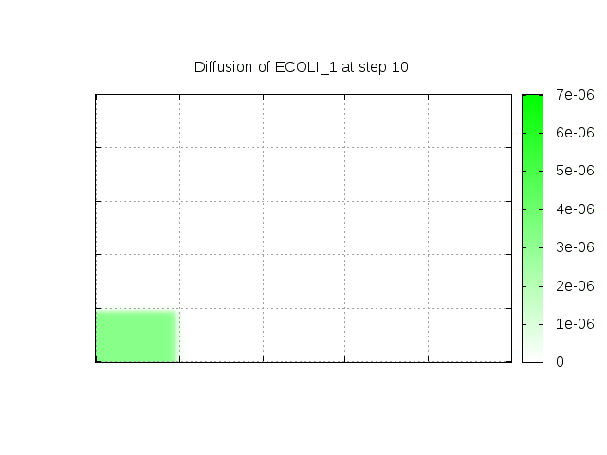
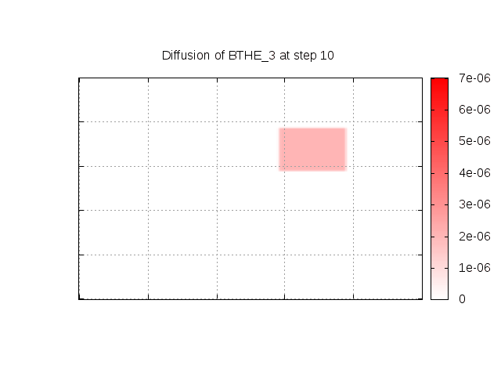
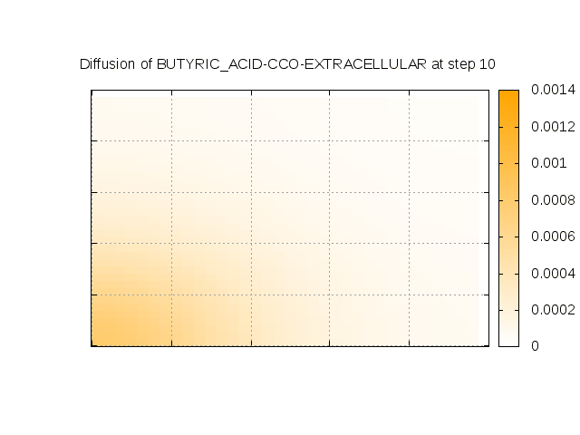
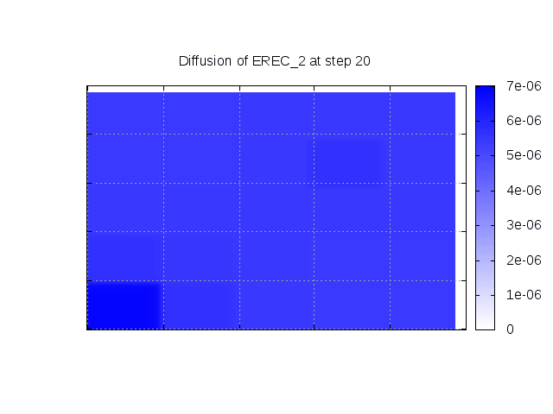
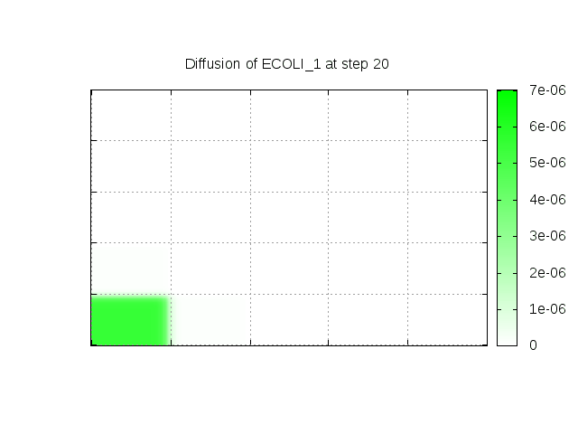
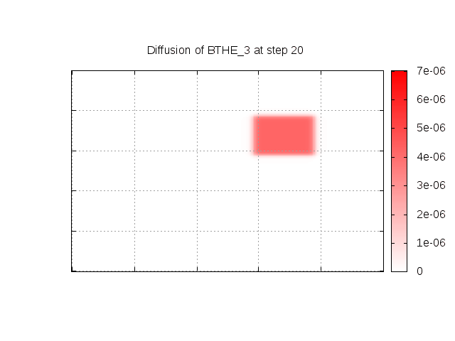
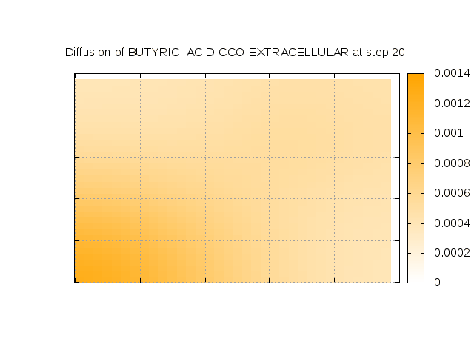
Dynamic Grid Modeling of a Simple Microbial Community
Initially, E. rectale is present throughout the grid; E. coli is present in southwest corner
Halfway through simulation, B. thetaiotamicron is added to the middle of the lawn
E. rectale shows higher growth where E. coli or B. theta are present because of availability of acetate from E. coli. E. rectale produces butyrate where acetate is present.
io
time
Notes:
Dan says:
E rectale produces the butyrate where acetate is present. E coli has been producing acetate since t=0 but B theta has only been producing acetate since t=10 (he thinks there hasn't been enough acetate produced for Erec to produce butyrate)
Consequently E rectale produces more butyrate over by the E coli corner It would probably be better to redo the illustration with a larger grid to more clearly show the different additions of acetate-production bacteria

Slide 34
BioCyc and Pathway Tools Availability
BioCyc.org Web site and database files available via subscription starting July 1, 2016

Slide 35
Acknowledgements
SRI
Suzanne Paley, Ron Caspi, Mario Latendresse, Ingrid Keseler, Carol Fulcher, Markus Krummenacker, Richard Billington, Pallavi Kaipa
EcoCyc Collaborators
Julio Collado-Vides, Robert Gunsalus, Ian Paulsen
MetaCyc Collaborators
Lukas Mueller, Hartmut Foerster
Sue Rhee, Peifen Zhang
Funding sources:
NIH National Institute of General Medical Sciences
http://www.ai.sri.com/pkarp/talks/
BioCyc webinars:
biocyc.org/webinar.shtml

