Slide 1


The Lost Discipline of Developing Analytics
Celeste Fralick, Ph.D., CQA
Chief Technology Officer-Analytics, Intel Security Group
Research Faculty – International Institute of Analytics
09/21/16 celeste.r.fralick@intel.com 480-554-0248
Join the Conversation #WolframDataSummit

Slide 2


Agenda
Why Now
Why We Should Care
Analytic Product Life Cycles
Select Recommended Content
Summary

Slide 3



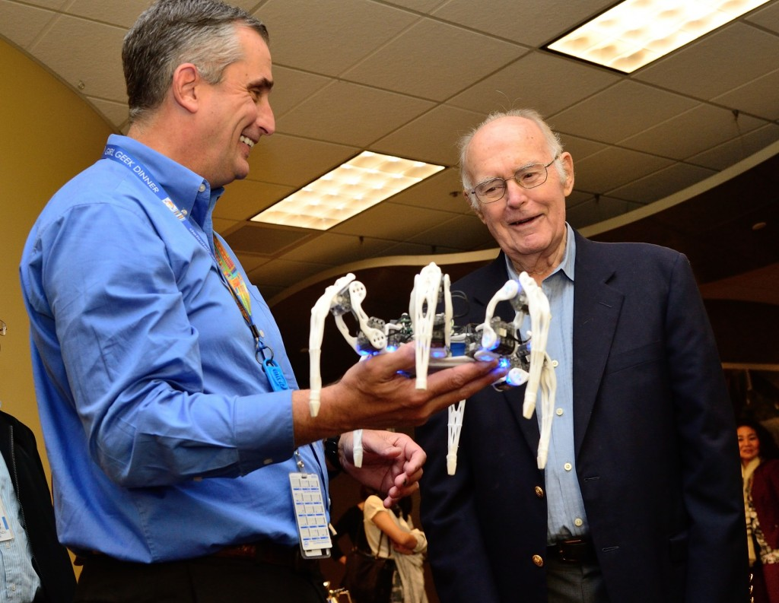

Why
Now?

Slide 4
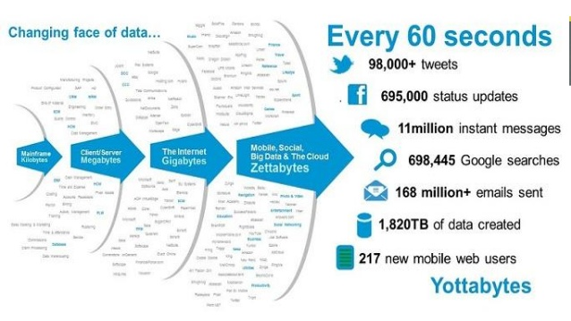
Source: http://www.slideshare.net/asertseminar/big-data-34369979
A gram of DNA can theoretically hold 455 exabytes!
Notes:
Third, as processing power and devices are connected, the amount of data continues to grow. We’ve certainly gone beyond the decimal system! We’re now nearing h
handle brontobytes (10²⁷ bytes) data – the measurement beyond yottabytes to describe the type of data we receive from sensors within the Internet of Things.
2017 global mobile data traffic will reach 11.2 exabytes per month (134 exabytes annually); growing 13-fold from 2012 to 2017
40 zettabytes by the end of the decade – CyberCoders Feb 2016 (=45 Trillion Gigabytes)

Slide 5
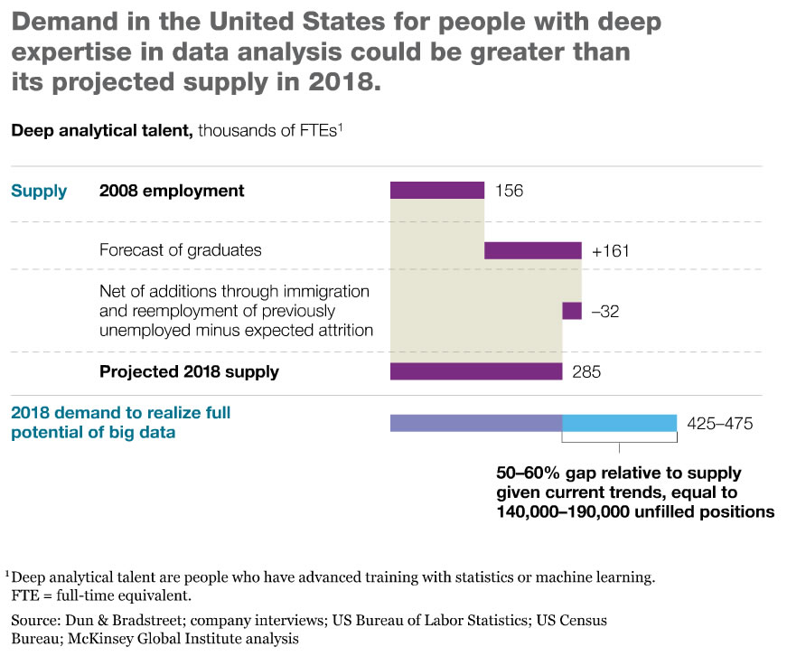
“…There is still a significant gap…”
M. Schmidt, CEO, Nutonian 2016
Notes:
CIO Journal of WSJ 2011
McKinsey projects that by 2018 demand for data scientists may be as much as 60 percent greater than the supply.
"Even in companies that are fortunate enough to have some of the data science talent, there is still a significant gap - the things they find still need to be translated to a business application. The data scientist is not the person that can do that. Their expertise is with statistics and algorithms and the programming," Schmidt explains. "You need a person that is intimately familiar with the operations of the company or the marketing of a product."
For many organizations, that means "the process needs to be automated," Schmidt says. "That's where data science is going to change from a cottage industry, to where it is industrialized and is broad
Michael Schmidt, CEO and founder of Nutonian, says, "2016 is the year that we bring transparency to all of the algorithms and statistics coming out of the data science movement. We're at a point where we can predict incredibly well, and now it's time to apply that in a much broader sense."

Slide 6
Best jobs in the U.S. 2015
Best jobs in the United States in 2015
Note: United States; 2015
Further information regarding this statistic can be found on page 8.
Source: Website (Careercast.com); ID 507185
Notes:
2015 MIT Sloan Management Review, 40 percent of the companies surveyed were struggling to find and retain the data analytics talent.

Slide 7
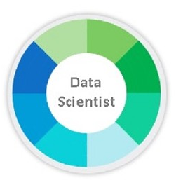

Why are there so many “fake data scientists”?
Sexy title (HBR)
Demand for immediate business intelligence & action
Too many areas to learn
Too few data scientists (supply & demand)
Ill defined job role
“Easy to learn” mentality without underlying statistical fundamentals
Credits: CIO Journal (2014) and B. Marr (2016)

Slide 8
The Analytic Development Process:
Product Life Cycle (“PLC”)
Planning
Production
Exploration
Planning
Exploration
Development
Production
Development
Define Usage Model & Problem Framing
Define Requirements
State of Art Assessment
Verification & Validation
Arrows indicate START of activity
Analytic Risk Assessment
Analytic
Plan & Peer Review
Analytic Report & Peer Review
Post Production Release Analytic Review(s)
Discover, develop & iterate analytics
Analytic Discontinuance

Slide 9



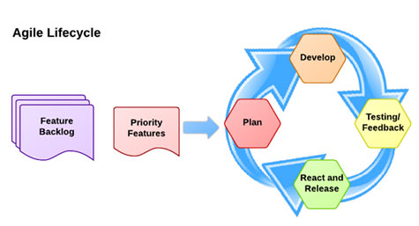



Agile Development for Analytics
Analytic Risk Assessment
Discover, develop & iterate analytics
Analytic
Plan & Peer Review
Verification & Validation
Test & Plan
Define Usage Model & Problem Framing
Define Requirements
State of Art Assessment
Analytic Discontinuance
Analytic Report & Peer Review
Post Production Release Analytic Review(s)

Slide 10
PLC | Agile | Analytic Activity | Purpose
Exploration | Epics | Define usage model and problem framing | To understand customer needs, issues, process & to encourage tie-in to action, business metrics
 | Epics | Risk assessment w/mitigation | To identify sources of error, boundary conditions, limitations, cost/benefit, data-flow
Planning | Epics | Define requirements | To define what is required to meet the customer needs & continue traceability back to customer
 | Epics | State of the art assessment | To minimize redundant efforts, perform lit search
 | Epics | Analytic Plan with peer review | To document and review analytic approach
Development | Epics | Develop iterative algorithms and models, including prototypes | To develop robust and optimum algorithms
 | Epics | Validation and Verification | To verify that the right analytic has been developed and the algorithm has been developed right
 | Epics | Analytic Report with peer review | To document, review, and release algorithm
Production/ Implementation | Epics | Post-production analytic review(s) | To assess if any internal or customer data, updates, and improvements are required in algorithm
 | Epics | Algorithm discontinuance | Evaluation of the analytic product and the criteria when its use should be discontinued

Slide 11
Each Section | Description
Purpose | Describes the section and why
Entrance Criteria | Previous requirements/steps
Target Audience | Details the who, i.e., Product Development Team
Participants | Details individual responsibilities
Recommended Contents | Detailed instructions & guidelines
Formats/Templates | Recommended forms/templates
Timing | Explains when activity occurs
Exit Criteria | Describes what is required to move on
Outcomes | The output of the activity
Records/Vaulting | Where to store information, how long

Slide 12
The Analytic Plan & Peer Review
Usage Model/Problem Framing
  What does the customer want? Why?
  Traceability starts HERE
Analytic Risk Assessment > continue throughout development
  Sources of error, cost/benefit ratio, latency/bandwidth limitations, storage/cache/memory challenges
  ISO 14971 Hazard Analysis
Define requirements
  Sample size, acceptance criteria, output expectations
State of the art assessment: Capture IP, assess literature
Plan includes: intent, hypothesis, targeted p-value, and….

Slide 13

Plan Contents: Data, Characteristics, Approach
Data type, units, definitions, source
Derived variable or variable
Sampling frequency, sample size, population
How data will be collected
Previous data analysis, how prior results/data will be used (esp. assumptions)
Expected data quality and description of plan to remove noise, outliers
Expected tolerance of sensor or equipment and how that will be accounted for
Defined sources of error and how to mitigate them
Randomization of data
Any gauge repeatability and reproducibility required
Assessment for any possible overfitting
Cost impact to customer (i.e., tolerance to false positives)
Physical relationships used or concerns, based on scientific knowledge

Slide 14
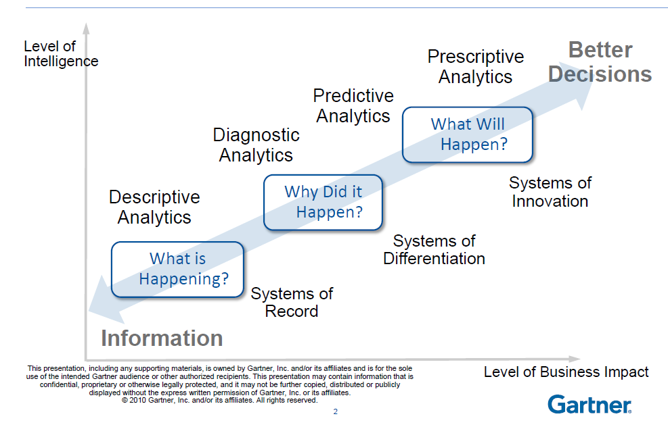
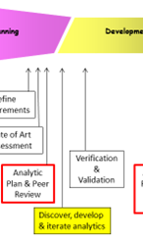
Reporting, Reactive, Proactive

Slide 15



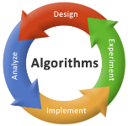
A General Process of Analytics
Analytic
Evolution
Reporting
Reactive
Proactive
Predictive
Prescriptive
General
Analytic
Process
Feature
generation
Feature
extraction
Classifier
design
System
evaluation
Iterative,
Trial and
Error for
Best Results
Description
Understand, filter, clean data, preprocess
Basic stats for data
Transform/normalize
Separate data
Understand features
Predictive math
Train, validate, score
Algorithm
Examples
Format of data (e.g., time series)
Noise of data (e.g. duplicative msmts)
Sources of error
De-identification, security measures
Structured or unstructured data
Data occurrence
Filter (e.g., Kalman)
Mean, Std Dev
Variance, Covariance
Kurtosis, Skewness
Distribution, GoFit
Range, Min, Max
Normalization
Receiver Operating Curve
Transformations (e.g., Box-Cox)
ANOVA, t-test
Clustering, One Way ANOVA with clustering
Linear or Quadratic Discriminate Analyses
Tukey-Kramer, Best Hsu’s, Dunnet’s
Partitioning
Hidden Markov
Tanimoto Test
K-Means, K-Nearest Neighbor
Winter’s Method
Time-Series Smoothing
Neural Nets
Levenberg-Marquardt
Variable K-Fold
Least Squares
Leave-One-Out
Deep Learning
Notes:
Be sure to build this.
The Reporting, Reactive, Proactive, Predictive, and Prescriptive correspond to the previous slide and GENERALLY follow the “general analytic process”.
Typically, we capture the data, analyze the data. and respond to the results of the analysis. This slide shows what a Data Scientist does when they are “analyzing the data”. While it is not inclusive of everything, it does provide a novice with a general process.
A “feature” is typically a parameter or variable that is important to the user and the model

Slide 16
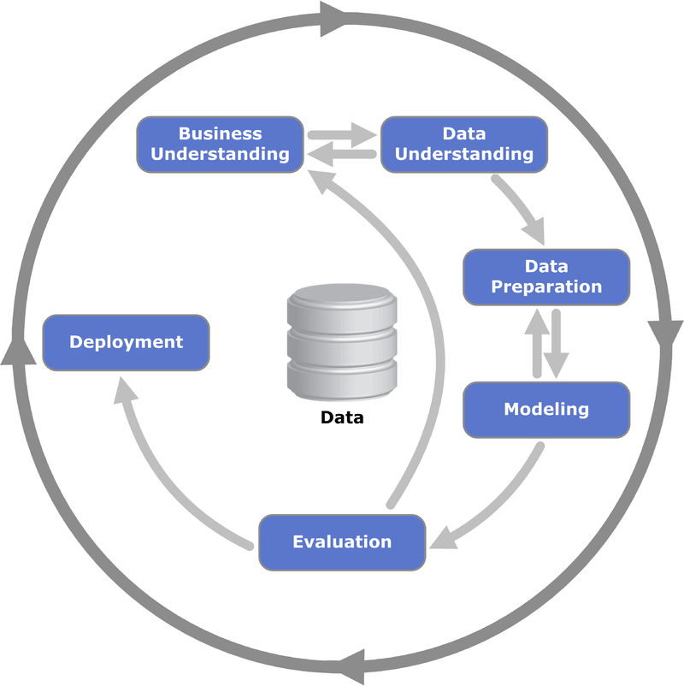
CRISP-DM Model
Source: Kenneth Jensen - Own work, CC BY-SA 3.0, https://commons.wikimedia.org/w/index.php?curid=24930610

Slide 17


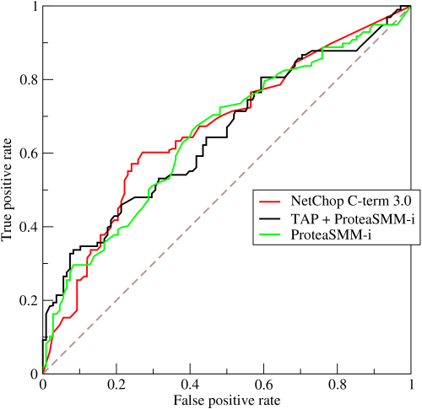
Validation: Have you done the RIGHT analytic?
  Trace back to customer use case and contract
    E.g.: Causal relationships, flow charts, visuals, graphs
Verification: Have you done the analytic RIGHT?
  Verify the mathematics and model fit
    E.g., ROC, MTBF, R², confidence limits
ROC: https://commons.wikimedia.org/wiki/File%3ARoccurves.png

Slide 18



Analytic V&V
Software Validation
System Validation
Waterfall
Analytic, Software, and System Validation
Concurrent
Analytic V&V
Analytic V&V
System Validation
Agile
SW Validation
SW Validation

Slide 19


Analytic Report & Peer Review
To document background, methods, results, conclusions
To mitigate unintended human resource issues
Include the how, why, where, when, what, and who > repeatability
  Preprocessing/cleaning
  Transformations, normalizations
  Summary statistics, models examined, verification & validation results
  Data set: dates, source, vaulting
  Disposition and mitigation of all risks especially sources of error
  Revisions: software, hardware, sensor source
  Implementation: constraints, assumptions, data flow

Slide 20

Post-Production Release Analytic Review
Review Analytic Report, current data status & management*, ask if it’s still the same
Why?
  Features and design space change
  Data decays
  Processes move
  Data flow changes
  Minimize liability
  Protect IP
  Mergers/Acquisitions
* e.g., policy, governance, compliance, quality, flow, regulations, APIs, interoperability, metadata

Slide 21

Analytic discipline protects you and your customer
Legal
Repeatability
Model Optimization
Monitoring post implementation
“Data Scientists”
Meeting customer needs

Slide 22
Thank You!!

Slide 23
App
INTERNET
App
“The Cloud”
Data
Acquisition,
Aggregation,
& Analysis
Private Cloud
Assess the Environment, Frame the Problem
Big Data
Embedded
Cloud
Example questions
Data
Acquisition,
Aggregation,
& Analysis
What is current infrastructure?
What is desired infrastructure?
What data is being collected now?
Where is the data being collected?
What are the storage, memory constraints?
How fast are results needed? Why?
What latency and bandwidth cost can be tolerated?
What is the maturity of the business?
What are current and desired states of security, manageability, connectivity?
Ask why, why, why!
App
n GATEWAYS
Increasing latency & bandwidth cost
Data
Acquisition,
Aggregation,
& Analysis
App
App
Sensor Hub
Sensor Hub
App
App
Device
Device
Edge or Client

