Slide 1
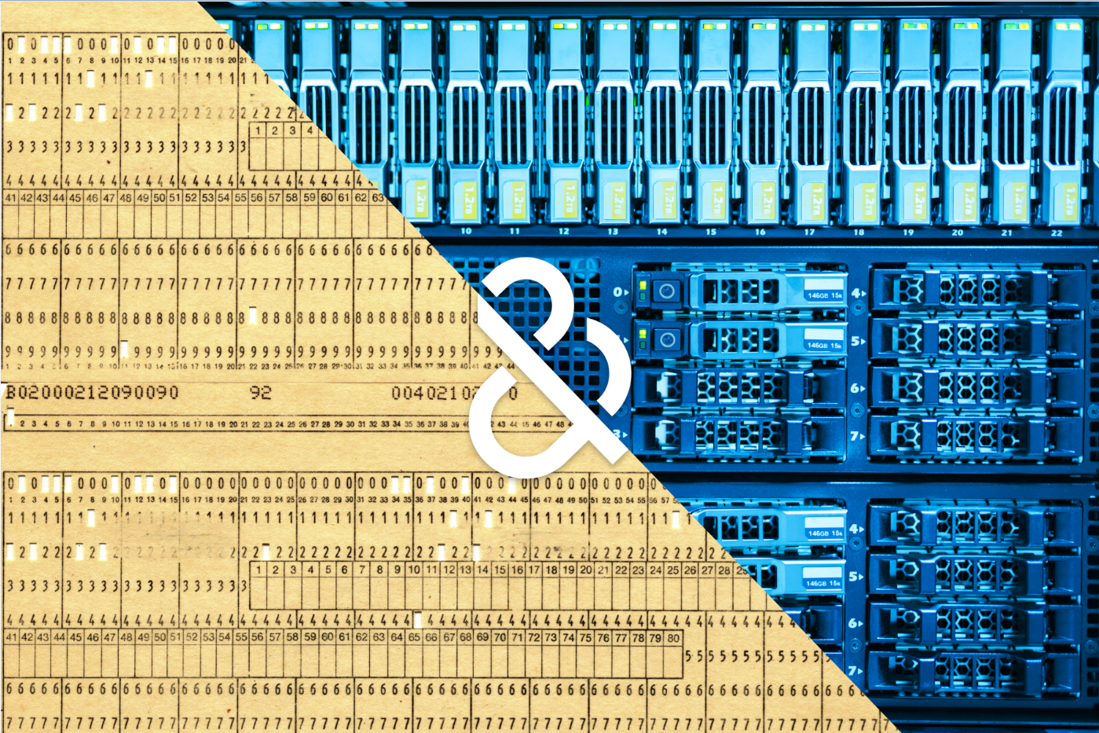

Things We Forget to Think About:
The not-so-obvious side of data science
Presentation for the 2016 Wolfram Data Summit
Anthony J. Scriffignano, SVP/Chief Data Scientist
September 2016

Slide 2

We need to seriously think about the implications of trivial inference from data…
Big questions…
How the data landscape is changing…
What we are doing in data science to respond?
The type of skills and thinking required to remain relevant in this evolving world.

Slide 3
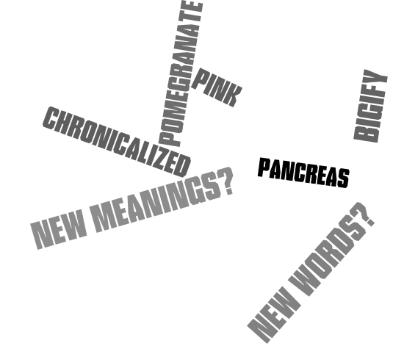
With data everywhere, maybe it’s time to think about what we are forgetting to consider
Big questions…
How the data landscape is changing…
What we are doing to respond?
The type of skills and thinking required to remain relevant in this evolving world.
Notes:
Just a placeholder for reference as Anthony built the deck

Slide 4

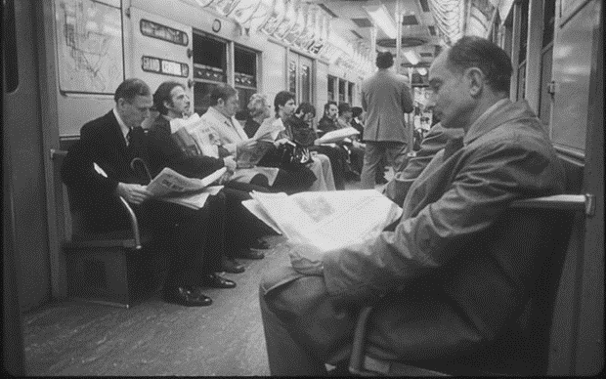
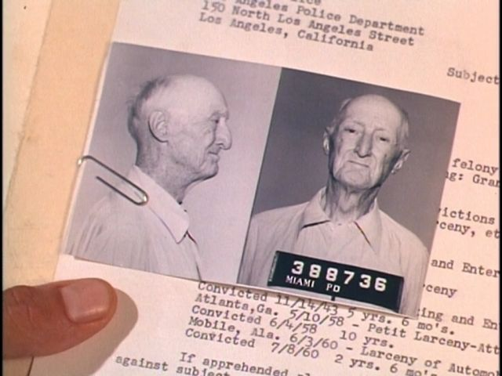
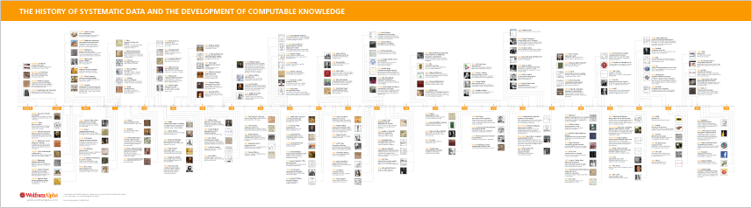
A lifetime journey in data…
1960’s
Reading about events that happened in the past, listening to people who are not present.
Information was created and shared on a limited basis
Reading about things in the “now” – can’t tell who is communicating with whom – does anybody really know what is going on?

Slide 5
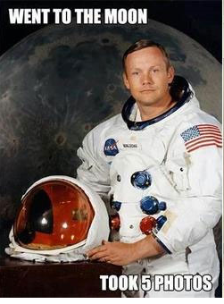
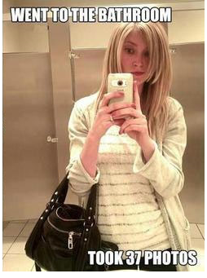
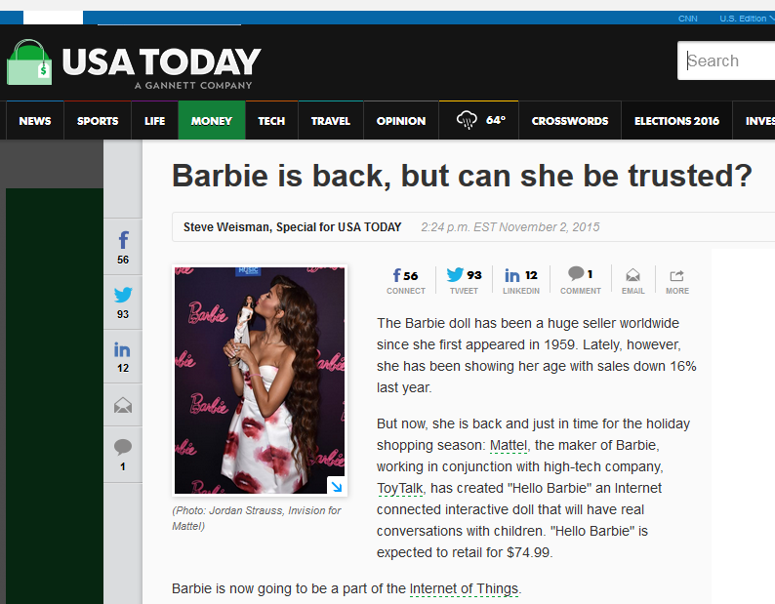

Uncovering truth and meaning – what does it mean?
“Mystery creates wonder, and wonder is the basis of man's desire to understand.
” – Neil Armstrong
“Great Party!
” – Anonymous
According to Google Plus. Precisely five photographs were ever taken of Neil Armstrong while Apollo 11 operated on the surface of the moon. Only four of those photos show Armstrong outside the Lunar Module and actually moonwalking. Only three of them show Armstrong in direct view, rather than a reflection. Aug 31, 2012

Slide 6
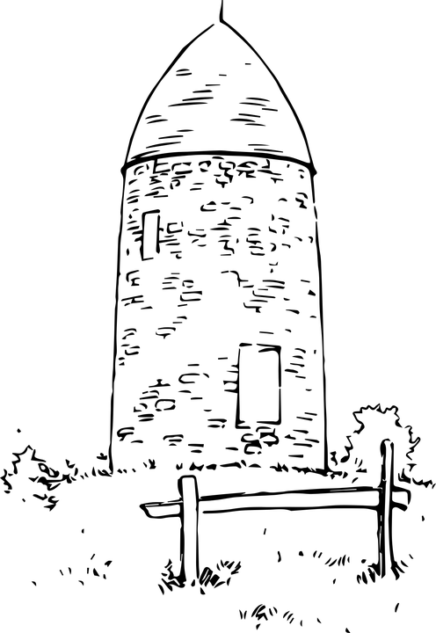
Part One
Silos of Information
Good thing we put the window on this side…

Slide 7
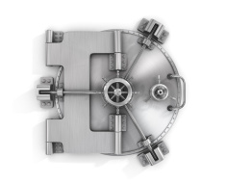

Dispositive Threshold
DATA IN HAND
DISCOVERABLE DATA
EXISTING BUT INACCESSIBLE DATA
Identify the Scenario
  Relative size
  Key question
Assess Threshold
Estimate
Triangulate
Decision Elasticity
Bias
Opportunity cost
Notes:
In right, imagine 3 rows – each data bucket, big bucket drives the decision

Slide 8
Dispositive Threshold in Practice
?
IN HAND
WORK TO DO?
RE-THINK THE QUESTION
Just “enough”
Estimate?
Lots of data in hand
No joss
Don’t even think about it!
Lots more out there
More
Even more
Even more
Notes:
Just a placeholder for reference as Anthony built the deck

Slide 9
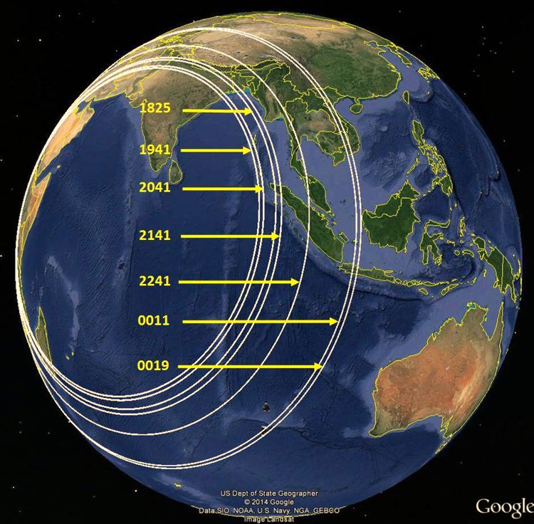
The burning platform…

Slide 10

Observer Effects
Changing the thing we want to measure by the very virtue of measuring it
  Consider the impact on the behavior if the observed population is aware of the measurement.
Notes:
Keep text, suggest new artwork if desired.
As executives in the IT world, you are constantly asked to invest in Technology platforms. Cloud platforms, software platforms, hardware platforms, but what I would like you all to consider today is that the most important platform for driving growth in your company isn’t hardware or software, it’s actually a process based platform that empowers you to harness the value out of your data.

Slide 11
“Making” the data…
OBSERVER EFFECTS
SAMPLING
BIAS
We change
when we measure
We influence
where we look
We influence
what we find
Notes:
Keep text, suggest new artwork if desired.
As executives in the IT world, you are constantly asked to invest in Technology platforms. Cloud platforms, software platforms, hardware platforms, but what I would like you all to consider today is that the most important platform for driving growth in your company isn’t hardware or software, it’s actually a process based platform that empowers you to harness the value out of your data.

Slide 12
Part Two
Permissible Use
I wonder if they have wi-fi.

Slide 13


Data is often manipulated, either for intended good or for malfeasance
TRADITIONAL VIEW
Money laundering
Bust- out
Shell Company
Corporate Theft Identify
MORE NUANCED VIEW
Trade Rings
Cybersecurity - inside
out/outside in
Data sovereignty
Permissible use
Discovering prior behavior
vs. emerging behavior in
extremely large sets of data
@Sciffignano1
THE SECRET EMOTIONAL LIFE OF DATA
13
Notes:
Image not licensed. Need image of people texting. Keep wording for “traditional view” and “more nuanced view” as is. Can change the look.
Note for
Pay attention to situations where there is intentional manipulation of data.
Reading about things in the “now” – can’t tell who is communicating with whom – does anybody really know what is going on?
Anthony:

Slide 14

The legislative landscape is constantly evolving
Data Privacy
Data sovereignty
Cybersecurity
Transferring data across borders
Protection
Predictive analytics
Expressed Consent
Compliance with industry standards and best practices
Data localization
@Sciffignano1
THE SECRET EMOTIONAL LIFE OF DATA
14
Notes:
Title – There are Rules dictate what you can and can’t do- and it varies globally
Replace with image that motivates Cybersecurity, Privacy, Data Sovereignty- keep words in BOLD on the page.

Slide 15


The Dark Room – The illusion of the “Best Place”
Related Issues
Public information
Open Data
Proprietary value proposition
Data at rest vs. Data in motion
Discoverable “unstructured content”
All of the experts
All of the knowledge
Captured learnings
Best practices

Slide 16
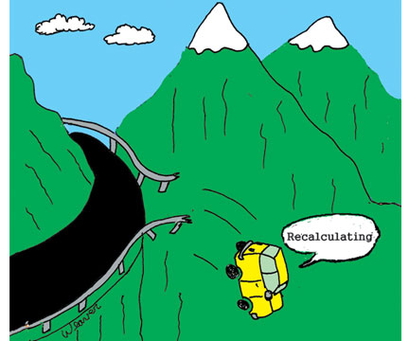
Part Three
Problem Formulation

Slide 17
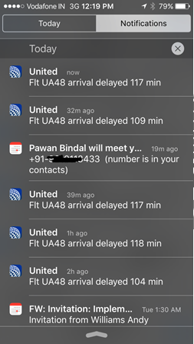
Relentlessly Curious
We embrace the change in the world around us. We know it brings new problems to solve,
new things to learn, and new ways to grow

Slide 18
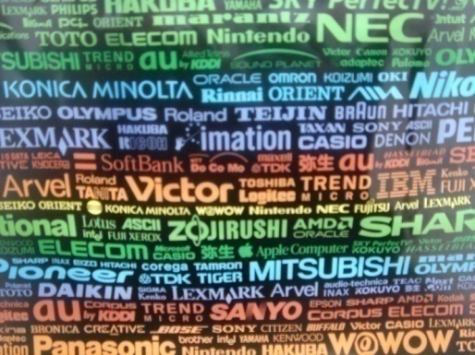
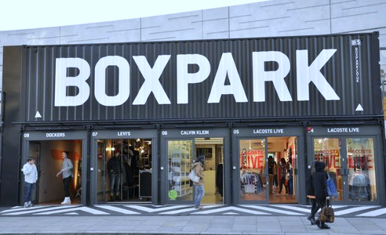
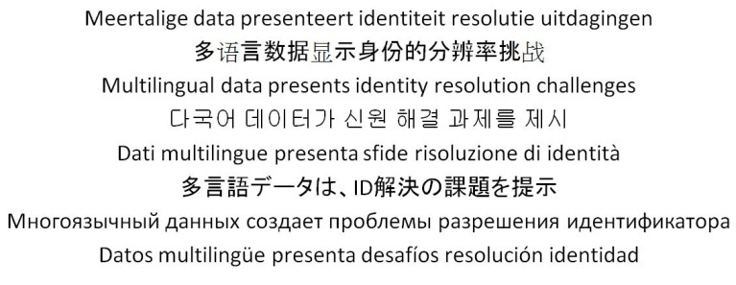
Using the scientific method to look critically
H(n) Hypotheses…
Observations:
Globalization
Prolonged Economic Uncertainty
New types of Malfeasance
“Big Data”
Regulatory Changes
A business’ geographic location, structure,
and physical customer interaction are
becoming irrelevant
More than 80% of all information is unstructured data. Much is ignored or discarded.
Unprecedented
Business Relationships
Disruptive Evolution (Mobile, Social, Cloud, Analytic)
More knowledge is created in different languages and writing systems
P(n) New Skills
Data Science
New technology skills
Semantic Disambiguation
Sentiment
Linguistic Integration
Permissible Use
Identity Resolution
Fraud Detection

Slide 19
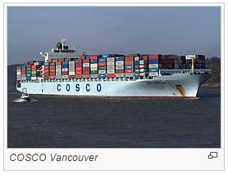

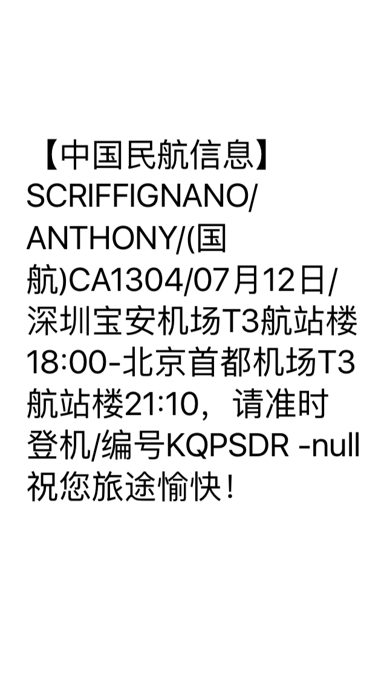
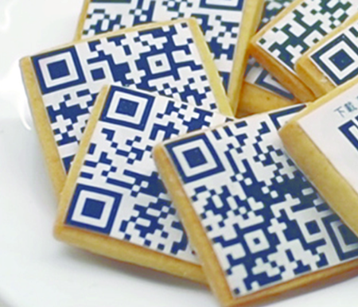
Getting to truth and meaning is not for the weak
COSCO: China Ocean Shipping (Group) Company
SOUND
MEANING
GEOPOSITION
CONTEXT
LINGUISTIC INFERENCE
ALTERNATIVE DIGITAL IDENTITIES

Slide 20
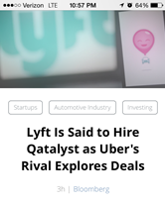
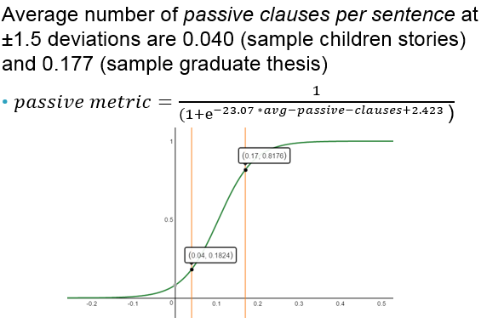
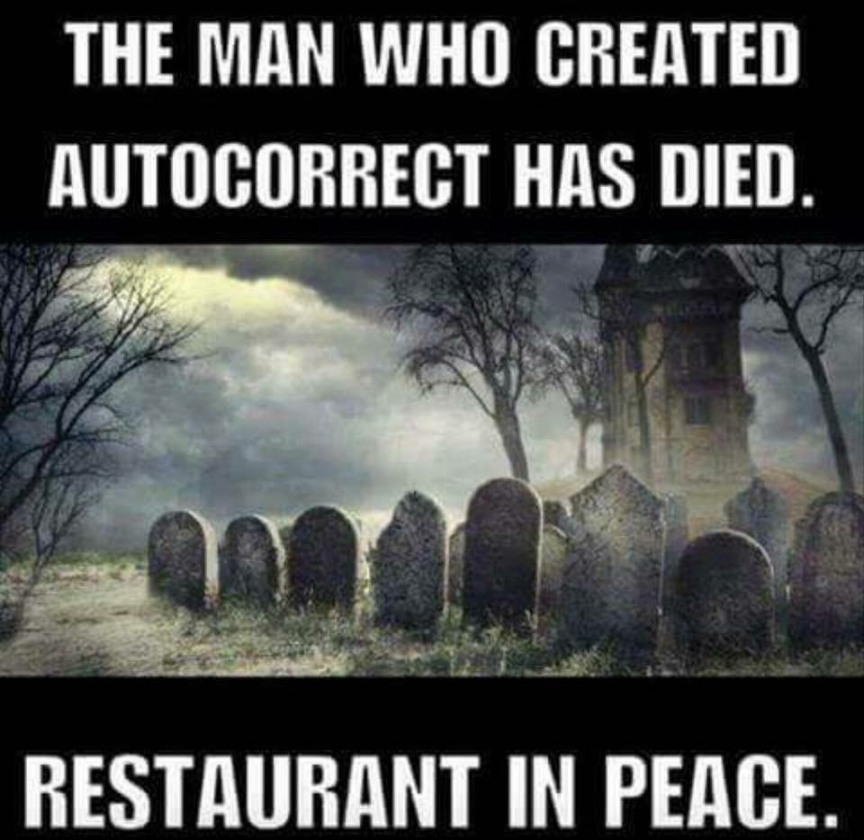
To avoid getting distracted by “all things social”, the science involves continuous evolution and focus on specific use cases that drive value
Entity Extraction
Sentiment Attribution
Context / Behavior
USE CASES
CONFOUNDING CHARACTERISTICS
DERIVING EMPIRICAL MEASURES THAT INFORM USE CASES
Sarcasm
  ABC corporation is a wonderful company, if you don’t do business with them.
Neologism
  Be sure to like us on FaceBook and use #shallow when you Tweet.
Grammar variations
  FBI is Hunting Terrorists With Explosives.
Punctuation
  “Hi mom!” vs. “Hi, mom?”
Spelling
  RU There?
D&B proprietary information, do not distribute or copy without permission

Slide 21
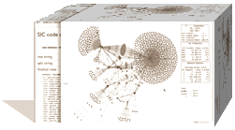
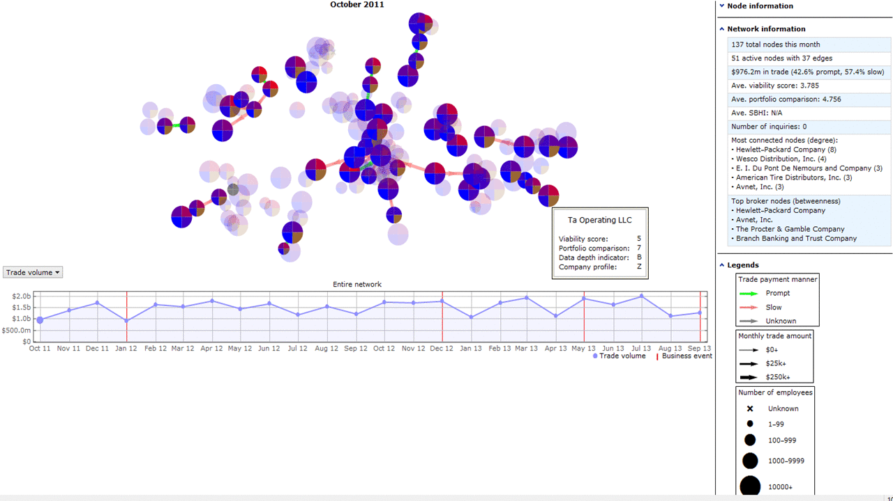

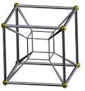
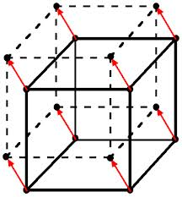
Visualizing extremely complex, changing relationships addresses questions never before feasible
Asking new questions never before feasible
Dyadic relationships across multiple perspectives
Some examples
Understanding Signals derived from changes to business information
Discovering and investigating clusters of unusual behavior
Exploring the impact of new regulation
Applying standard measures to a highly dynamic environment
Exploring the impact of new market forces
Studying the real or potential impact of supply chain interruptions
Investigating emerging capabilities (e.g. reputational risk)
Observing key measures over time
Blending with similarly constructed graphs
Events
News
“What If” scenarios
Internal Data
Social signals
Time
Market Data
Abstracting dimensions
D&B proprietary information, do not distribute or copy without permission
Notes:
CIOs today play a strategic role in driving the company’s growth. By integrating all your company’s most vital relationships (customers, prospects suppliers, and partners) into one singular version of the truth – you can gain critical transparency within those relationships so you can better understand risk or opportunity.
Once you have this single view, you can leverage advanced analytics to deliver the foresight you need to take proactive actions. Ultimately, this provides you the competitive advantage to enable profitability and growth.
Based on a Forrester study of Dun & Bradstreet customers and aggregate results experienced by customers using Dun & Bradstreet, their results include:
Reduce duplication by 10-20%
Improve integration productivity in year one by 15% and up to 30% in years two and three
Significant cost savings from eliminating redundancy

Slide 22

Putting things in perspective, reflecting on the journey.
Reflecting on the Journey -- Things to Consider
What do we have to believe?
  Start with a problem or question, not a tool or dataset
  Understand the going-in assumptions
  Have a clear definition of “done” to avoid analysis paralysis
Not all data is useful?
  Consider data in hand vs. data available and not available
  Select methods carefully, use new methods and visualizations for a reason, not for an expedient
  Always make an effort to understand the bias in your analysis and the sensitivity of your answer to the question at hand
A new science?
  Continuously evaluate new skills and capabilities
  Challenge assumptions, understand the “inconvenient truths” of big data and the risks of ignoring the changing nature of data
  Continuously evaluate new ways of knowing, breaking down problems into smaller pieces, reducing complexity
@Sciffignano1
THE SECRET EMOTIONAL LIFE OF DATA
22
Notes:
Leave content as is, ad visual improvement.

Slide 23
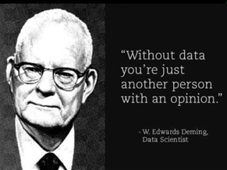
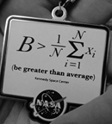
Totally New Questions and Challenges
@Sciffignano1
THE SECRET EMOTIONAL LIFE OF DATA
23
Notes:
Computable data allows answering questions we couldn’t have thought asking

Slide 24


Anthony Scriffignano, Ph.D., Chief Data Scientist
scriffignanoa@dnb.com
@SCRIFFIGNANO1

Slide 25
Abstract
Abstract: Data Science has advanced to the point where there is ample access to tools, environments, and resources to handle large amounts of highly dynamic data. Organizations are beginning to realize that the greater challenges come from looking beyond the data to the bigger problems, like how to deal with silos of information, data privacy and sovereignty, and problem formulation in the face of overwhelming data (e.g. where to start). This session, thought provoking and at times irreverent, will focus on phenomena that are all around us in the data-driven world that we may sometimes fail to notice. Understanding the implications of using the data we have vs. the “rest of the data” (dispositive threshold), focusing ever-increasing resources on problems which can only be solved with new types of thinking (Red Queen Problems), and other scenarios will be discussed with real-life examples. The challenge to all of us is to make new mistakes every day!

