Slide 1
Big Data and Crowdsourcing for Better Public Health
Clark Freifeld, PhD
@clarkfreifeld
Research Software Developer
Computational Epidemiology Group, Harvard Medical School

Slide 2
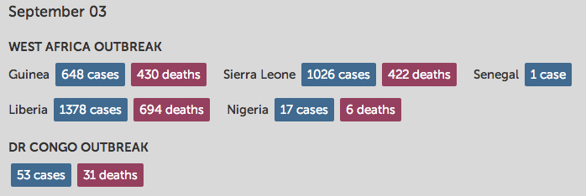
Ebola

Slide 3
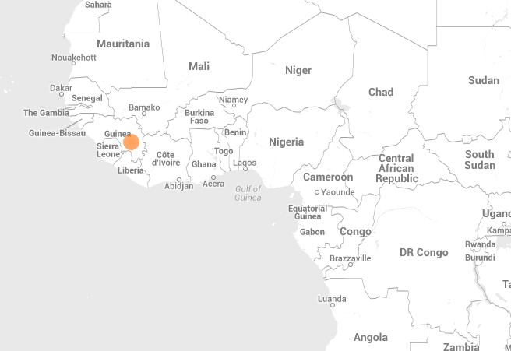
March 14: 8 deaths
Notes:
March 14: 8 deaths

Slide 4
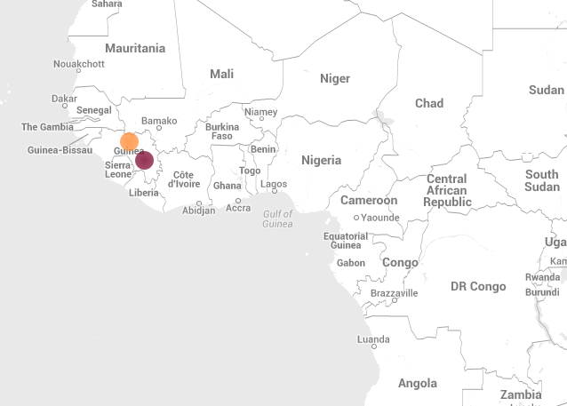
March 19: 23 deaths
Notes:
March 19: 23 dead, 35 susp
Samples sent to France and Senegal

Slide 5
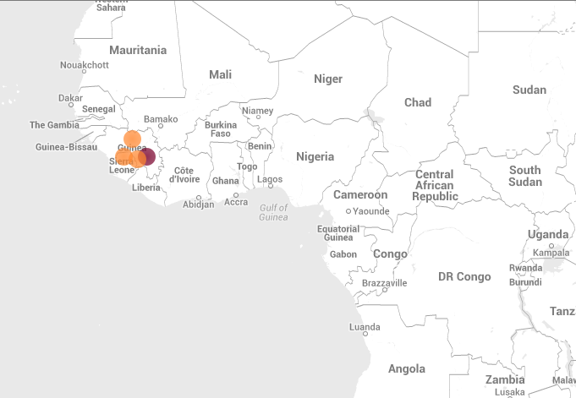
March 21: 29 deaths
Notes:
March 21: 29 deaths, 49 susp
Outbreak started February 9th

Slide 6
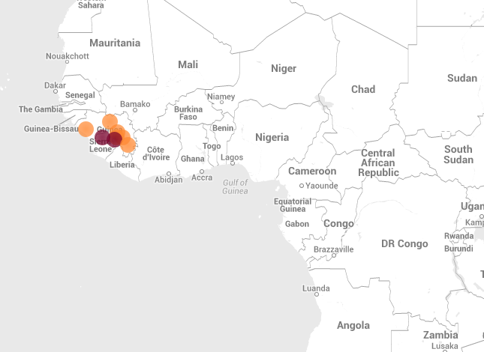
March 22: 59 deaths
Sierra Leone: 1st case
Notes:
March 22: 59 deaths, 1st sierra leone

Slide 7
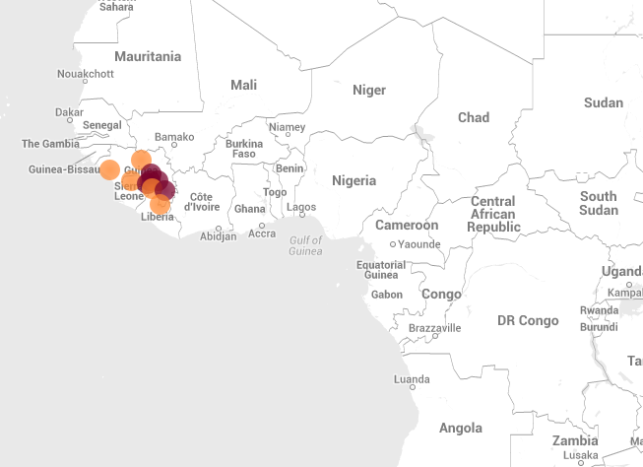

March 23: WHO confirms 29 deaths, 2 in Conakry
Notes:
March 23: cases in Guinea capital of Conakry; first WHO announcement

Slide 8
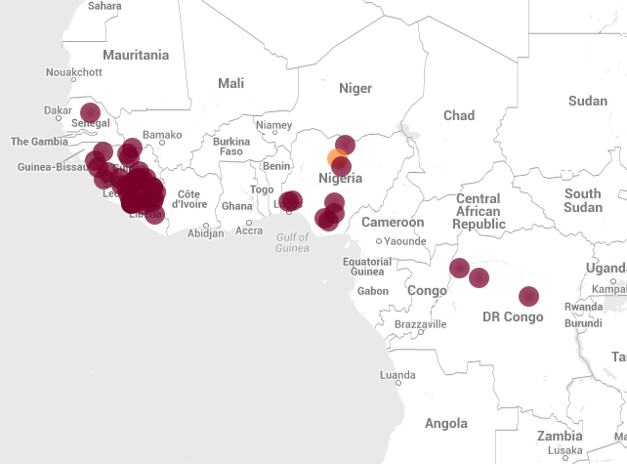
healthmap.org/ebola

Slide 9

















Digital disease detection picks up early signals
Traditional public health monitoring

Slide 10
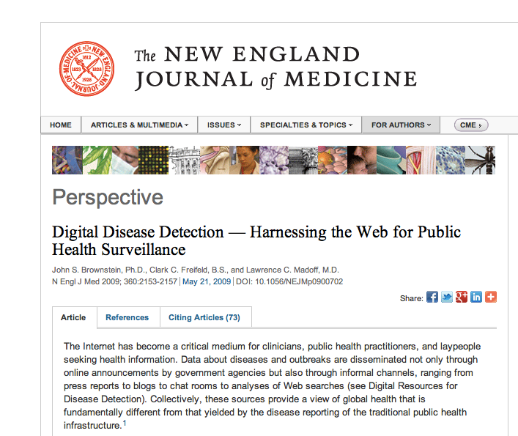

Slide 11
Traditional
Disease Reporting
1
Public
2
Healthcare Workers, Electronic Health Records
3
Laboratories
4
Ministries of Health
5
World Bodies (WHO)

Slide 12
1
Public
2
Healthcare Workers, Electronic Health Records
3
Laboratories
4
Ministries of Health
5
World Bodies (WHO, EMA)

Slide 13
Digital
Disease
Detection
Public
Healthcare Workers
Electronic Health
Records
Laboratories
Ministries of Health
World Bodies
(WHO, EMA)

Slide 14
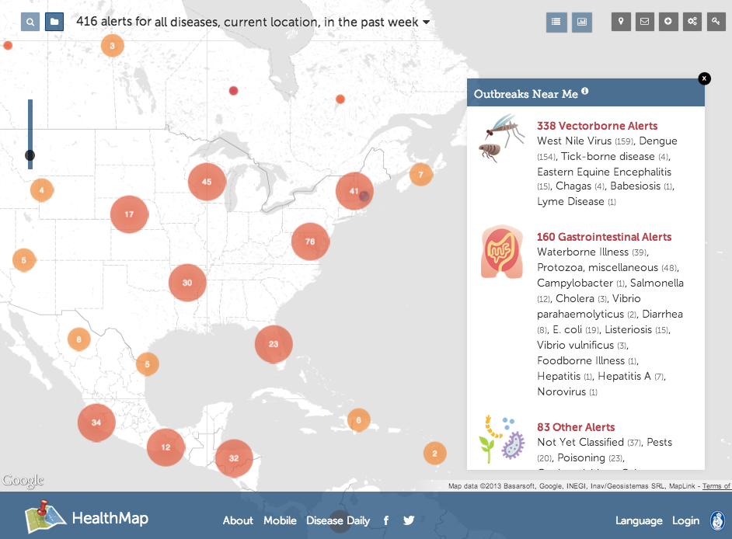

Slide 15

}
}
Every hour
24/7
93
15
2,000
Public & private
sources
Languages
alerts per day, precisely placed in
10,000+
100,000
locations
Web Sites

Slide 16




Articles are scanned for key information
using natural language processing
Typhoid cases in Mufulira have
reached 2, 227 with health authorities
calling for increased efforts to prevent
new infections in Mupambe Township.
Typhoid
Mufulira
2, 227
#
Mupambe Township

Slide 17


220
10,500
species
locations
4800
Case and
Death Counts
#
disease patterns

Slide 18

91%
accuracy
Articles are categorized using more than
19 million phrases
Breaking News
Warning
Old News
Context
Not disease related

Slide 19

Text matching, similarity score, and rating value determine the significance of the alert
91%
accuracy
Articles are categorized using more than
19 million phrases
Breaking News
Warning
Old News
Context
Not disease related

Slide 20
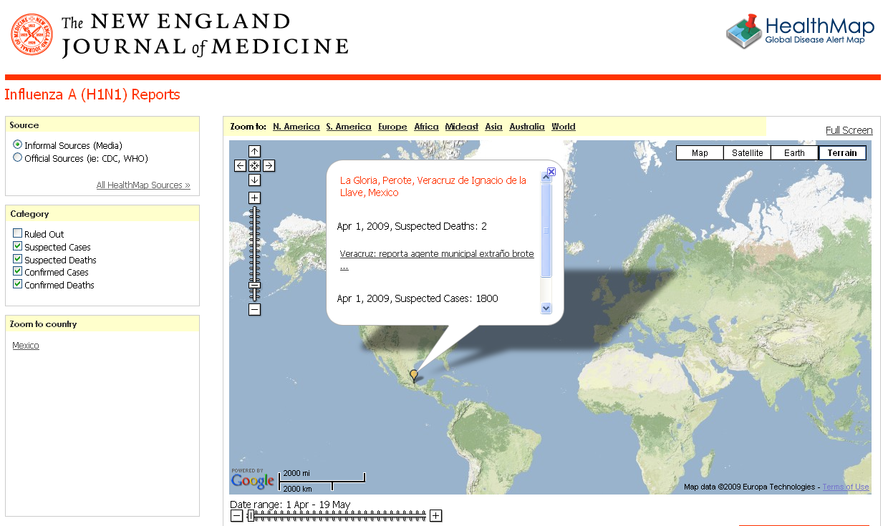
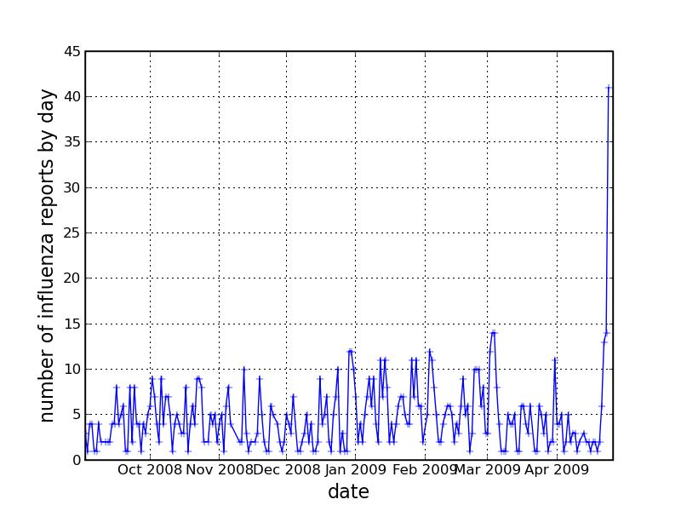
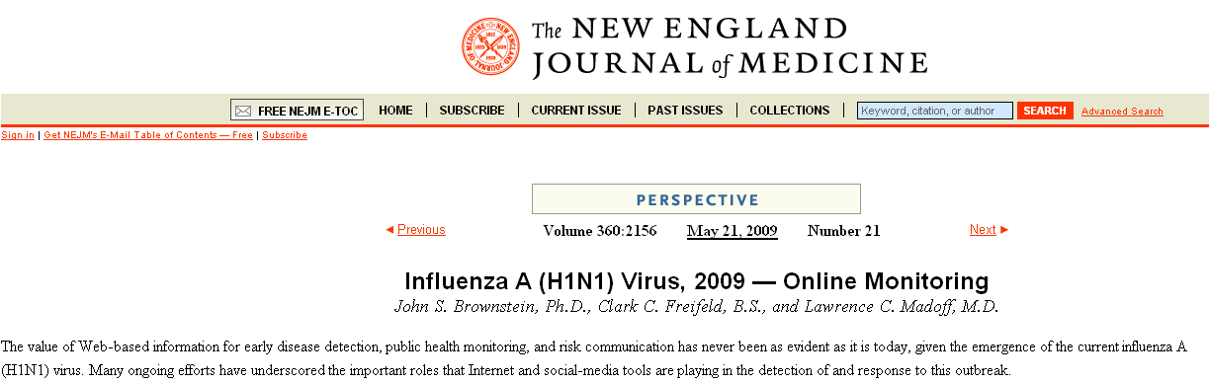
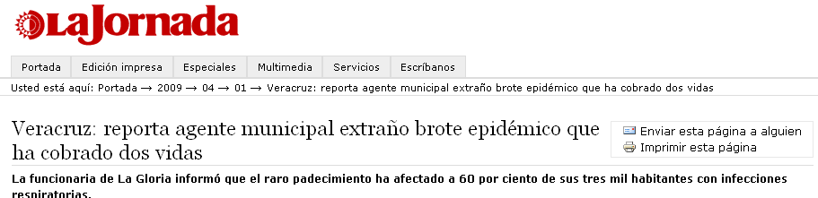

Slide 21
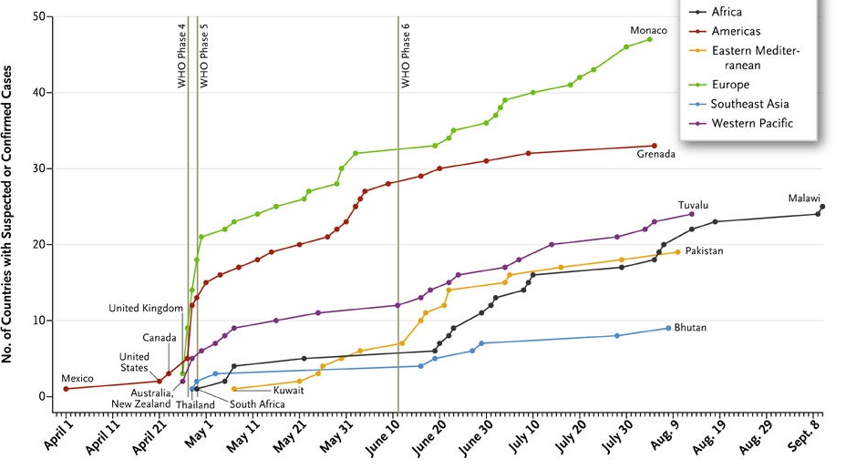
Global spread of H1N1 with informal sources
Brownstein et al. 2010. New England Journal of Medicine.

Slide 22


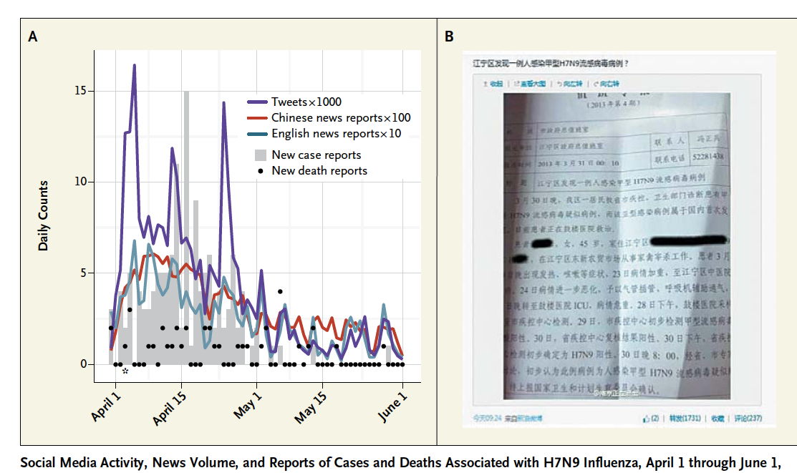

Slide 23
MERS Risk Mapping

Slide 24
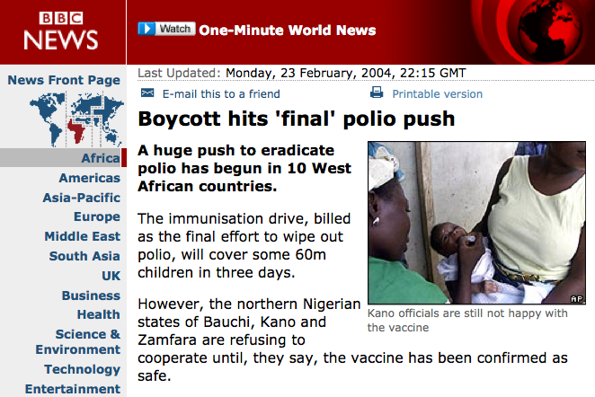
In northern Nigeria, religious and political leaders, led by the chairman of the Supreme Council for Sharia in Nigeria, Datti Ahmed, boycotted the polio vaccine in 2003, claiming that the oral polio vaccine was contaminated with HIV and could also cause sterilisation in those vaccinated, fuelling widespread public distrust.

Slide 25
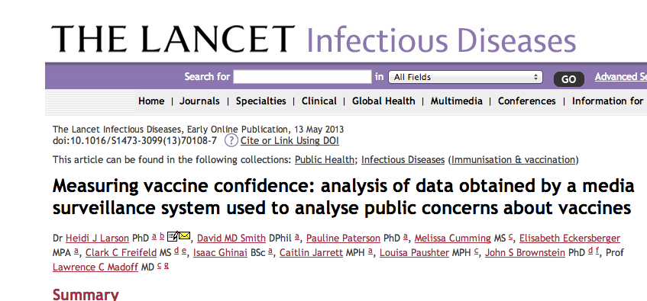
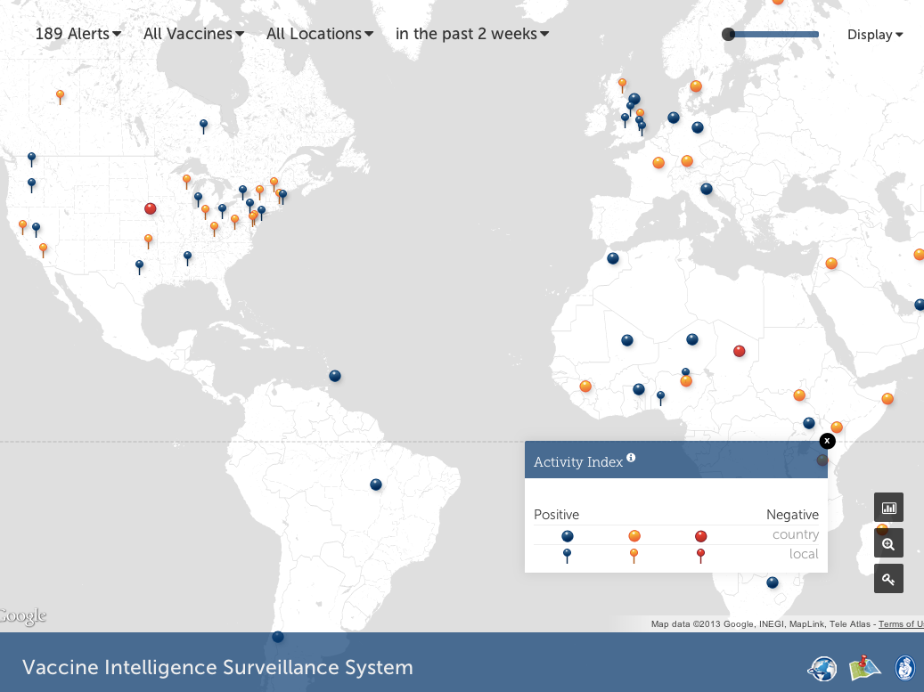

Slide 26
Online Vaccine Rumours By Country
(01 Nov 2010 – 31 Oct 2011)

Slide 27



Slide 28

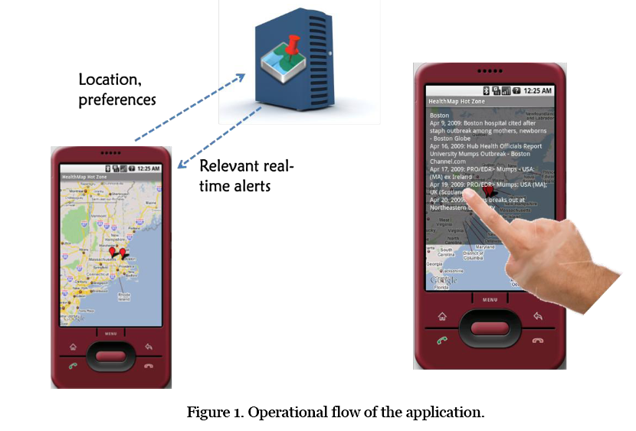
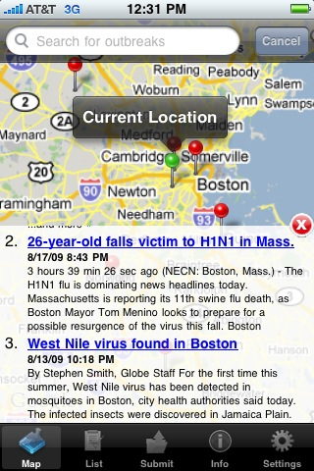
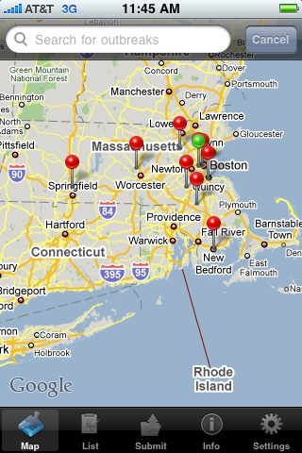
HealthMap
Outbreaks Near Me

Slide 29
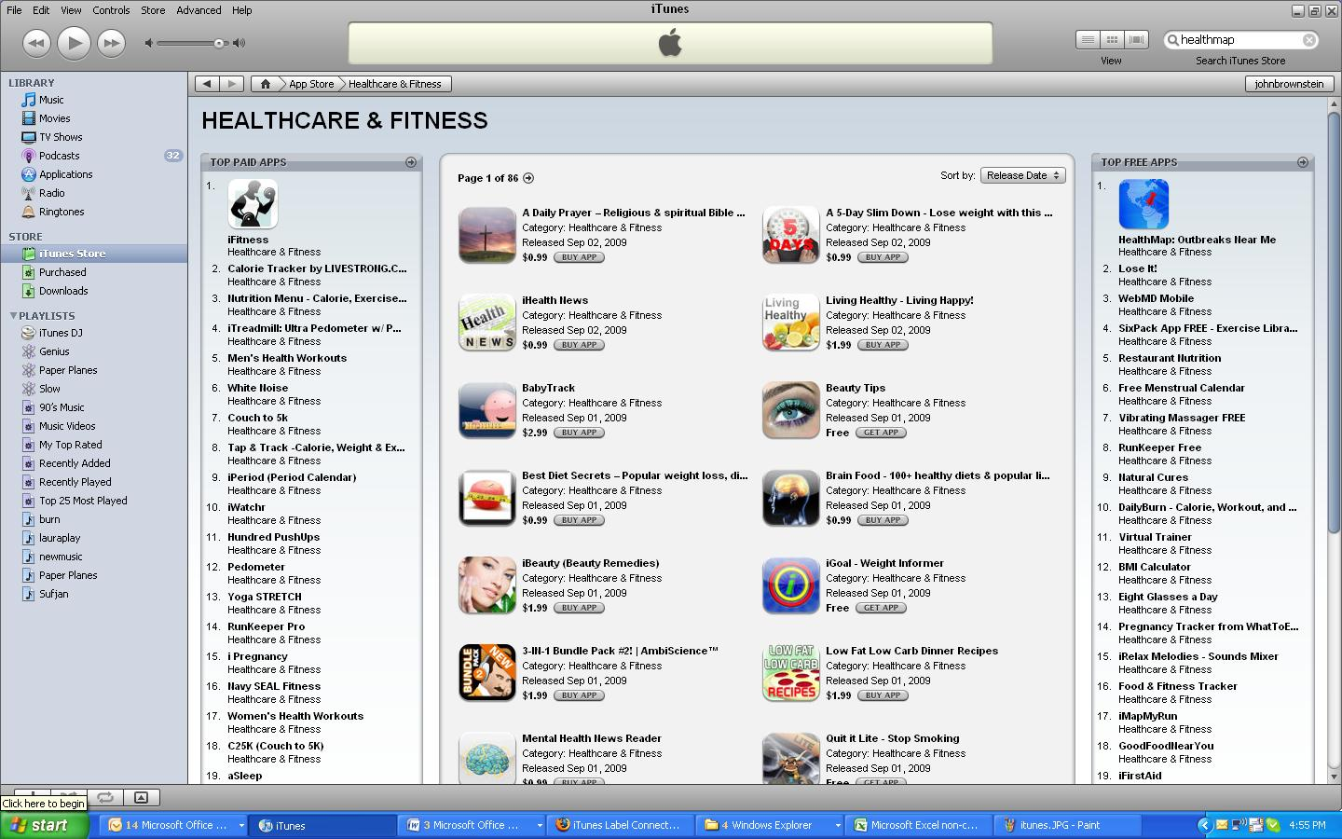
> 500k downloads

Slide 30
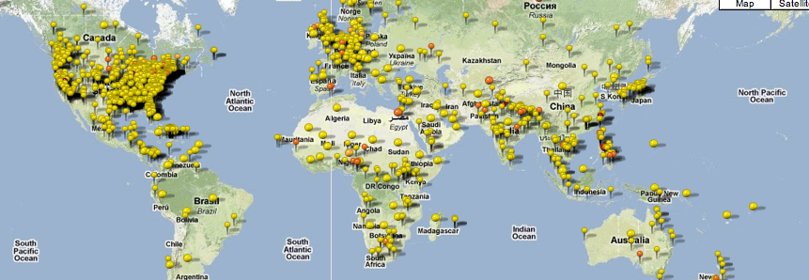
worldwide user submitted reports

Slide 31
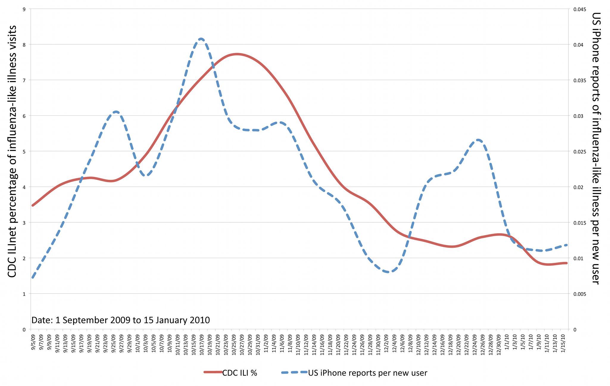
2009 flu surveillance crowdsourcing
Freifeld et al, PLOS Medicine 2010

Slide 32
Putting the Public Back in Public Health
Notes:
Thank you to the hosts and organizers of this challenge, to the judges, the other finalists, and the audience for joining us today.
I am representing team Flu Near You and I am going to explain how our tool can be used to put the public back into public health.

Slide 33
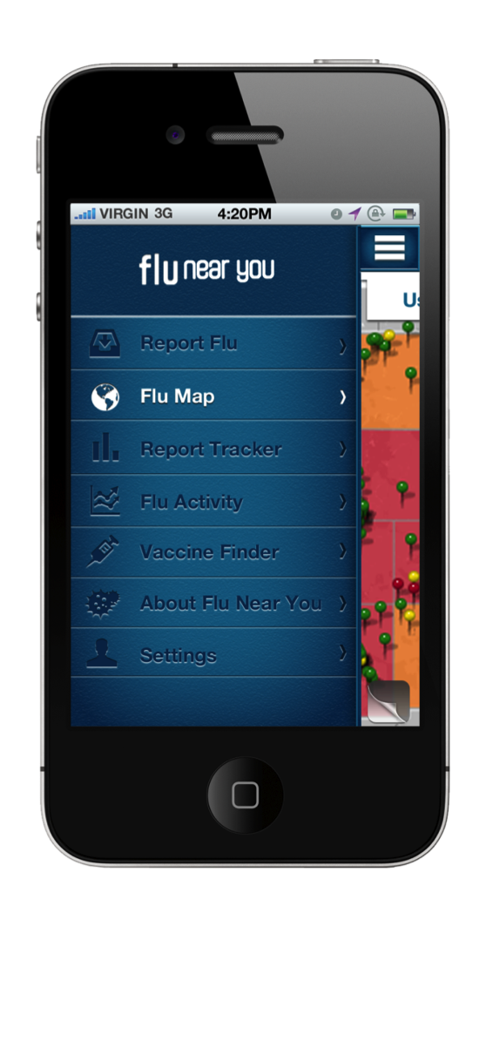
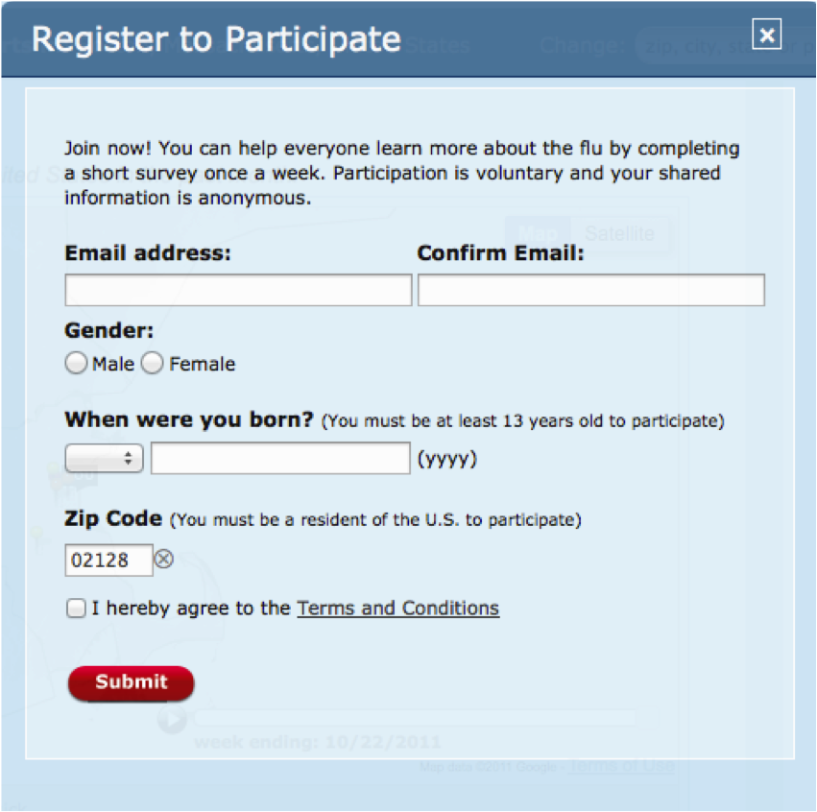
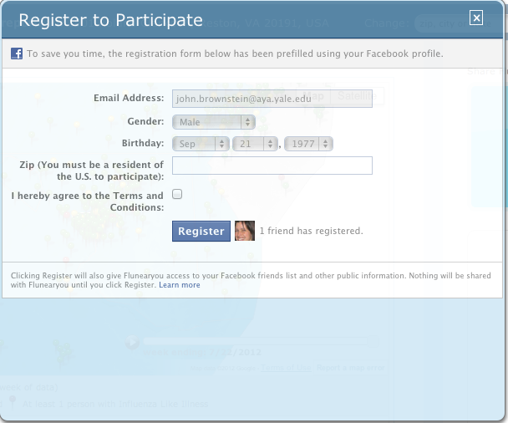
How it works
Register online by computer or phone
Notes:
The process is very simple. You register online via the website, via facebook, or phone application

Slide 34
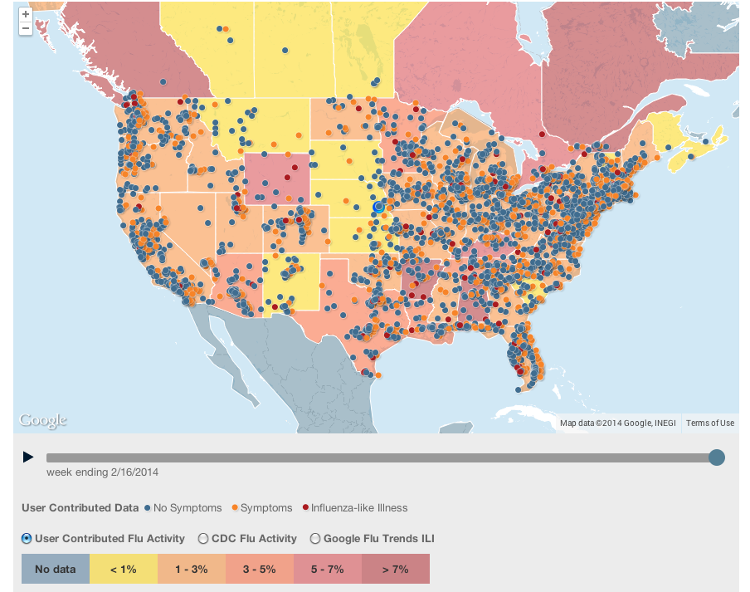
Notes:
Pins, pin color, overlay (options), overlay color

Slide 35
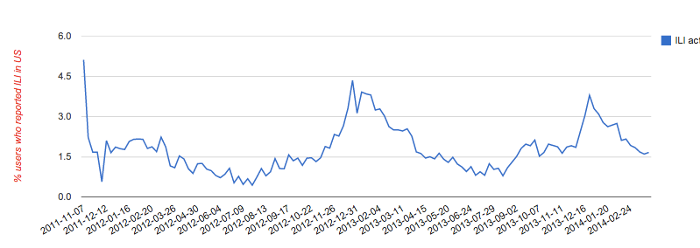
Temporal VISUALIZATION OF ILI
ILI - fever + cough or sore throat
2013-2014 FNY Peak: Week 51 – 3.8%
2013-2014 CDC Peak: Week 52 – 4.4%

Slide 36
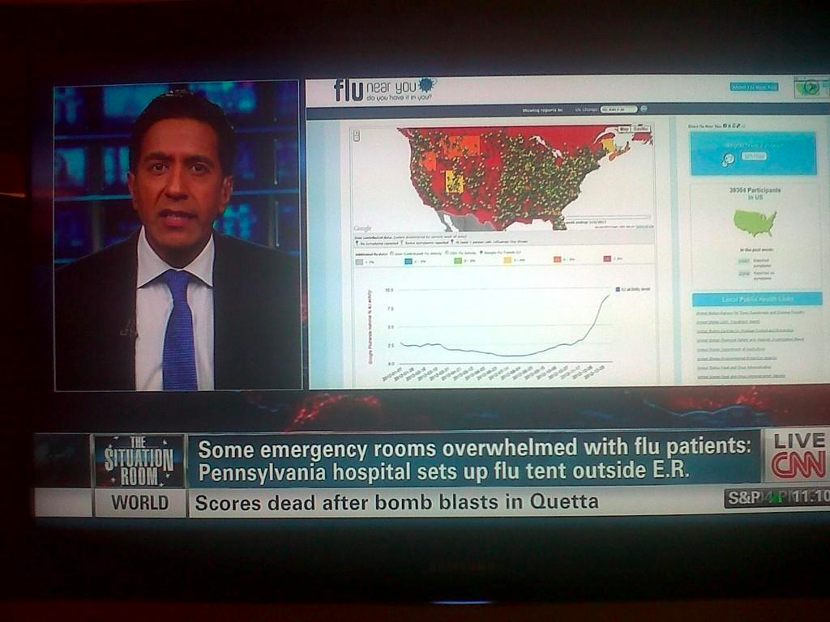

Slide 37

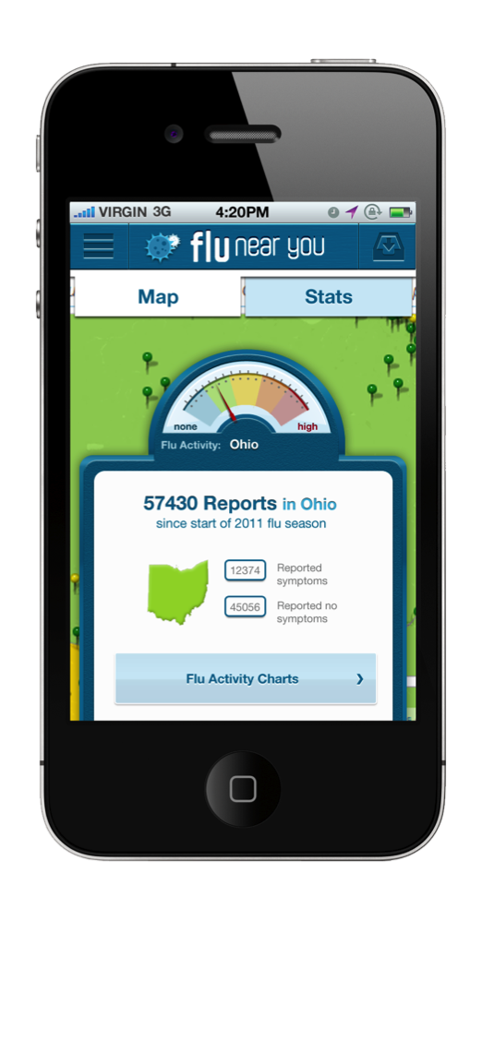
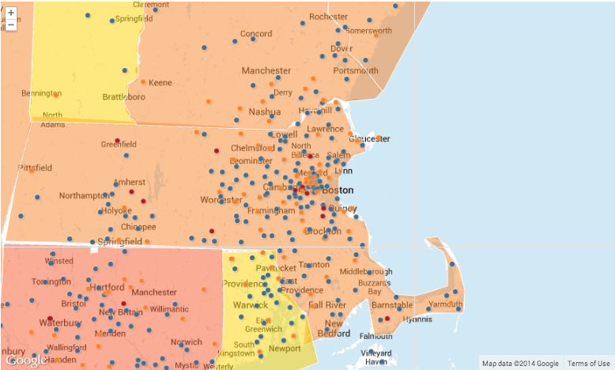
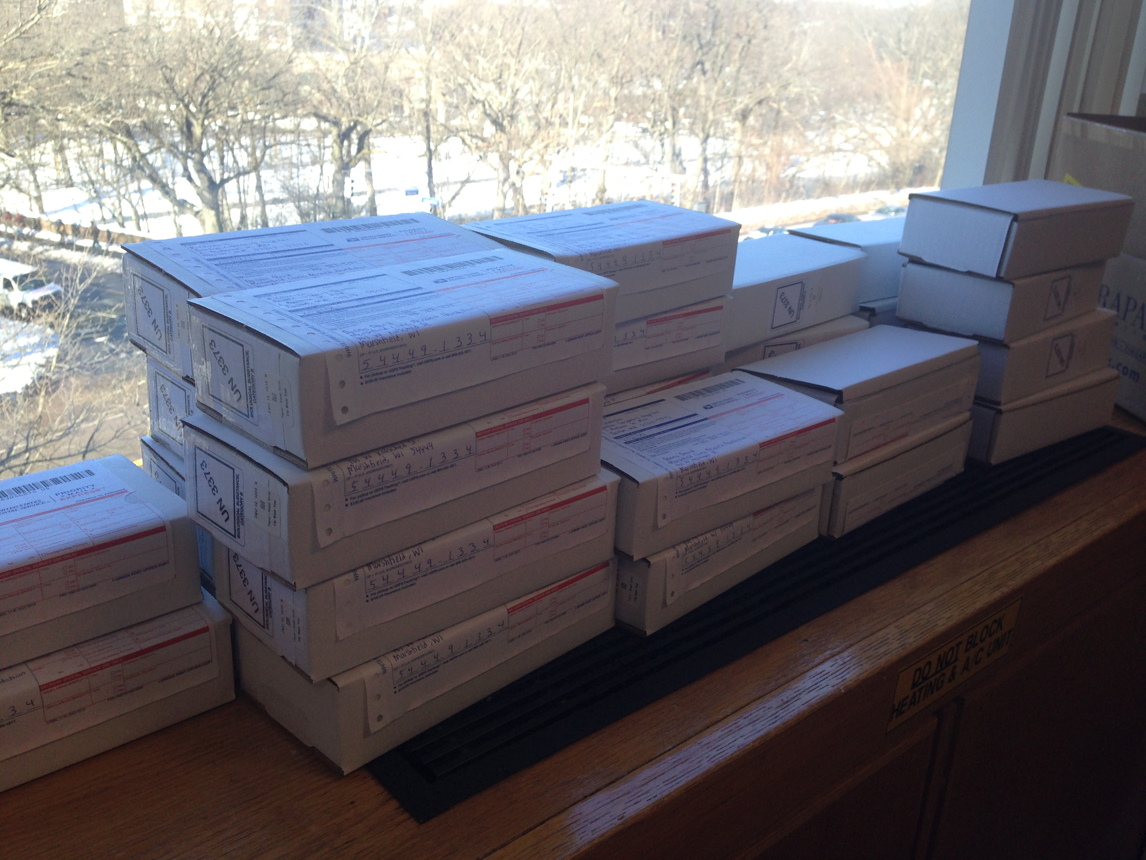
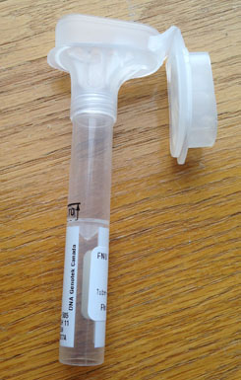
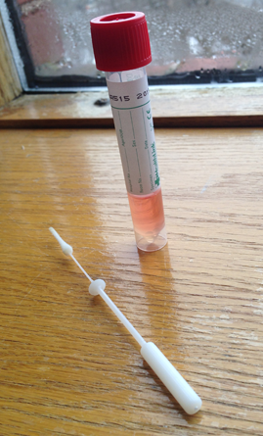
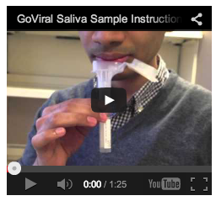
GoViral Data Collection Protocol
Weekly
FNY
Survey
Collect &
Send
Samples
Sample Processing
Feedback and analysis
Mail kit
Recruitment
Social Media
Geo-located Google/Facebook Ads
Interested communities
Schools
Craigslist
Multiplex PCR:
Flu A (H1N1, H3N2, pH1N1)
Flu B RSV A
RSV B
Parainfluenza 1, 2, 3 and 4
Human Metapneumovirus
Human Rhinovirus
Adenoviruses B, C and E
Coronaviruses 229E, Nl63, HKU1 and OC43
Notes:
Add picture of kit/flow chart?

Slide 38
Early Results
Initial Pathogen Distribution (n=30)
Days Between Illness Onset
and Sample Generation
Coronavirus
NL63
RSV
Influenza A
(H1N1)
Coronavirus
229E
HKU1
+229E
Coronavirus
HKU1
Notes:
Goviral participants initial results – replace with days to sample collection, pathogens detected

Slide 39
Beyond Infectious Disease

Slide 40
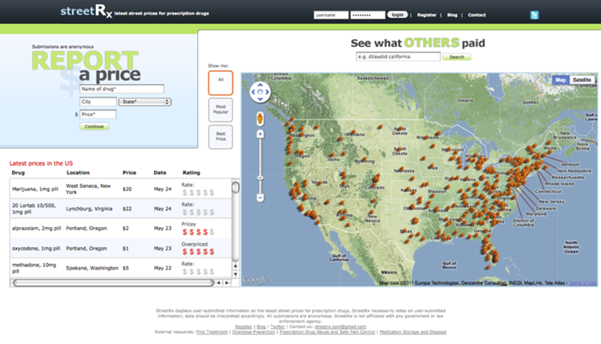

Slide 41
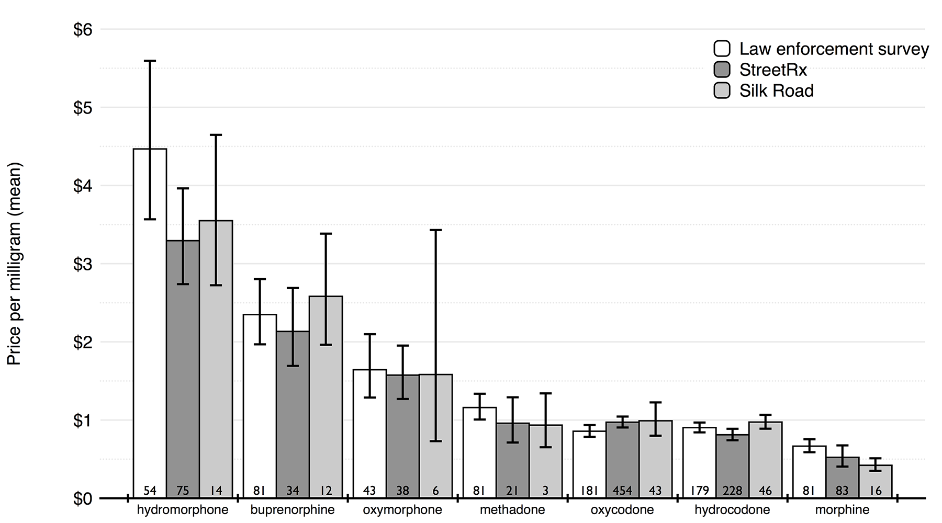
Cross-Validation of Black Market Prices

Slide 42
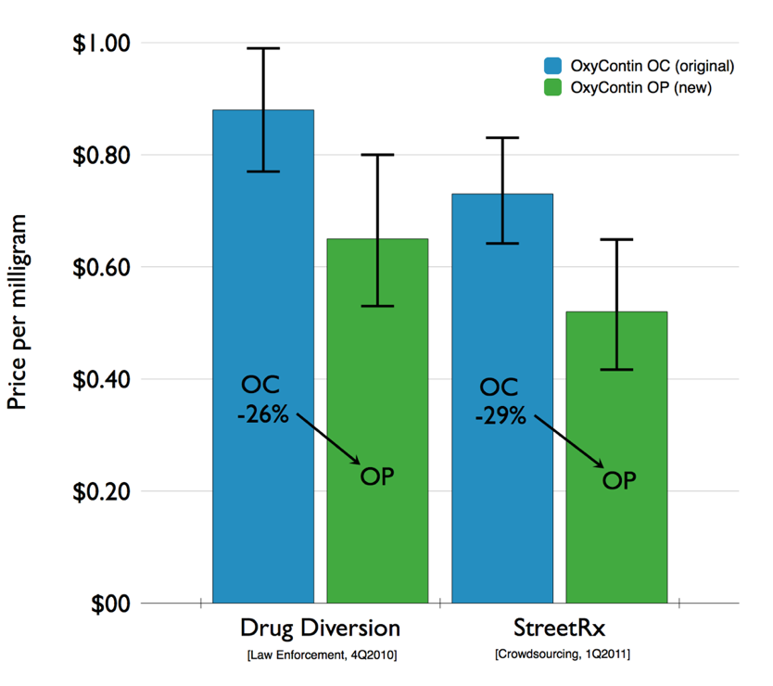
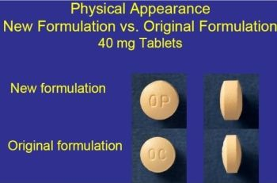

Slide 43
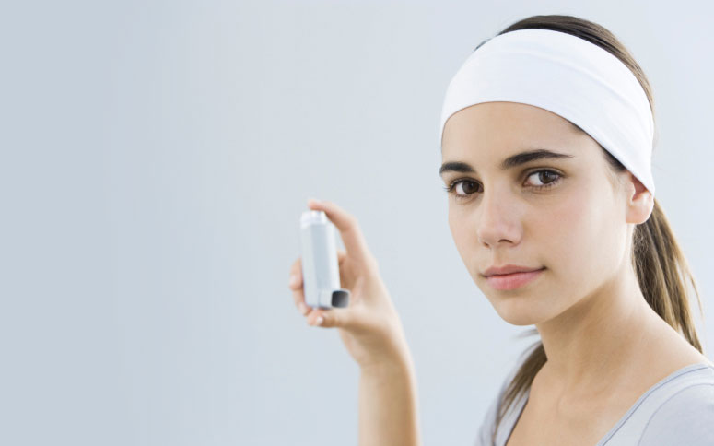
Product Safety Monitoring

Slide 44
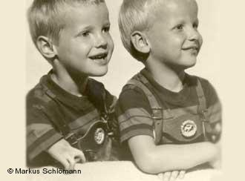
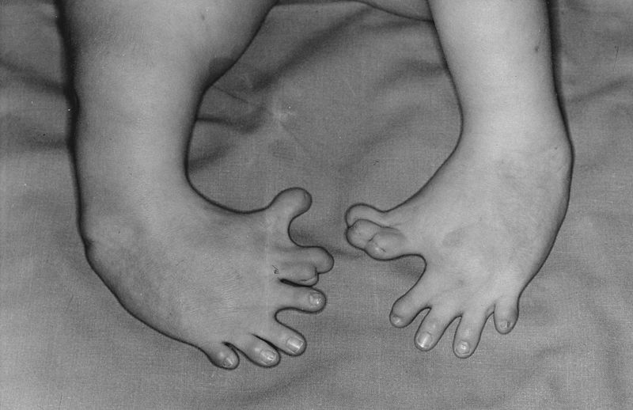
Thalidomide
Otis Historical Archives National Museum of Health and Medicine

Slide 45
Thalidomide Timeline
1957 – marketed in West Germany by Grünenthal.
1959 – first reports suggesting polyneuropathy.
1960 – US refuses to approve.
1961 – Australian Dr William McBride voices suspicion. Initial withdrawal from market.
1962 – full worldwide withdrawal.
2010 - €500M total paid to victims to date.
2012 – most recent civil case, Grünenthal issues apology.

Slide 46
Background
47% of Americans take a prescription drug (US CDC)
51% of approved drugs have serious side effects not detected before approval (Strom, Pharmacoepidemiology)
25% have adverse events, 3% serious (Gandhi, NEJM 2003)
Massive underreporting
Notes:
(Storm, Pharmacoepidemiology, p. 8)
http://www.cdc.gov/nchs/data/hus/hus04trend.pdf - 1999-2000, table 86 44%
http://www.cdc.gov/nchs/data/hus/hus11.pdf 2005-2008, table 99 47%
Likely that everyone in the room has either experienced an adverse event or has a loved one who has. My own grandfather died from C. difficile related diarrhea, a known side effect of antibiotic treatment

Slide 47
SOCIAL

Slide 48
FDA-sponsored social media monitoring platform
SOCIAL

Slide 49
Adverse Events
Sleep:
  No more Ativan, back to Zoloft. Goodbye sleep.
  If I closed my eyes right now I would fall asleep Immediately. Accutane is making me soooooo sleepy allllllllllll the time!
Withdrawal:
  Ugh! Effexor withdrawl: headache, vertigo, brain making zapping noises. Not fun. No choice. No insurance, no refills, no money for dr. visit

Slide 50
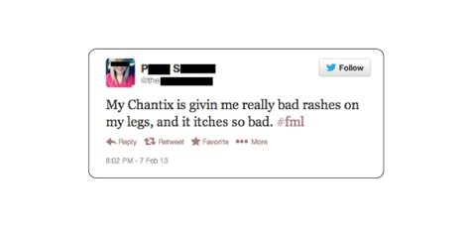
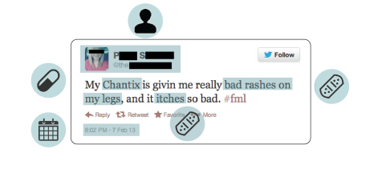
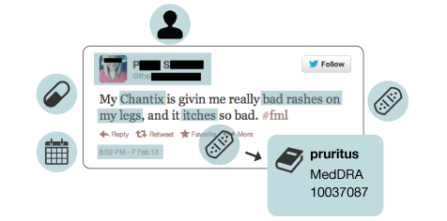
Vernacular-to-Regulatory Translation

Slide 51
visual snow
dont want to eat
cross vision
lost my appetite
apetite surpressed
apetite surpressed
googley eyed
googley eyed
no appetitey
no appetitey
doublevision
blind
appetite is nonexistent
blurry vision
miss feeling hungry
anorexic
double vision
#notevenhungry
cant eat
#notevenhungry
blindness
couldn’t see
making me eat like a mouse
making me eat like a mouse
vision change
blurry
lost appetite
lost their eyesight
didn’t get hungry
seeing double
can’t eat
killed my apetite
killed my apetite
googly eyed
googly eyed
lost teh appetite
lost teh appetite
lost apetite
lost apetite
crosseyed
killed my appetite
seeing weird
couldnt see
cross eyed
seeing weird colour
changes in vision
seeing weird colour
stomach small
lack of apetite
never hungry
lack of apetite
never want to eat
never want to eat
seeing weird color
seeing weird color
Internet Vernacular Translation
Combined or invented words
Spelling Variations
Implied phrases
Typos
Visual impairment
MedDRA
10047571
Visual impairment
SNOMED
397540003
Decreased appetite
MedDRA
10061428
Loss of appetite
SNOMED
79890006

Slide 52
visual snow
dont want to eat
cross vision
lost my appetite
apetite surpressed
googley eyed
no appetitey
doublevision
blind
appetite is nonexistent
blurry vision
miss feeling hungry
anorexic
double vision
#notevenhungry
blindness
cant eat
couldn’t see
making me eat like a mouse
vision change
blurry
lost appetite
lost their eyesight
didn’t get hungry
seeing double
can’t eat
killed my apetite
googly eyed
lost teh appetite
lost apetite
crosseyed
killed my appetite
seeing weird
couldnt see
cross eyed
seeing weird colour
stomach small
changes in vision
lack of apetite
never want to eat
seeing weird color
never hungry
Visual impairment
MedDRA 10047571
Decreased appetite
MedDRA 10061428
Visual impairment
SNOMED 397540003
Loss of appetite
SNOMED 79890006

Slide 53
MedWatcher Social
TOTALS 2013
20.5M
Drug Mentions
Harvested
324K
Adverse Events
Tagged

Slide 54
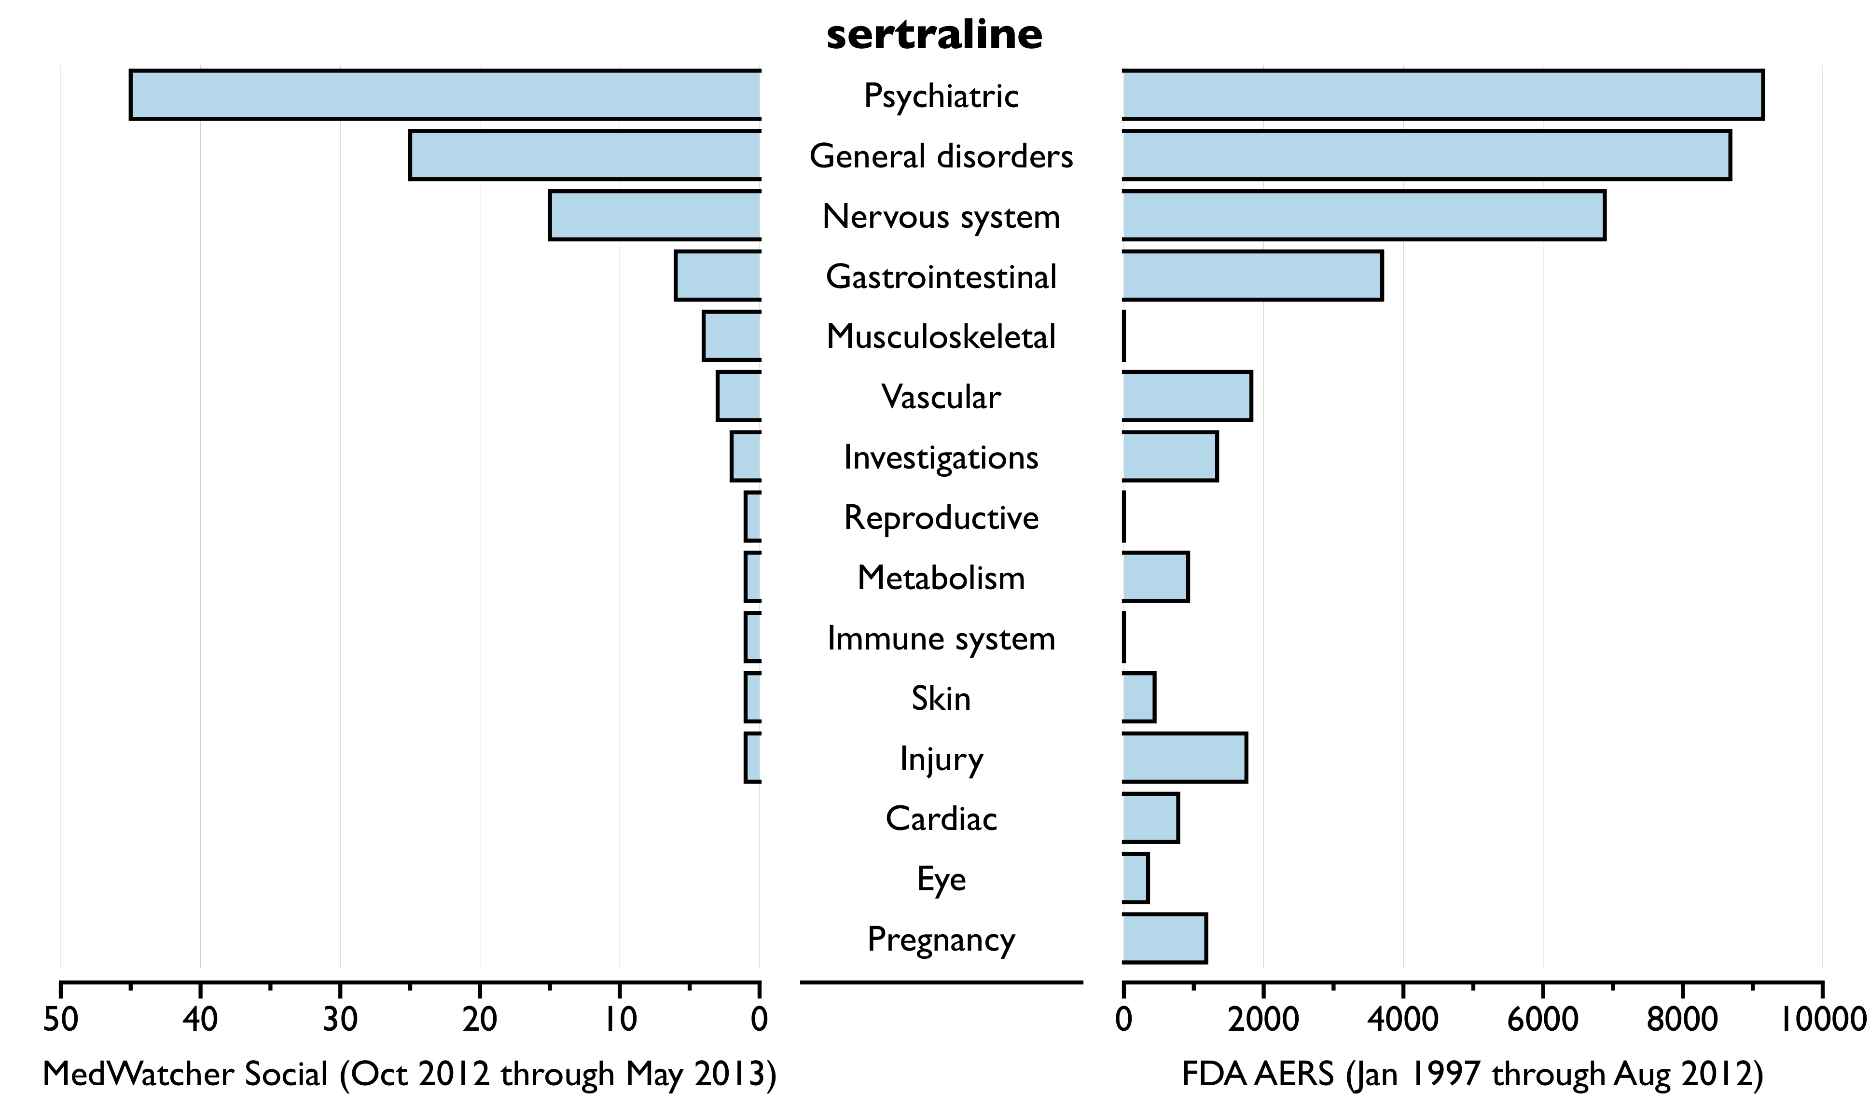
Concordance: Sertraline (Zoloft) for Major Depression
Zoloft is notorious for making stomachs sick and I just vomited... I think I'm gonna go off it
These jittery, anxious, shaky, racing & very yucky feelings are a sign that I didn't listen to the doctor about mixing Zoloft and Caffeine
At least hallucinations is a common side affect of overdosing on Zoloft so I'm not going completely insane
i've washed my hands so many times the skins peeling off. if #Zoloft is indicated for ocd, then i'm a baboon #Pfizer

Slide 55
Isotretinoin (Accutane) for Acne
Accutane + tanning isn't a good combination. My lips are SO chapped. #accutaneprobz
this hair loss is seriouly scaring me im going to stop accutane right now bye
My liver is keeping me up again. :( I'm probably going to be babying it for the rest of my life after accutane gave me hepatitis. No fun.
having to put vaseline on your eyelids because they are so dry and hurt so bad <<<<< #accutane #accutaneprobz

Slide 56
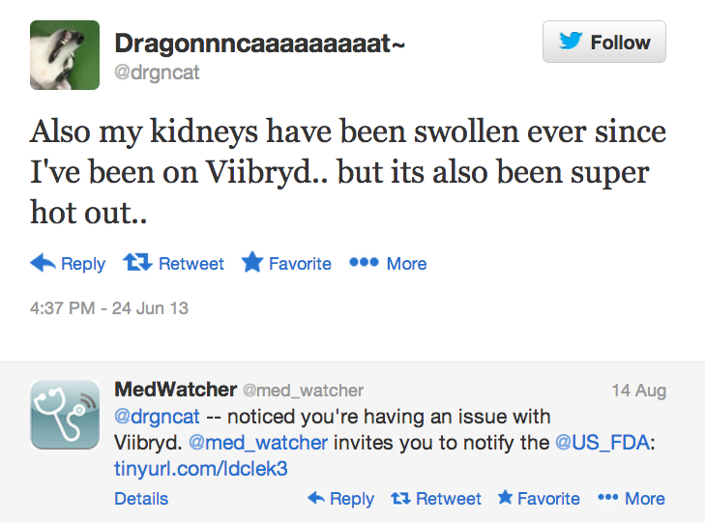
Engaging users directly

Slide 57
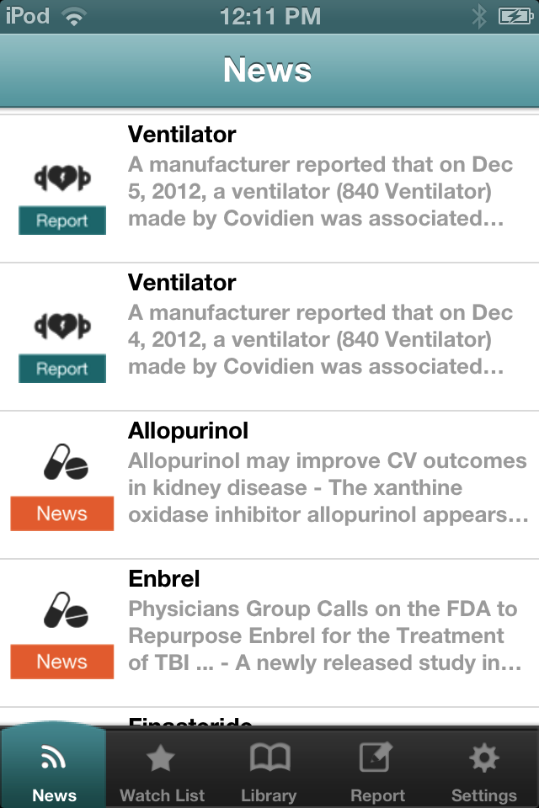
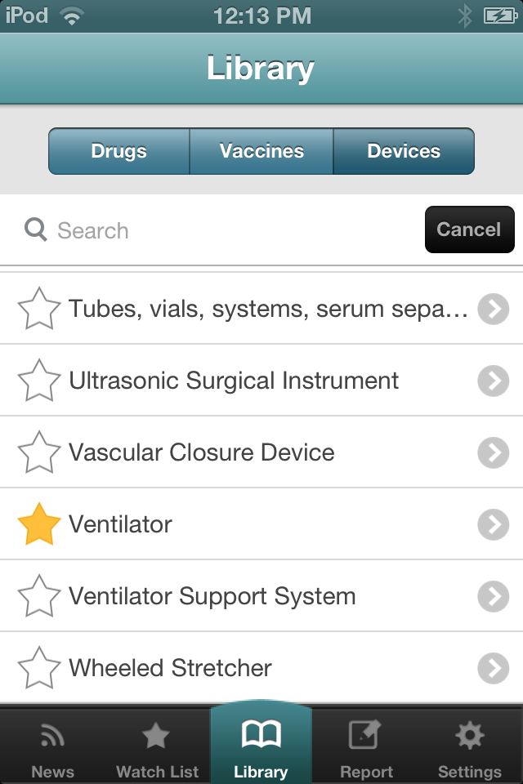

medwatcher.org

Slide 58
Report Submitted via MedWatcher
87 year-old male
Dx: metastatic prostate cancer and spinal cord compression
Tx: Casodex 50 mg/day
LFTs normal at initiation of therapy
AE: hepatic failure after 3 weeks of therapy
Death 5 weeks after initiation of therapy
Death certificate only lists prostate cancer as COD
“Pt was my father. I am a NP.”
Notes:
“Death cert lists prostate Cancer but prognosis prior to fulminant hepatic failure was months to years. Pt died within 5 wks of starting casodex. There are post marketing case reports of this ADE.”

Slide 59




Slide 60

Essure – Implantable Birth Control
1,000+ reports

Slide 61
Sample Reports
Age 30, from GA: “worked great for 2years now I have severe bleeding during cycle with huge clots! Severe constant headaches with bad cramping! Always have red bumps come up in pelvic area, inner thighs and under the arms”
Age 31, IL: periods…extremely heavy, painful, irregular, and full of clots.…frequent migraines, dizzy spells, UTI's/other vaginal infections, kidney infection, major bloating in my stomach, sharp stabbing pains by my ovaries, frequent/urgency to urinate, swelling in hands and feet, mood swings

Slide 62
Comparison
MedWatcher vs FDA reports, across 64 symptom categories with 3 or more reports:
  Spearman Rank Correlation =
  0.65
  p-value 1.0 x 10⁻⁸, CI: [0.48 - 0.77]

Slide 63















Computational Epidemiology Group
Rumi
Aranka
Leila
Dave
Erik
Jared
John
Oktawia
Sumi
Sue
Rachel
Jane
Clark
Elaine
Sheryl

Slide 64
Questions?
clark.freifeld@childrens.harvard.edu
@healthmap
@med_watcher
@clarkfreifeld

