Slide 1
IOT in Healthcare:
"Sensory overload, Sensory Dis-Integration,
Signal vs. Noise, Behavioral Symphony of Wellness, and Creative Reconstruction of Healthcare"
John Mattison, MD, CMIO
Assistant Medical Director
Kaiser Permanente, SCAL
Wolfram IOT, 2014
@johnemattison
Notes:
People don’t care how much their doctor knows, until they know how much she cares
Docs today are already overwhelmed by the avalanche of clinical data.
In 2020 95% of new knowledge will be generated in silico analytics, not in RCTs.
10X in 5 years, 100X in 10 years
So How will the doc of the future preserve the human connection while exploiting big data analytics?
Common clinical scenario: what to do?
45yo mother of 3 in for sinus infection.
Daughter is getting married in 3 months and she is under a lot of stress
30 family members flying in from India for the wedding and staying for 3 weeks While in for her sinusitis, she reveals chronic headaches and thirst
New onset HTN and Diabetes confirmed
So How does her doc maintain the caring touch while brokering the mashup of bigdata (CDS genomics, pharmacogenomics for DM, HTN in 45yo woman) with
Little data (everything we know about her, including genome, proteome, exposome, sensor data?

Slide 2
Survey
Have EVER used a fitbit or other pedometer? Have one on today?
Wear a multifunctional sensor or multiple sensors?
Believe wearable sensors will become a big consumer market?
Have emailed your doctor? 25K/day
Have given other digital data to your doctor?
Notes:
----- Meeting Notes (9/4/14 10:17) -----
Why have I dubbed the current generation the SCI-FI generation?

Slide 3
Exponentiality, The SCIFI Generation And Implications for Healthcare
Compression of Transformational Time: Generational cycle time now down to 5 years.
5 years ago: AT&T advertisement exposed the compression of generational experience
Today’s Teens Zeitgeist: Sci-Fi Generation, Tricorder X-Prize and mentoring for hundreds of startups.
SCI-FI generation: Disruptive change and experience is the new norm. Healthcare is at the center of this vortex, out of both necessity and opportunity.

Slide 4
Constraints of Your Doctor’s Brain:
At the 2012 Health Informatics Policy Meeting The invited “Patient representative” railed how her doctor didn’t even know about the statin-antibiotic interaction that had caused her harm.
50% searching mid-meeting for “interaction of statin with antibiotic”

Slide 5
Physician Sensory Overload and Sensory Data Dis-Integration
Information overload is already critical
Wearable Sensor data (healthIOT) is rising exponentially
Converting streams of disparate datatypes into actionable info, aka Clinical Decision Support, remains primitive
Impact: Stressed doctors, missed opportunities

Slide 6
WSJ Article 8/29/14: Why Doctors Are Sick of Their Profession:
Same tired descriptions of discontent, BUT no mention of the role of information overload.
No mention of novel opportunities to cure: 1) Extracting Signal from Noise 2) Advanced Clinical Decision Support 3) Virtual Care and Self Care
4) Visualization Tools 5) Activating People in their own health 6) Addressing Social Determinants of Health

Slide 7
Exponential Data Tsunami:
90% of digital data was created in last 2 years
95% of new clinical knowledge will be generated in silico by 2020,
Emerging data interrogation techniques infer causality by reproducing results in different data sets and conditions.
Randomized Clinical Trials (aka traditional clinical research) will be reserved for a) ambiguous inferences of causality from correlation b) critical conclusions with more than one viable option c) controlled long term trials
Omics (genomics, transcriptomics, proteomics, lipidomics reactomics, metabolomics, exposomics, socialomics, wearable sensor omics) 10X in 5yrs, 100X in 10yrs (GA4GH)
Microbiomics 10X, 100X, 100 diseases, C. dif, C-sections
Healthcare IOT and wearable sensor data will generate massive streams of dynamic data

Slide 8
Exponentiality and the Healthcare Plecosystem:
Internet and cloud provide connectivity to every corner of the globe.
Smartphone with video dialtone and Modality Steering: Stationary!!!
Socialome: The Digital data harvested for health and wellness
IOT and Quantified Self: Non-invasive biometric sensing, Tricorder, wearables Enhance our capacity to understand what is important, and support behavioral models to initiate, motivate, and sustain healthy behaviors at the individual level KEY VARIANT: Quantified Pedigree (context is king)
Exposome: Pervasive environmental sensing will bring new knowledge to public policy decisions about creating a healthier physical environment, and
$1000 genome (genome, microbiome, transcriptome, lipidome, proteome, metabolome, multiome/panarome) Stem Cell and Genetic Tx (2000+ trials)
EHR data: exponential growth of phenome from Electronic Health Records
Predictive Analytics (Machine learning, AI, and Visualization)
Persuasive Technologies: Behavioral and motivational sciences
Avatars, AI, Robotics, Heads-up displays, 3D printing, Augmented Reality: increasingly broker the PERSONALIZED digital relationships between individual people and their world.

Slide 9
Quantified Self Movement
Larry Smarr, UCSD CalIT2—KP Collaboration --Multiomics, Exposome, Phenome, Socialome, Visualization
Mike Snyder, Stanford, iPOP study (earlier work of George Church)
Jessica Richman: UBIOme: citizen science and the MicroBiome/Microbiomics, aka metagenomics:
Linda Avey, Curiosity
PGHD TEP: Painful process of paradigm shift
23&me: ‘meet your family’: imminent crisis on discovery of biologic parents, sibs
**EasyDNA: “Who’s your daddy?” 20-25% 9/11 and Katrina
**Sneakpeeks: sperm donor selection: founder’s friction
**Persistent value of Data and sustainability: Mattison’s Principle
**Privacy implications: HIMSS Privacy book, Web Genomics
**Open mHealth and Catalyst Initiative: Sensemaking

Slide 10
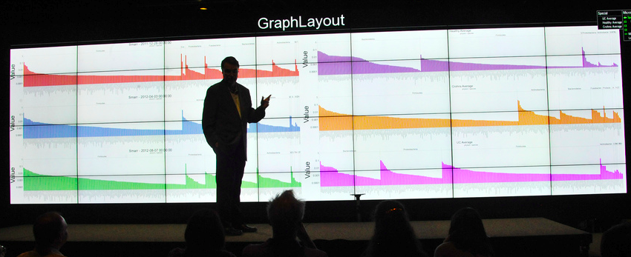
Larry Smarr, The Microbiome, and Health HPC To Analyze Human Microbiome Complexity
10X cells, 100X genes Over 100 diseases with ‘microbiomic signature’ Microbiome-Genome-Immunome-Neurobiome Linkage

Slide 11
The Intuitively Geometric vs. Non-intuitive Exponential Experience
Geometric: Health Information Exchange is already causing a backlash. --Doctors can’t imagine abandoning their historic ethical and legal accountability to review ALL input into EHR.
Exponential: aka Plecosystem overload Multi-omics and wearable sensors will soon BURY us in data

Slide 12
Where is Healthcare IOT in The Gartner Hype Cycle?
“Mobile health monitoring” is approaching the bottom of the so-called “trough of disillusionment”. Mobile health monitoring will need another 5-10 years before reaching its “plateau of productivity” and steady market adoption. In 2009 Gartner placed “home health monitoring” in almost the exact same place on its visualization with a similar time frame required for maturity. MobiHealth News
“Wearable device shipments worldwide will rise” over 5X in the next 4 years, from 19M to 112M units. International Data Corporation.
Notes:
----- Meeting Notes (8/28/14 08:25) -----
Yesterdays news

Slide 13
Emerging Data Sources/News
Nanobots for detecting all kinds of things early cancers (especially recurrences, when you know what you’re looking for).
Point of care PCR testing for H1N1, H2N5, H5N7, RSV, and antioiogram etc. Model of triage before they all cross-contaminate each other in the waiting rooms. NOW involved with Ebola epidemic.
Autism is associated with >600 SNPs that map to four neurogenic or neural pruning processes. Autism Speaks has complete sequencing of 10,000 autistic kids. I have a hypothesis that can only be tested on a huge pedigree cohort with access to massive supercomputers, i.e. is one of the potential contributors to autism the unintended consequences of deliberate genetic innovation with intelligence in a HOX-like gene associated with neurogenesis and neural pruning?
Schizophrenia 3X the number of genetic markers from pooling data (immune system prominent) twin studies 51% from pooled genomic databases
Collaboration and Semantic Interoperability: GA4GH efforts

Slide 14
Five Generic Filters for IOT (and other data) Extricate Signal from Noise and Escalate from Machine to Human
Value (numeric, graphical)
Value Trend and Velocity (e.g. glucose)
Aggregate value (hydration)
Aggregate value trend and velocity
Textual Data, NLP, NLU, and CLU
Personalized circadian nomograms, e.g. temperature, will double the number of filters.

Slide 15
Topology of the SENSOR Avalanche First Mile of 3,682 Connected Devices
From edge (sensor) to cloud (aggregated, federated) Sensor, sensor network (person or place) Local router/middleware Data Staging for analytics, filters, M2M escalators Internal Cloud: analytics, filters, algorithmic aggregators, M2C escalators External Cloud (Central or federated) analytics, filters, algorithmic aggregators, M2C escalators
DataTypes: Time Series, Text (PGHI, Open Notes), Image
Parameters: Sense, normalize, transform, aggregate, store, compute/analyze, Escalate, Compress, archive, purge
Principles: Accordion Model of Learning: Knowledge, Modeling M2M escalation vs. M2C escalation Move the Analytics to the data, rather than the reverse

Slide 16
What We Need From Sensor Device Manufacturers
Old Features: Value/dimension, TCO, reliability, volume pricing, durability, multi-user
New Requirements: security transparency into open source components and open source strategy and failure issues (OpenFDA) Self-awareness of location and failure, Self-reporting, self healing Full IOT integration compliance

Slide 17
What We Need From Sensor Device Manufacturers
Future Requirements: Broader use case coverage (VS monitoring) Context sensitivity (error detection/correction within field) Temporal sensitivity (e.g. new brittle DM vs. Chronic stable DM) Earlier disclosure of problems Pre-510K partnerships/testbeds Clear strategy for data DTC No Device manufacturer repository of “de-identified data” without consent, e.g. (NIH genomics) Earlier disclosure of product roadmaps in volatile fields

Slide 18
FDA and 23&me:
Within 5 years, docs will be routinely challenged by VERY compelling data about which drug at what dose is best for which person based on their genomics proteomics metabolomics, and pharmacogenomics
FDA Regulation: Challenged 23&me re: statistical methodologies for assigning probabilities of risks based on exome, e.g. ascertainment bias. Wrong question.
The correct question is HOW will the FDA Manage the tsunami of actionable knowledge? Certify Crowd Sourcing
Grainger, DoD supplier: Feds want Grainger to assure chain of custody, i.e. prevent frauds from entering supply chain because they know their regulatory process cannot keep up with the exponential growth of products. Problem: Feds insist that industry follow their own federal process (General Services FAR (Federal Acquisition Regulations, 200K pages) to take over the feds regulatory role for excluding counterfeit parts from the supply chain for DoD. Huh?

Slide 19
Battle between Eutopianists vs. Dystopianists:
AI and Robotics will replace 50% of all current jobs within 5-10 years.
Google acquired 8 robotics companies and hired Ray Kurzweil, to head up their machine learning program. Google to use robotics and AI to replace (unemploy) millions of cleanroom sweatshop workers at FOXCONN
Stephen Schwartzman, CEO of Blackstone, $3billion, 40 countries, 4 months, #1 concern: structural unemployment.
Peter Diamandis, X-Prize founder, Singularity U cofounder, poll: How many leaned towards more unemployment, vs. more new jobs, vs. better work/life balance with shorter workweeks.
Schizophrenia: Last week, International pooling of affected individual genomes tripled the number of known associated SNPs, including immune system (NB: metabolic fatigue during transcription with smell and some immune diversity occuring at the end of the transcription). Very complex still, but will catapult understanding and therapy of schizophrenia.
So the dilemma is an impedance mismatch between new knowledge and skills, and the capacity of the human brain to evolve fast enough to keep up with shift to more cognitive jobs AND revaluing old jobs of compassionate community service..

Slide 20
Big Opportunities to create: Behavioral Symphony of Wellness & Creative Reconstruction of Healthcare

Slide 21
Opportunity #1: Embrace the Whole Person with a Behavioral Symphony of Wellness
Healthcare Enterprise Vs. Person-Centric Health
Consumer Terminology and Professional terminology
Quantified Self, PHR vs. EHR, OpenNotes, Delbanco
Alternative—Complementary--Integrative Medicine
Address the whole person: Mind—Body—Soul
Linking the 99.95% of life with the power of the 0.05%
Using BJ Fogg’s model of Persuasive Technologies with micro-changes.

Slide 22
Opportunity #2: Community Centric Health and Wellness Compassionate Reallocation: Harvesting Compassionate Excess
Blue Zones (diet, exercise, sleep……….SOCIAL!!!)
AirBNB, Uber and reciprocal transparency
Cognitive Excess and re-allocation: MIT Red Balloons, Protein FoldIt
Compassionate Excess and Reallocation: Hyperlocal: NextDoor.com Global: Impossible.com, Lily Cole A Healthier Alternative to playing Angry Birds!!!!

Slide 23
Opportunity #3: Applying Evidence Based Discipline and Positive Deviance to Compassionate Action
Dambisa Moyo and “Dead Aid” in Africa
Localized Community Needs Assessments
Generational focus on parenting and children
Survey gaps and positive deviances Validate gap, appetite, capacity, tools (NGOs, foundations, etc.) synergies, sequence.
Evidence-based execution

Slide 24
Opportunity #4: Privacy vs. Reciprocal Transparency
NSA vs. Edward Snowden and Angela Merkel
Uber, AirBnB, and reciprocal transparency
Who Owns your Avatar and why do you care?
How do we implement reciprocal transparency without sacrificing IP assets?
How do we address the GINA shortfall (life, disability, LTC) and THEN legitimately motivate people to share their data
Kristakis & Fowler: Genetics of Friendship 1932 Framingham heart study subjects, 1.5M genetic markers, 1% identity = 4th cousins, esp. smell, immunity
Power of numbers: (Autism, Schizophrenia)
Motivate OPEN SHARING of data when the lie of De-identification responsibly replaced by adequate protections.

Slide 25
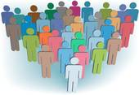
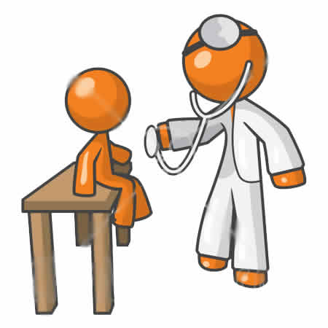
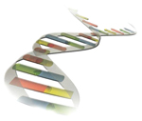
The Growing Complexity Of Whole Person Digital Information
Demographics & Firmographics
(Age, Address, Employer, Industry)
Behavioral Data
(Life Style Choices,
Preferences, Activities, QoL)
Medical Records
(encounter, labs,
Rx, medical devices, etc.)
Social Data
(Friends, Family, Affiliations, Communication, Activities)
Member
Personal “-omics”
(Genomics, Proteomics, Transcriptomes, Metabolomics)
Contextual
Environment
Geographic
(Temperature,
Humidity,
Pollen Count,..)
(Closest Hospital,
Pharmacy,
Care Clinic,…)
Legend:
KP Internal
External

Slide 26
Six Dimensions in the Management of Personal Data
First Dimension: Archetypes of data: 1) Time Series, 2) Text 3) Graphic
Second Dimension: Filters 1) value, 2) trend 3) aggregation of data (including imaging)
4) aggregate trends
5) NLP
Third dimension: N=1 personal circadian nomograms
Fourth Dimension: Escalations: 1) M2M 2) M2C
Fifth Dimension: Avatars as brokers
Sixth Dimension: Staged Cycles of Learning Accordion Model of Learning

Slide 27
Role of Pervasive Sensing
Five Tiers of Pervasive Sensing:
Athlete/warrior: realtime tuning
Acute Illness, wireless inpatient monitoring
Chronic Illness: Post-discharge from hospital: early event detection and intervention (Mayo Study)
Restoring Wellness through mindfulness (Acceleromoters, GSR, glucose, cortisol,…..etc) a) Initiation b) Motivation, and c) Calibration (extending observation interval of fitbit)
Environmental sensors to identify health risks
NB: Habituation to digital nanny replaced by mindfulness
Market segmentation: Fashion statement vs. function. Location of sensors DOES matter.

Slide 28
How will the Digital IOT World Shape the Future of Human Evolution?

Slide 29
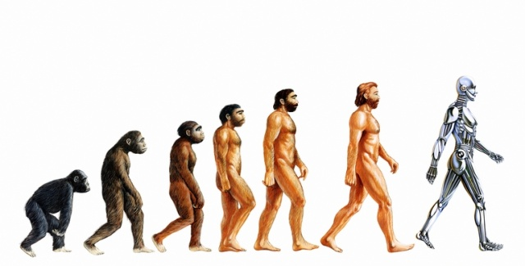
Homo Metricus: embedded sensor loops

Slide 30
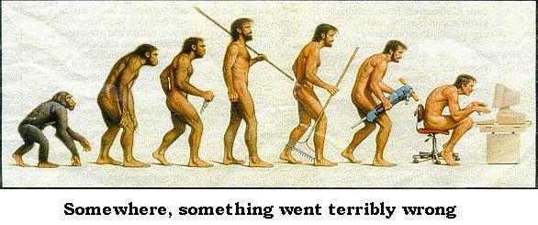
Homo Geekus
Notes:
The experience of Homo Geekus

Slide 31
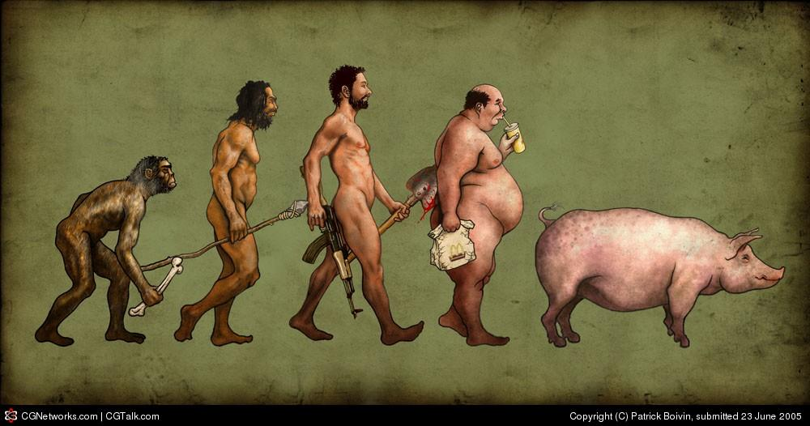
Homo FastFooderus
Notes:
The experience of Homo McDonaldensis

Slide 32
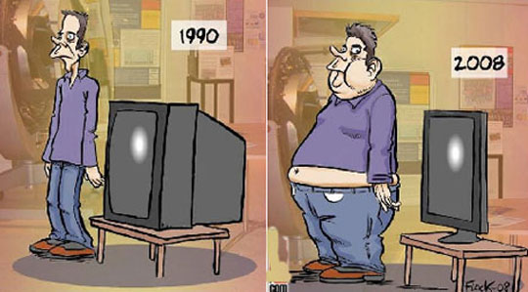

Slide 33
Visualization Tools to Support Three Conversations
Patient with Professional Care team
Patient with Personal Care team
Patient with the Person that houses the patient persona: “Person-Centricity”
Primary sort is values-based, drill down to data. Assess values/objectives, Validate, apply with SDM:
45 yo woman with new onset diabetes and hypertension: 1) Value-based SDM for options 2) Localize use of streaming data from wearables to enhance and sustain mindfulness first and foremost.

Slide 34
Using mHealth, Sensors, Big Data, Avatars to Humanize Experience
Passive sensing and reporting to detect trends and alert threshholds (M2M, M2P, M2C)
Personalization of HOW we communicate optionality, medium, humor, gaming, motivation 3.0
Role of Avatars personalized, motivational, 3D multimedia Coaches, Motivators, Aspirational (bariatric)
Integration of Personal network with professional network.
Inpatient: two social networks with simple tools for patient control over bridging the two networks.

Slide 35
Avatars
Avatars for docs (heads up displays) Augmented Google Glass
Avatars for patients:
Scores of avatar-based health coaches already to augment human care team messaging.
Health Coaches: Restoring ancient wisdom with mindfulness around diet, exercise, sleep, SOCIAL, role of avatars
Aspirational: Bariatric Surgery
Brokers with Universe PUC (meta-augmentation of google glass)

Slide 36
Privacy vs Reciprocal Transparency
Edward Snowden and NSA: We can’t get the privacy genie back in the bottle, but we can implement reciprocal transparency so that we better understand when our free corporate-sponsored avatars (dominant sales and marketing medium soon), are actually serving US, vs. when they are service their financial master.
Who owns your avatar and why do you care? 2009, 1.3million retweets.

Slide 37
The New Healer (Avatar Augmented)
Leads with empathy, the foundation of simplicity.
Teaches mindfulness: “Moment to moment non-judgemental awareness” Steven Hickman, Director, UCSD
Coordinates the professional team for the person
Puts the person first: “The patient is ready for you now”
Elaborates and validates every individual’s values and goals, and then mentors the individual to chart their own course.
Understands radical transformation of etiologic causal relationships based on emerging omics science, behavioral and environmental synergies.
Supports their goals and choices through personalized motivational tools -how, when, where the individual wants, -with technology in the background as much as possible.
Compassionately uses face-to-face opportunities to help individuals use digital tools to maximum benefit in the 99.9% of their lives outside the clinic where they make the micro-decisions that help them reach their goals to thrive.

Slide 38
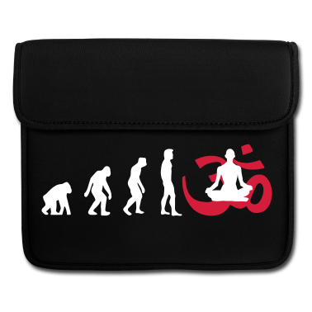
Mindful Man
Visualization is about surfacing human relevant context in
Notes:
The new mindful person as a path to wellness, restoring ancient wisdoms and blue zone evidence

Slide 39
Hubert Humphrey at HHS
It has been said that the moral test of government is how that government treats -those who are in the dawn of life, the children; -those who are in the twilight of life, the elderly; -and those who are in the shadows of life, the sick, the needy and the handicapped.
We must consciously use technology, including mHealth to close social inequities and health inequalities, or we have all failed as technologists.
The Second Machine Age chronicles the creation of a systemic underclass

Slide 40
Questions

